Slide 1
Web services - Retrofit

Slide 2
Contents
Web services
Retrofit

Slide 3
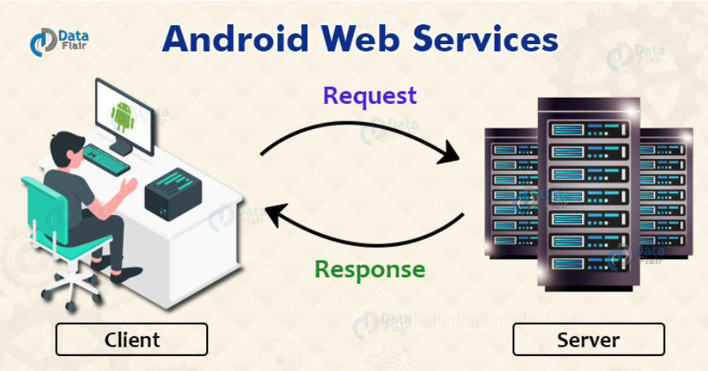
Android web services

Slide 4
Retrofit
A type-safe REST client for Android developed by Square
Easy to retrieve and upload JSON (or other structured data) via a REST based webservice
Set up
dependencies { implementation 'com.squareup.retrofit2:retrofit:2.0.2' implementation 'com.squareup.retrofit2:converter-gson:2.0.2‘
}

Slide 5
HTTP Methods
POST creates a resource on the server .
GET retrieves an appropriate resource .
PUT should be used to update the resource or change the state .
DELETE is used only to remove the resource .

Slide 6
Method Annotations
@Body: sends Java objects as request body.
@Path: variable substitution for the API endpoint
@Url: use dynamic URLs.
@Query: To URL encode a query use the form
@Field: send data as form-urlencoded. The @Field parameter works only with a POST

Slide 7
Retrofit Implementation steps
Model class which is used as a JSON model
Interfaces that define the possible HTTP operations
Retrofit.Builder class - Instance which uses the interface and the Builder API to allow defining the URL end point for the HTTP operations.

Slide 8
Retrofit Implementation
- Creating the API Interface
public interface MyApiEndpointInterface {
@GET("users/{username}")
Call<User> getUser(@Path("username") String username);
@GET("group/{id}/users")
Call<List<User>> groupList(@Path("id") int groupId, @Query("sort") String sort);
@POST("users/new")
Call<User> createUser(@Body User user);
}

Slide 9
Retrofit Implementation
Create Java Classes for Resources Using jsonschema2pojo
Creating the Retrofit instance
public static final String BASE_URL = "http://api.myservice.com/";
Retrofit retrofit = new Retrofit.Builder() .baseUrl(BASE_URL)
.addConverterFactory(GsonConverterFactory.create()) .build();
MyApiEndpointInterface myRetrofitAPI = retrofit.create(MyApiEndpointInterface.class);

Slide 10
Retrofit Implementation
Call
myRetrofitAPI.getUsers(“12”).enqueue(new Callback<User>() {
@Override
public void onResponse(Call<User> call, Response<User> response) {
// Success
}
@Override
public void onFailure(Call<User> call, Throwable t) {
//Failed
}
});

Slide 11
Classwork
Create a List screen using RecyclerView
Load data from api: https://jsonplaceholder.typicode.com/posts
Show data on RecyclerView
(More apis: https://jsonplaceholder.typicode.com/ )

Slide 12
References
https://guides.codepath.com/android/consuming-apis-with-retrofit
https://jsonplaceholder.typicode.com/

