Slide 1
Android Socket

Slide 2
Contents
Socket concept
Socket implementation

Slide 3
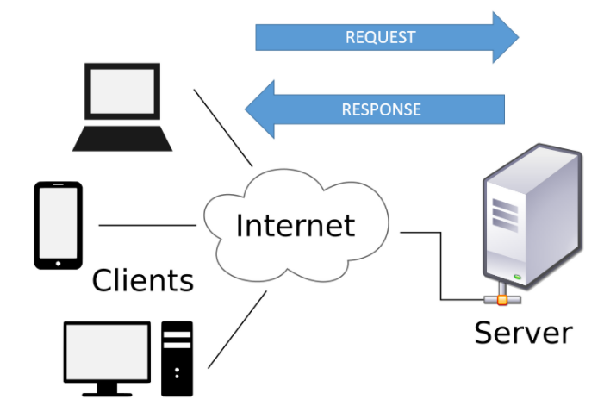
Client/Server communication
Client/Server communication involves two components, namely a client and a server.
The clients send requests to the server and the server responds to the client requests.

Slide 4
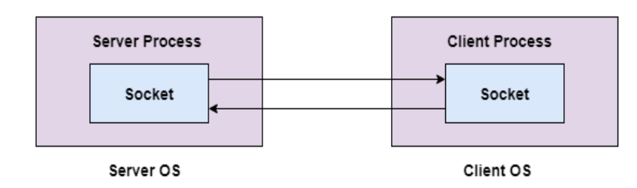
Socket
A socket is a software endpoint that can plug into or be plugged into to create a bi-directional communication link between software processes
A socket is a common interface for performing network communication
Android’s HTTP client library is using sockets to send and receive data

Slide 5
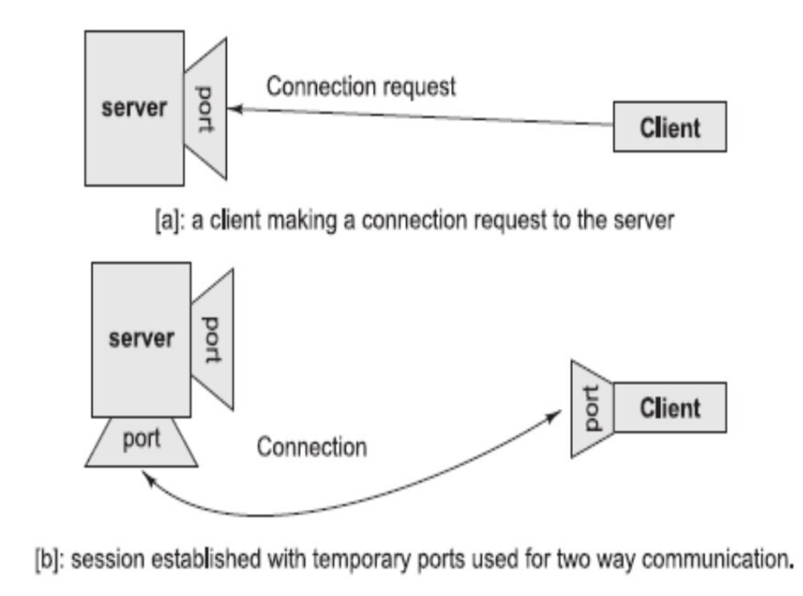
Socket connection

Slide 6
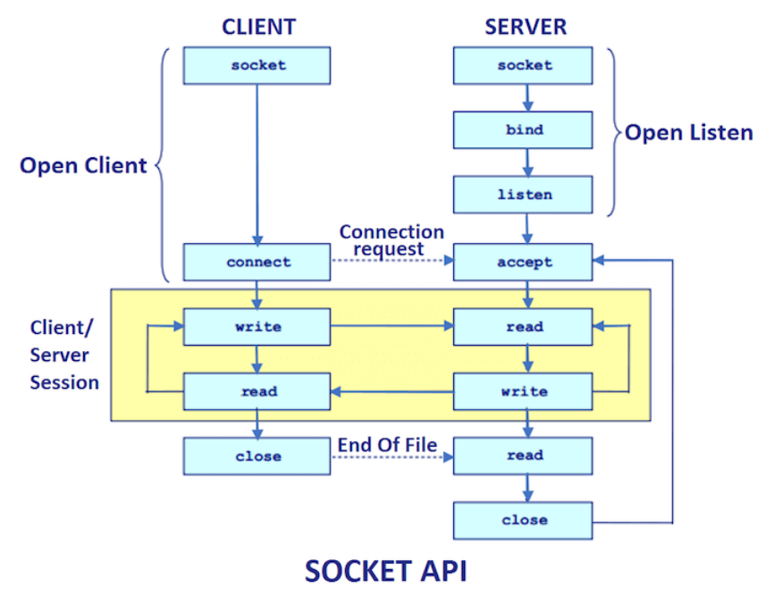
Socket programming

Slide 7
Socket programming methods
socket(): Create a socket
bind(): bind a socket to a local IP address and port #
listen(): passively waiting for connections
connect(): initiating connection to another socket
accept(): accept a new connection
write(): write data to a socket
read(): read data from a socket
sendto(): send a datagram to another UDP socket
recvfrom(): read a datagram from a UDP socket
close(): close a socket (tear down the connection)

Slide 8
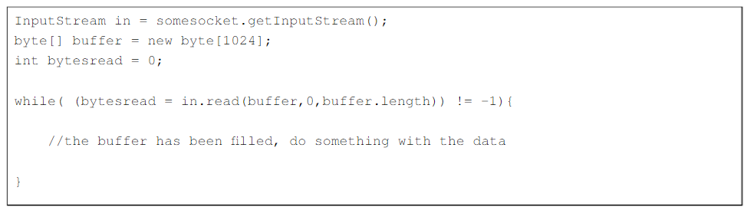
InputStreams in Java
An InputStream is a stream of incoming byte data
An InputStream can be obtained from a Socket by using the getInputStream() method
In order to read from a stream, you must create a byte buffer to read in data
Each call to read on an InputStream fills your buffer with data and returns the number of bytes read

Slide 9
OutputStreams in Java
An OutputStream is a stream of outgoing byte data
An OutputStream can be obtained from a Socket by using the getOutputStream() method
You can write data to a stream by passing in a byte buffer of data
You should use the flush() method if you want to make sure that the data you have written has been output to disk or sent to the other end of the socket

Slide 10
Steps to create Server program
Open the server socket
ServerSocket server = new ServerSocket(PORT)
Wait for the client request
Socket client = server.accept()
Create I/O stream for communicating to the client
output = new PrintWriter(client.getOutputStream());
input = new BufferedReader(new
InputStreamReader(client.getInputStream()));
Perform communication with client
Receive from client: String message = input.readLine();
Send to client: output.write(message);
Close socket: client.close

Slide 11
Steps to create Client program
Create a Socket object
Socket socket = new Socket(SERVER_IP, SERVER_PORT);
Create I/O stream for communicating to server
output = new PrintWriter(socket.getOutputStream());
input = new BufferedReader(new
InputStreamReader(socket.getInputStream()));
Perform communication with server
Receive from client: String message = input.readLine();
Send to client: output.write(message);
Close the socket
client.close

Slide 12
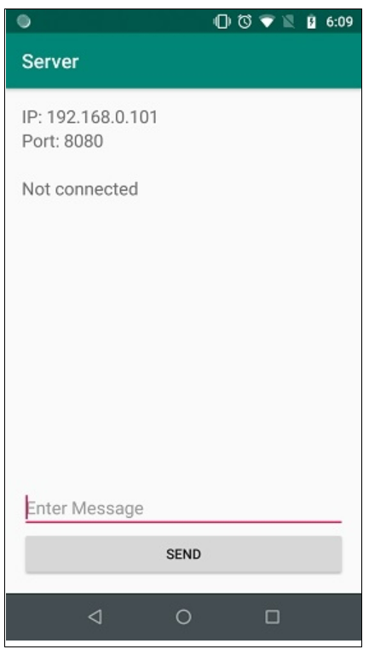
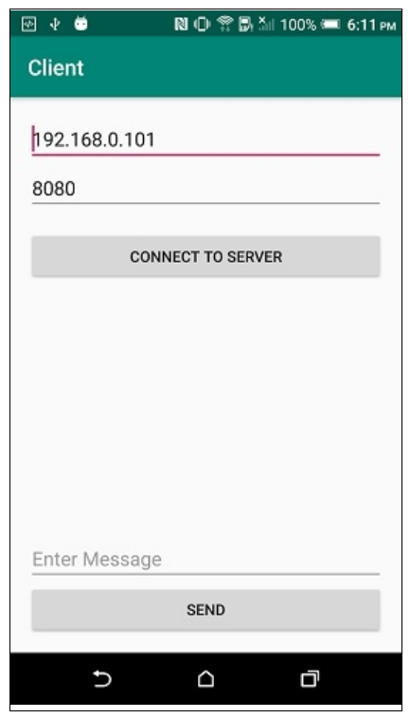
Usage
2 Android applications connect together by Socket:
1 Android application is Server
1 Android application is Client

Slide 13
Classwork
Make a chat program by socket using socket.io library
https://socket.io/blog/native-socket-io-and-android/

Slide 14
References
https://guides.codepath.com/android/Sending-and-Receiving-Data-with-Sockets
https://www.tutorialspoint.com/sending-and-receiving-data-with-sockets-in-android
https://github.com/nkzawa/socket.io-android-chat
http://android-er.blogspot.com/2014/08/bi-directional-communication-between.html

