Slide 1
Broadcast Receiver

Slide 2
Contents
Broastcast
Broastcast receiver implementation

Slide 3
Broadcast
Broadcasts are messages sent by Android system and other Android apps, when an event of interest occurs
Types of broadcast:
System broadcast: are the messages sent by the Android system, when a system event occurs, that might affect your app
Custom broadcast: are broadcasts that your app sends out, similar to the Android system.

Slide 4
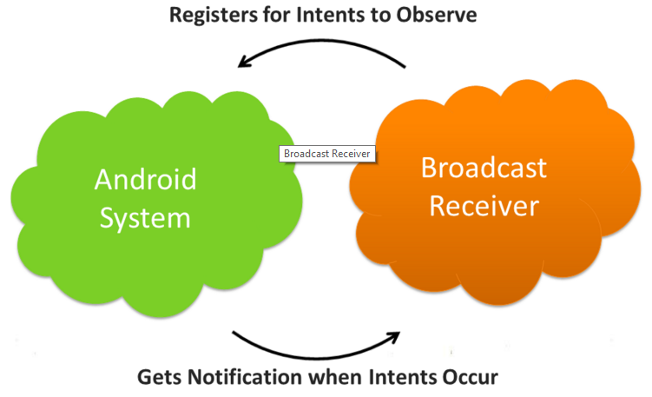
Broadcast Receiver

Slide 5
Broadcast Receiver
Broadcast receivers are app components.
They register for various system broadcast and or custom broadcast.
They are notified (via an Intent):
By the system, when a system event occurs that your app is registered for.
By another app, including your own if your app is registered for that custom event.

Slide 6
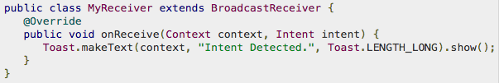
Implementation
Creating the Broadcast Receiver
Extends BroadcastReceiver
Implement onReceive method

Slide 7
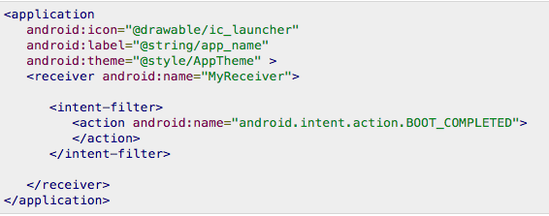
Implementation
Registering Broadcast Receiver
Static: Use <receiver> tag in your Manifest file. (AndroidManifest.xml)
Dynamic: Use Context.registerReceiver () method to dynamically register an instance.

Slide 8
Register dynamically
Register your receiver in onCreate() or onResume().
// Register the receiver using the activity context.
this.registerReceiver(mReceiver, filter);
Unregister in onDestroy() or onPause().
// Unregister the receiver
this.unregisterReceiver(mReceiver);

Slide 9
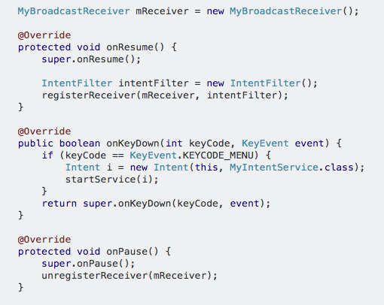
Implementation
Dynamic registration example:

Slide 10
Receiving a system broadcast
Starting from Android 8.0 (API level 26), static receivers can't receive most of the system broadcasts.
Use a dynamic receiver to register for these broadcasts.
If you register for the system broadcasts in the manifest, the Android system won't deliver them to your app.

Slide 11
Custom Broadcast
Sender and receiver must agree on unique name for intent (action name)
Define in activity and broadcast receiver
private static final String ACTION_CUSTOM_BROADCAST = “com.tutorialspoint.CUSTOM_INTENT";

Slide 12

Custom Broadcast
Use sendBroadcast()
Create a Broadcast Receiver
Register/Receive broadcast

Slide 13
Send a custom broadcast
Android provides three ways for sending a broadcast:
Ordered broadcast.
Normal broadcast.
Local broadcast.

Slide 14
Ordered Broadcast
Ordered broadcast is delivered to one receiver at a time.
To send a ordered broadcast, use the sendOrderedBroadcast() method.
Receivers can propagate result to the next receiver or even abort the broadcast.
Control the broadcast order with android:priority attribute in the manifest file.
Receivers with same priority run in arbitrary order.

Slide 15
Normal Broadcast
Delivered to all the registered receivers at the same time, in an undefined order.
Most efficient way to send a broadcast.
Receivers can’t propagate the results among themselves, and they can’t abort the broadcast.
The sendBroadcast() method is used to send a normal broadcast.

Slide 16
Local Broadcast
Sends broadcasts to receivers within your app.
No security issues since no interprocess communication.
To send a local broadcast:
To get an instance of LocalBroadcastManager.
Call sendBroadcast() on the instance.
LocalBroadcastManager.getInstance(this)
.sendBroadcast(customBroadcastIntent);

Slide 17
Classwork
Showing message on app when:
Wifi is on/off
Bluetooth is on/off

Slide 18
References
https://google-developer-training.github.io/android-developer-fundamentals-course-concepts-v2/

