Slide 1
Simple UI Widgets

Slide 2
Contents
Views
ViewGroups
View hierarchy

Slide 3
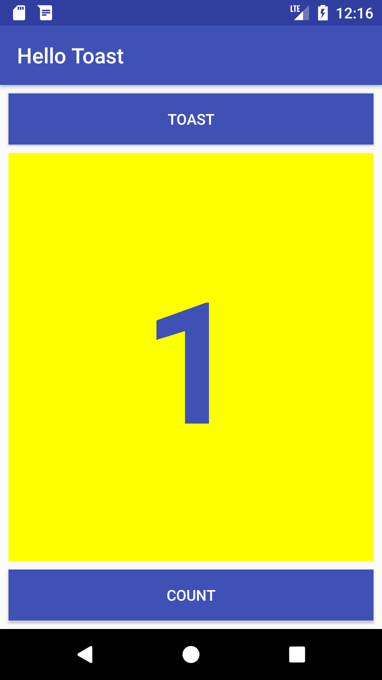


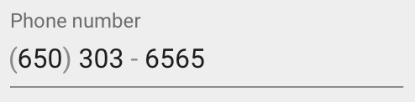

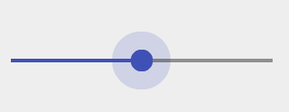
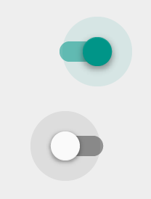
Views
Everything you see is a view
Examples of views
Views
Button
EditText
Slider
CheckBox
RadioButton
Switch

Slide 4
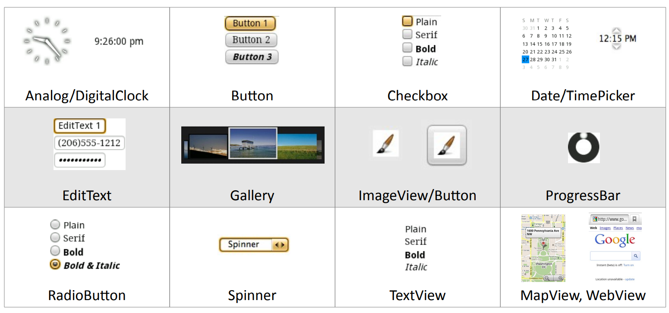
Android Widgets

Slide 5
Create views and layouts
Android Studio layout editor: visual representation of XML
XML editor
Java code

Slide 6
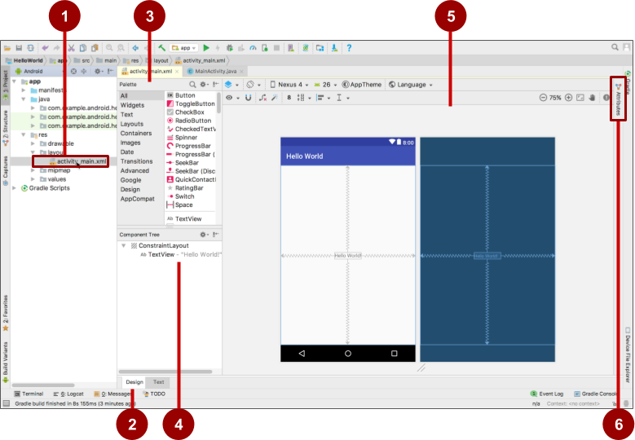
Android Studio layout editor
XML layout file
Design and Text tabs
Palette pane
Component Tree
Design and blueprint panes
Attributes tab

Slide 7
View defined in XML
<TextView
android:id="@+id/show_count"
android:layout_width="match_parent"
android:layout_height="wrap_content"
android:background="@color/myBackgroundColor"
android:text="@string/count_initial_value"
android:textColor="@color/colorPrimary"
android:textSize="@dimen/count_text_size"
android:textStyle="bold"
/>

Slide 8
View attributes in XML
android:<property_name>="<property_value>"
Example: android:layout_width="match_parent"
android:<property_name>="@<resource_type>/resource_id"
Example: android:text="@string/button_label_next"
android:<property_name>="@+id/view_id"
Example: android:id="@+id/show_count"

Slide 9
Create View in Java code
In an Activity:
TextView myText = new TextView(this);
myText.setText("Display this text!");

Slide 10
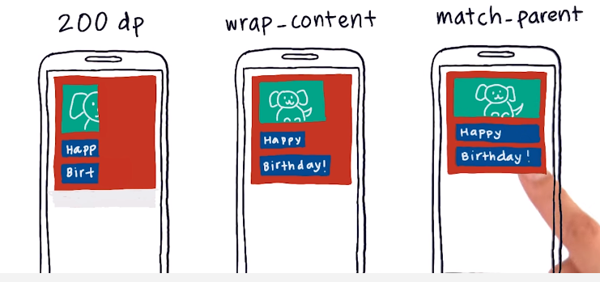
Views width

Slide 11
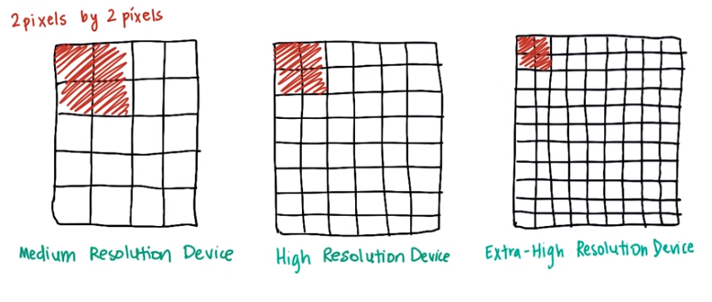
Density – independent pixels

Slide 12
Measure – inch and dp
inch = 2.54 cm
dp or dip: (density-independent pixel)Pixels - lenght measure (similar with inch, Density-independent cm, mm)
Base on 160dpi (Dots per inch), 1dp - 1px on a screen which has 160dpi.
Dpi != 1, number of pixels in 1 dp = n * size/160.
160 dp = 1 inch –>
1dp = 1/160 = 0.00625 inch
100dp = 1.5785cm
1cm = ? inch

Slide 13
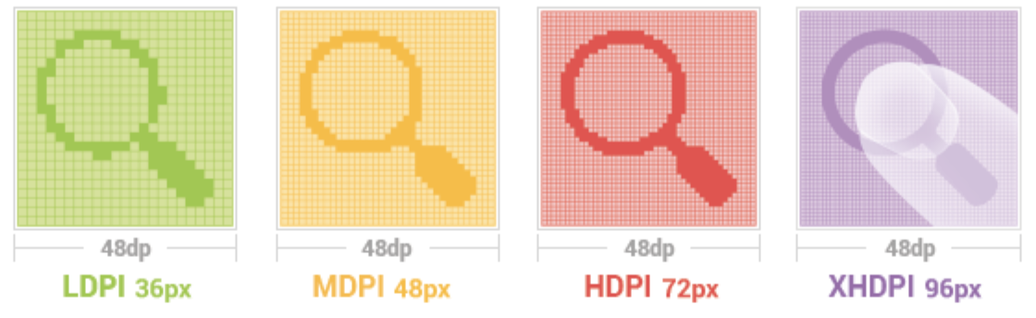
Demonstrate px and dp
(Number of) px = (number of)dp * (dpi / 160)
Example dpi of screen is 320
10 dp has: 10 * (320/160) = 20 px, 1 dp has 2 px.

Slide 14
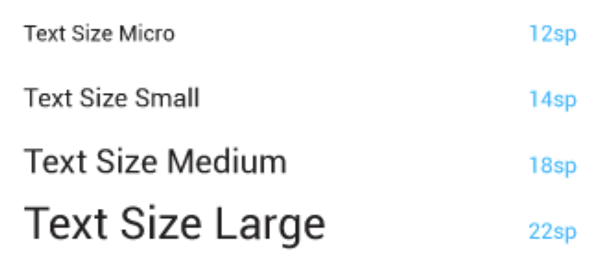
Measure - sp
sp: Scale-independent Pixels – Similar with dp, but scaled to suitable with size of fonts..
The size of font is adjust base on 3 conditions:
The adjust from programmer
screen density
Setting of font size on device.
Default: 1SP = 1DP.

Slide 15
Measure - dpi
Screen density : number of pixels on 1 inch of screen, called dpi (dots per inch)
Base on dpi, the screen is classify:
ldpi (low) ~120dpi
mdpi (medium) ~160dpi
hdpi (high) ~240dpi
xhdpi (extra-high) ~320dpi
xxhdpi (extra-extra-high) ~480dpi
xxxhdpi (extra-extra-extra-high) ~640dpi

Slide 16
Measurements
Density-independent Pixels (dp): for Views
Scale-independent Pixels (sp): for text
Don't use device-dependent or density-dependent units:
Actual Pixels (px)
Actual Measurement (in, mm)
Points - typography 1/72 inch (pt)

Slide 17
Common Widgets
Button
TextView
EditText
ImageView
CheckBox
RadioButton
WebView
AdapterView
- ListView
- Spinner
RecyclerView
…

Slide 18
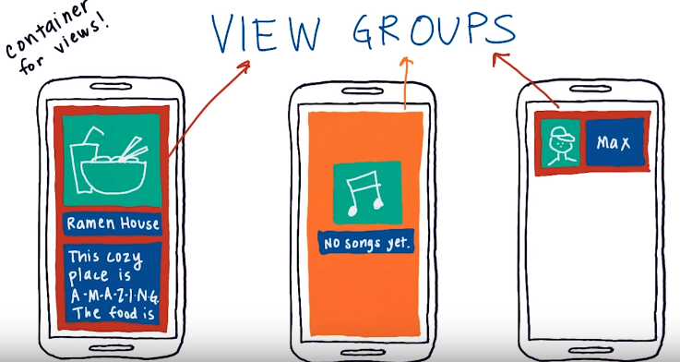
ViewGroups
ViewGroup contains "child" views

Slide 19
ViewGroups
Common Layout Classes
ConstraintLayout: Connect views with constraints
LinearLayout: Horizontal or vertical row
TableLayout: Rows and columns
FrameLayout: Shows one child of a stack of children

Slide 20


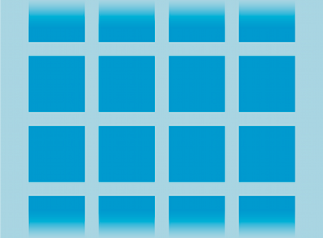

ViewGroups
Common Layout Classes
LinearLayout
ConstraintLayout
GridLayout
TableLayout

Slide 21
Hierarchy of viewgroups and views
ViewGroup
Root view is always a ViewGroup
ViewGroup
View
View
View
View
View

Slide 22
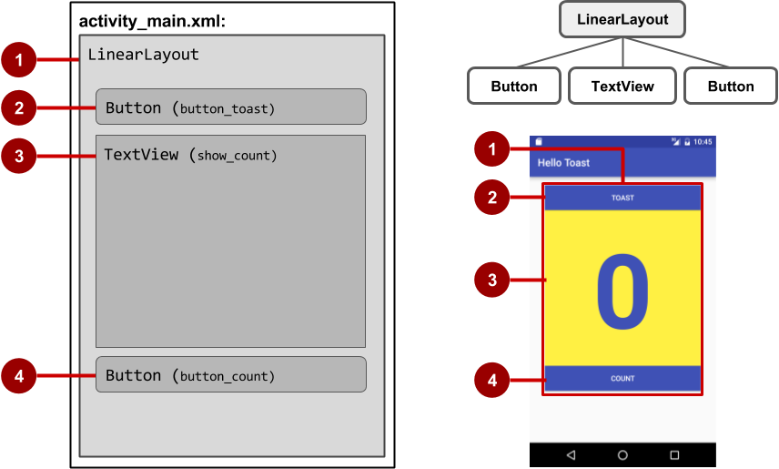
View hierarchy and screen layout

Slide 23
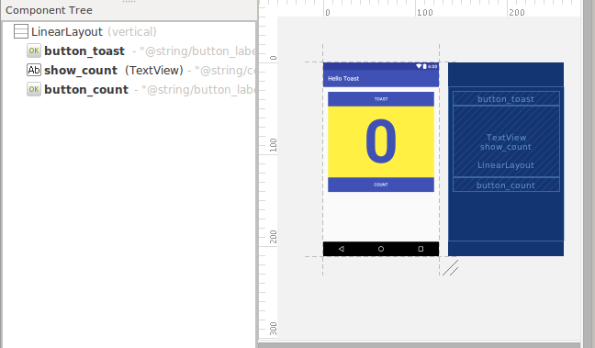
View hierarchy in the layout editor

Slide 24
Layout created in XML
<LinearLayout
android:orientation="vertical"
android:layout_width="match_parent"
android:layout_height="match_parent">
<Button
... />
<TextView
... />
<Button
... />
</LinearLayout

Slide 25
Layout created in Java Activity code
LinearLayout linearL = new LinearLayout(this);
linearL.setOrientation(LinearLayout.VERTICAL);
TextView myText = new TextView(this);
myText.setText("Display this text!");
linearL.addView(myText);
setContentView(linearL);

Slide 26
Set width and height in Java code
LinearLayout.LayoutParams layoutParams =
new Linear.LayoutParams(
LayoutParams.MATCH_PARENT, LayoutParams.MATCH_CONTENT);
myView.setLayoutParams(layoutParams);

Slide 27
LinearLayout
A box model – widgets or child containers are lined up in a column or row, one after the next.
Special attributes:
orientation: indicates whether the LinearLayout represents a row or a column (vertical or horizontal)
weight: indicates whether the LinearLayout represents a row or a column
gravity: is used to indicate how a control will align on the screen
LinearLayout

Slide 28
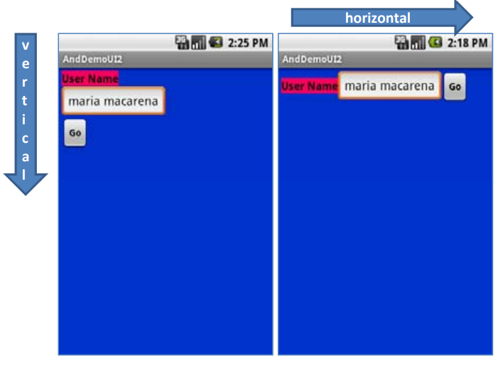
LinearLayout - Special attributes
orientation
Name: android:orientation
Value: vertical, horizontal

Slide 29
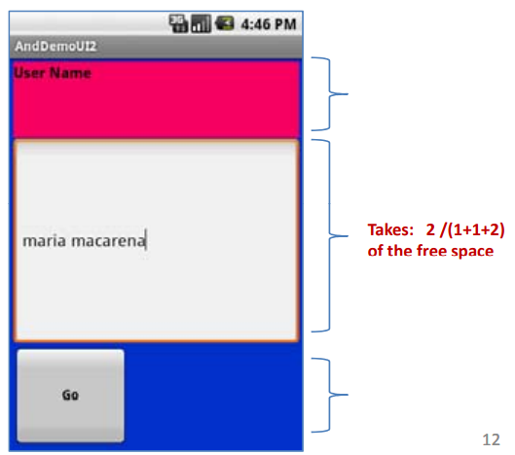
LinearLayout - Special attributes
weight
Name: android:layout_weight
Value: 1, 2, 3, …

Slide 30
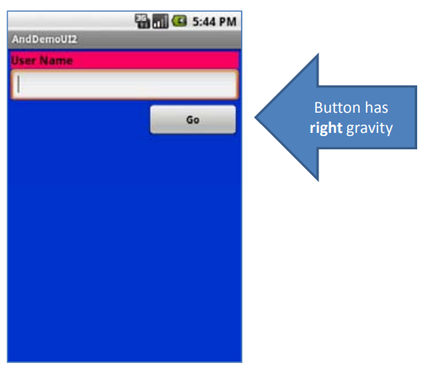
LinearLayout - Special attributes
gravity
Name: android:layout_gravity
Value: left, center, right, top, bottom, etc.

Slide 31
ConstraintLayout
Self-study
https://developer.android.com/training/constraint-layout
https://developer.android.com/codelabs/constraint-layout#0

Slide 32
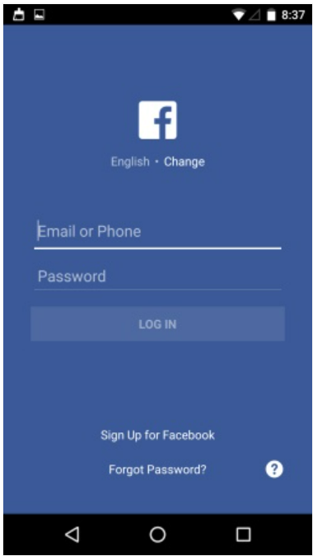
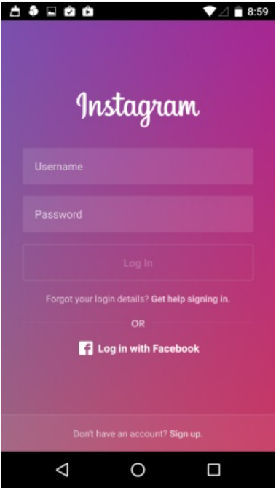
Classwork
Design one of Login Screens as below:

Slide 33
References
https://pttrns.com/android-patterns
https://google-developer-training.github.io/android-developer-fundamentals-course-concepts-v2/

