Slide 1
Style and Theme

Slide 2
Contents
Style
Theme

Slide 3
What is a Style?
Collection of attributes that define the visual appearance of a View
Reduce duplication
Make code more compact
Manage visual appearance of many components with one style

Slide 4
Defining Styles
The XML file resides under res/values/ directory of your project and will have <resources> as the root node which is mandatory for the style file.
<style> tag is used to define a style.
Each style is uniquely identified by it’s name.
Style attributes can be set using the <item> tag.
<resources> <style name="TextviewStyle"> <item name="android:textColor">#86AD33</item> <item name="android:textStyle">bold</item> <item name="android:textSize">20sp</item> <item name="android:padding">10dp</item> </style> </resources>

Slide 5
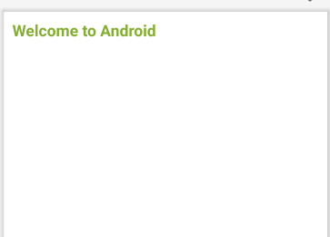
Using style
<TextView android:id="@+id/txtResult" android:layout_width="wrap_content" android:layout_height="wrap_content" android:textColor="#86AD33" android:textSize="20sp“
android:padding=“10dp” android:textStyle="bold" />
<TextView android:id="@+id/txtResult" android:layout_width="wrap_content" android:layout_height="wrap_content" style="@style/TextviewStyle" android:text="Welcome to Android"/>
<resources> <style name="TextviewStyle"> <item name="android:textColor">#86AD33</item> <item name="android:textStyle">bold</item> <item name="android:textSize">20sp</item> <item name="android:padding">10dp</item> </style> </resources>

Slide 6
Android Style Inheritance
<style name="TextviewStyle" parent="@android:style/Widget.TextView"> <item name="android:textColor">#86AD33</item> <item name="android:textStyle">bold</item> <item name="android:textSize">20dp</item> </style>

Slide 7
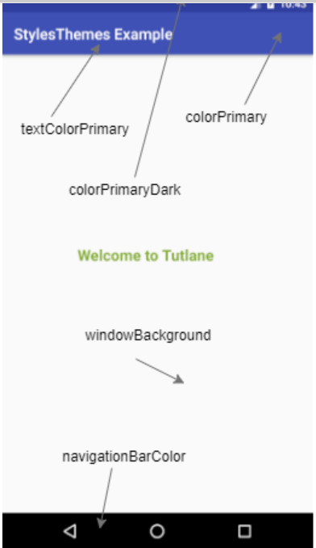
Android Styling Color Palette
In android, we can customize the application basic theme colors based on our requirements.
The example of basic material design in the android application

Slide 8
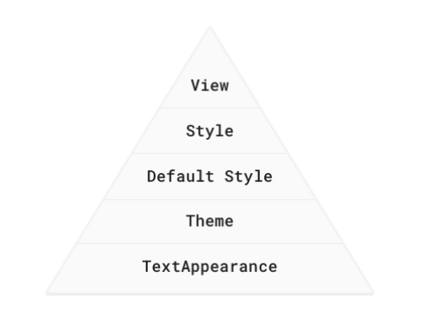
Android's styling system
The diagram shown below summarizes the precedence of each method of styling
Priority is top-down

Slide 9
Android's styling system
View attributes
Use view attributes to set attributes explicitly for each view. (View attributes are not reusable, as styles are.)
You can use every property that can be set via styles or themes.
Styles
Use a style to create a collection of reusable styling information, such as font size or colors.
Good for declaring small sets of common designs used throughout your app.
Default style: This is the default styling provided by the Android system.
Text Appearance: For styling with text attributes only, such as font family.

Slide 10
Themes
A Theme is a style applied to an entire activity or even the entire application
Themes are applied in AndroidManifest.xml
<application android:theme="@style/AppTheme">

Slide 11
Customize AppTheme of Your Project
<!-- Base application theme. -->
<style name="AppTheme" parent="Theme.AppCompat.Light.DarkActionBar">
<!-- Try: Theme.AppCompat.Light.NoActionBar -->
<!-- Customize your theme here. -->
<item name="colorPrimary">@color/colorPrimary</item>
<item name="colorPrimaryDark">@color/colorPrimaryDark</item>
<item name="colorAccent">@color/colorAccent</item>
</style>

Slide 12
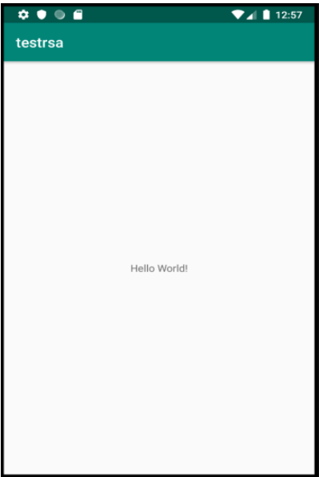
Using theme
<resources>
<style name="AppTheme"
parent="Theme.AppCompat.Light.DarkActionBar">
<item name="colorPrimary">@color/colorPrimary</item>
<item name="colorPrimaryDark">@color/colorPrimaryDark
</item>
<item name="colorAccent">@color/colorAccent</item>
</style>
</resources>

Slide 13
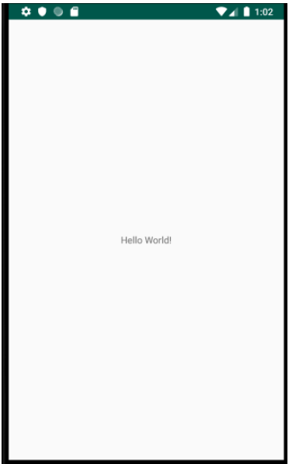
Using theme
<resources>
<style name="AppTheme"
parent="Theme.AppCompat.Light.NoActionBar">
<item name="colorPrimary">@color/colorPrimary</item>
<item name="colorPrimaryDark">@color/colorPrimaryDark
</item>
<item name="colorAccent">@color/colorAccent</item>
</style>
</resources>

Slide 14
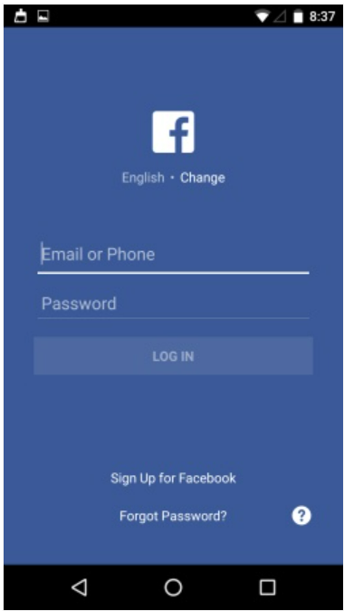
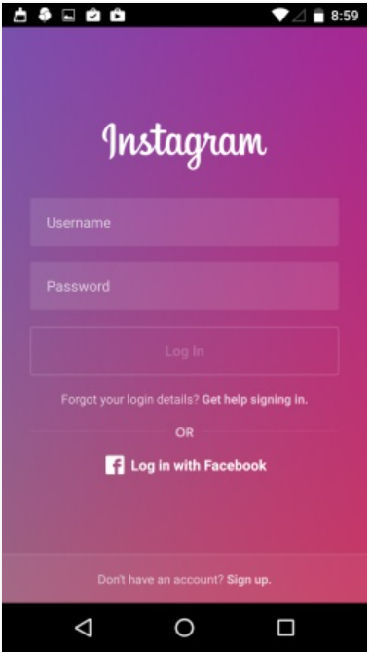
Classwork
Apply style and theme to Login screens

Slide 15
References
https://google-developer-training.github.io/android-developer-fundamentals-course-concepts-v2/
https://www.tutlane.com/tutorial/android/android-styles-and-themes-with-examples

