Slide 1
Activity & Lifecycle

Slide 2
Contents
Activities
Defining an Activity
Activity lifecycle
Activity lifecycle callbacks

Slide 3
Activity
An Activity is an application component
Represents one window, one hierarchy of views
Java class, typically one Activity in one file

Slide 4
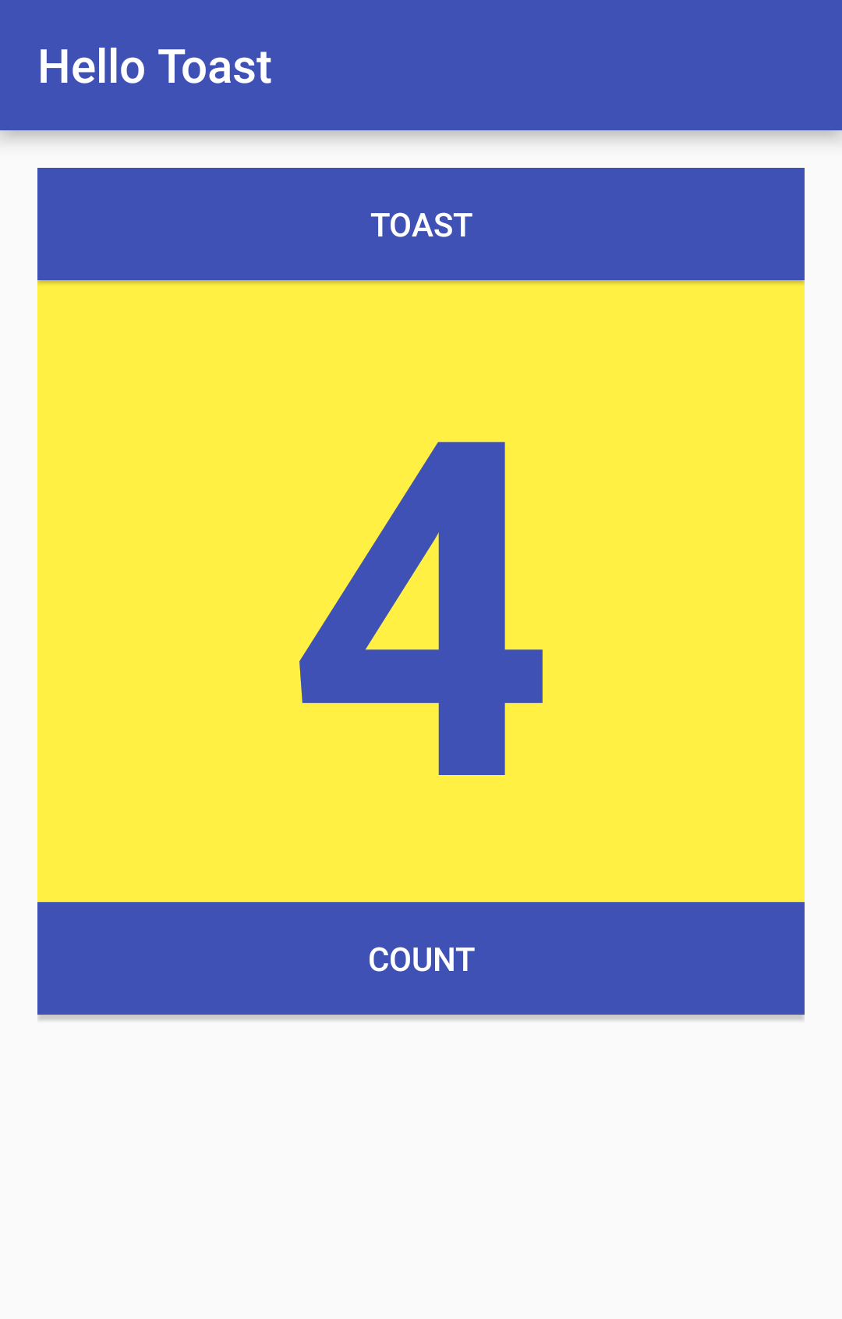
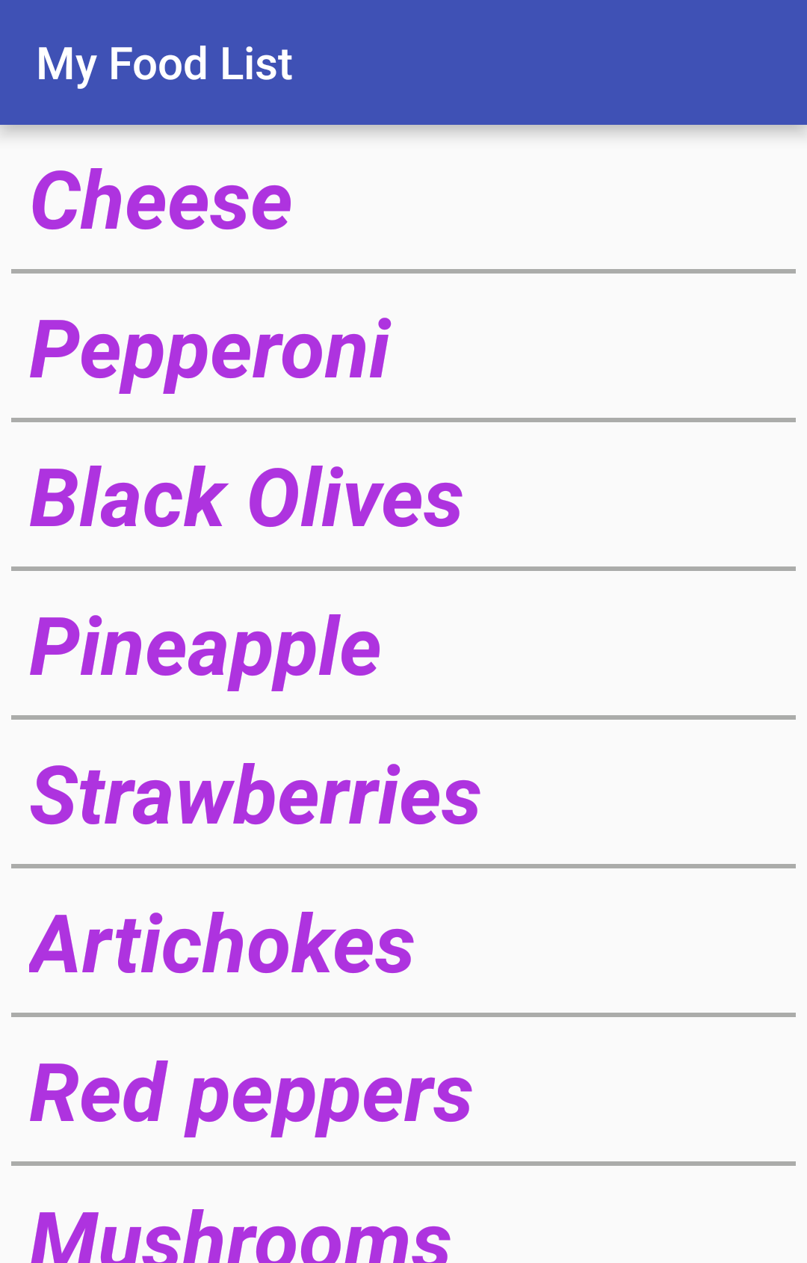
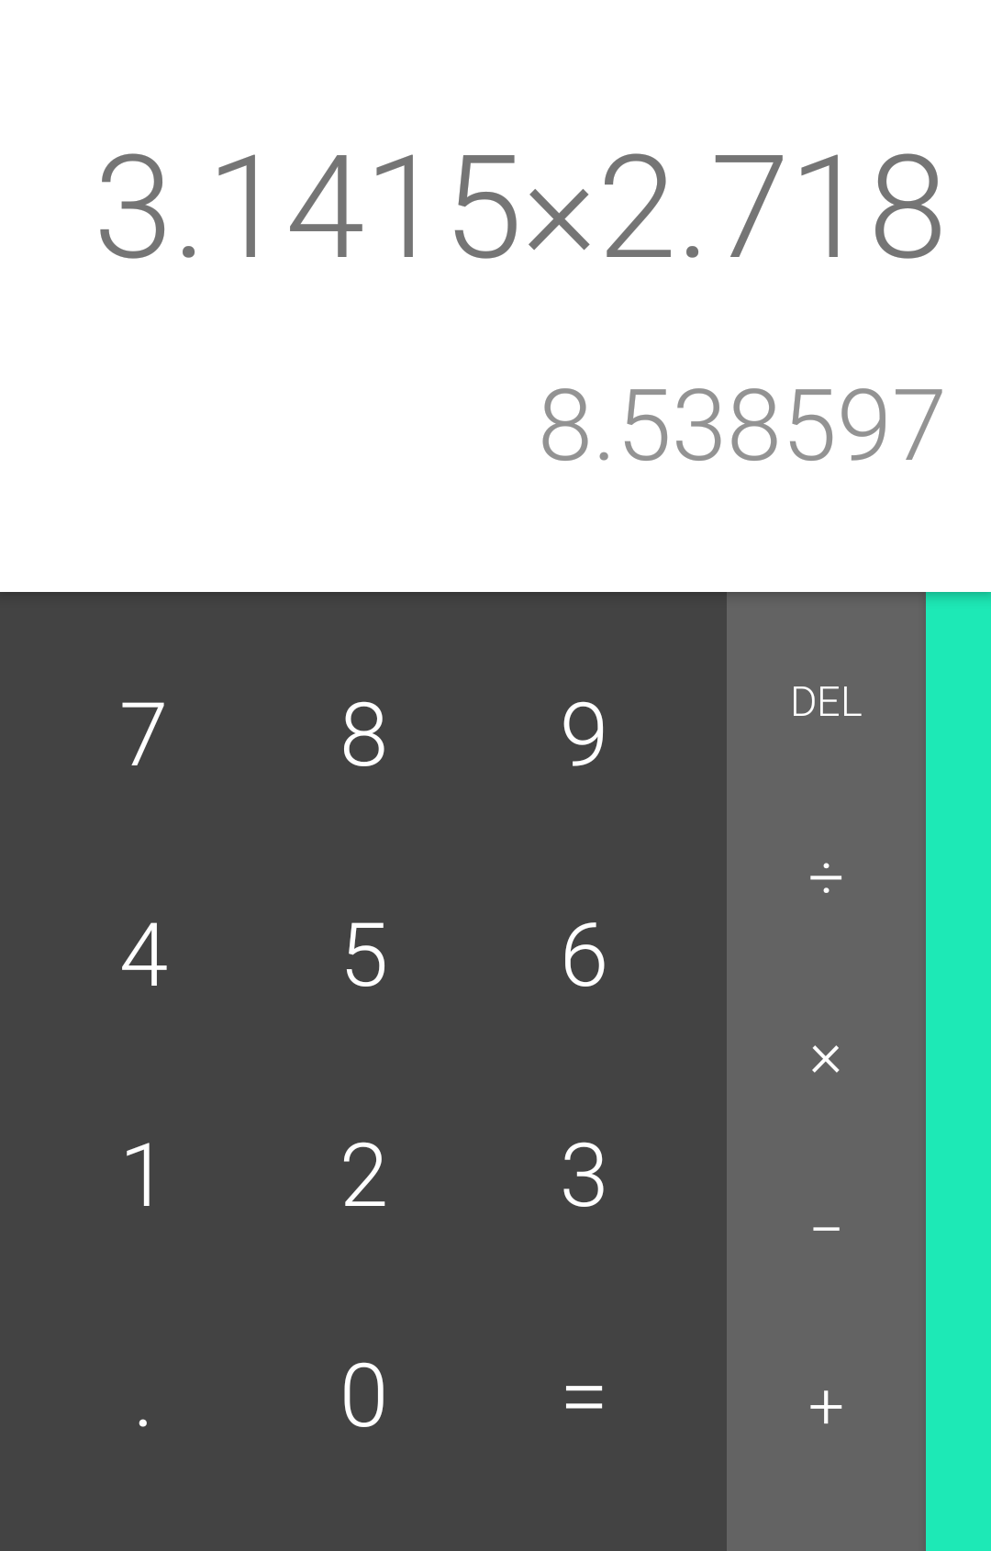
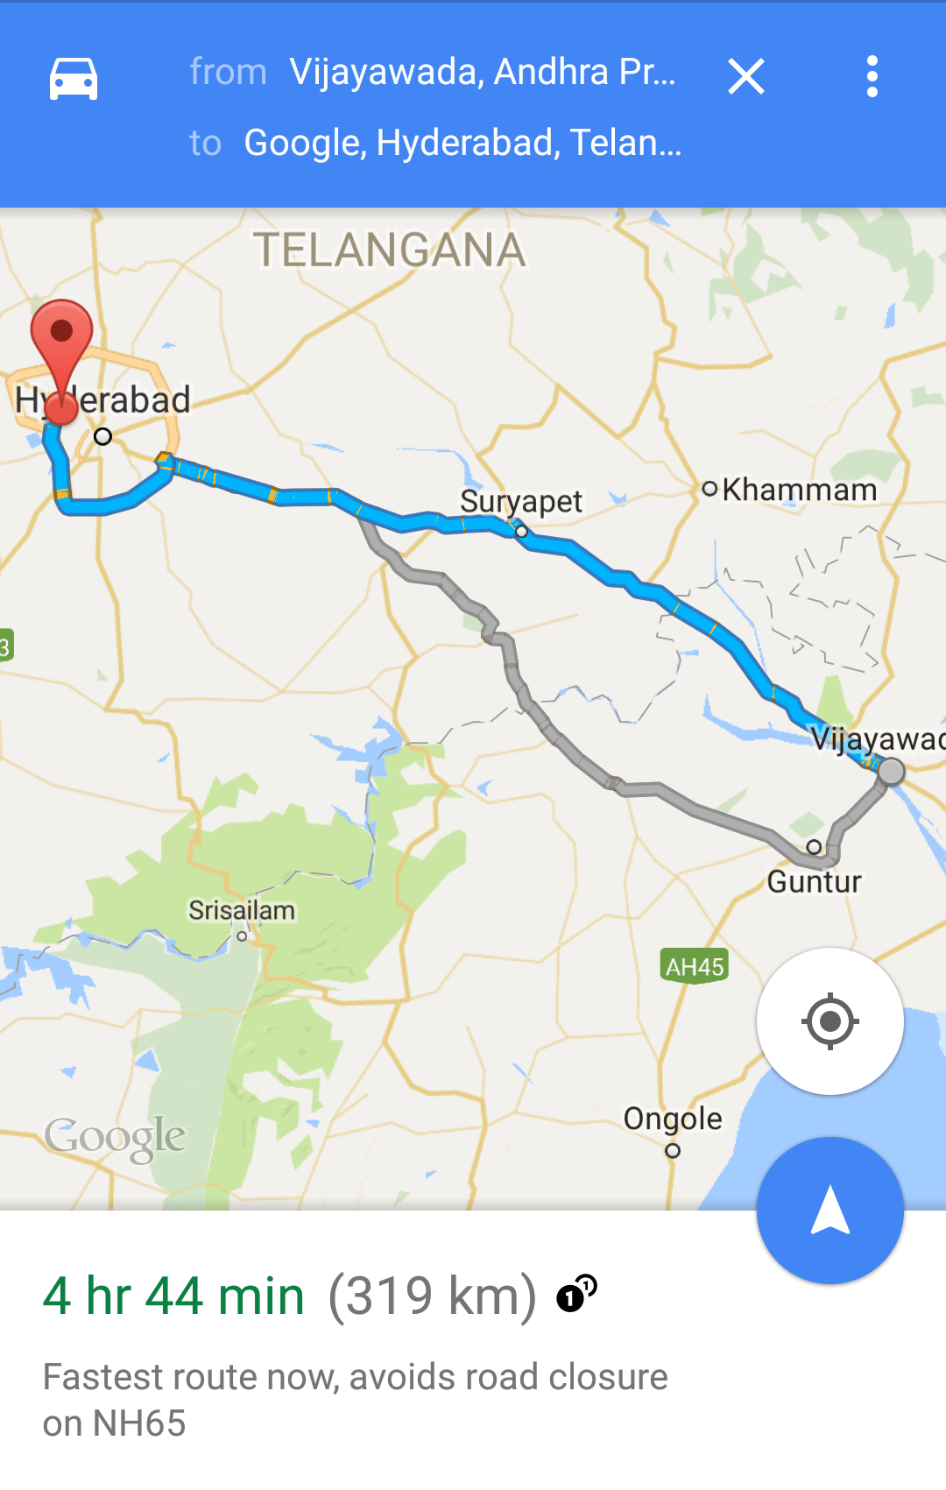
Activity

Slide 5
Activity
An Activity typically has a UI layout
Layout is usually defined in one or more XML files
Activity "inflates" layout as part of being created

Slide 6
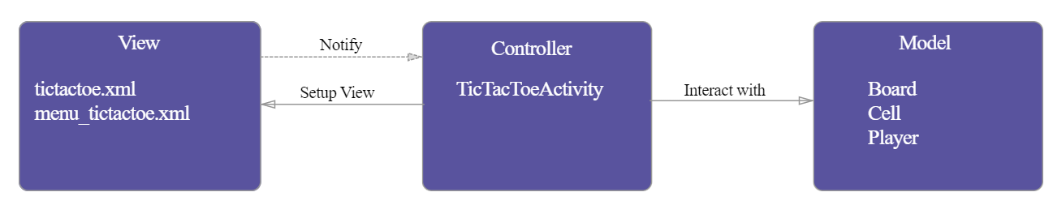
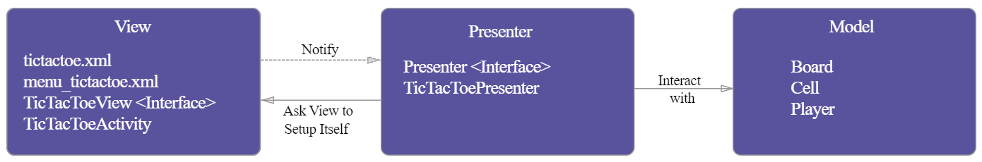
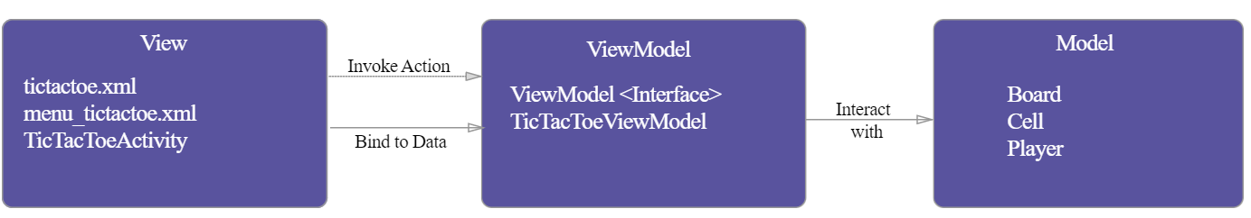
Activity
Activity is a necessary component in an Android application.
MVC
MVP
MVVM

Slide 7
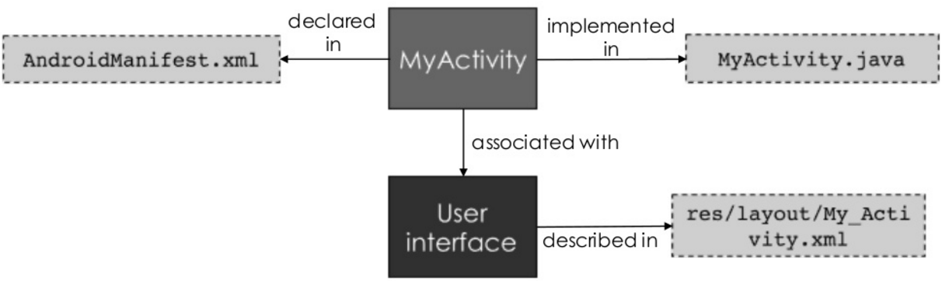
Activity

Slide 8
Implement new activities
Define layout in XML
Define Activity Java class
extends AppCompatActivity
Connect Activity with Layout
Set content view in onCreate()
Declare Activity in the Android manifest

Slide 9
Activity Implementation
Define Activity Java class
public class ExampleActivity extends AppCompatActivity {
@Override
protected void onCreate(Bundle savedInstanceState)
{
super.onCreate(savedInstanceState);
}
}

Slide 10
Activity Implementation
Connect Activity with layout
public class ExampleActivity extends AppCompatActivity {
@Override
protected void onCreate(Bundle savedInstanceState) {
super.onCreate(savedInstanceState);
setContentView(R.layout.activity_main);
}
}

Slide 11
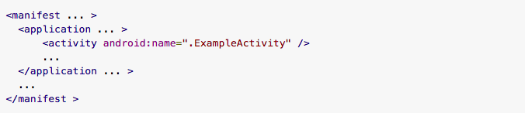
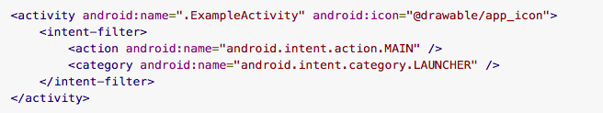
Activity Implementation
Declaring the activity in the manifest
Declaring the activity as a launch screen

Slide 12
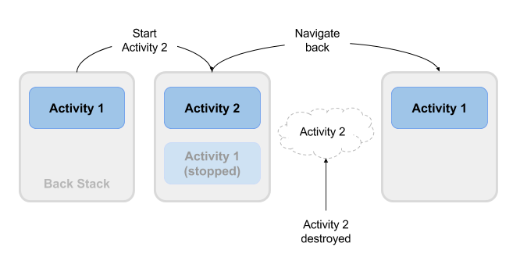
Activity Lifecycle
The set of states an Activity can be in during its lifetime, from when it is created until it is destroyed

Slide 13
Activity states and app visibility
Created (not visible yet)
Started (visible)
Resume (visible)
Paused(partially invisible)
Stopped (hidden)
Destroyed (gone from memory)
State changes are triggered by user action, configuration changes such as device rotation, or system action

Slide 14
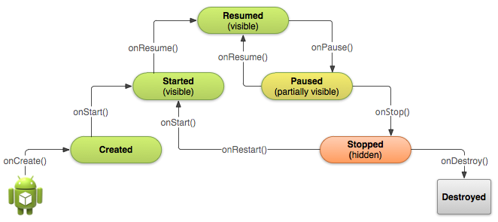
Activity states and callbacks graph

Slide 15
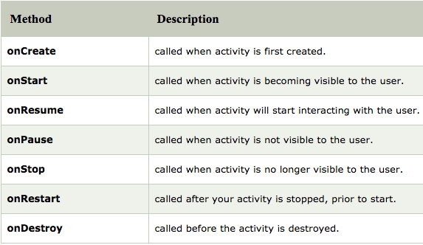
Activity Lifecycle callbacks

Slide 16
onCreate() –> Created
Called when the Activity is first created, for example when user taps launcher icon
Does all static setup: create views, bind data to lists, ...
Only called once during an activity's lifetime
Takes a Bundle with Activity's previously frozen state, if there was one
Created state is always followed by onStart()

Slide 17
onCreate(Bundle savedInstanceState)
@Override
public void onCreate(Bundle savedInstanceState) {
super.onCreate(savedInstanceState);
// The activity is being created.
}

Slide 18
onStart() –> Started
Called when the Activity is becoming visible to user
Can be called more than once during lifecycle
Followed by onResume() if the activity comes to the foreground, or onStop() if it becomes hidden

Slide 19
onStart()
@Override
protected void onStart() {
super.onStart();
// The activity is about to become visible.
}

Slide 20
onRestart() –> Started
Called after Activity has been stopped, immediately before it is started again
Transient state
Always followed by onStart()

Slide 21
onRestart()
@Override
protected void onRestart() {
super.onRestart();
// The activity is between stopped and started.
}

Slide 22
onResume() –> Resumed/Running
Called when Activity will start interacting with user
Activity has moved to top of the Activity stack
Starts accepting user input
Running state
Always followed by onPause()

Slide 23
onResume()
@Override
protected void onResume() {
super.onResume();
// The activity has become visible
// it is now "resumed"
}

Slide 24
onPause() –> Paused
Called when system is about to resume a previous Activity
The Activity is partly visible but user is leaving the Activity
Typically used to commit unsaved changes to persistent data, stop animations and anything that consumes resources
Implementations must be fast because the next Activity is not resumed until this method returns
Followed by either onResume() if the Activity returns back to the front, or onStop() if it becomes invisible to the user

Slide 25
onPause()
@Override
protected void onPause() {
super.onPause();
// Another activity is taking focus
// this activity is about to be "paused"
}

Slide 26
onStop() –> Stopped
Called when the Activity is no longer visible to the user
New Activity is being started, an existing one is brought in front of this one, or this one is being destroyed
Operations that were too heavy-weight for onPause()
Followed by either onRestart() if Activity is coming back to interact with user, or onDestroy() if Activity is going away

Slide 27
onStop()
@Override
protected void onStop() {
super.onStop();
// The activity is no longer visible
// it is now "stopped"
}

Slide 28
onDestroy() –> Destroyed
Final call before Activity is destroyed
User navigates back to previous Activity, or configuration changes
Activity is finishing or system is destroying it to save space
Call isFinishing() method to check
System may destroy Activity without calling this, so use onPause() or onStop() to save data or state

Slide 29
onDestroy()
@Override
protected void onDestroy() {
super.onDestroy();
// The activity is about to be destroyed.
}

Slide 30
Some methods related to activity lifecyle
finish()
OnBackPressedDispatcher
OnBackPressedDispatcher onBackPressedDispatcher = getOnBackPressedDispatcher();
onBackPressedDispatcher.addCallback(this, new OnBackPressedCallback(true) {
@Override
public void handleOnBackPressed() {
// Handle back button press
}
});

Slide 31
References
https://google-developer-training.github.io/android-developer-fundamentals-course-concepts-v2/

