Slide 1
Intent & Connecting Activities

Slide 2
Contents
Intent
Starting a new Activity with an Intent
Passing data between activities with extras
Navigating between activities

Slide 3
Intent
An Intent is a description of an operation to be performed.
An Intent is an object used to request an action from another app component via the Android system.
Originator
App component
Intent
Action
Android System

Slide 4
What can intents do?
Start an Activity
A button click starts a new Activity for text entry
Clicking Share opens an app that allows you to post a photo
Start a Service
Initiate downloading a file in the background
Deliver Broadcast
The system informs everybody that the phone is now charging

Slide 5
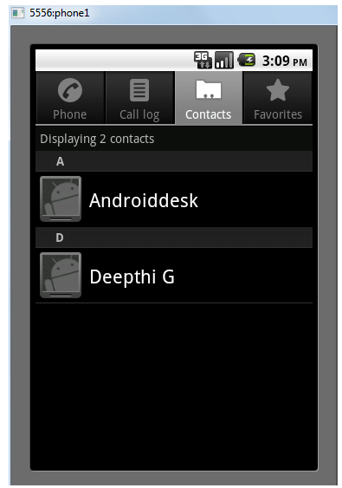
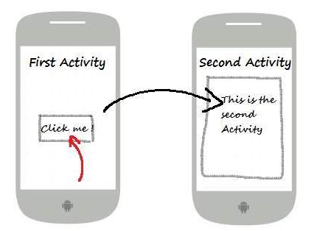
INTENT
Explicit Intent: Starts a specific Activity
Implicit Intent: Asks system to find an Activity that can handle this request

Slide 6
INTENT
Explicit Intent
Intent i = new Intent(FirstActivity.this, SecondActivity.class);
startActivity(i);
Implicit Intent
Intent read1=new Intent();
read1.setAction(android.content.Intent.ACTION_VIEW);
read1.setData(ContactsContract.Contacts.CONTENT_URI);
startActivity(read1);

Slide 7
Implicit Intents - Examples
Show a web page Uri uri = Uri.parse("http://www.google.com"); Intent it = new Intent(Intent.ACTION_VIEW,uri); startActivity(it);
Dial a phone number Uri uri = Uri.parse("tel:8005551234");
Intent it = new Intent(Intent.ACTION_DIAL, uri);
startActivity(it);

Slide 8

Activity Implement
Start another Activity
LoginActivity.this: Current activity ProfileActivity.class: The activity need to launch

Slide 9
Sending and retrieving data
In the first (sending) Activity:
Create the Intent object
Put data or extras into that Intent
Start the new Activity with startActivity()
In the second (receiving) Activity:
Get the Intent object, the Activity was started with
Retrieve the data or extras from the Intent object

Slide 10


Communicating Between Activities
Pass data from Activity A to Activity B.
Get data from Activity A at Activity B.

Slide 11


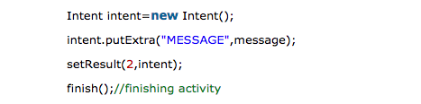
Communicating Between Activities
Pass data from Activity A to Activity B and Receive a result back, using:
Activity A starts activity B
Activity B sends result
Activity A receives the result back

Slide 12
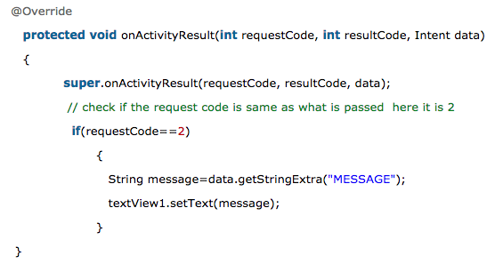
Communicating Between Activities
Pass data from Activity A to Activity B and Receive a result back (cont'd)
Activity A receives the result back

Slide 13
Communicating Between Activities startAcvityForResult is deprecated
private ActivityResultLauncher<Intent> activityResultLauncher; @Override protected void onCreate(Bundle savedInstanceState) { super.onCreate(savedInstanceState); setContentView(R.layout.activity_main); // Register the activity result launcher activityResultLauncher = registerForActivityResult(new ActivityResultContracts.StartActivityForResult(), new ActivityResultCallback<ActivityResult>() { @Override public void onActivityResult(ActivityResult result) { if (result.getResultCode() == Activity.RESULT_OK) { Intent data = result.getData(); // Handle the returned data } } } );

Slide 14
Communicating Between Activities startAcvityForResult is deprecated
// Example: Launch another activity findViewById(R.id.btn_go).setOnClickListener(new View.OnClickListener() { @Override public void onClick(View v) { Intent intent = new Intent(MainActivity2.this, MainActivity.class); activityResultLauncher.launch(intent); } });

Slide 15
Activity stack
When a new Activity is started, the previous Activity is stopped and pushed on the Activity back stack
Last-in-first-out-stack—when the current Activity ends, or the user presses the Back button, it is popped from the stack and the previous Activity resumes

Slide 16
Activity Stack
After viewing shopping cart, user decides to add more items, then places order.
OrderActivity Place order
CartActivity View shopping cart
CartActivity View shopping cart
OrderActivity Place order
CartActivity View shopping cart
CartActivity View shopping cart
FoodListActivity Choose food items
FoodListActivity Choose food items
FoodListActivity Choose food items
FoodListActivity Choose food items
MainActivity What do you want to do?
MainActivity What do you want to do?
MainActivity What do you want to do?
MainActivity What do you want to do?

Slide 17
Classwork
Create LoginActivity:
Enter name and touch Login Button to close Login Activity & open HomeActivity
Send name to HomeActivity
Clear field name if minimize and re-open app
Create HomeActivity:
Get name from LoginActivity and show it on screen
Press CLOSE button to finish app

Slide 18
References
https://google-developer-training.github.io/android-developer-fundamentals-course-concepts-v2/

