Slide 1
RecylerView

Slide 2
Contents
What is RecyclerView?
Implementing a RecyclerView

Slide 3
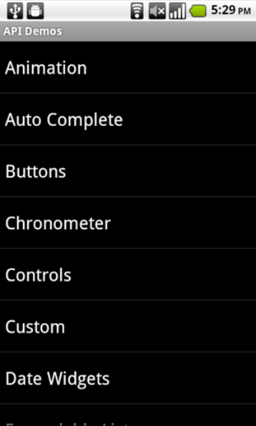
What is RecyclerView?
RecyclerView is a view capable of displaying scrollable list of items
It only creates views (widget) if needed
It recycles views, if a row is not displayed anymore, it will be recycled and only its content will change.
Efficient
Uses and reuses limited number of View elements
Updates changing data fast

Slide 4
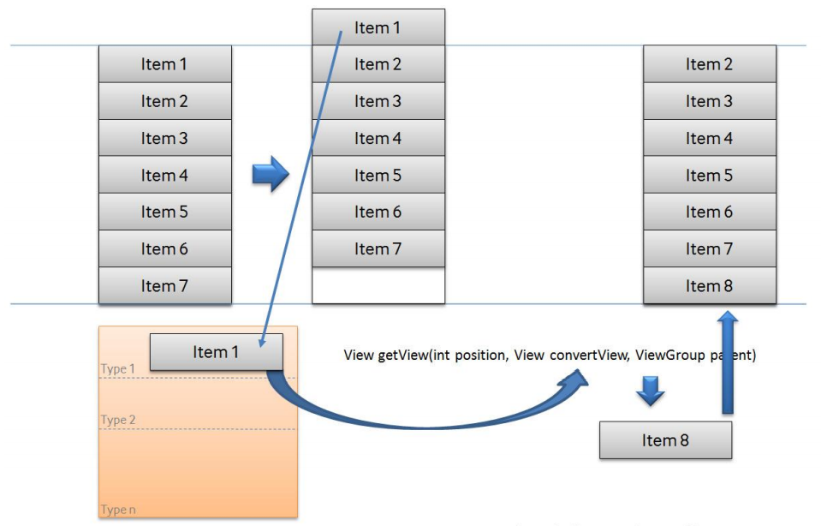
View recycling

Slide 5
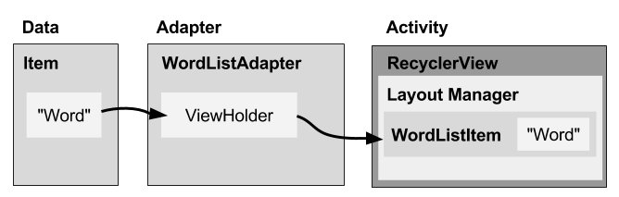
RecyclerView components

Slide 6
RecyclerView components
Data
RecyclerView scrolling list for list items—RecyclerView
Layout for one item of data—XML file
Layout manager handles the organization of UI components in a View—Recyclerview.LayoutManager
Adapter connects data to the RecyclerView—RecyclerView.Adapter
ViewHolder has view information for displaying one item—RecyclerView.ViewHolder

Slide 7
Layout manager
Each ViewGroup has a layout manager
Use to position View items inside a RecyclerView
Reuses View items that are no longer visible to the user
Built-in layout managers
LinearLayoutManager
GridLayoutManager
StaggeredGridLayoutManager
Extend RecyclerView.LayoutManager

Slide 8
Adapter
Helps incompatible interfaces work together
Example: Takes data from database Cursor and prepares strings to put into a View
Intermediary between data and View
Manages creating, updating, adding, deleting View items as underlying data changes
RecyclerView.Adapter

Slide 9
ViewHolder
Used by the adapter to prepare one View with data for one list item
Layout specified in an XML resource file
Can have clickable elements
Is placed by the layout manager
RecyclerView.ViewHolder

Slide 10
Implementing RecyclerView
Add RecyclerView dependency to build.gradle if needed
Add RecyclerView to layout
Create XML layout for item
Extend RecyclerView.Adapter
Extend RecyclerView.ViewHolder
In Activity onCreate(), create RecyclerView with adapter and layout manager

Slide 11
1. Add dependency to app/build.gradle
Add RecyclerView dependency to build.gradle if needed:
dependencies {
...
compile 'com.android.support:recyclerview-v7:26.1.0’
...
}

Slide 12
2. Add RecyclerView to XML Layout
<android.support.v7.widget.RecyclerView
android:id="@+id/recyclerview"
android:layout_width="match_parent"
android:layout_height="match_parent">
</android.support.v7.widget.RecyclerView>

Slide 13
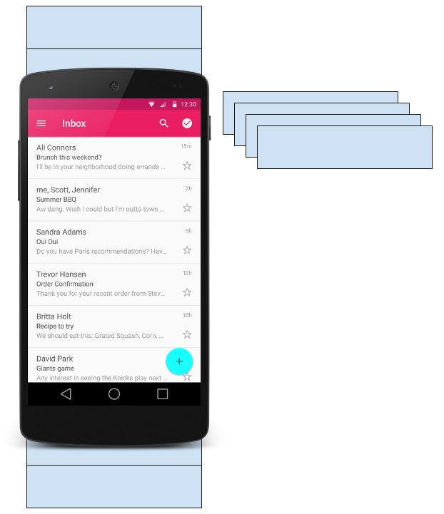
3. Create layout for 1 list item
<LinearLayout …>
<TextView
android:id="@+id/word"
style="@style/word_title" />
</LinearLayout>

Slide 14
4. Implement the adapter
public class WordListAdapter
extends RecyclerView.Adapter<WordListAdapter.WordViewHolder> {
public WordListAdapter(Context context,
LinkedList<String> wordList) {
mInflater = LayoutInflater.from(context);
this.mWordList = wordList;
}
}

Slide 15
Adapter has 3 required methods
onCreateViewHolder()
inBindViewHolder()
getItemCount()

Slide 16
onCreateViewHolder()
@Override
public WordViewHolder onCreateViewHolder( ViewGroup parent, int viewType) {
// Create view from layout
View mItemView = mInflater.inflate(
R.layout.wordlist_item, parent, false);
return new WordViewHolder(mItemView, this);
}

Slide 17
onBindViewHolder()
@Override
public void onBindViewHolder( WordViewHolder holder, int position) {
// Retrieve the data for that position
String mCurrent = mWordList.get(position);
// Add the data to the view
holder.wordItemView.setText(mCurrent);
}

Slide 18
getItemCount()
@Override
public int getItemCount() {
// Return the number of data items to display
return mWordList.size();
}

Slide 19
5. Create the view holder in adapter class
class WordViewHolder extends RecyclerView.ViewHolder { //.. }
If you want to handle mouse clicks:
class WordViewHolder extends RecyclerView.ViewHolder
implements View.OnClickListener { //.. }

Slide 20
View holder constructor
public WordViewHolder(View itemView, WordListAdapter adapter) {
super(itemView);
// Get the layout
wordItemView = itemView.findViewById(R.id.word);
// Associate with this adapter
this.mAdapter = adapter;
// Add click listener, if desired
itemView.setOnClickListener(this);
}
// Implement onClick() if desired

Slide 21
6. Create the RecyclerView in Activity onCreate()
mRecyclerView = findViewById(R.id.recyclerview);
mAdapter = new WordListAdapter(this, mWordList);
mRecyclerView.setAdapter(mAdapter);
mRecyclerView.setLayoutManager(new
LinearLayoutManager(this));

Slide 22
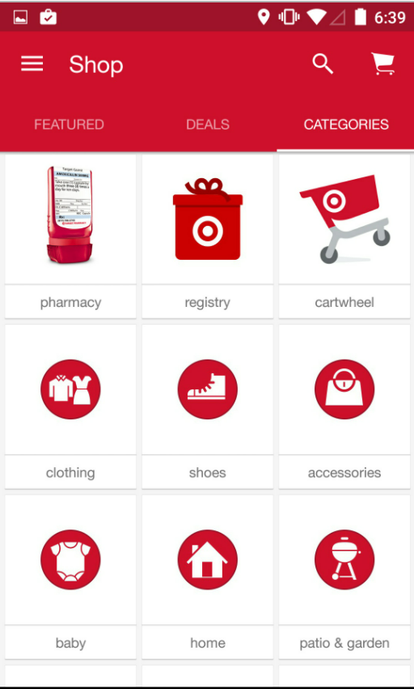
Classwork
Use RecyclerView to show list of products in HomeActivity
Click an Item, show DetailActivity

Slide 23
References
Using the RecyclerView | CodePath Android Cliffnotes
https://google-developer-training.github.io/android-developer-fundamentals-course-concepts-v2/

