Slide 1
Deep-learning Based Vehicle Re-identification
ENGG 4999 Final Year Project
2018/03/19
Author: QUAN, Pengrui
Supervisor: Prof. Xiaogang Wang

Slide 2
Content
Introduction
Approaches
Experiments
Observation
Conclusion
Reference
Appearance based vehicle Reid
Orientation based vehicle Reid
Appearance based vehicle Reid
Orientation based vehicle Reid

Slide 3
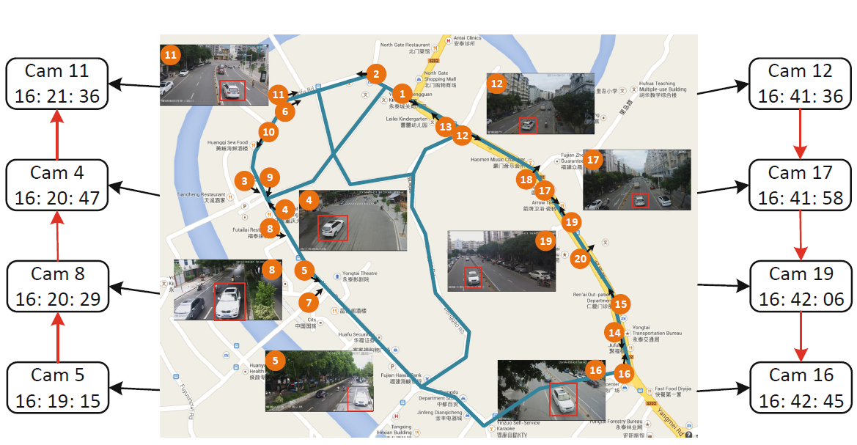
1. Introduction
Vehicle re-identification (ReID): the ReID problem derives from a real world problem – we want to keep track of a suspected vehicle within an urbane surveillance system.
The spatiotemporal information of a vehicle in the surveillance network.

Slide 4
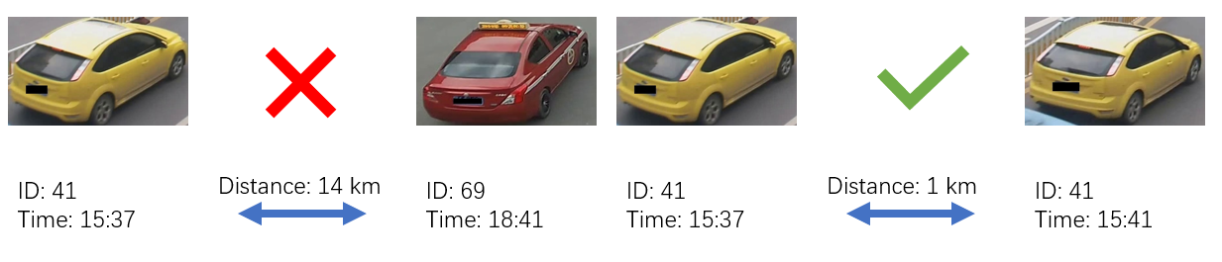
1. Introduction
Vehicle re-identification (ReID): given one query image of one specific vehicle, a vehicle ReID system is expected to provide all the images of the same vehicle from a large gallery database.
Vehicle ReID Task

Slide 5
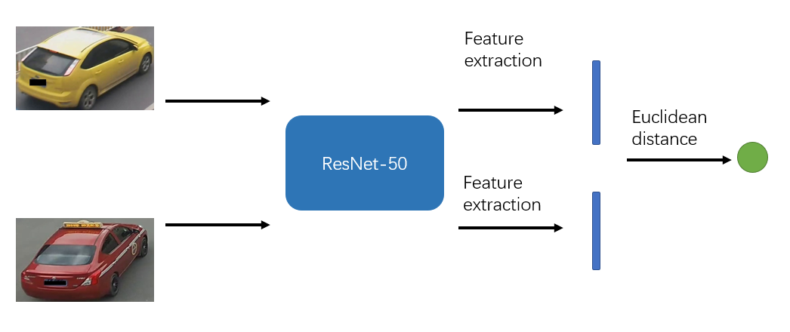
2.1 Appearance based Approaches
Single Neural Network: The network consists of a ResNet models. After passing a pair of queries image into the network in sequence, the network can generate a pair of feature vectors, from which the similarity score of two vehicles can be calculated.
baseline model with single convolutional neural network

Slide 6
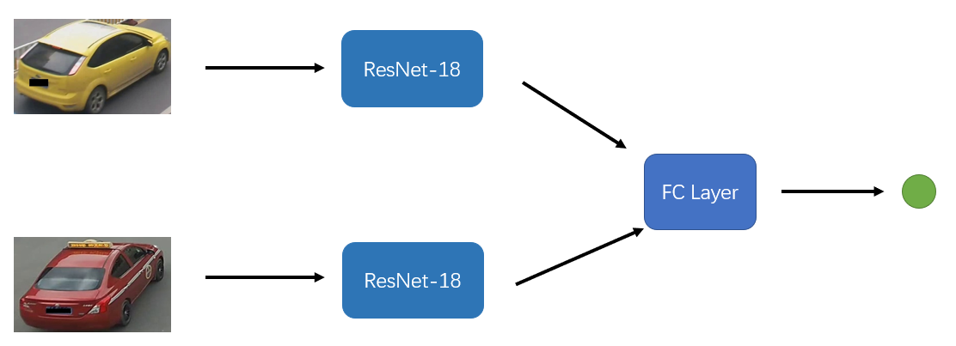
2.1 Appearance based Approaches
Siamese Neural Network: The network consists of two parallel ResNet models. After passing a pair of queries image into the network, the SNN produces a two-dimensional vector that represents the similarity confidence score.
baseline model with Siamese neural network

Slide 7
2.2 Appearance based Approaches
Spatiotemporal Posterior Probability:
Assumption: vehicles of the same identity will have a small distance in time and geo-location when captured, while those of different identities will have relatively large distance.
Parameter | same class | different classes
μ_{t} / (frame) | 6460 | 29473
δ_{t} / (frame) | 13243 | 20755
μ_{d} / (m) | 390 | 595
δ_{d} / (m) | 364 | 440

Slide 8

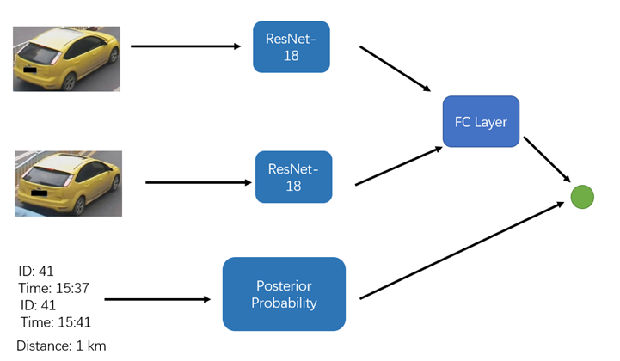
2.2 Appearance based Approaches
Spatiotemporal Posterior Probability:
Linear Approximation: compute their posterior class probability with respect to their difference in time and space.
baseline model with posterior probability

Slide 9
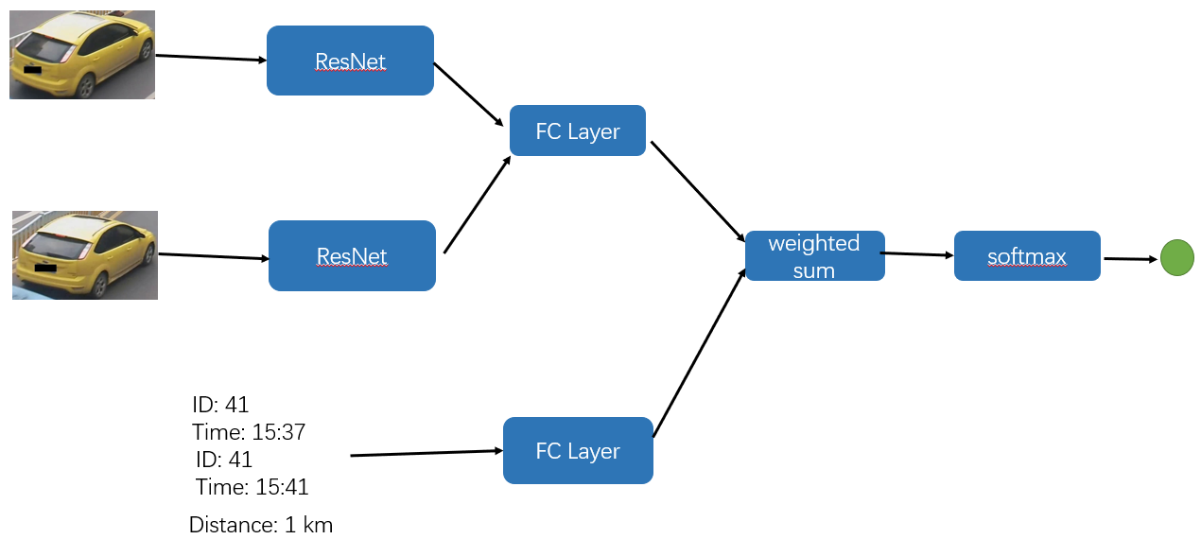
2.3 Appearance based Approaches
Integrated Siamese Neural Network: an end-to-end training approach utilizing a visual-spatiotemporal deep neural network (called integrated SNN) consisting of the baseline SNN for appearance information and a fully connect neural network for spatiotemporal information.
Integrated Siamese neural network

Slide 10
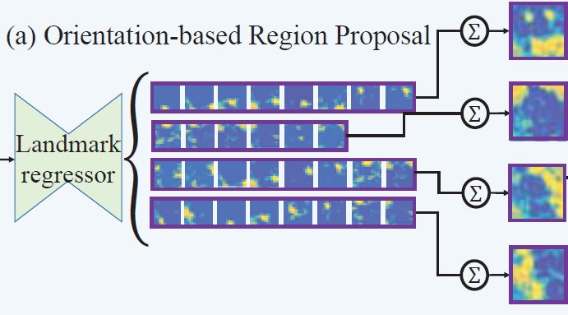
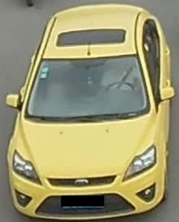
2.4 Orientation based Approaches
Orientation Based Feature Propose: Since images of different orientations of one identical vehicle is constantly captured by different cameras, we intend to design an orientation-based vehicle reidentification network to improve the performance of the whole model.

Slide 11
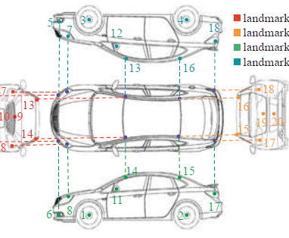
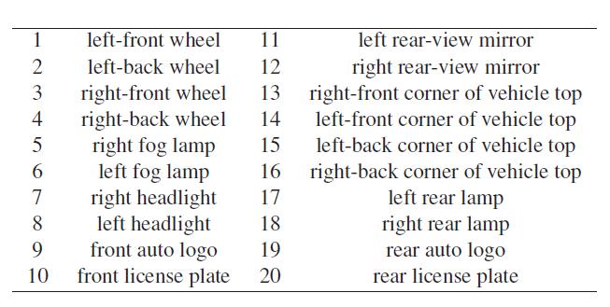
2.4.1 Key points of vehicles
Key points: The key point regressor takes the image as input and outputs one response map Fi ∈ R^{X×Y} (i ∈ 1, ..., 20) for each of the 20 key points, where X and Y are the horizontal and vertical dimensions of the feature maps.

Slide 12
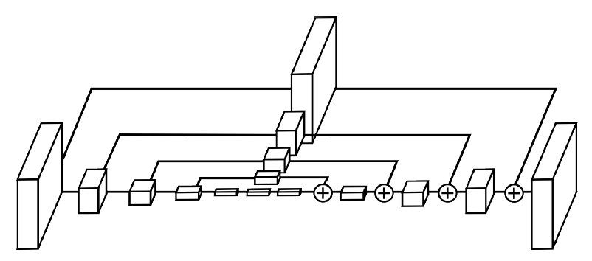
2.4.2 Hourglass Model
Hourglass network for key point detection: the hourglass module before stacking is closely connected to residual layer and other designs that process spatial information at multiple scales for dense prediction.
Figure 1 An illustration of a single hourglass module. Each box in the figure corresponds to a residual module.

Slide 13
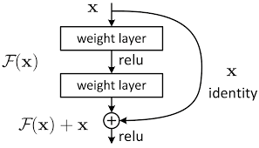
2.4.2 Residual Layer
Residual Layer: Basic building blocks of hourglass model. The residual layer convolutes the input with several kernels of different sizes with the aid of activation functions.
Figure 2 An illustration of a residual layer used in the Hourglass Network.

Slide 14
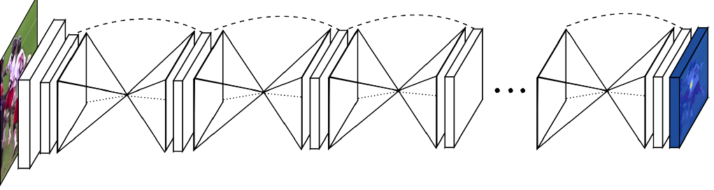
2.4.2 Hourglass Model
Stacked hourglass network: We take our network architecture further by stacking multiple hourglasses end-to-end, feeding the output of one as input into the next. The key to this approach is the prediction of intermediate heatmaps upon which we can apply a loss.
Figure 3 An illustration of Stacked hourglass module.

Slide 15



2.4.3 Generation of Ground True
Gaussian-like landmark generation: ground-truth heatmap consisting of a 2D gaussian (with standard deviation of 2 px) centered on the joint location. If there are no key points appearing, the ground-truth heatmap will zero everywhere.
Negative Sample
Positive Sample with sigma = 2 pixels
Positive Sample with sigma = 6 pixels

Slide 16

2.4.2 Detection Accuracy
Precision of key points detection: if the maximum point of predicted heatmap is pretty close to position of key points in ground-truth, then we think the key point is predicted.
if max(pred_map) > threshold && $\left|x−x_{0}\right|<r$ && $\left|y−y_{0}\right|<r$:
return True
else if max(pred_map) <= threshold:
return True
else:
return False
where pred_map is the heatmap generated by the hourglass. (x, y) is the location of the predicted heatmap. $\left(x_{0}, y_{0}\right)$ is location of the ground true.

Slide 17
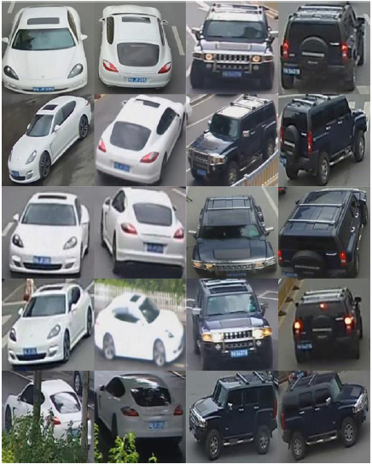
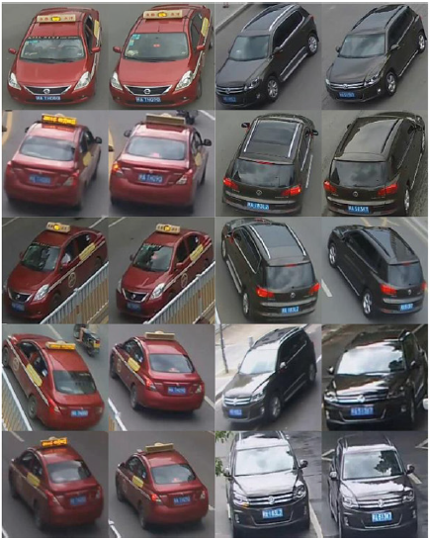
3. Experiments
VeRi-776 dataset: consists of 51,035 images of 776 vehicles. Each vehicle is capture by 2 to 18 cameras with timestamps and geo-locations of cameras with respect to each image provided. The entire dataset is divided into a training dataset comprised of 31,535 images of 576 vehicles, a validation dataset of 6,243 images of 100 vehicles, and a query and gallery dataset of 1,678 and 11,579 images for future testing.

Slide 18





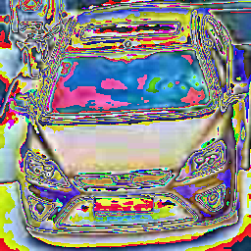


3.1.1 Experiments on Key Points Detection
Figure 2-6 Outputs of Hourglass Network: the first two heatmaps are negative samples, while the last three are positive.
Figure 1 Vehicle Image after transformation
Figure 7-11 Ground-truth heatmap : the first two heatmaps are negative samples, while the last three are positive.

Slide 19







3.1.1 Experiments on Key Points Detection
Figure 2-6 Outputs of Hourglass Network: the first two heatmaps are negative samples, while the last three are positive.
Figure 1 Vehicle Image after transformation
Figure 7-11 Ground-truth heatmap : the first two heatmaps are negative samples, while the last three are positive.

Slide 20
3.1.2 Experiments on Key Points Detection

Slide 21


3.2 Criterion for Vehicle ReID
Evaluation Criterion: Apart from top 1 and top 5 accuracy, the mean Average Precision (mAP) is also utilized to evaluate the performance of the proposed vehicle ReID framework, whereby:

Slide 22
3.2 Experiments on Spatio-temporal Vehicle Detection
Key points detection | Best average accuracy (%)
Sigma = 2 | 89.6
Sigma = 4 | 85.4
Sigma = 6 | 77.6

Slide 23
3.2 Experiments on Spatio-temporal Vehicle Detection
Method | mAP (%) | top 1 accuracy (%) | top 5 accuracy (%)
SNN (ResNet-18) | 41.1 | 89.4 | 95.2
SNN (ResNet-18) + regularized term | 42.4 | 89.9 | 96.3
SNN (ResNet-50) | 48.9 | 93.3 | 98.6
SNN (ResNet-50) + regularized term | 50.6 | 94.7 | 99.5
Integrated SNN (ResNet-18) | 49.7 | 94.8 | 100
Integrated SNN (ResNet-50) | 58.6 | 96.6 | 100
Siamese Hourglass (σ = 2) | 25.7 | 44.7 | 71.6
Siamese Hourglass (σ = 6)

Slide 24
3.2 Experiment Observation
As for the vehicle key points detection, the best accuracy is 89.6%, obtained at the epoch of 66.
the SNN baseline model would further give us 41% mAP. When the linear approximate model is combined with the scores output by SNN, the mAP is increased by 1.3%. It tells us that the assumption of the linear approximation is reasonable.
The integrated SNN can have a much better performance than previous and achieve a mAP of 58.6%, which outperforms all of the previous methods dramatically.

Slide 25
4 Conclusion
In this project, I make use of several frameworks for vehicle ReID with both visual and spatiotemporal information.
Making use of the power of computation, the stacked hourglass network can detect the key points of vehicles quite well.
Based on ResNet-18, a baseline model can be learnt to characterize the similarity regarding visual information of vehicles.
The linear approximate assumption is reasonable: two images have higher possibility to be the same vehicle if they have small space or time distance, and lower possibility otherwise.
With the aid of a pre-trained SNN, the network can have a much more better performance. It can make up for the deficiency when the appearance information is not accurate enough.

Slide 26
5. Parameters Used in Key Points Detection
Parameter | Value
Training images | 31284
Test images | 11178
Sigma for gaussian-like ground-truth heatmaps | 2
Radius for ground-truth generation | 8
Radius for key points detection | 2
Threshold for negative samples | 0.01
Batch size | 200
Learning rate | 0.0025
Stacks of hourglasses | 2

Slide 27
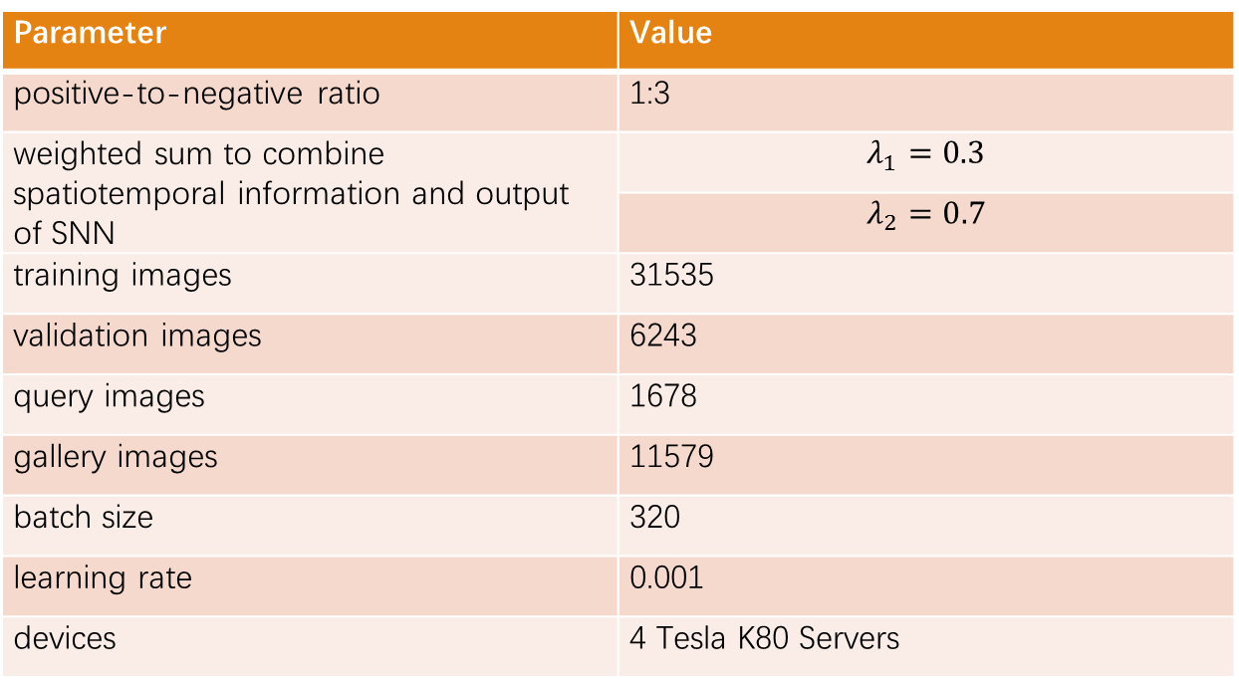
5. Parameters Used in Experiments
Parameter | Value
positive-to-negative ratio | 1:3
Weights to combine spatiotemporal information and output of SNN
training images | 31535
validation images | 6243
query images | 1678
gallery images | 11579
batch size | 320
learning rate | 0.001
devices | 4 Tesla K80 Servers

Slide 28
6. Reference
Shen Y, Xiao T, Li H, et al. Learning Deep Neural Networks for Vehicle Re-ID with Visual-spatio-temporal Path Proposals[J]. arXiv preprint arXiv:1708.03918, 2017.
Krizhevsky A, Sutskever I, Hinton G E. Imagenet classification with deep convolutional neural networks[C]//Advances in neural information processing systems. 2012: 1097-1105.
He K, Zhang X, Ren S, et al. Deep residual learning for image recognition[C]//Proceedings of the IEEE conference on computer vision and pattern recognition. 2016: 770-778.
Bromley J, Guyon I, LeCun Y, et al. Signature verification using a" siamese" time delay neural network[C]//Advances in Neural Information Processing Systems. 1994: 737-744.
Liu X, Liu W, Mei T, et al. A deep learning-based approach to progressive vehicle re-identification for urban surveillance[C]//European Conference on Computer Vision. Springer International Publishing, 2016: 869-884
D. Zapletal and A. Herout. Vehicle re-identification for automatic video traffic surveillance. //In Proceedings of the IEEE Conference on Computer Vision and Pattern Recognition Workshops, pages 25–31, 2016.

Slide 29
6. Reference
Newell A, Yang K, Deng J. Stacked hourglass networks for human pose estimation[C]//European Conference on Computer Vision. Springer, Cham, 2016: 483-499.
Andriluka M, Pishchulin L, Gehler P, et al. 2d human pose estimation: New benchmark and state of the art analysis[C]//Proceedings of the IEEE Conference on computer Vision and Pattern Recognition. 2014: 3686-3693.
Wang Z, Tang L, Liu X, et al. Orientation Invariant Feature Embedding and Spatial Temporal Regularization for Vehicle Re-identification[C]//Proceedings of the IEEE Conference on Computer Vision and Pattern Recognition. 2017: 379-387.

