Slide 1
Computer Vision – HW2
Abhinuv Pitale

Slide 2

Problem 1: Keypoints and Feature Tracking
Part A : Keypoint Detection using second moment matrix to detect corners.
Pseudo Algo
Smoothen the image to clean and remove any noise
Get Image gradients in the x and y directions Ix and Iy
Compute Ix*Ix, Ix*Iy, Iy*Iy
Smoothen Ix*Ix, Ix*Iy, Iy*Iy to get local gradients
Compute Harris function using
Normalize this matrix to 1
Perform non-max suppression
->just keep the maxima of a local neighbourhood. (used a 5*5 window)
Threshold the points.

Slide 3
Pseudo Code
imGau = GaussianFilter(inputImage,tuningConstants1)
Ix,Iy = gradient(imGau)
Compute Ix*Ix, Ix*Iy, Iy*Iy
A = GaussianFilter(Ix*Ix,tuningConstants2)
B = GaussianFilter(Ix*Iy,tuningConstants2)
C = GaussianFilter(Iy*Iy,tuningConstants2)
H = (A.*C - B.*B)./(A+C);
Normalize H
Non Max suppression
nonMaxNormH(find(normH ~= maximum(normH,25,ones(5)))) = 0;
Return find(nonMaxNormH > tuningConstant3 );

Slide 4
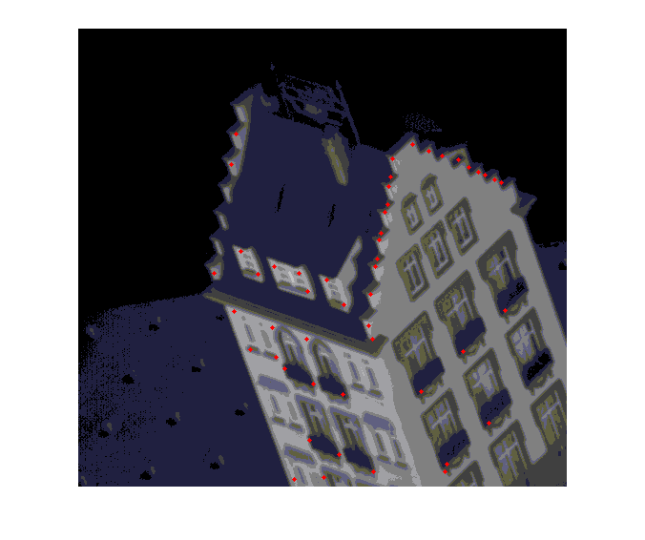
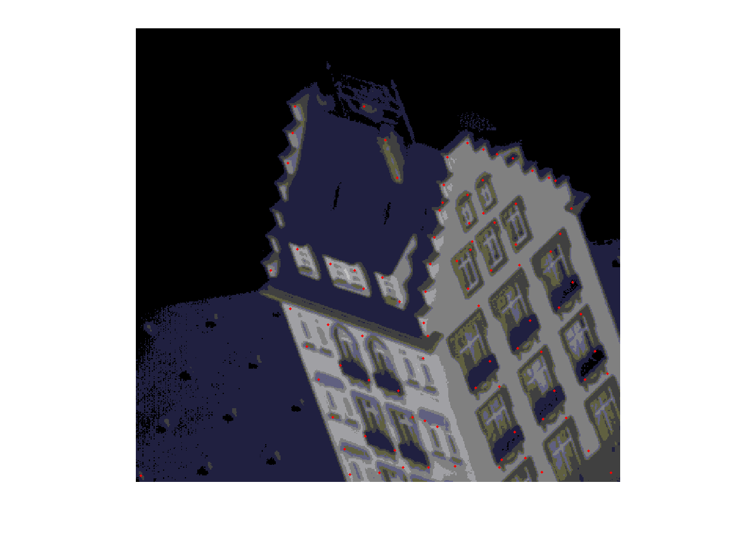
Tau = 0.5 with 5*5 window for non max suppression
Tau = 0.6 with 10*10 window for non max supp.

Slide 5
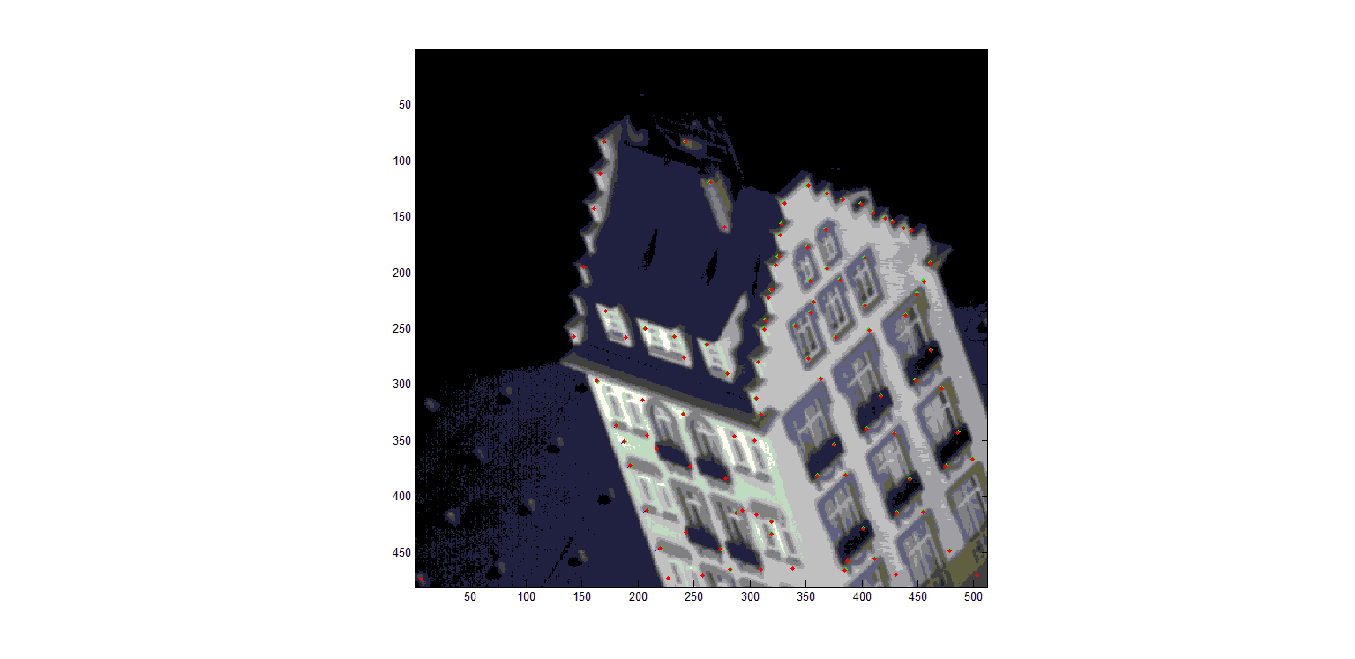
Part 2: Key Point Tracking
For all the keypoints, display (1) the keypoints at the first frame (as green) and (2) the tracked keypoints at the second frame (as red) on the first frame of the sequence.
Green Points correspond to the keypoints in the first frame
Red Points correspond to the tracked keypoints in the second frame.
This image is the initial Frame.

Slide 6
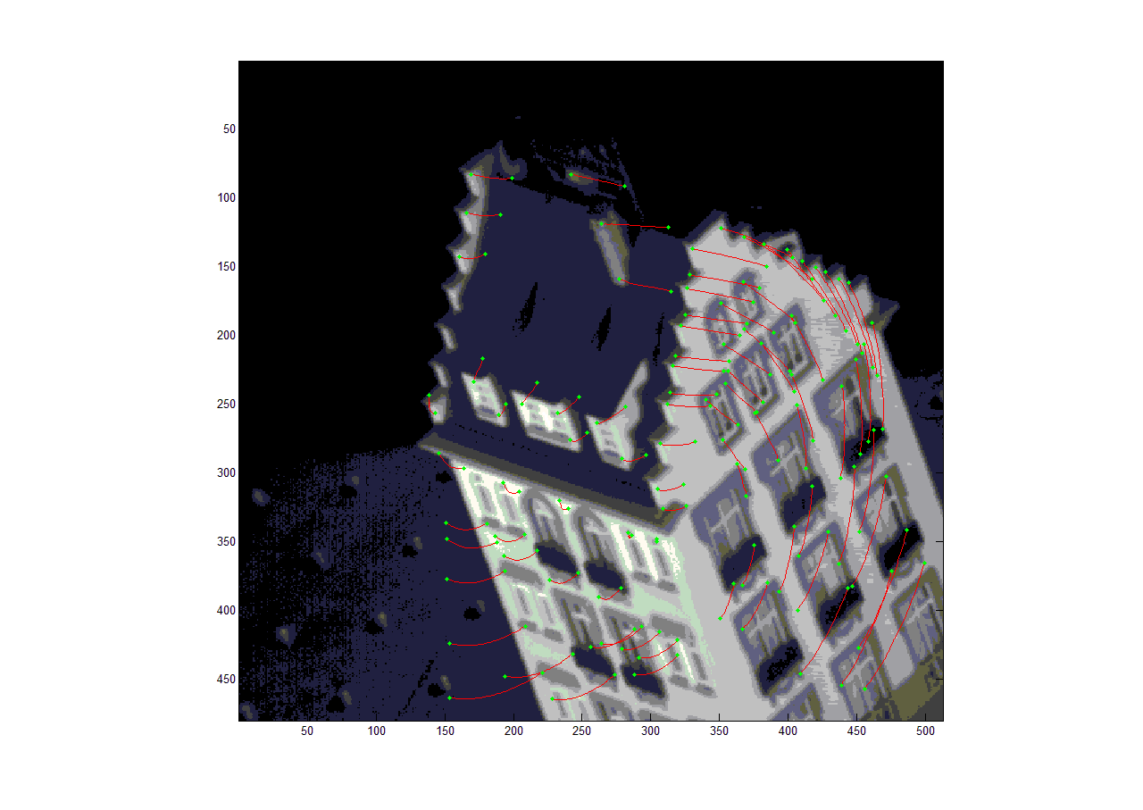
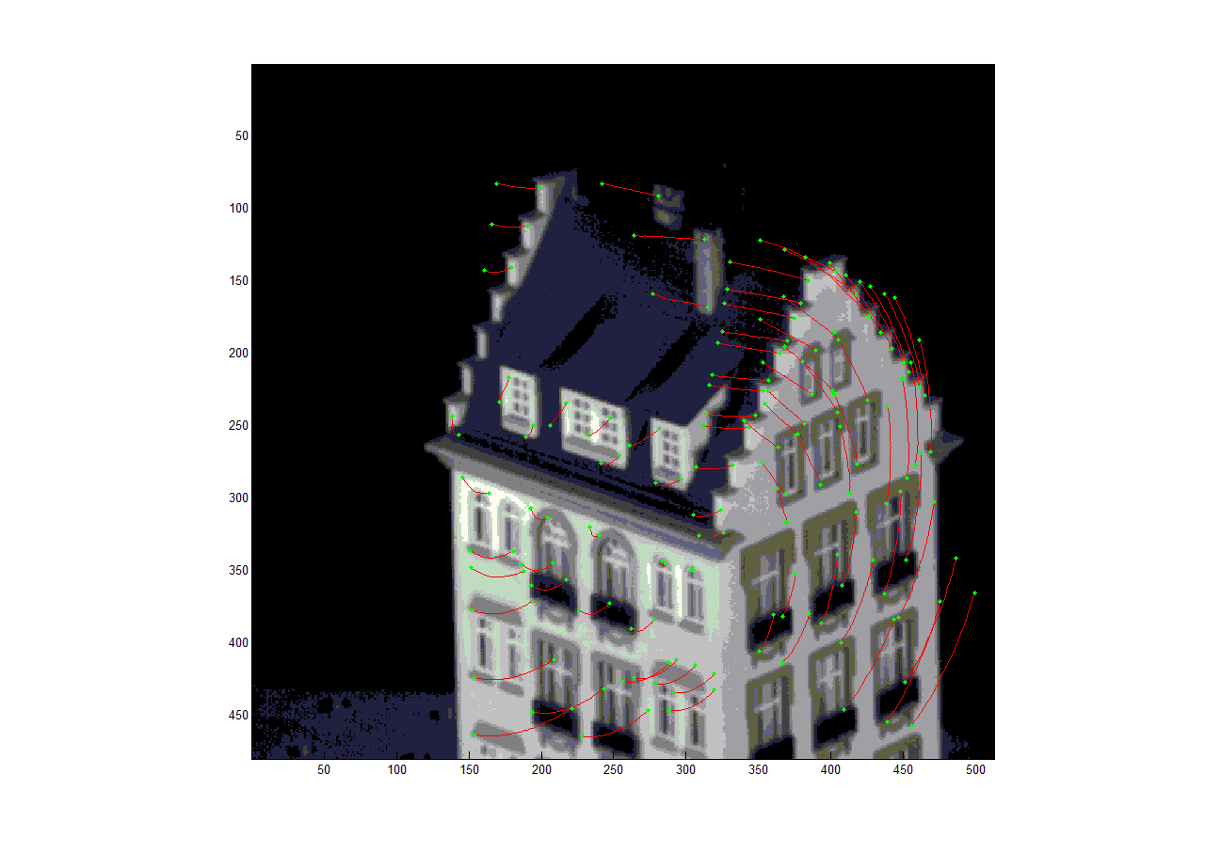
Frame 1 -> -> -> -> -> -> -> -> -> -> -> -> -> -> -> -> -> -> -> -> -> -> -> -> -> -> -> -> -> -> -> -> -> -> -> -> -> -> -> -> -> Frame 50

Slide 7
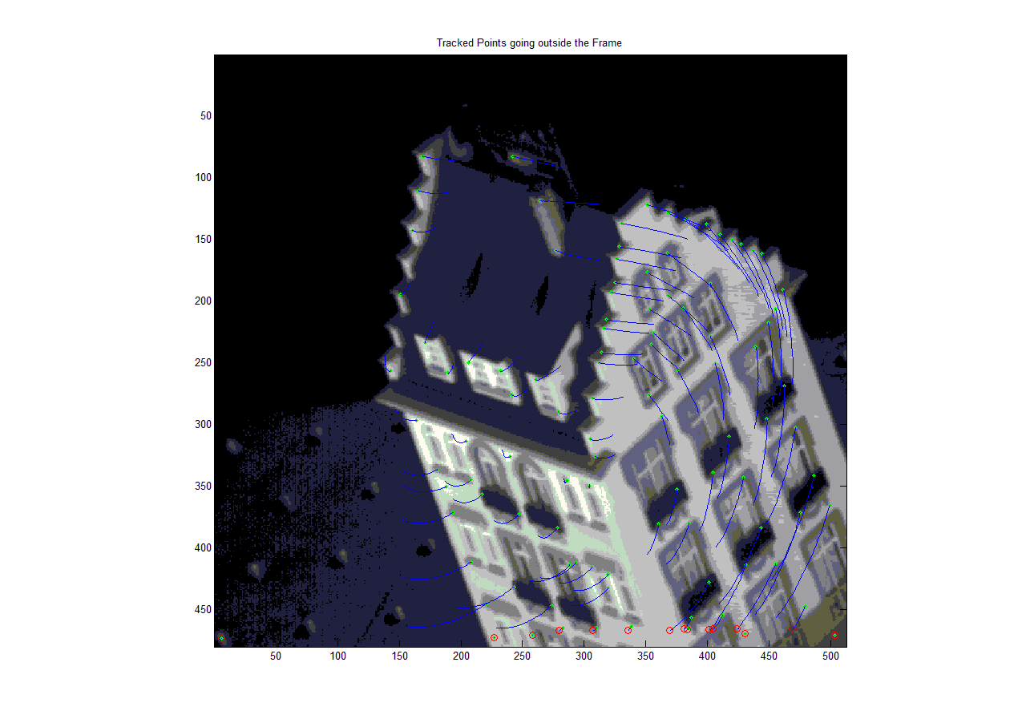
On top of the first frame, plot the points which have moved out of frame at some point along the sequence.
Green -> Initial keyPoints from image0
Blue -> Tracked keyPoints through frame0-50
Red -> Points which have gone out of the frame during tracking.

Slide 8
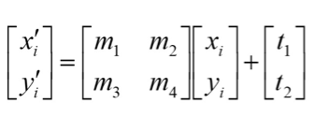
Problem 2: Shape Alignment
Algorithm used:
I have used an ICP algorithm with least squares for shape alignment
Compute the translation, scaling and rotation from image 1 to image 2 to create a Transformation Matrix, T which is used as a good initialization measure.
Convert image 1 key points using T
Using L-2 norm to find the closest points from the transformed image to image 2.
Using the corresponding points, find the affine transform by solving the equation
Find m1,m2,m3,m4,t1,t2
NewT = T*[m1 m2 t1;m3 m4 t2;0 0 1] -> to compute the new transform matrix
Repeat step 3-6, until maximum convergence. (Least squares method)

Slide 9
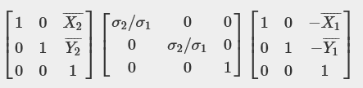
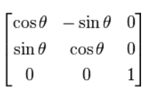
Initialization
Use the mean of the image to get the translation
Use the standard deviation to get the scaling
Use the eigen vectors of the variance to get the rotation
Translation ->
Rotation ->
Where theta = theta2-theta1(from image2 and image1’s eigen vectors)
Model
We have used an affine transform, even though the matrix T is a 3x3 dimensioned, the bottom row is always [0 0 1], hence we are not warping.

Slide 10
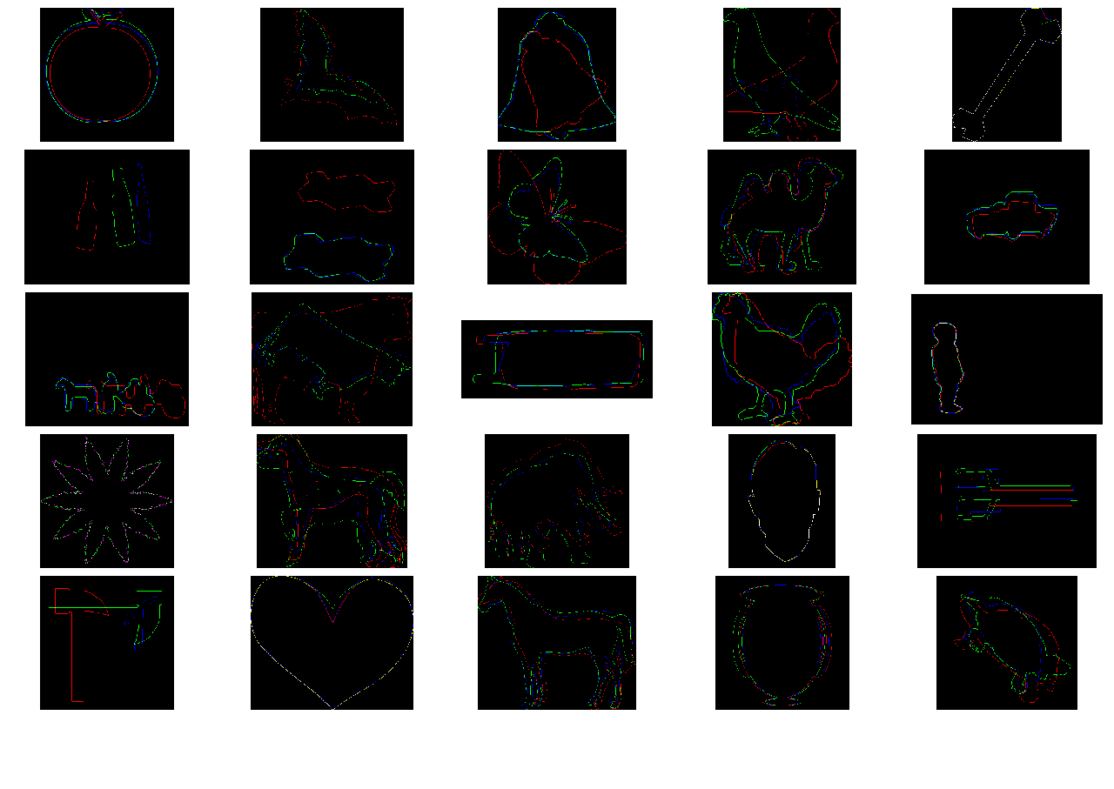
Red -> Image 1
Blue -> Image 2
Green -> Transform
Good cases -> Apple, Bell, Butterfly, children, face, fork
Bad Cases -> hammer (orientation issues)
Bird (Flipped Image, needs better initialisation)
Bottle (Rank and Condition of the transformation matrix issues, can be solved using lesser number of iterations to get a denser matrix.)

Slide 11
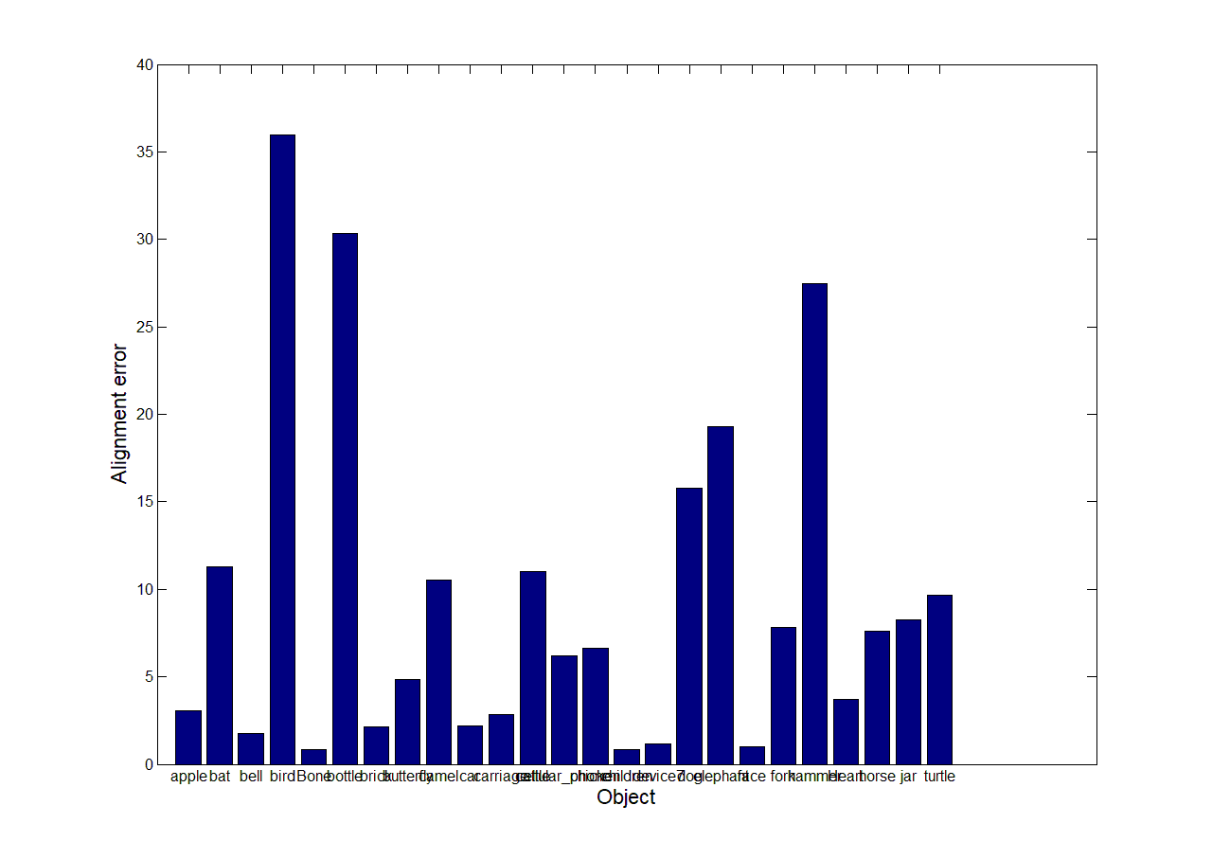

Slide 12
Elapsed time is 0.158766 seconds.
Error for aligning "apple": 3.043444
Elapsed time is 0.772311 seconds.
Error for aligning "bat": 11.279076
Elapsed time is 0.107247 seconds.
Error for aligning "bell": 1.755130
Elapsed time is 0.310239 seconds.
Error for aligning "bird": 35.966709
Elapsed time is 0.356721 seconds.
Error for aligning "Bone": 0.864518
Elapsed time is 0.027540 seconds.
Error for aligning "bottle": 30.321011
Elapsed time is 0.116633 seconds.
Error for aligning "brick": 2.137177
Elapsed time is 0.314929 seconds.
Error for aligning "butterfly": 4.862310
Elapsed time is 0.527191 seconds.
Error for aligning "camel": 10.521843
Elapsed time is 0.106424 seconds.
Error for aligning "car": 2.183107
Elapsed time is 0.173127 seconds.
Error for aligning "carriage": 2.824559
Elapsed time is 1.718400 seconds.
Error for aligning "cattle": 10.993303
Elapsed time is 0.254183 seconds.
Error for aligning "cellular_phone": 6.220031
Elapsed time is 0.169589 seconds.
Error for aligning "chicken": 6.643210
Elapsed time is 0.081180 seconds.
Error for aligning "children": 0.839553
Elapsed time is 2.978270 seconds.
Error for aligning "device7": 1.175451
Elapsed time is 1.319479 seconds.
Error for aligning "dog": 15.768100
Elapsed time is 2.459379 seconds.
Error for aligning "elephant": 19.307802
Elapsed time is 0.170811 seconds.
Error for aligning "face": 1.007701
Elapsed time is 0.878260 seconds.
Error for aligning "fork": 7.831508
Elapsed time is 0.133916 seconds.
Error for aligning "hammer": 27.452896
Elapsed time is 0.478326 seconds.
Error for aligning "Heart": 3.713124
Elapsed time is 2.589780 seconds.
Error for aligning "horse": 7.603043
Elapsed time is 0.948099 seconds.
Error for aligning "jar": 8.271256
Elapsed time is 0.279771 seconds.
Error for aligning "turtle": 9.640903
Averaged alignment error = 9.289071
Elapsed time is 18.638936 seconds.

Slide 13
Problem 3: Feature Matching
Plot matches using nearest neighbor
-> It gives us lots of matches with lots of false positives, this is because those points are not reliably matched.
Plot Matches with distance ratio test
-> Better results as lots of false positives are discarded since we are thresholding those points.

Slide 14
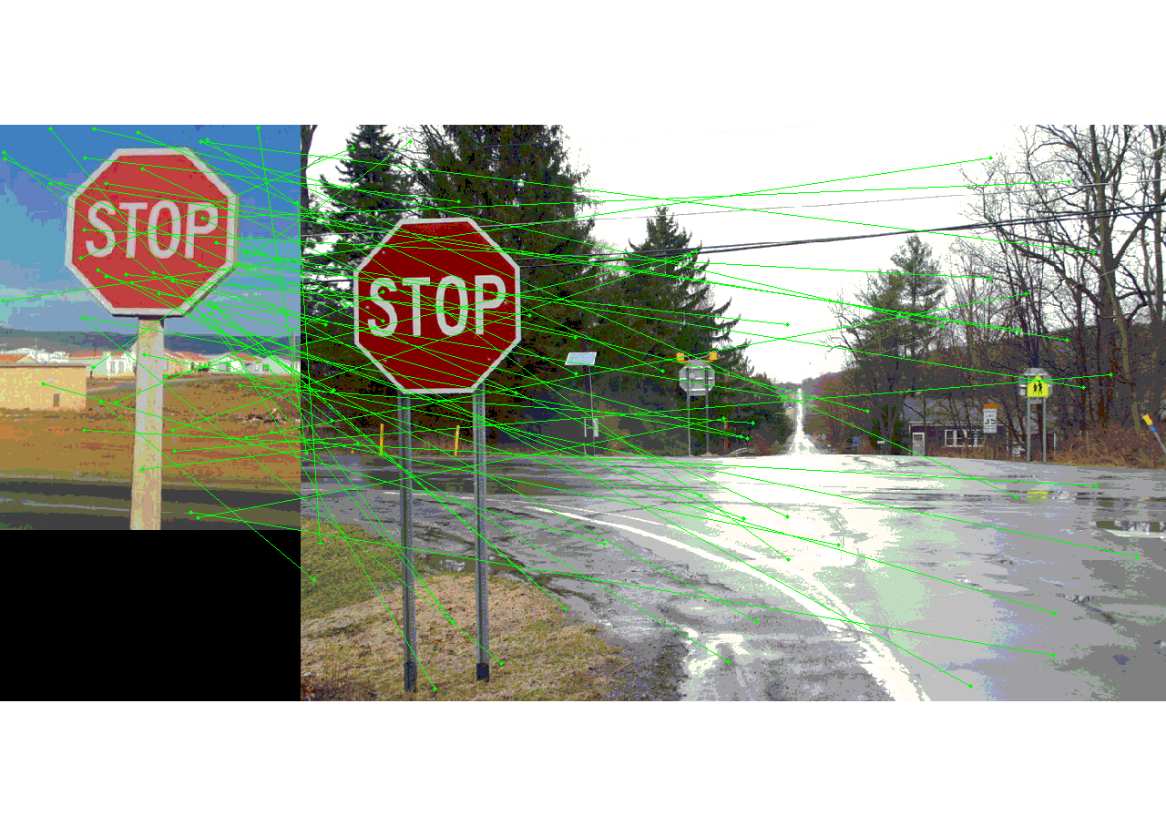
Nearest Neighbor matching with normalized threshold on distances = 0.7

Slide 15
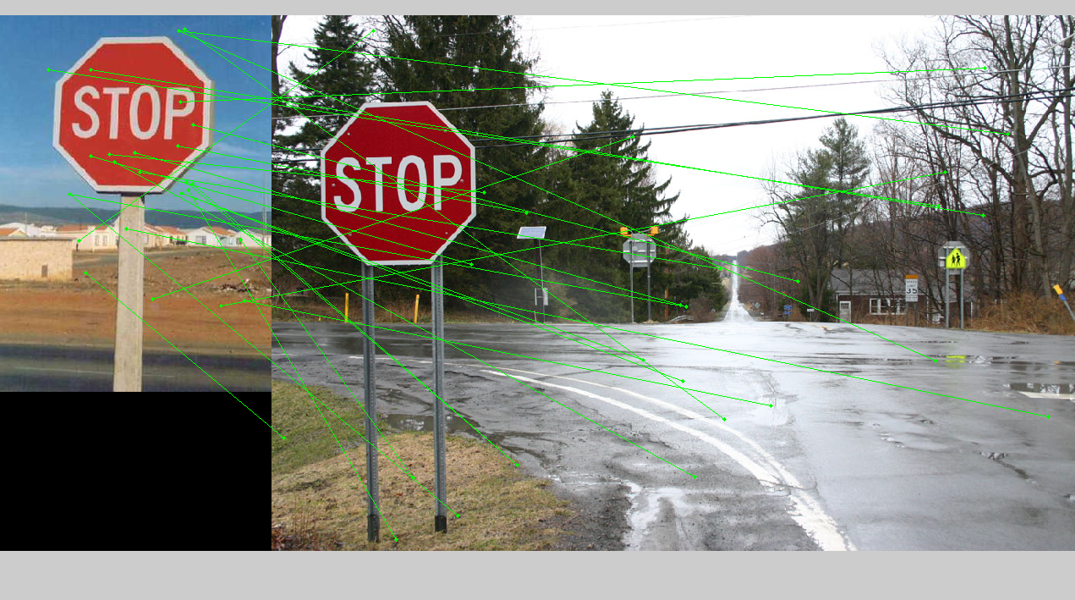
Nearest Neighbor matching with normalized threshold on distances = 0.8

Slide 16
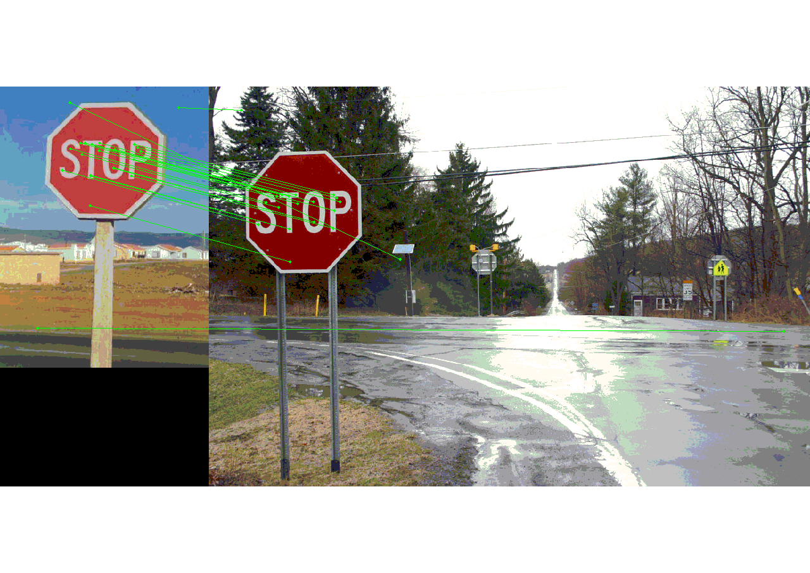
Distance Ratio Test with thresholding for 0.7

Slide 17
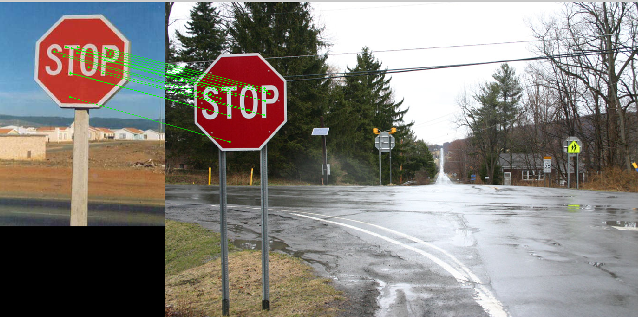
Distance Ratio Test with thresholding for 0.5

Slide 18
Graduate Points
Use a space partitioning data structure like a kd-tree or some third party approximate nearest neighbor package to accelerate matching. Report the before/after runtime.
I am using the k-d tree model provided by MATLAB in createns function for nearest neighbor search.
mdl = createns(Descriptor1','NSMethod','kdtree’); // This creates the object which contains the k-d tree
in = knnsearch(mdl,Descriptor2','K',2); // Uses the tree,to find the smallest distances (&indexes in the desc2)
I also used the in-built function pdist2 for finding the nearest neighbor.
[D, I] = pdist2(Descriptor2',Descriptor1','euclidean','Smallest',2); // D-> distances I-> Indexes
Elapsed time is 0.637881 seconds. -> This time is reported when individual distances are calculated
Elapsed time is 0.541532 seconds. -> This time is reported when using the k-d tree
Elapsed time is 0.190694 seconds. -> This time is reported using pdist2 function, which is optimized for finding k nearest neighbours.

Slide 19
Improve your shape alignment results. For example, you can try using multiple initialization trials (e.g. horizontal flips) and pick the best one. Explain your approach and report improvement.
I checked the correlation of the image1 with image2, with image1 having gone through various transforms
1. Horizontal Flip
2. Vertical Flip
3. Horizontal and Vertical Flip
4. Rotation through 90,180,270 degrees
Pros of the technique ->
Averaged alignment error = 5.308495 (Reduced from 9.7)
Cons of the technique ->
Increased the total time of execution!

Slide 20
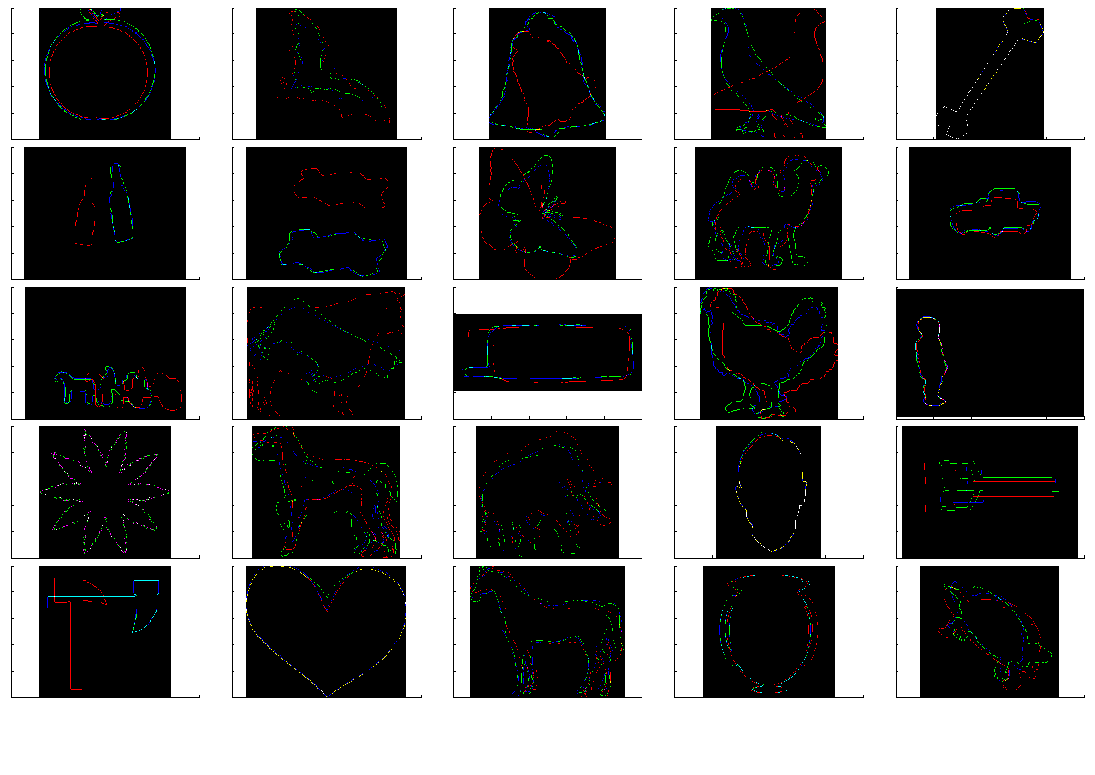
Improved Results for:-
Bottle – Since horizontal flip makes the matching better
Bird –Horizontal Flip
Hammer – rotate by 270
Cellular phone – Vertical fllip

Slide 21
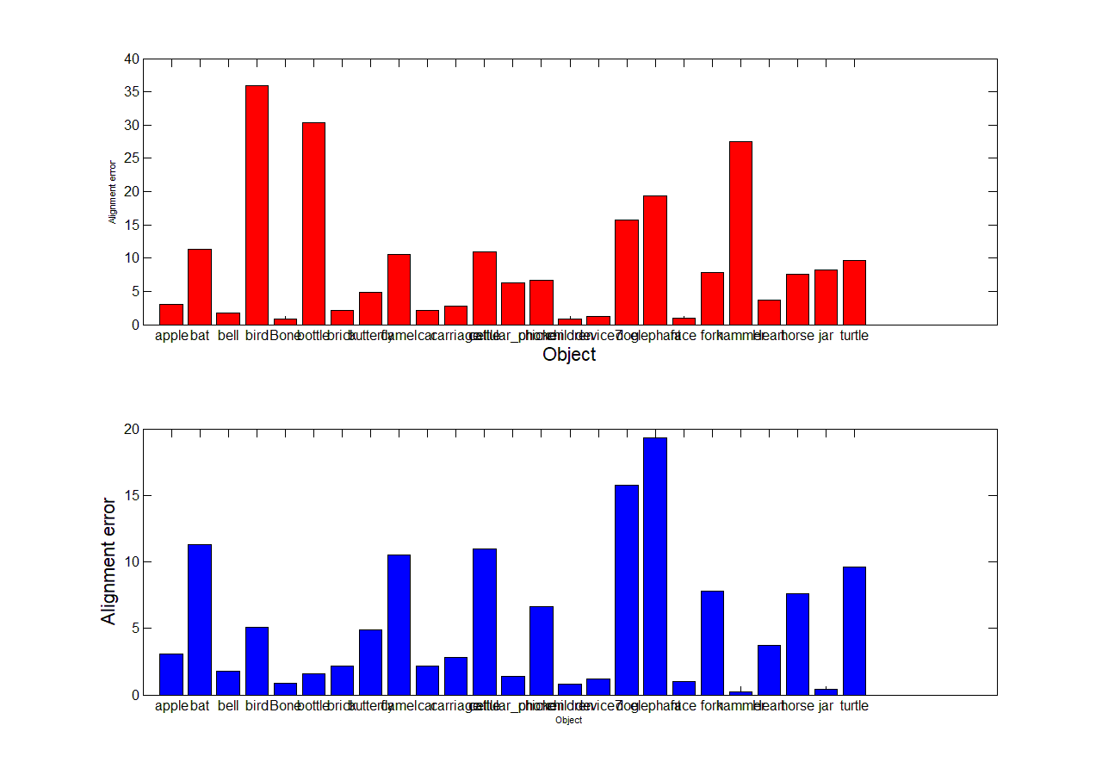
Improved Results!!

