Slide 1


Team Details
  Team name: zerochills
  Team leader name: [OWNER TO FILL]
  Problem Statement:
  Small business owners need regular, good-looking, truthful posts, but have no design skills, time or budget. Generic AI tools invent facts and garble local-language text.
Weekly Posts
Notes:
We are building for the owner of a small shop or service who knows their business but not design.

Slide 2
Brief about the idea
Weekly Posts: details first, then design.
1 Details
Offer, selling points, contacts, QR, dates
The owner fills a short brief: offer, selling points, contacts, QR, dates.
AI drafts captions and ideas; code draws every word, logo and QR.
Posts state only facts from the brief.
The owner approves; posts are scheduled and published one at a time.
2 Post
Drawn by code, checked, approved
Notes:
The order matters: we lock down what is true before anything is designed, so the post can never claim something the owner did not say.

Slide 3
Opportunities
Different: no other tool joins brief-first facts, code-drawn text and one brand face.
Solves it: the owner states facts once; the app drafts, designs, checks and schedules.
USP: details first, then design; every post states only what the owner said.
 | Canva | Buffer, Hootsuite | Predis, Ocoya | Freelancer | Weekly Posts
Facts only from owner | No | No | No | Depends | Yes, checked
Code-drawn text and QR | Manual | No design | AI design | Manual | Yes
Approval before publish | n/a | Yes | Yes | Yes | Yes
Brand Face | No | No | No | Costly | Yes
Cost | Free/paid | Paid (USD) | ~$29-59/mo | Rs 15K-50K/mo | [OWNER TO DECIDE]
Problem size
7.9 crore Indian enterprises registered; MSMEs are 99.8% of firms in developing Asia.
Only 13% of Indian MSMEs use social media marketing.
56% of small businesses get an hour or less a day for marketing.
Sources: MSME Ministry via IANS, 2026; ADB Asia SME Monitor 2025; SIDBI via Entrepreneur India, 2025; Constant Contact, 2024 (US/UK/AU/CA).
Notes:
Each tool covers one piece; nobody combines brief-first facts, code-drawn text and a consistent brand face for small businesses (Stage 3 research).
A freelancer to run a shop's social media in India costs ₹15,000-50,000 a month (upGrowth, 2026), close to or above the ₹17,821 average monthly salary of a social media specialist (Indeed India, 2026).
USP lines:
1. Details first, then design.
2. Facts only from the brief; anything else is flagged "please check".
3. Approval before anything is published.
4. Text, logos and QR drawn by code; a payment QR must scan back to the exact saved ID.
5. Brand Face: one consistent character, made once and reused at no extra cost.
6. Built for Indian and global small businesses: posts in 20+ languages, any currency, every time zone.
Research caveat: most competitor sources are vendor blogs; pain points are desk hypotheses not yet validated with users. Willingness to pay (likely Rs 199-499/month, if anything) is our own hypothesis, not a sourced number.

Slide 4
List of features offered by the solution
Create a post: details, 3 design options, review, schedule
Design Studio: drag, resize, edit text, add contacts and QR
Plan a week from one sentence of offers
Carousels of 3-10 slides
13 code-drawn characters, 41 actions
Brand Face in 4 kinds; price approved first
Ideas: weekly trend research with dated sources
Queue, Meta publishing, admin dashboard
Notes:
Everything listed is built and working. Reels show as "Coming soon". Meta publishing works for app testers; public use waits on Meta App Review. The post results (insights) job is built but waits on Meta permissions.

Slide 5
Process flow diagram or Use-case diagram
Ideas
"Make this post"
Plan a week
one sentence
1. Sign in
email link
2. Set up brand
import website or answer questions
3. Write the brief
offer, selling points, contacts, QR, dates
4. Pick and edit a design
3 options or Design Studio
8. Results
clicks and QR scans
7. Published or emailed
ready to share
6. Approve and schedule
owner decides; nothing skips this
5. Review
fact flags, captions
Flags loop back to the brief; changes loop back to design.
Notes:
The same path serves a single post or a whole week from one sentence; nothing goes out without the approval step.

Slide 6
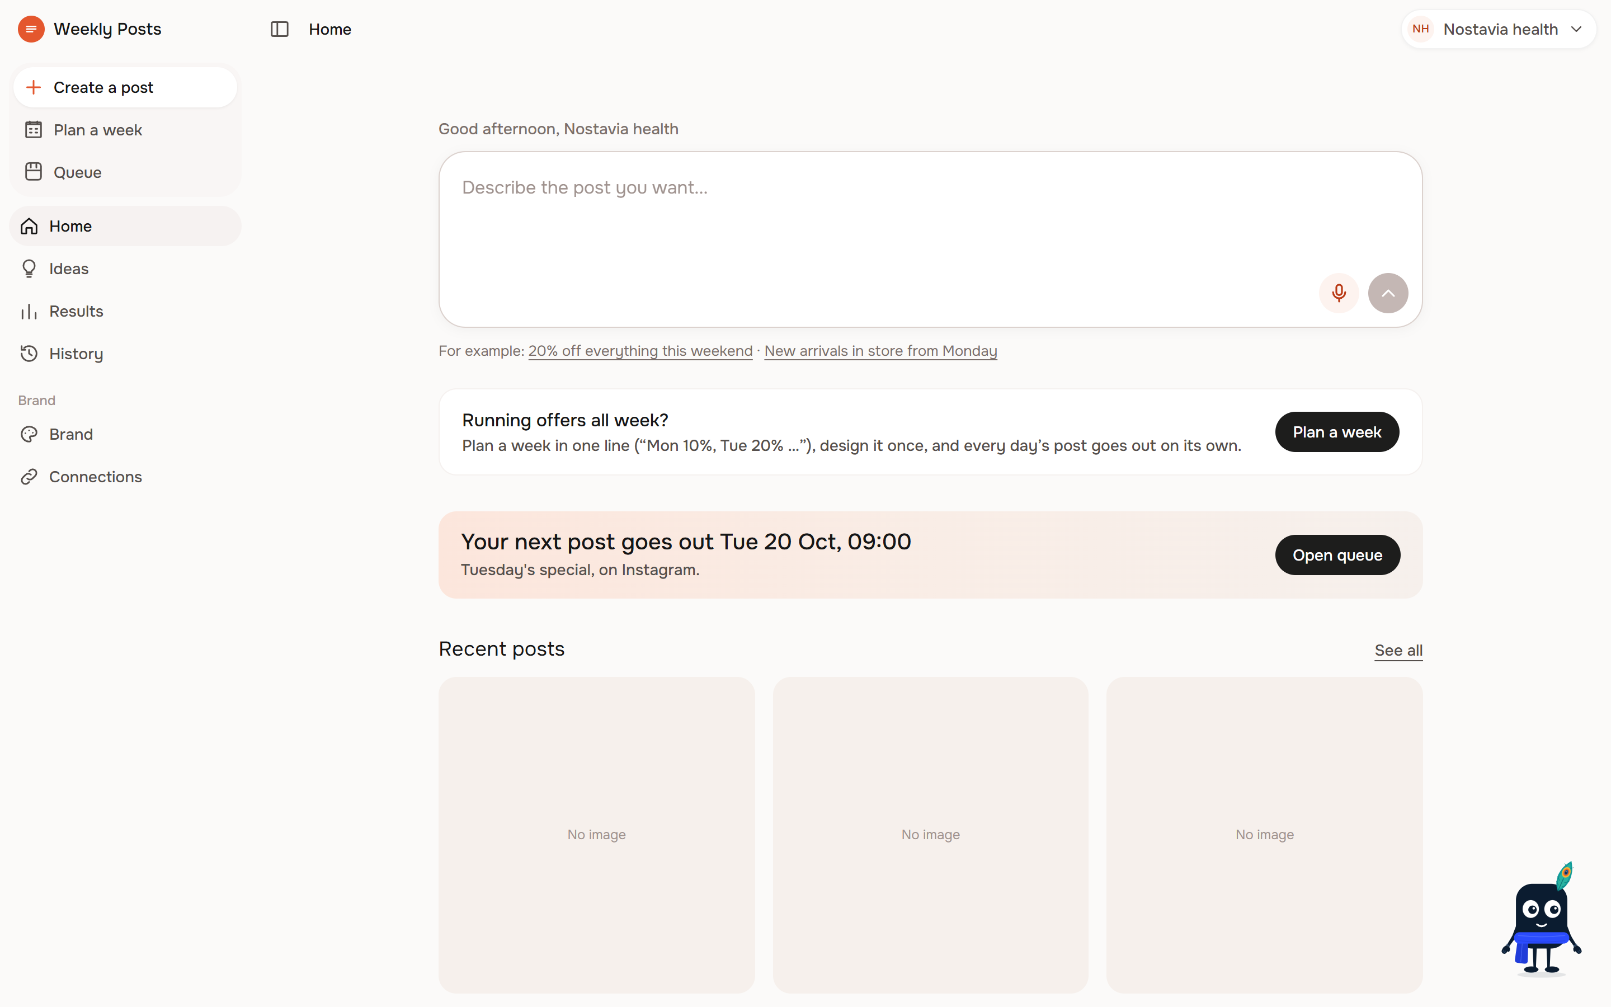
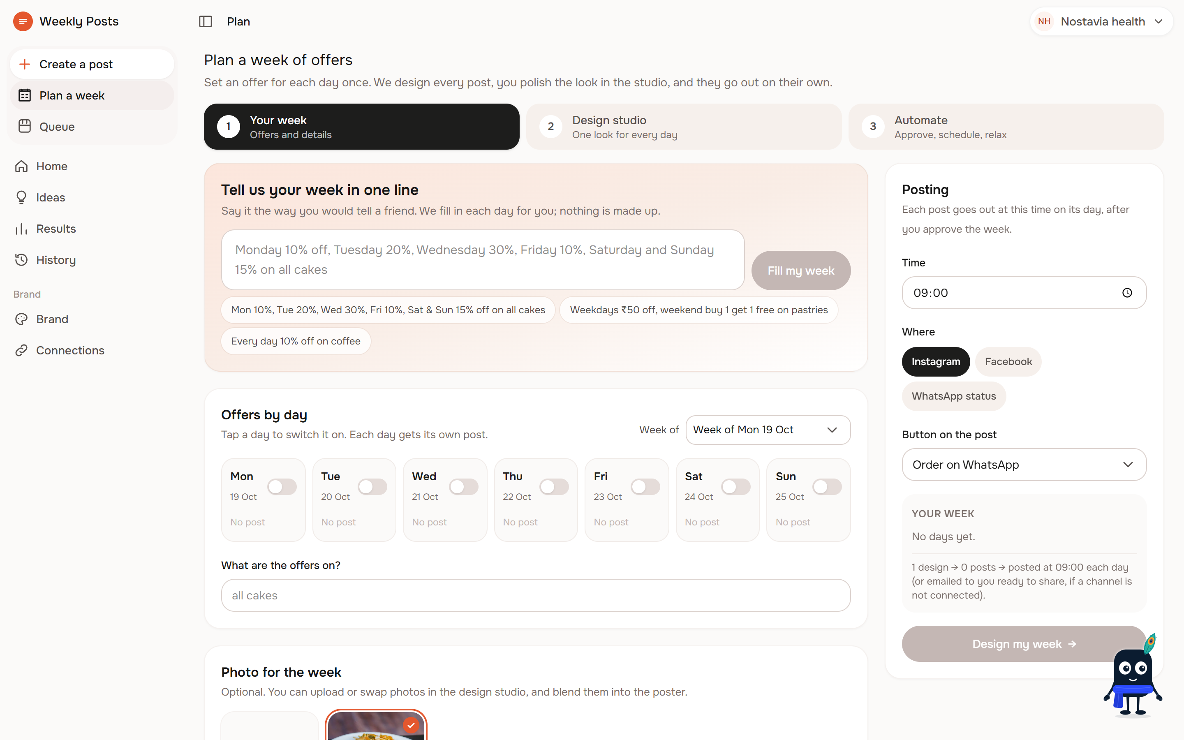
Wireframes/Mock diagrams of the proposed solution (optional)
Real screens from the running app, not mock-ups.
Home: this week at a glance
Plan a week: one sentence of offers
Notes:
We show the working app rather than wireframes. These are screenshots of the local development app.

Slide 7
Architecture diagram of the proposed solution
Next.js app
Cloud Run
australia-southeast1
Renders all text and QR with code
Gemini on Vertex AI
text, image, grounded search
Owner's browser
desktop or phone
Supabase Postgres
row-level security
Cloud Storage
photos, renders, faces
Cloud Scheduler
cron routes: queue, reminders, weekly, insights
Resend
sign-in and post emails
Meta Graph API
Instagram and Facebook publishing
Firestore + Firebase Auth
live status per brand, read-only rules
Supabase holds the data; Firestore only live status.
Notes:
One Next.js app on Cloud Run does everything; all text and QR codes are rendered on the server by code, and AI never touches payment IDs. Firestore gives owners live status: when the Cloud Scheduler sweep publishes a post or Gemini makes a Brand Face pose, the server writes a tiny brand-scoped status doc; the browser signs in to Firebase Auth with a short-lived custom token minted keylessly by Cloud Run and listens with onSnapshot. Rules allow reading only your own brand and never writing. A second Cloud Run service hosts the admin dashboard.

Slide 8
Technologies to be used in the solution
Google Cloud
Cloud Run, Cloud Scheduler, Cloud Build
Firestore + Firebase Auth (live status)
Cloud Storage, Secret Manager
Vertex AI
Gemini (gemini-3.8-flash)
Gemini 3.1 Flash Image, Imagen 4
Google Search grounding
App and data
Next.js (App Router, TypeScript)
Supabase Postgres with row-level security
Rendering and integrations
HarfBuzz + resvg, open-licence fonts
Resend email; Meta Graph API
Notes:
Gemini does the language work; code does every pixel of text, so Hindi and other scripts render correctly.

Slide 9
Estimated implementation cost (optional)
Item | Cost
AI per brand per week (posts, captions, checks) | capped at $0.50
One post's copy (Gemini) | about $0.01
Abstract background (Imagen 4) | about $0.04-0.05
Ideas research | about $0.33, cap $0.50 a week
Brand Face (once) | about $1.32, cap $2, owner approves first
Face in each post | $0
Cloud Run + Supabase per month | [ESTIMATE]
Any AI run estimated over $0.50 needs the owner's approval first.
Notes:
Every AI run over $0.50 needs the owner's approval first, and every brand has a weekly cap enforced in code. A Rs 450 a month budget alert is set on the Cloud project; that is an alert, not a measured cost. Hosting cost per month is not yet estimated.

Slide 10
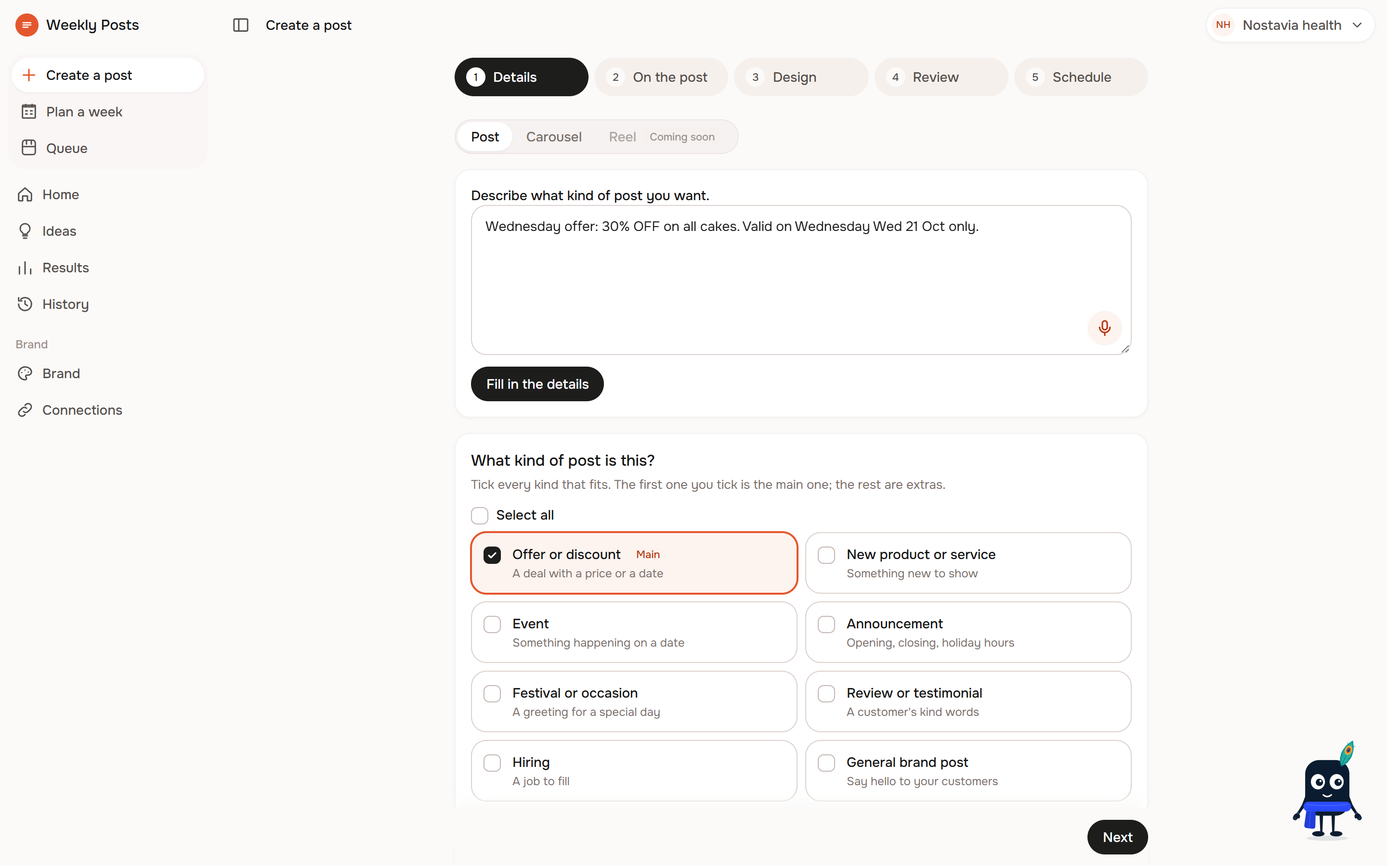
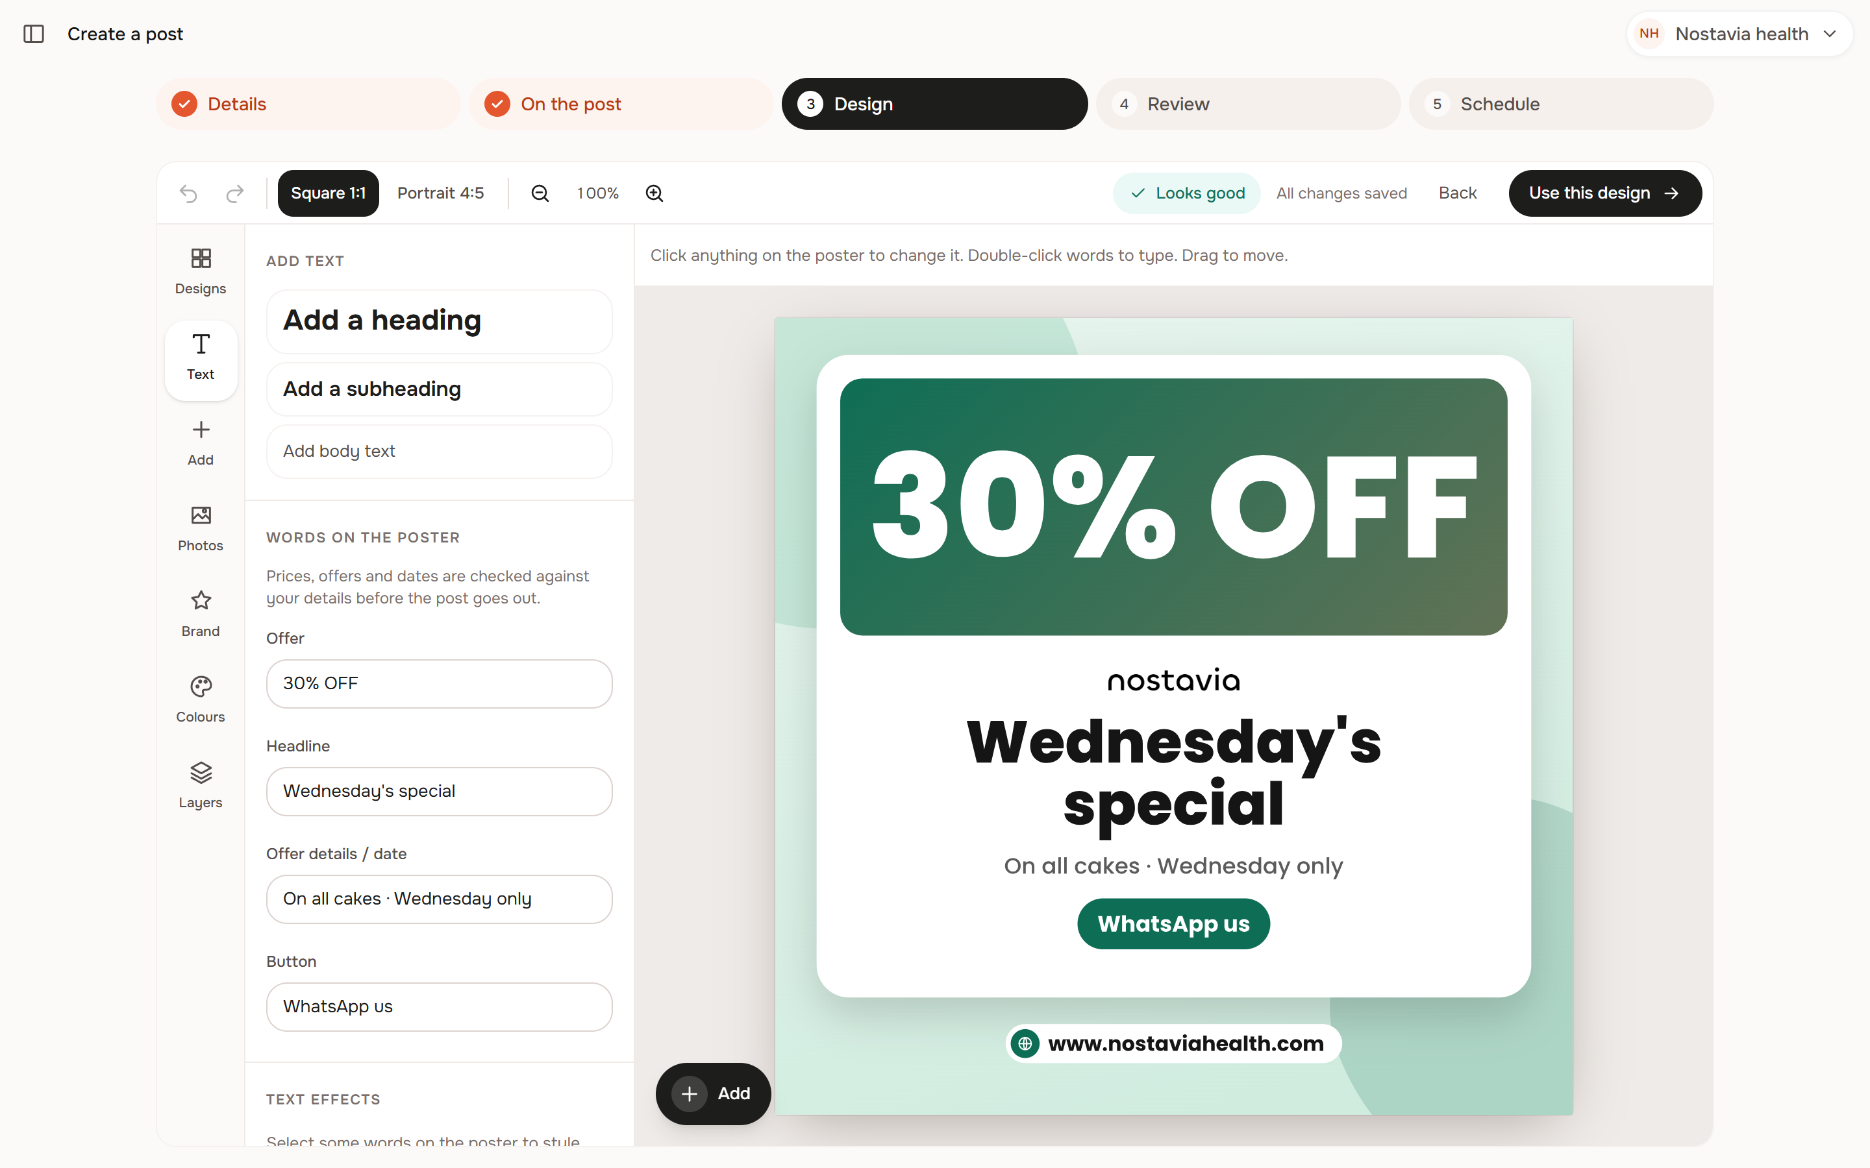
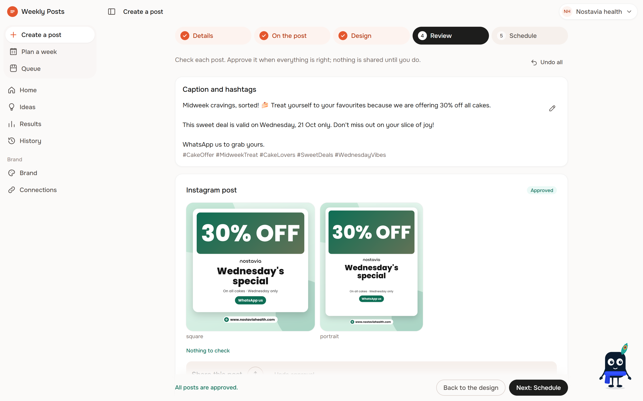
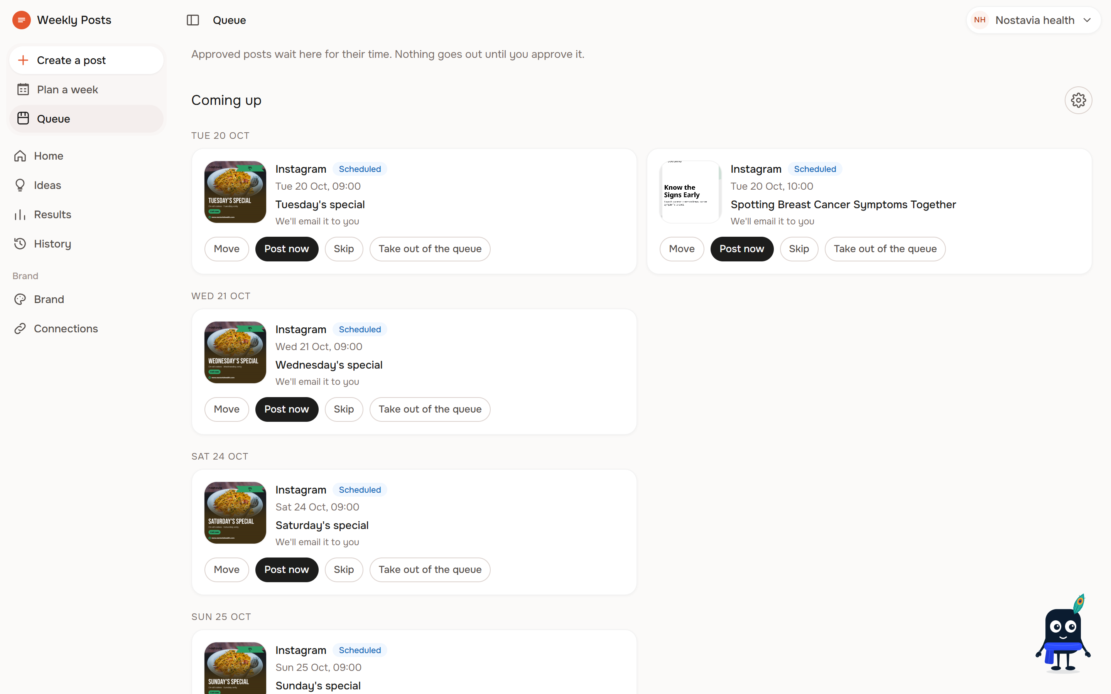
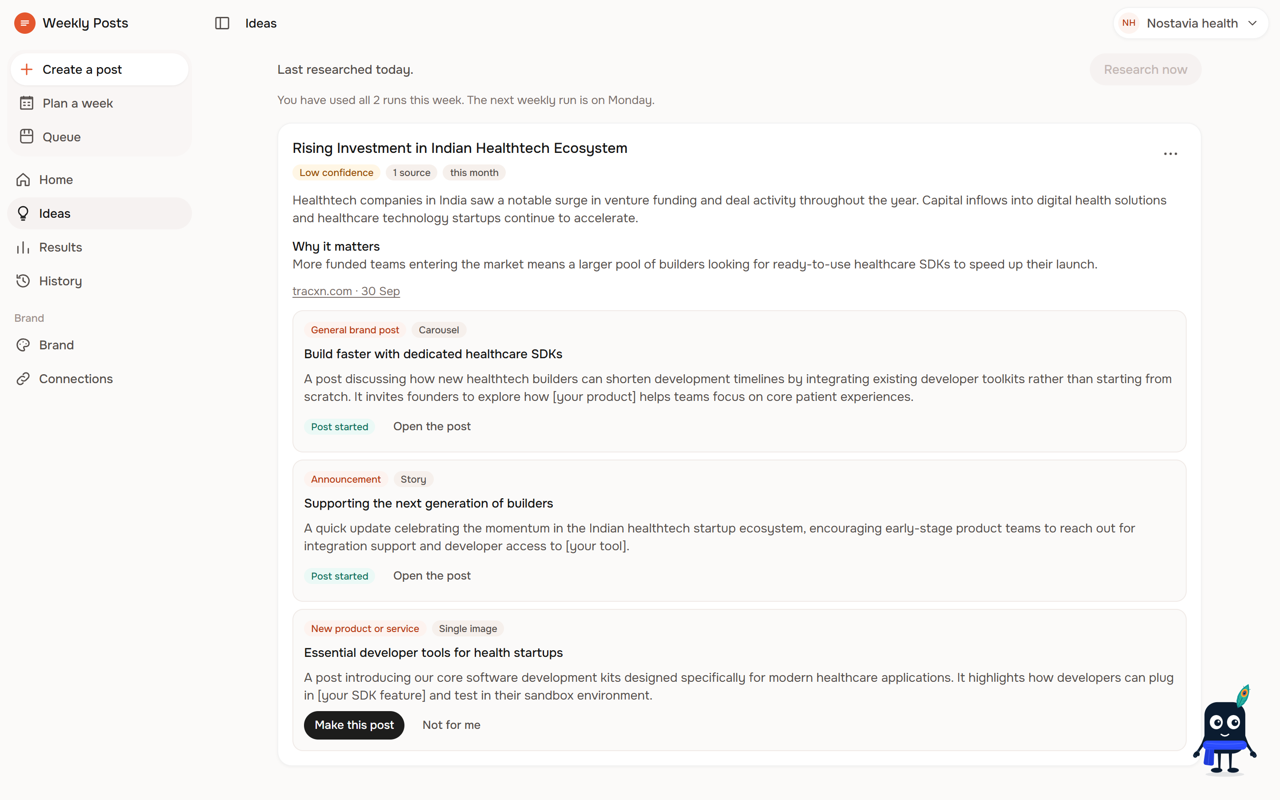
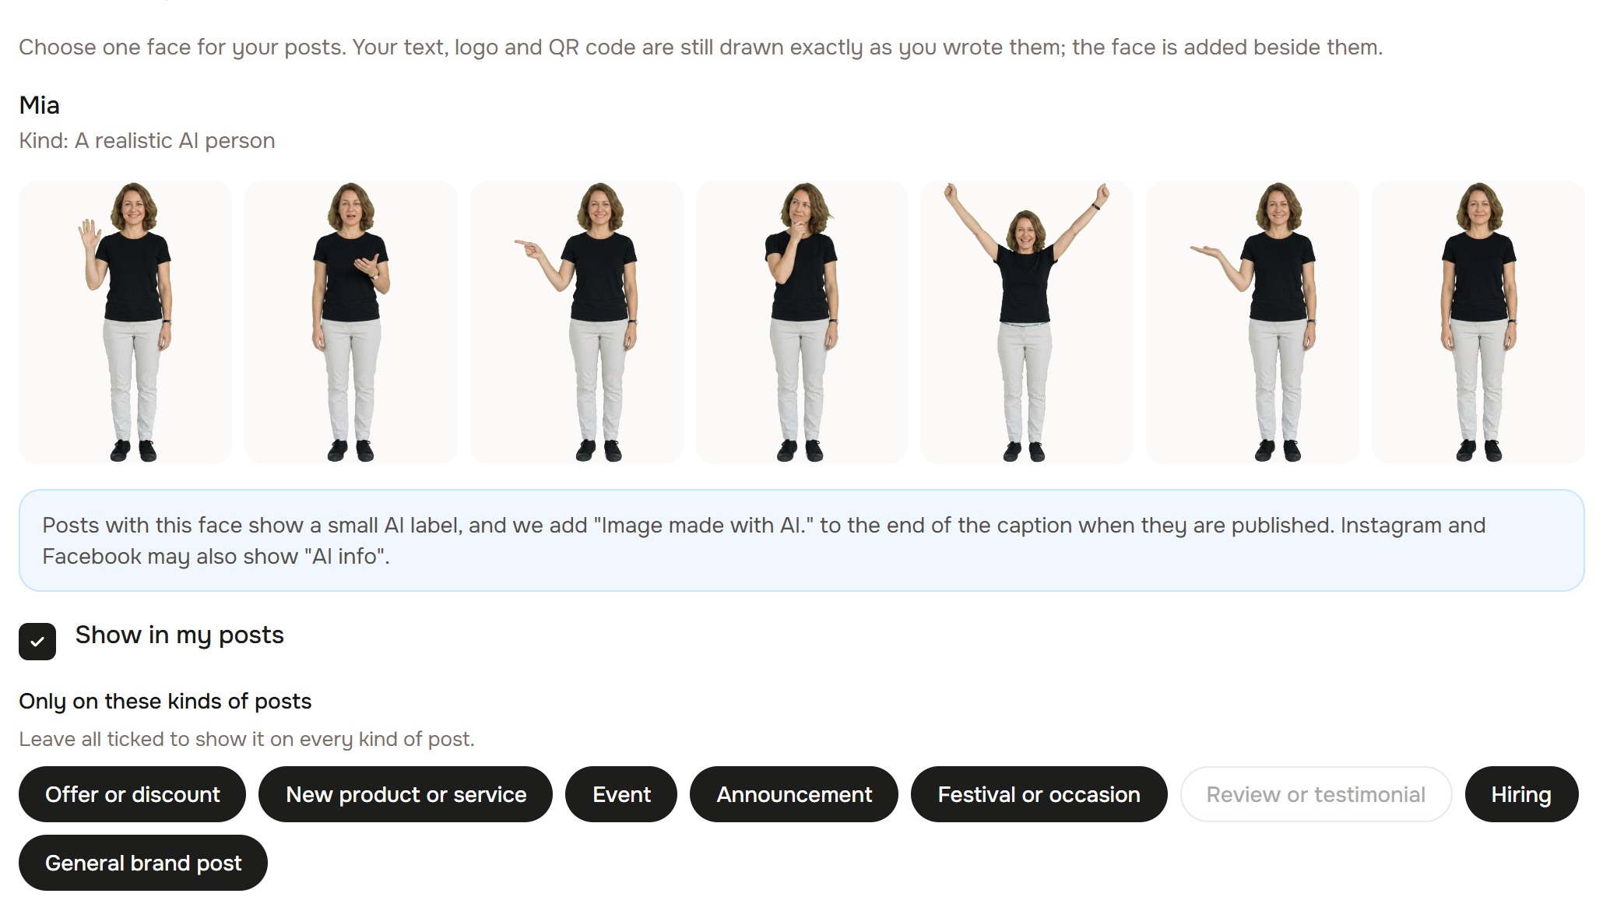
Snapshots of the prototype
The owner says what is true first: offer, contacts, QR, dates.
Live editing; every word, logo and QR is drawn by code.
Anything not in the brief is flagged "please check" before approval.
Approved posts go out one at a time, at the owner's chosen slot.
Weekly trend cards with dated sources, and "Make this post".
One consistent face; the price is shown and approved first.
Notes:
These are screenshots of the running local app.

Slide 11
Prototype Performance report/Benchmarking
4,716
automated tests passing
Clean
TypeScript and lint
49 of 49
tables with row-level security
$0.50
weekly AI cap per brand, enforced in code
Checked
fact guardrail: code + AI check of prices, dates, contacts, ratings
Exact
payment QR must decode to the saved ID, or the post is blocked
First post time and render speed: [TO MEASURE]
Notes:
These are measured from the codebase (full suite on 2026-10-18: 4,716 passed, 5 skipped). User-facing timings against the PRD targets (first post under 5 minutes, 3 design options under 15 seconds, render under 1.5 s, planted false facts flagged at least 95% of the time) are still to be measured.

Slide 12
Additional Details/Future Development (if any)
Now
Next
Later
Meta publishing for app testers
Free pilot on Cloud Run
Post results from Instagram and Facebook insights (waits on Meta App Review)
Reels and short videos (Veo), opt-in, priced first
YouTube Shorts, Google Business Profile, LinkedIn
WhatsApp delivery
Growth report and benchmarks (BigQuery)
Agency workspace for many brands
Business model: [OWNER TO DECIDE]
Notes:
The next steps reuse the same engine; pricing is open, and our docs say the pilot is free.

Slide 13
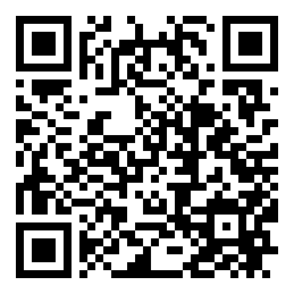
Provide links to your:
GitHub Public Repository: [OWNER TO FILL]
Demo Video Link (3 Minutes): [OWNER TO FILL]
Final Product Link:
https://weekly-posts-526531409571.australia-southeast1.run.app
Scan for the live app
Notes:
The live link is the deployed app. The GitHub repository is currently private; a public link is needed for submission.

Slide 14
Responsible AI and safety
AI images: abstract backgrounds only, never products or people
Brand Face: owner-approved, never a real person, labelled "AI"
No text in AI images: code draws all text, logos and QR codes
Facts only from the brief; anything else flagged "please check"
Payment IDs typed by the owner, confirmed by email, never sent to AI
Approval before anything is published; row-level security on every table
Notes:
One exception to abstract-only images: an owner-approved Brand Face, made once and reused. Never a real or famous person; realistic faces are always labelled AI and never used for health or finance brands; never shown as a professional, customer or in a testimonial. Payment IDs are never written, edited or suggested by AI. Publishing tokens are encrypted at rest.

Slide 15


