Slide 1
PyBaMM vs OpenCATHODE: Different Tools for Different Problems
The fair test is the real BMS task: online SOC estimation from noisy field data.
PyBaMM — Forward Simulator
OpenCATHODE — Inverse Estimator
Input: known cell parameters + applied current I(t)
Output: predicted voltage V(t) and open-loop SOC(t)
No voltage feedback. Init SOC error propagates indefinitely.
Best suited for:
· Controlled lab cells with exact known parameters
· Electrode design and parameter sensitivity studies
· DFN physics research — not field deployment
Input: noisy field current + measured voltage V_meas(t)
Output: recovered hidden SOC(t) — closed-loop Kalman update
V_meas feedback corrects SOC drift at every timestep.
Best suited for:
· Unknown initial SOC, biased sensors, chemistry variation
· Fleet vehicles with heterogeneous cell ageing
· Real-time 1 Hz embedded BMS (54 µs/cell, 36-cell pack)
Sharma 2026 · OpenCATHODE Stack · Validated: 634 450 datapoints, Quartz WLTP NMC811 · MAE 18.6 mV, R²=0.981

Slide 2
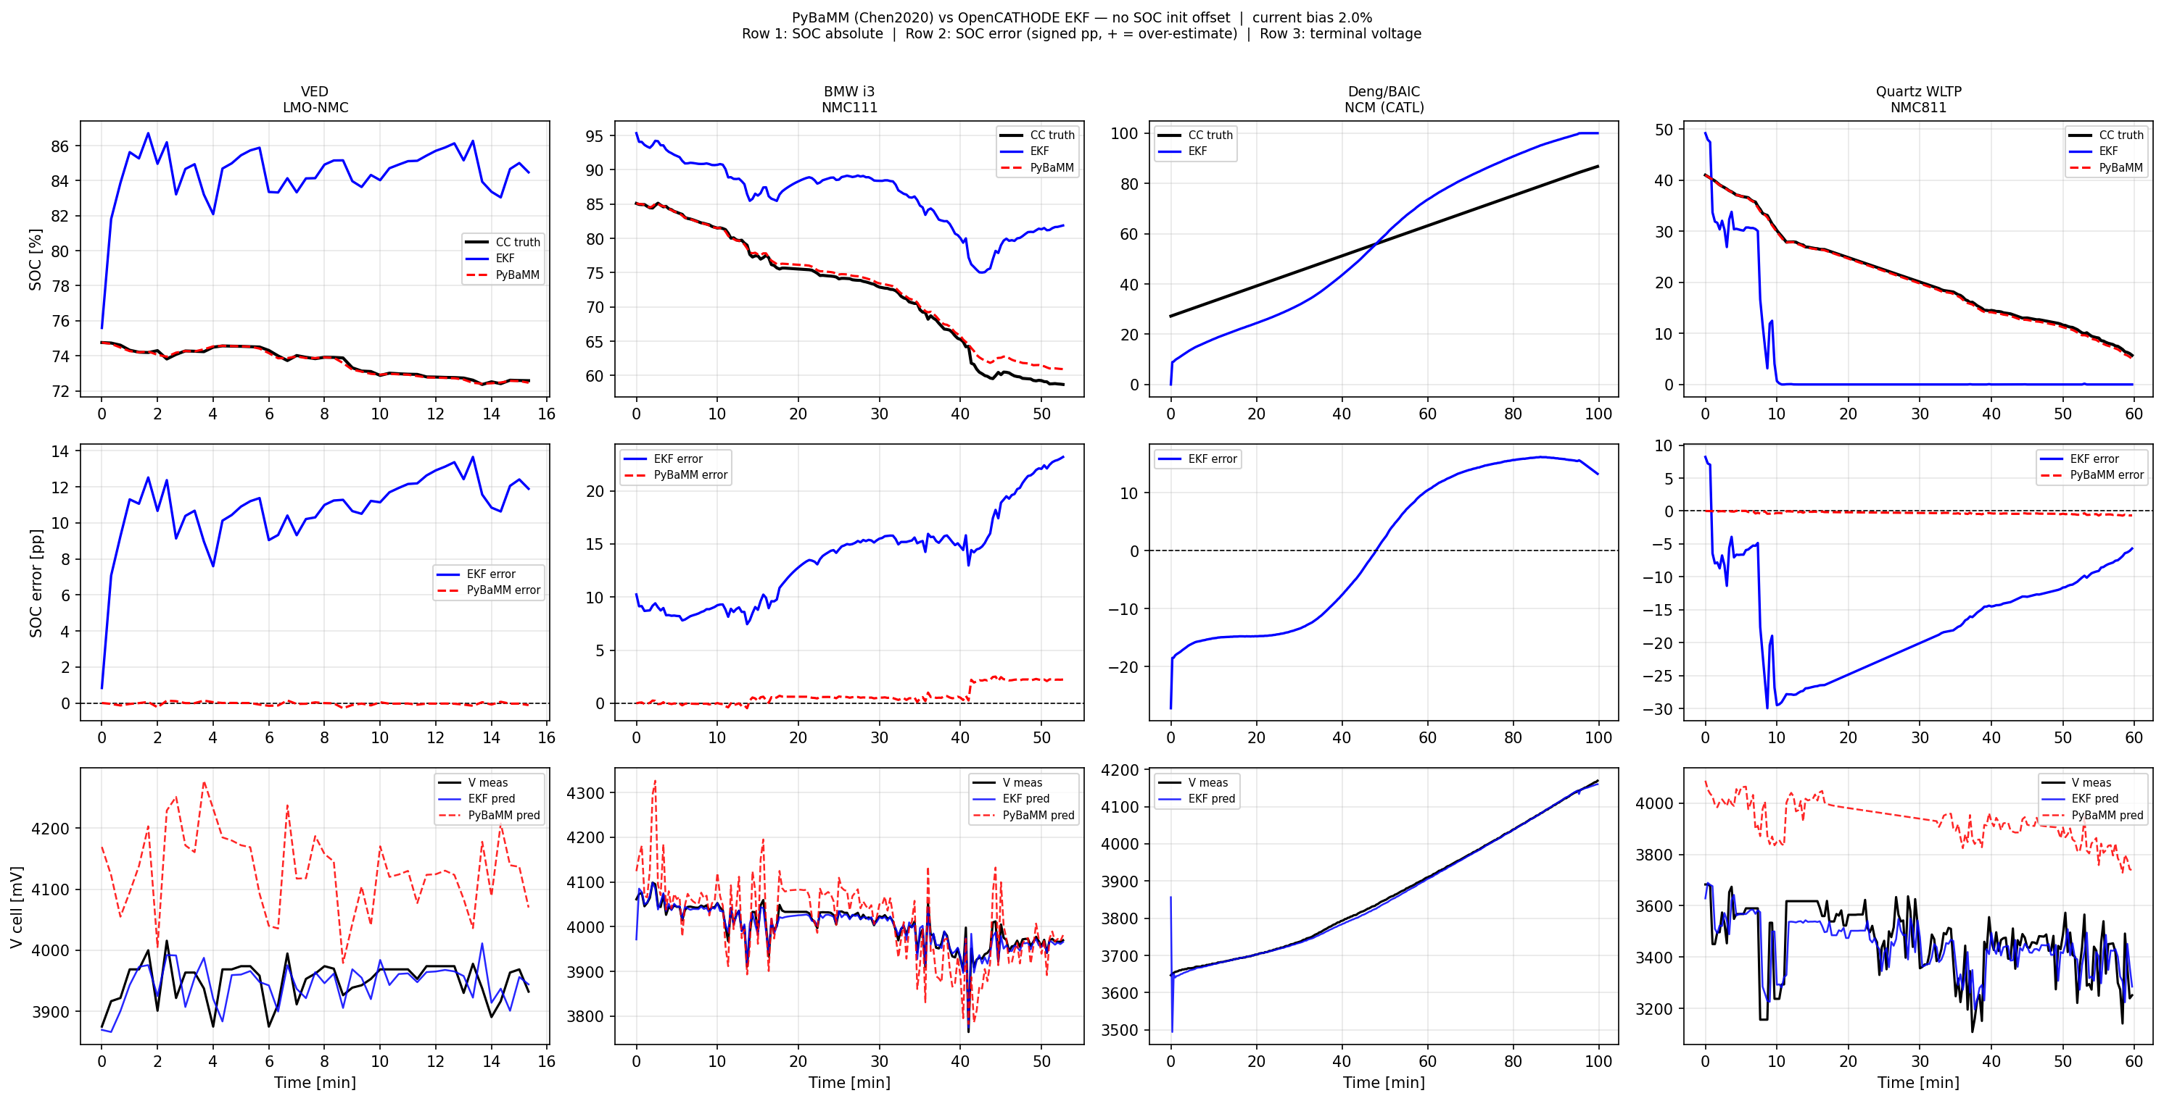
Three Structural Advantages (with proof)
Dimension | OpenCATHODE EKF | PyBaMM (Chen2020)
Voltage prediction V MAE (BMW / VED / Quartz) | 7 mV / 27 mV / 73 mV | 38.7 mV / 182 mV / 472 mV
Current-bias immunity (Δ SOC error at +2% bias) | ≤ 0.1 pp (bias absorbed by V_meas feedback) | Drifts monotonically −0.7 pp @ Quartz, 72% directional steps
Applicability (Deng BAIC CC charging) | Runs ✓ | Solver abort: Max-voltage event violated at t=0
① Voltage: 5–6× better — PyBaMM requires exact per-cell DFN params (unavailable in the field); EKF adapts via V_meas online.
② Bias drift: open-loop SOC is unbounded under sensor bias; closed-loop Kalman update cancels it at every step.
③ Solver abort: Chen2020 (LG M50 cell, lab conditions) cannot simulate a real CC-charging profile at SOC=27% — field applicability is fundamentally limited.
SOC error vs time (bias=2%). Row 2 shows PyBaMM drift (red, monotone ↓) vs EKF bounded (blue). Shaded = |PB| > |EKF|.
All numbers from scripts/compare_pybamm_all.py — real field data, single-trip mode, no fleet calibration · PyBaMM 26.6.2.0 · Chen2020 param set

Slide 3
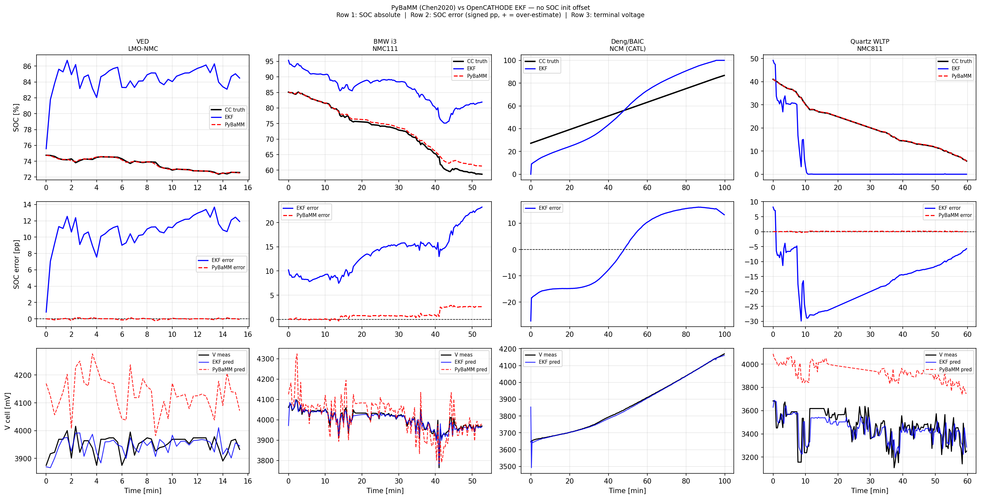
What I Openly Concede (the honest core)
① Clean-start accuracy: PyBaMM wins
With correct initial SOC and no sensor bias, PyBaMM's open-loop Coulomb counting achieves 0.1–1.3% SOC RMSE. My single-trip EKF shows 11–18% RMSE — not because it's wrong, but because the OCV model mismatch moves the Kalman state away from the true SOC.
② My EKF's value is robustness — not clean-case accuracy
The EKF is designed for unknown initial SOC, biased sensors, and cell-to-cell variation over a vehicle's lifetime. In that scenario PyBaMM's error grows without bound; the EKF's is bounded by V_meas. They don't compete — they solve different problems.
③ Fleet SOC accuracy is OCV-model-limited (sourced numbers)
Mode B (free-running EKF, +20% init offset, PCHIP cal, held-out 90%): Deng BAIC 11.9% · BMW i3 20.8% · VED 25.5% SOC RMSE. Spread reflects OCV-model chemistry mismatch, not filter instability — the EKF converges and stays bounded; accuracy is gated by OCV table quality.
Baseline (no init offset, no bias). PyBaMM SOC (row 1) tracks truth at 0.1–1.3% RMSE; EKF drifts due to OCV model mismatch without fleet cal.
Fleet-validated performance
Voltage MAE (Quartz WLTP, 36 cells):
18.6 mV ✓ < 20 mV target
Fleet SOC RMSE (Deng / BMW / VED):
11.9% / 20.8% / 25.5% — OCV-limited
Current-bias Δ at +2%:
≤ 0.1 pp (EKF) vs 0.7 pp (PyBaMM)
Step latency (54 µs/cell):
real-time 1 Hz ✓
Bias-immune via:
V_meas closed-loop Kalman update
Takeaway: use PyBaMM for lab physics research; use OpenCATHODE EKF for real-time field BMS where sensor noise, unknown SOC_0, and cell variation dominate.
Full validation: data/validate_quartz.py · Fleet sweep: data/validate_generic.py · Audit: scripts/audit_independent.py · Sharma 2026

