Slide 1
Confringo

Slide 2
agenda
a
Product overview​
Hardware and Tech Stack
What next?
Product Briefing Architecture Overview
Current Features
Hardware used
Tech-Stack
Features planned
Optimizations planned

Slide 3
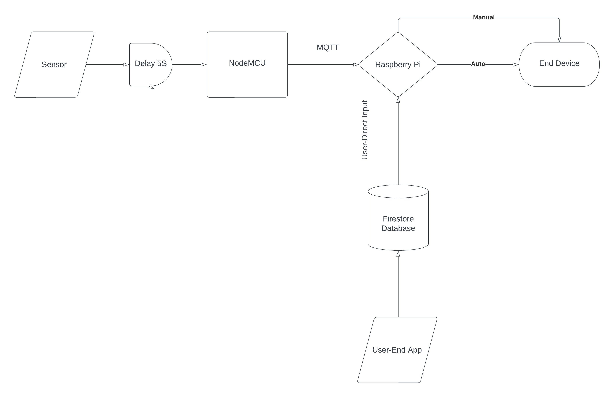
Architecture Overview

Slide 4
Product Briefing
Making general electrical devices into smart devices using NodeMCU and Raspberry Pi
Main goal of our product is to actuate/operate every possible end device remotely and automate them to save electricity and effort
Using the light weight protocol – MQTT Sensors communicate with the central controller which in turn controls the end devices based on the sensor feedback and the User input through our application LUMOS.

Slide 5
Hardware aND Tech Stack
1
2
HARDWARE USED
Raspberry Pi – Controller/MQTT Broker
NodeMCU – MQTT Client
PIR Sensor – Sense human presence
TECH STACK
Python – Controller
Python - Backend
Flutter, CSS – FrontEnd
Database – No SQL Database (Firestore)

Slide 6

What Next?
Features
Fixes
Plug and Play
Easy User Access
Connectivity of other smart Devices
Creating a centralised solution for a connected home
Local Network control
Security Fixes
Improved UI
Better capable sensors
Cost Reduction
Improved Response Time

Slide 7
~Team Conringo
Thank
thank
Thank
You
You
You
you
Thank you

