Slide 1
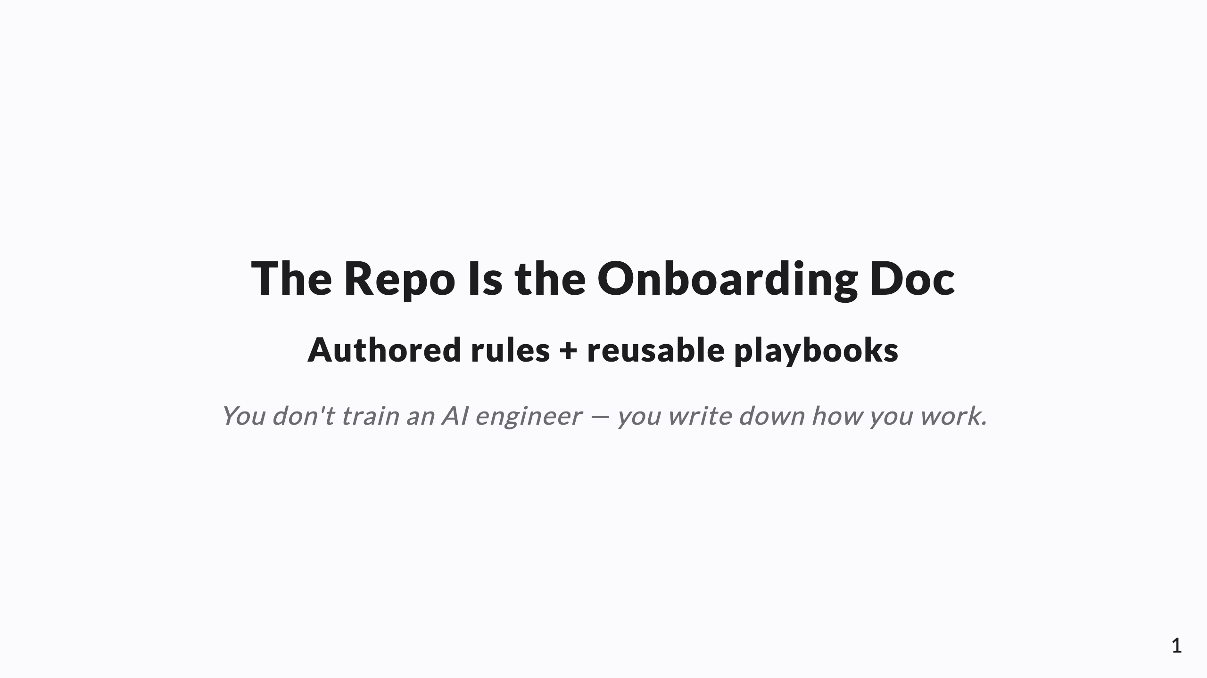
Notes:
SPEAKER NOTES → PPTX presenter notes. The authored-rules layer of the operating model. Knowledge-share framing. Through-line: you don't train an AI engineer, you write down how you work where it reads it. Authored rules (policy) + reusable playbooks (procedure), distinct from learned memory.

Slide 2
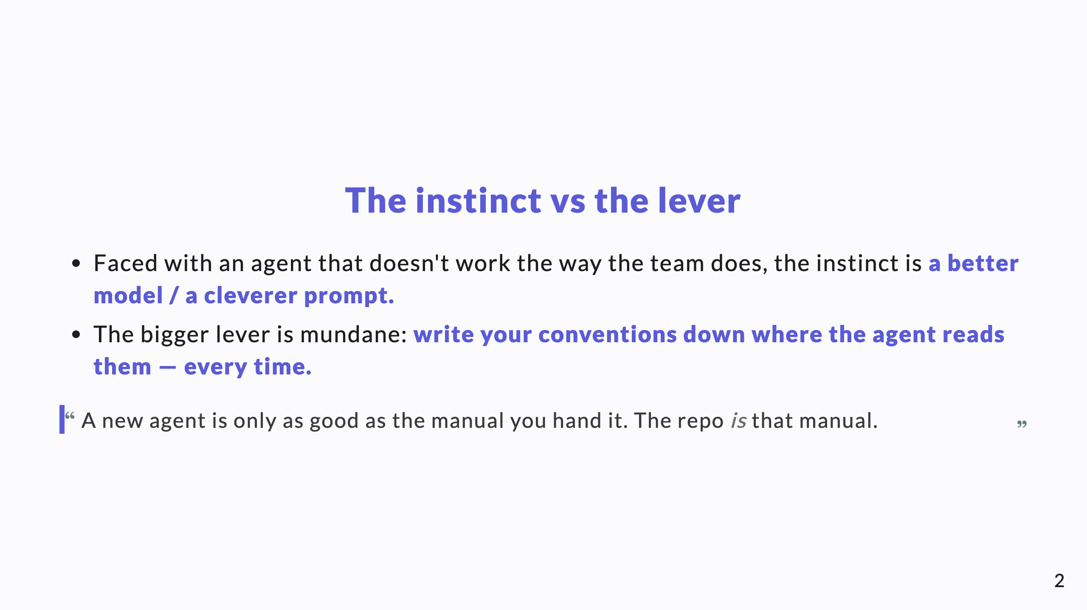
Notes:
Reframe AI enablement away from model-shopping toward something the team fully controls: what they write down. This lands well with a CTO who's tired of "we need a better model" asks.

Slide 3
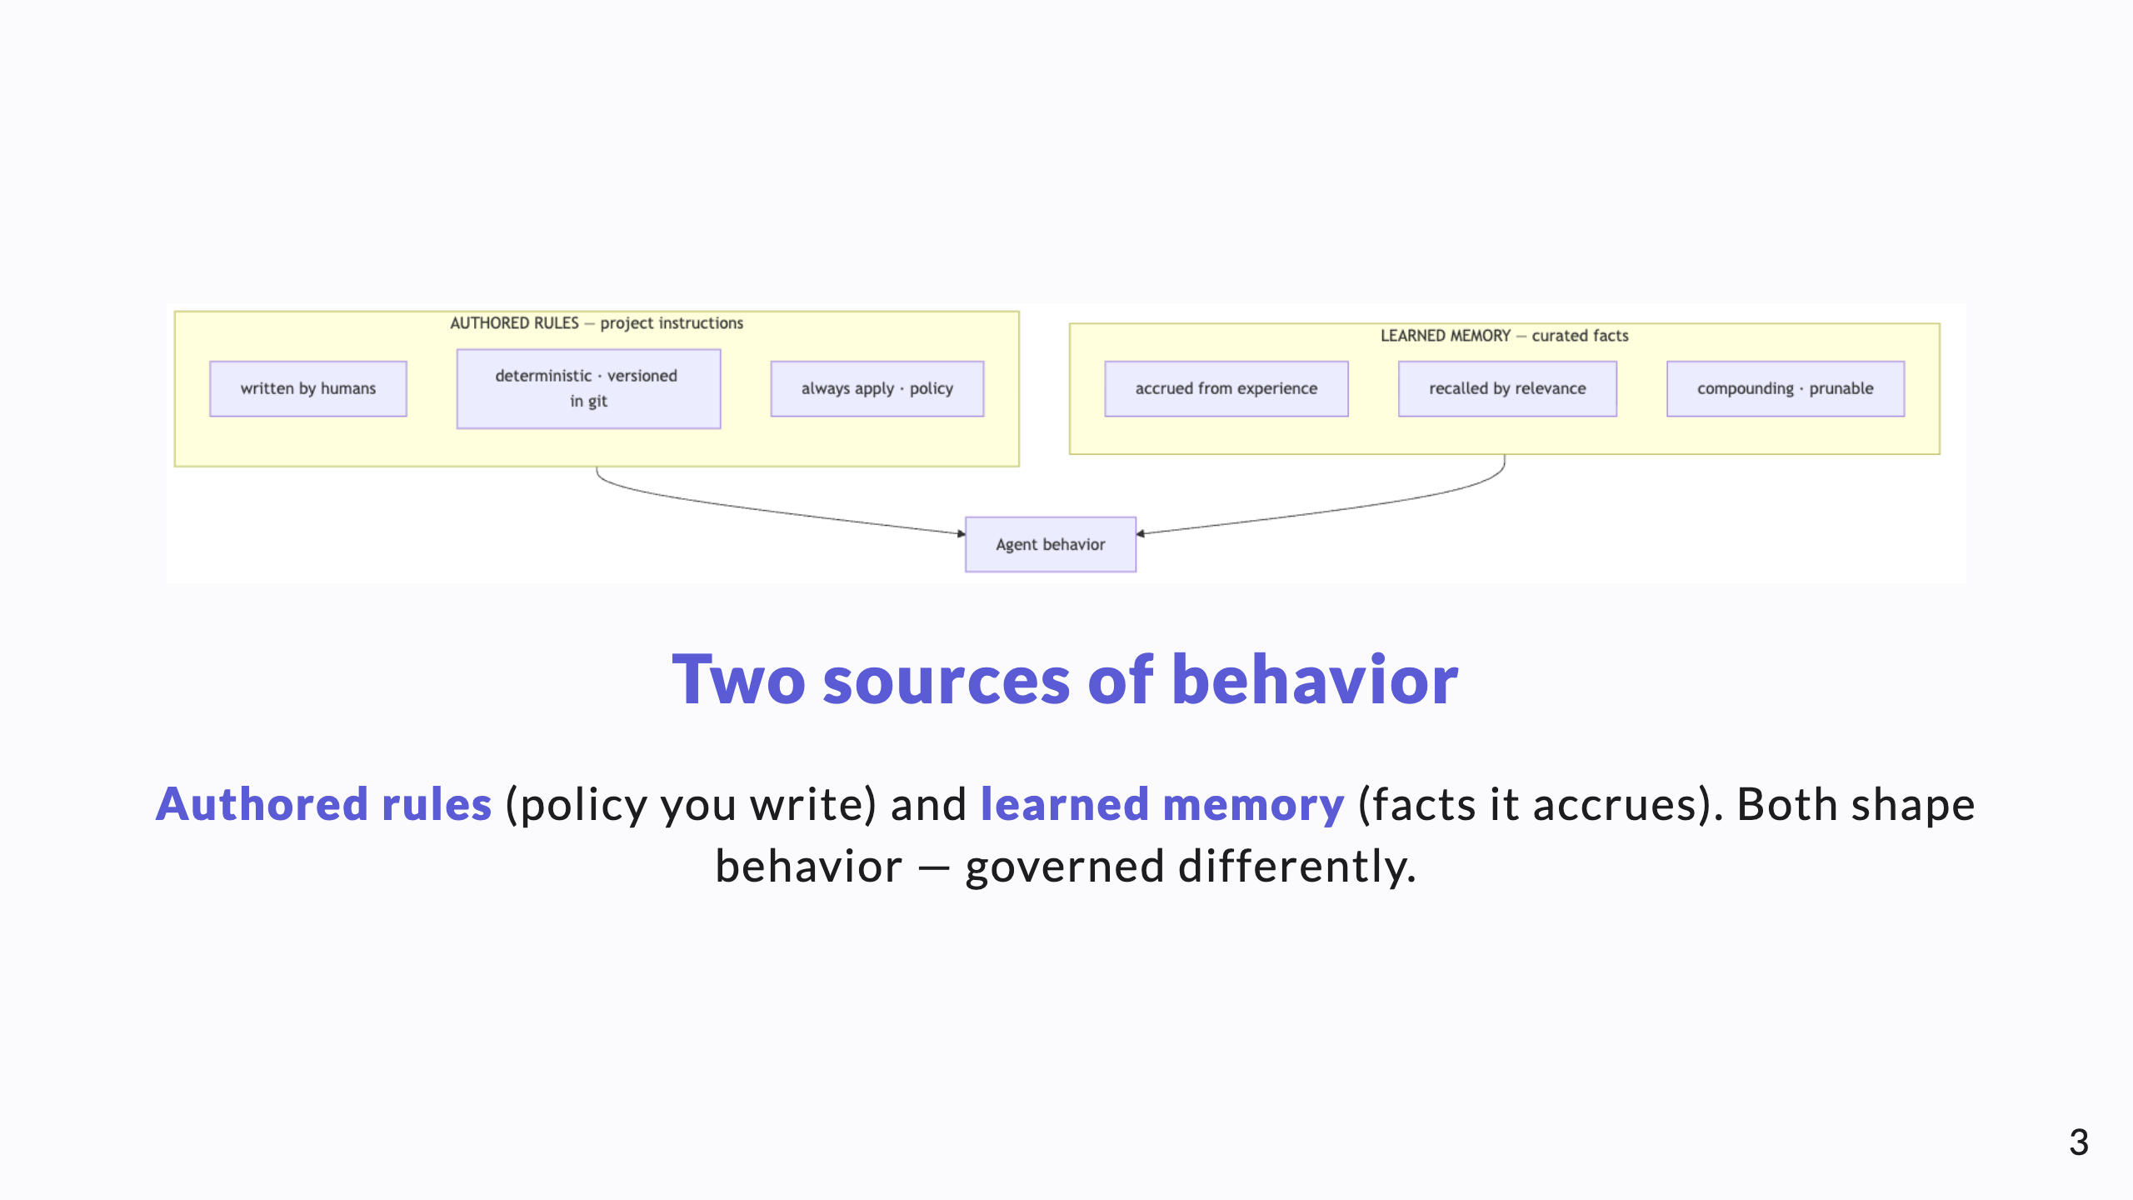
Notes:
Diagram A. The whole talk hinges on keeping these two apart. Rules are written and deterministic; memory is learned and situational.

Slide 4
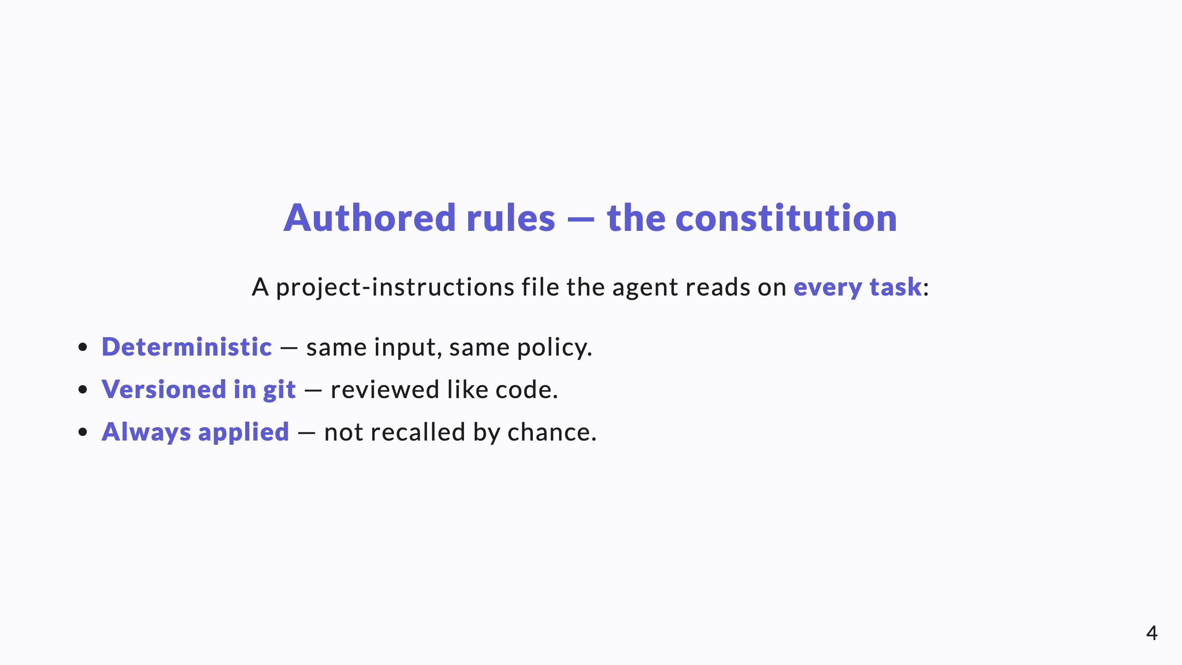
Notes:
"Constitution" is the right register: it's the standing law of the repo, not a suggestion and not a fact. It applies every time, by construction.

Slide 5
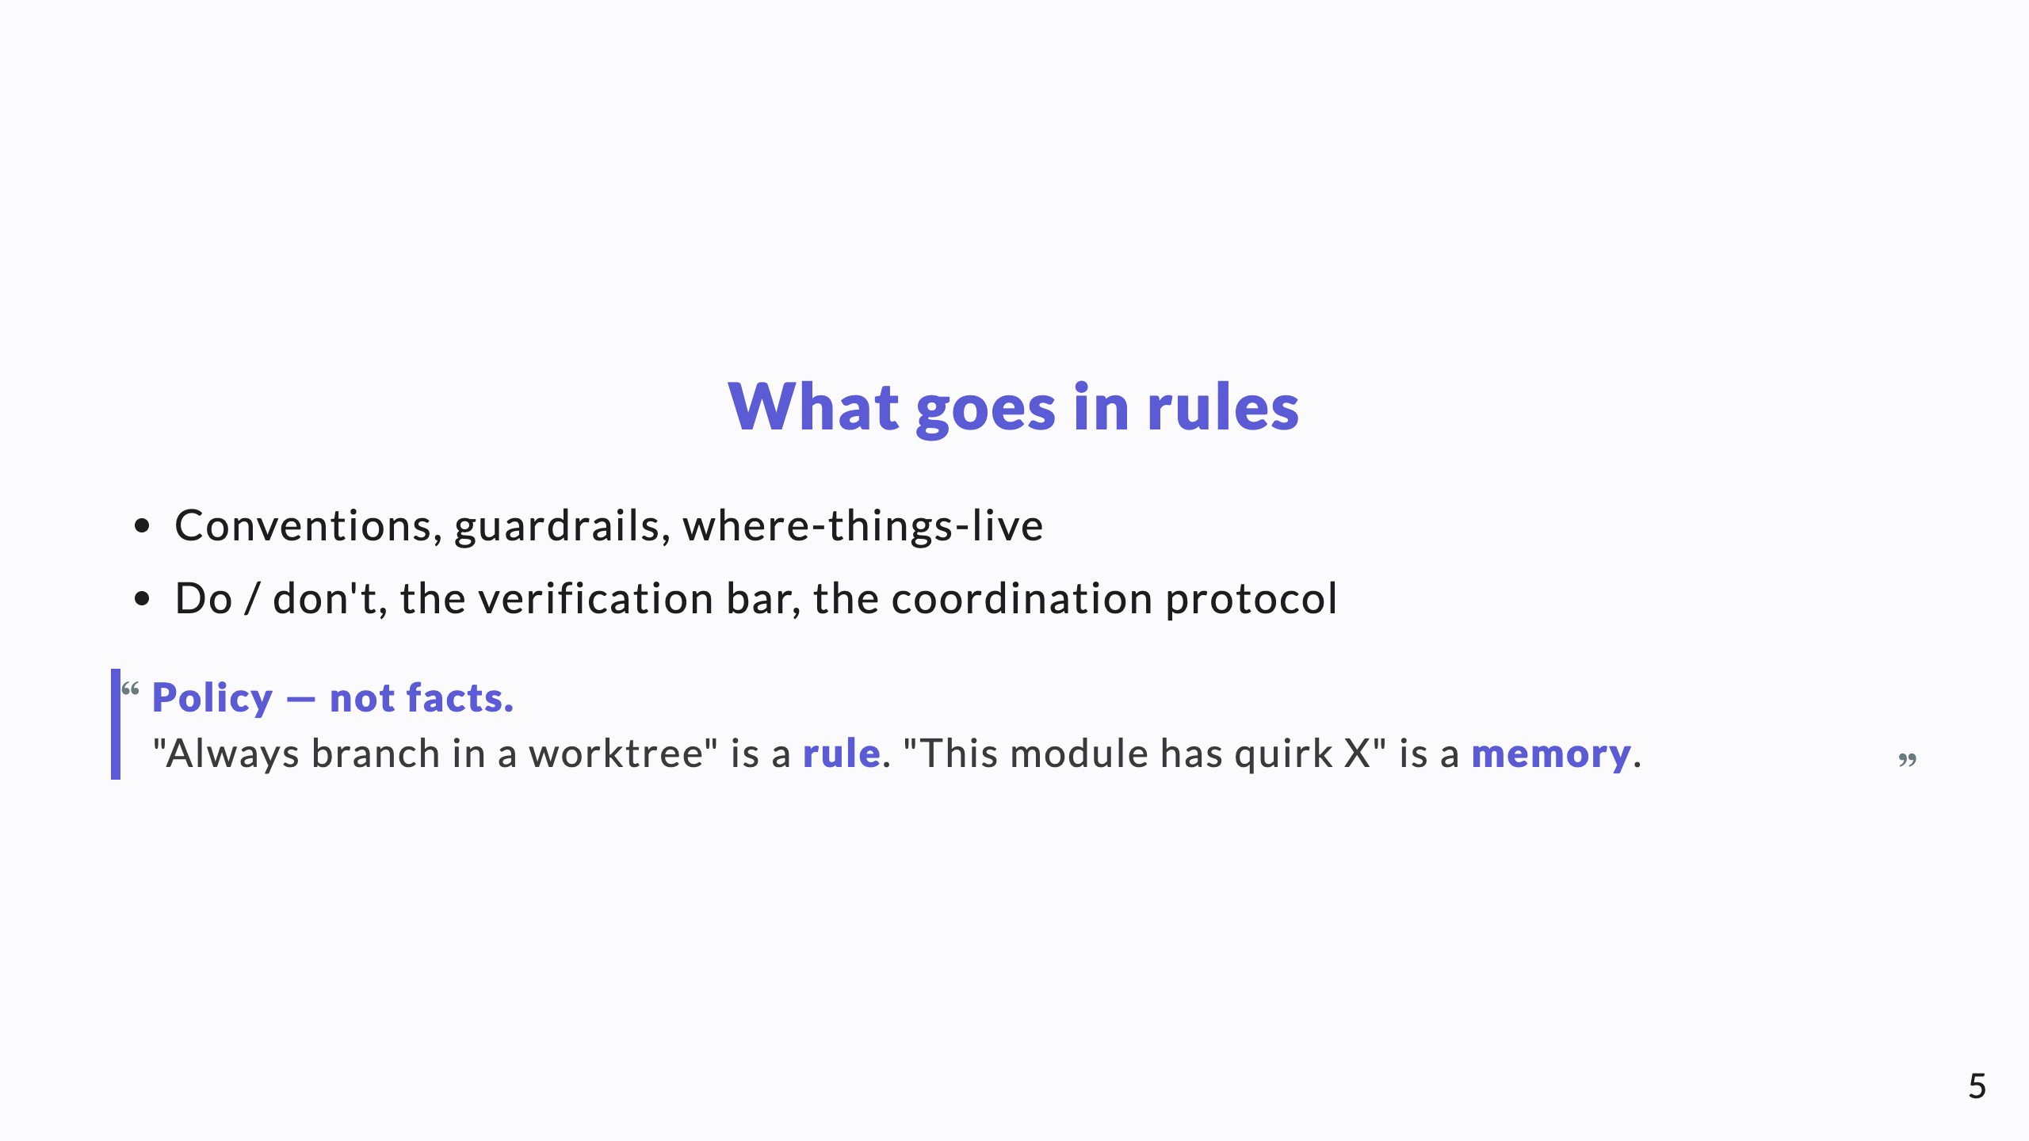
Notes:
The example is the clearest way to teach the rules-vs-memory split. Repeat it; it's the crux.

Slide 6
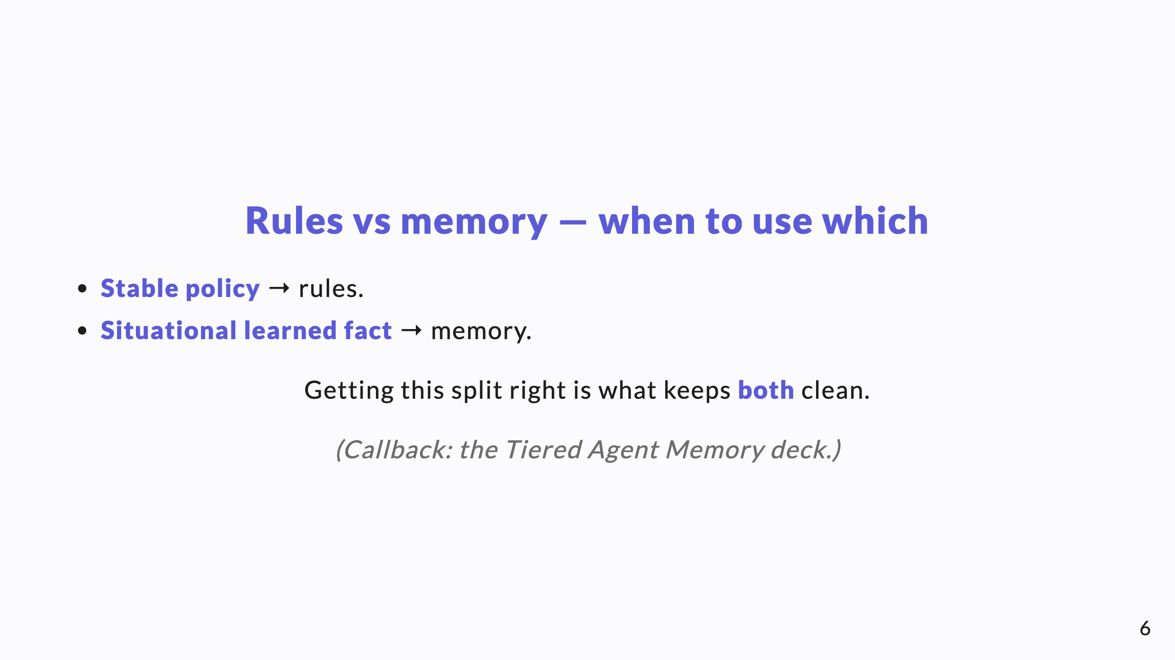
Notes:
Tie back to the memory deck explicitly — together they cover the full picture of what shapes an agent's behavior.

Slide 7
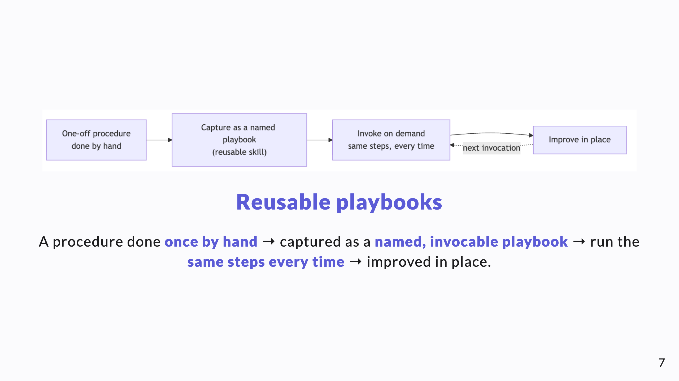
Notes:
Diagram B. Playbooks are the procedural complement to rules: rules say what's allowed; playbooks encode how a recurring job is done.

Slide 8
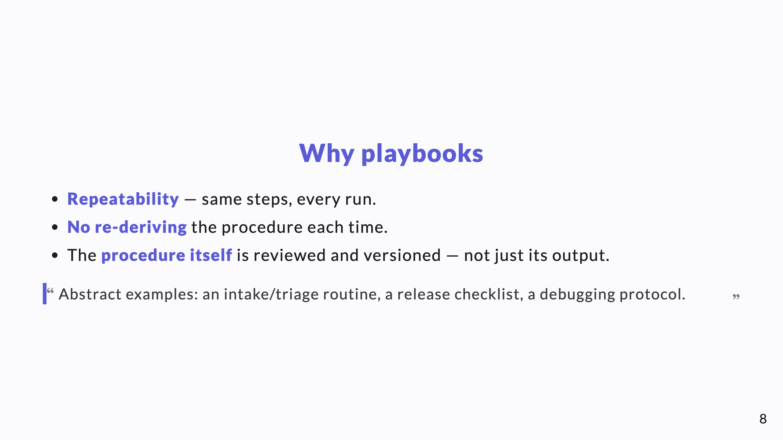
Notes:
The subtle win: you get to version *how the work is done*, not only what it produced. That's process-as-code.

Slide 9
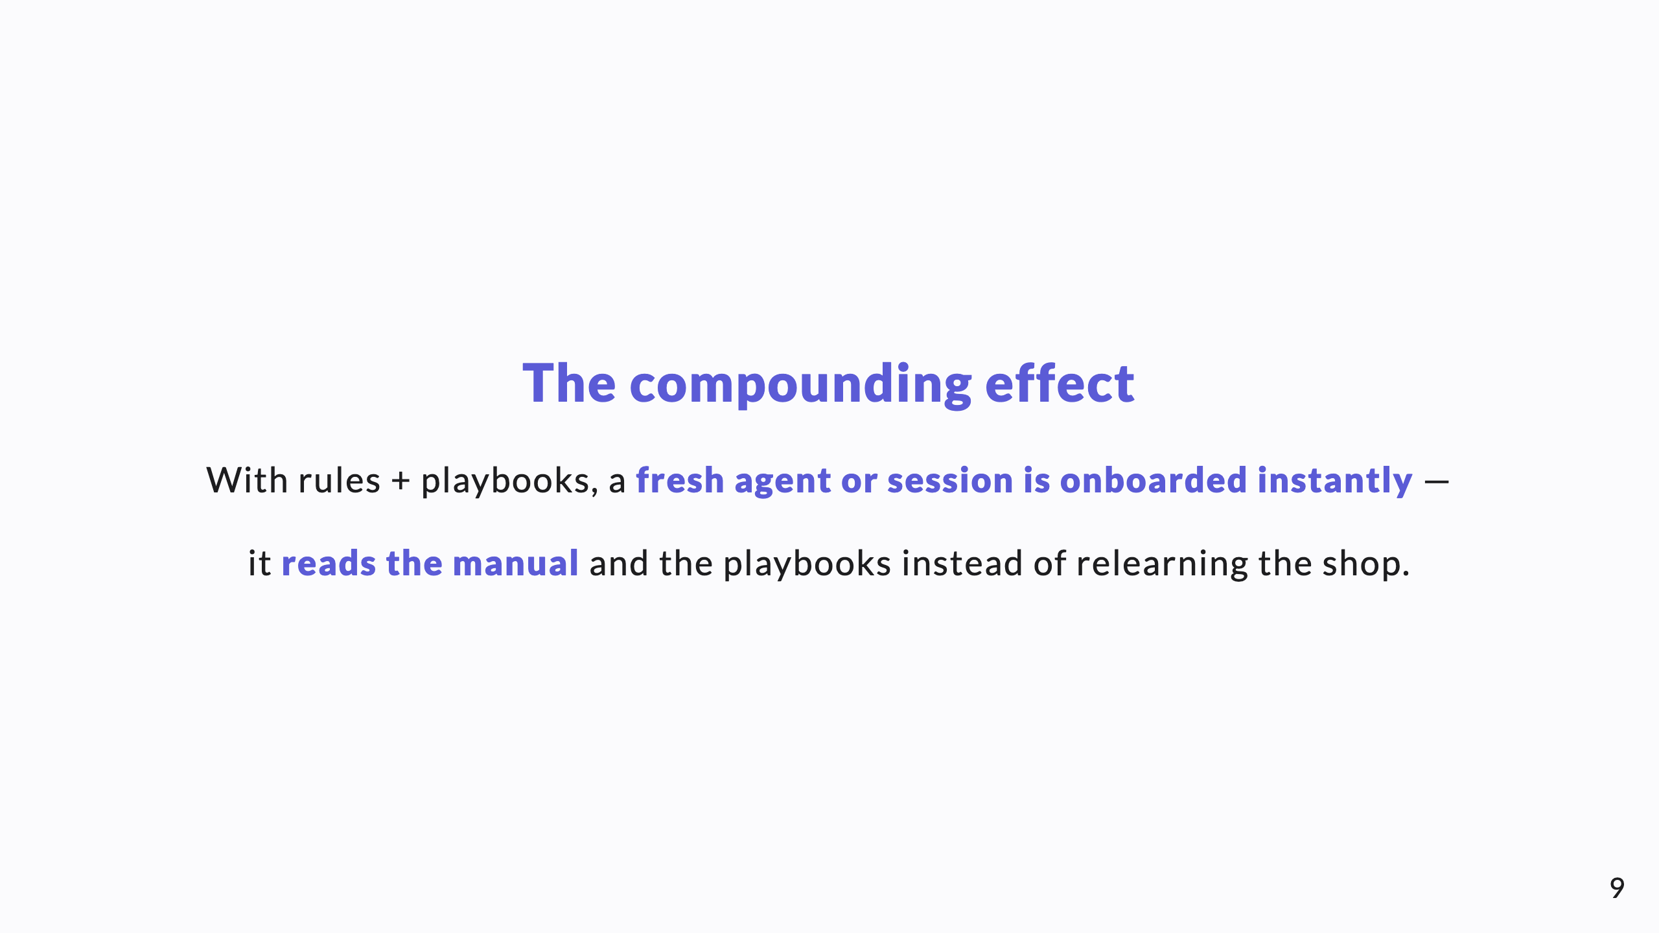
Notes:
This is the ROI line for a CTO: zero-ramp onboarding for every new agent or session, because the knowledge is in the repo, not in someone's head.

Slide 10
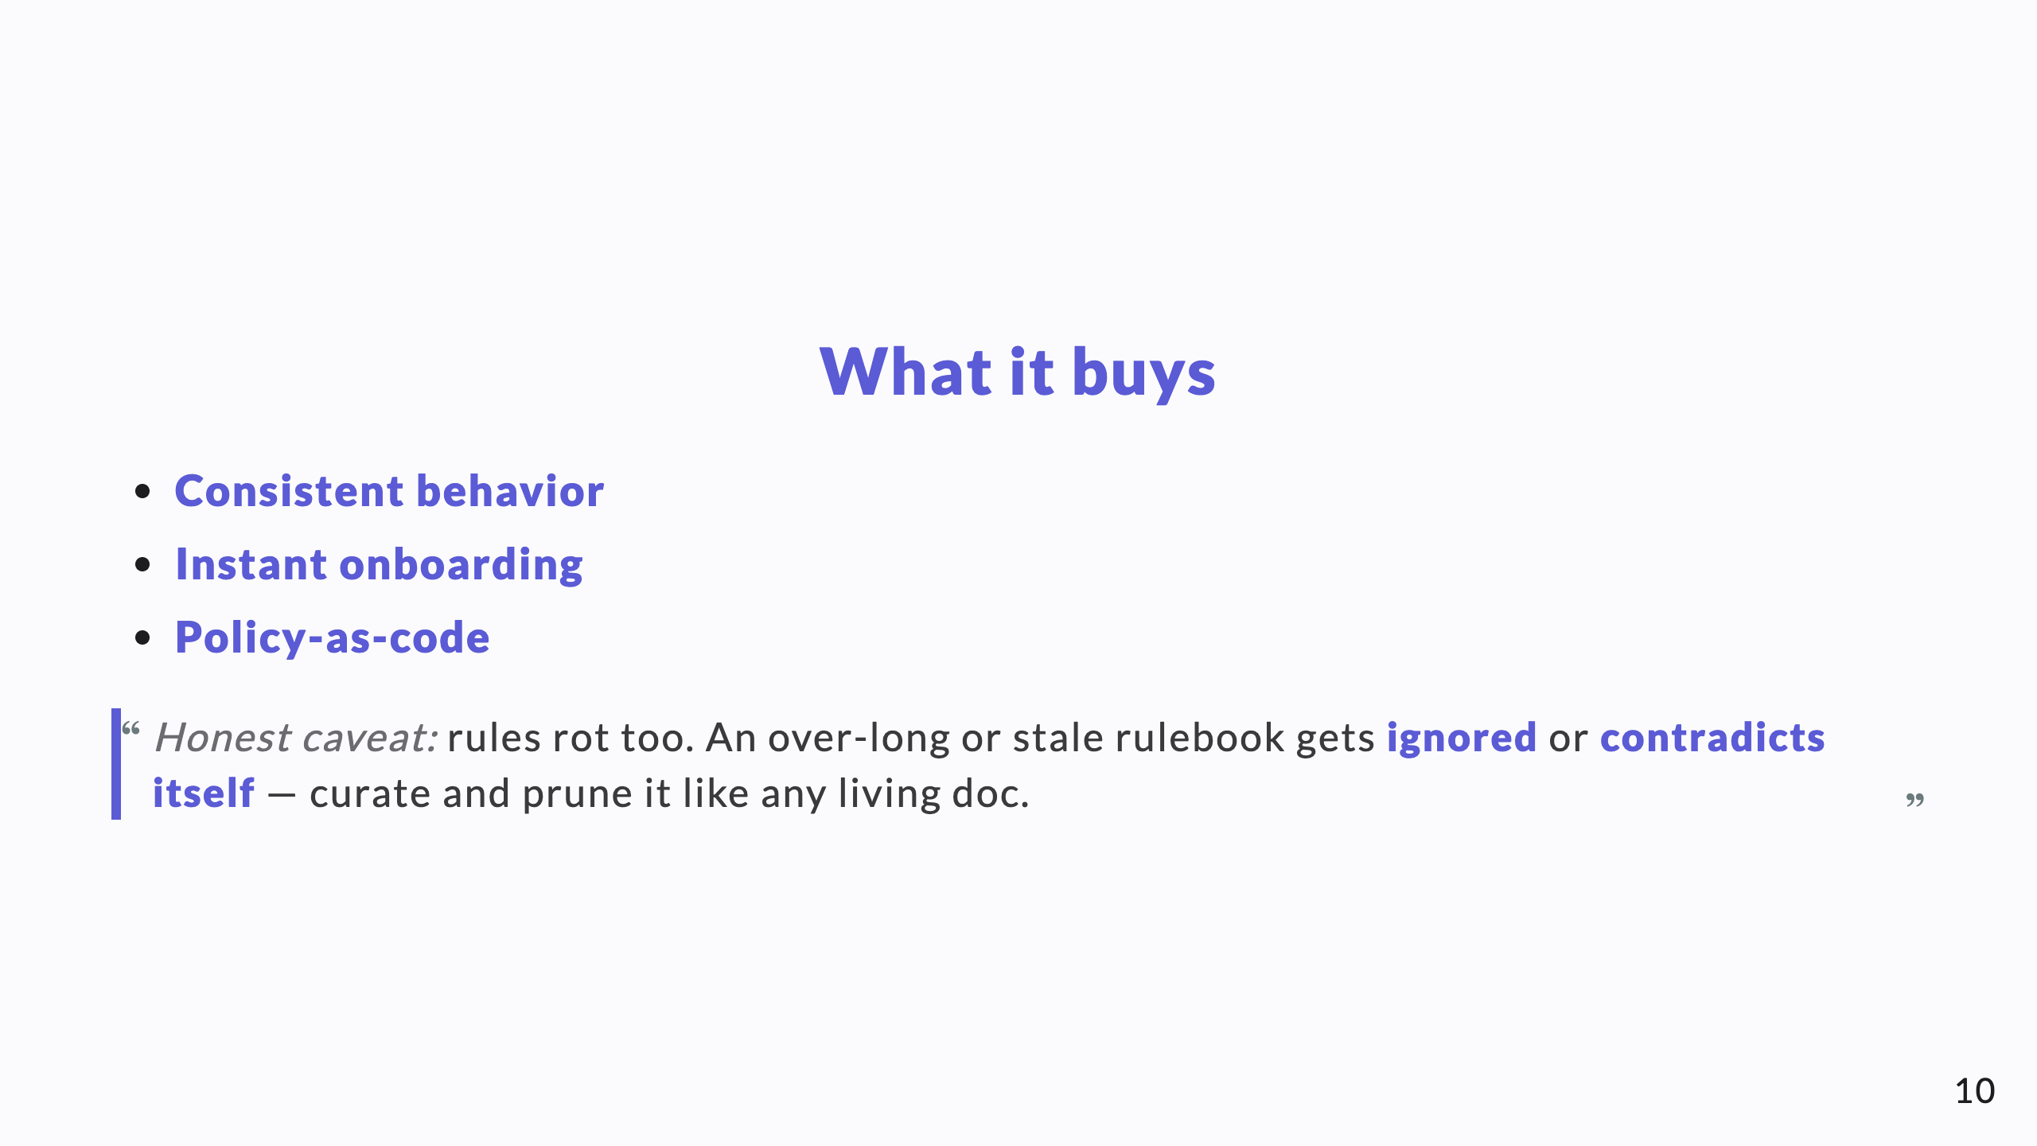
Notes:
Value, then the honest failure mode: a bloated rules file is worse than a short one, because agents (and humans) stop reading it.

Slide 11
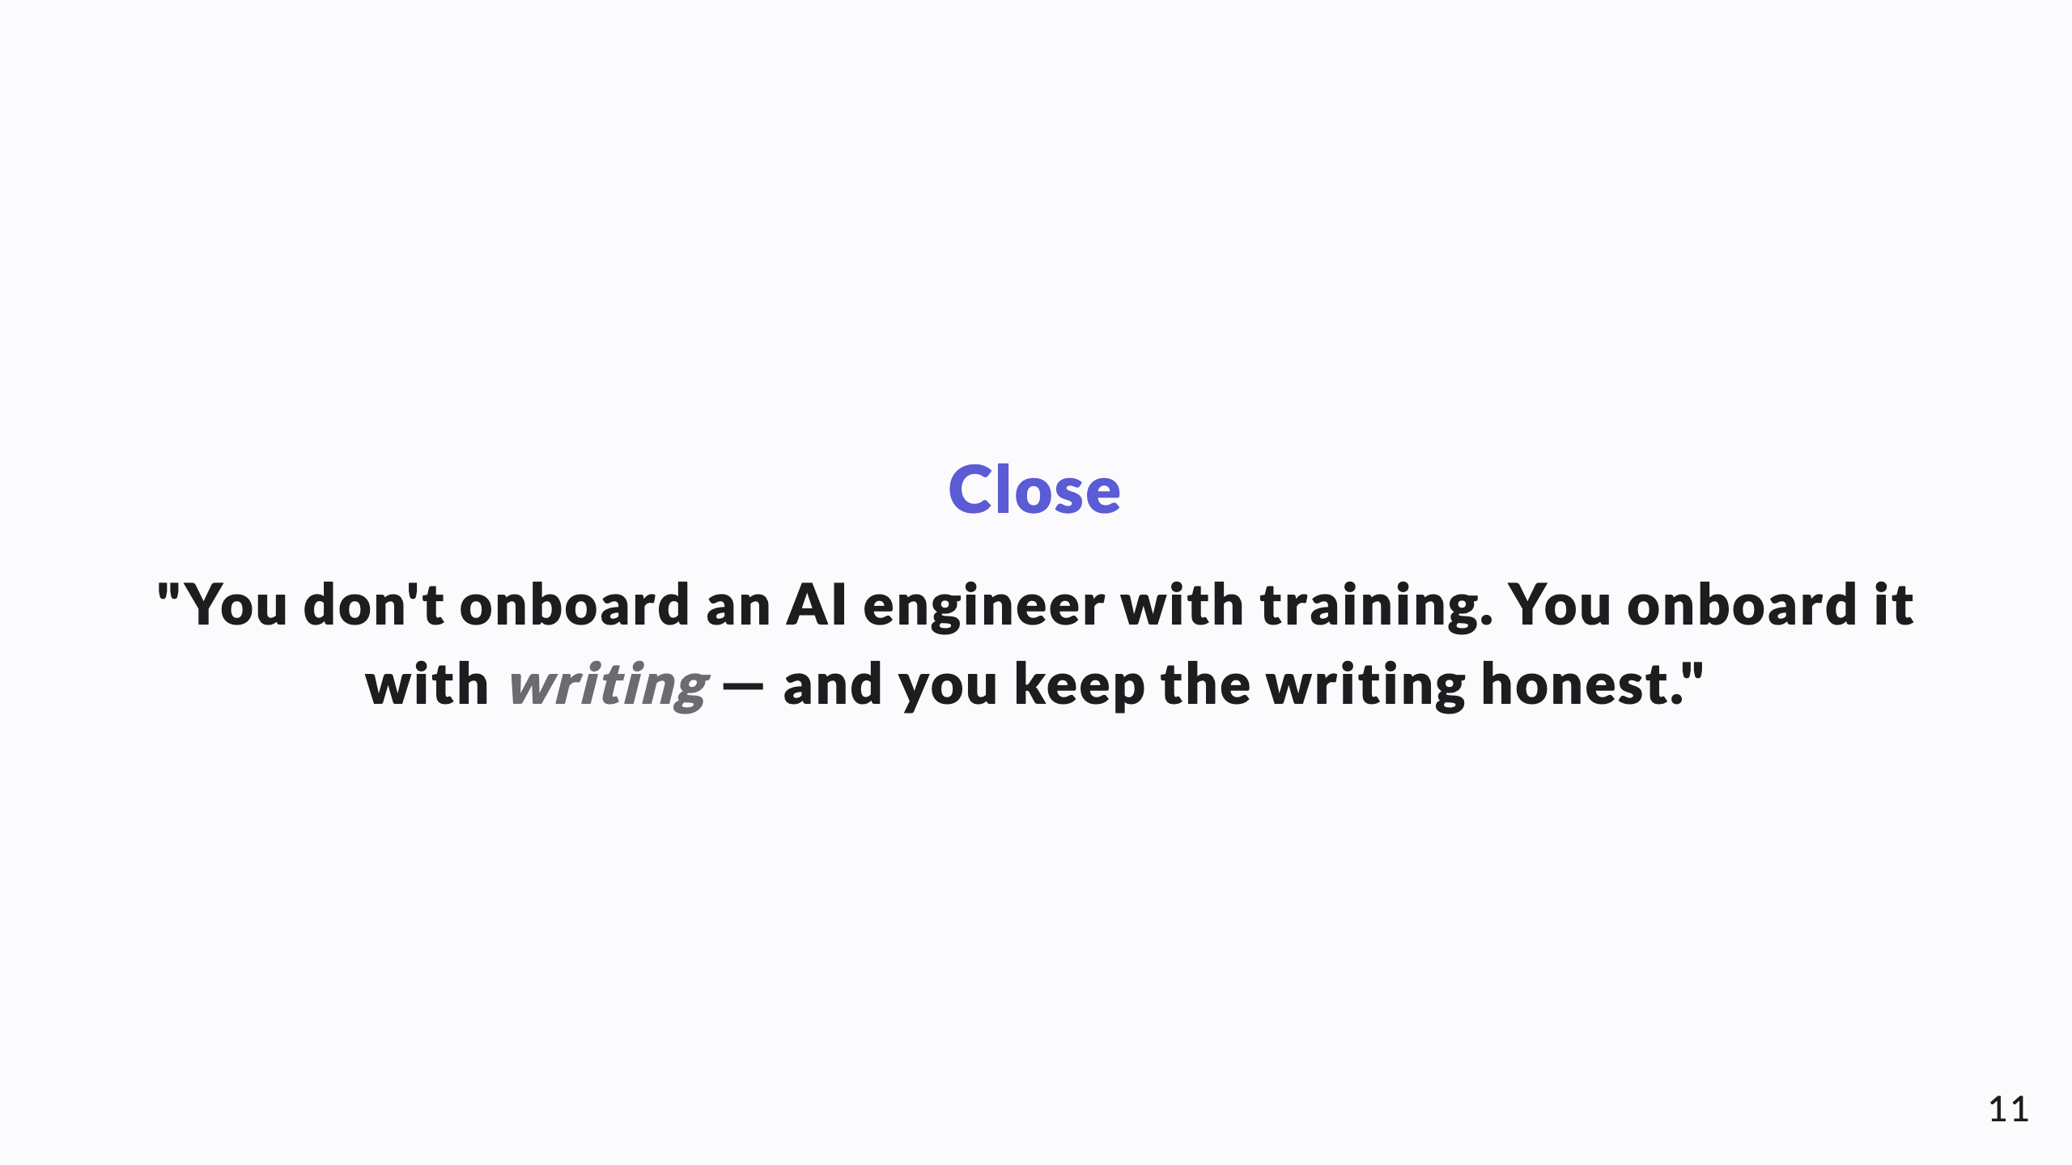
Notes:
The takeaway: enablement is a writing-and-curation discipline, fully in the team's control.

