Slide 1
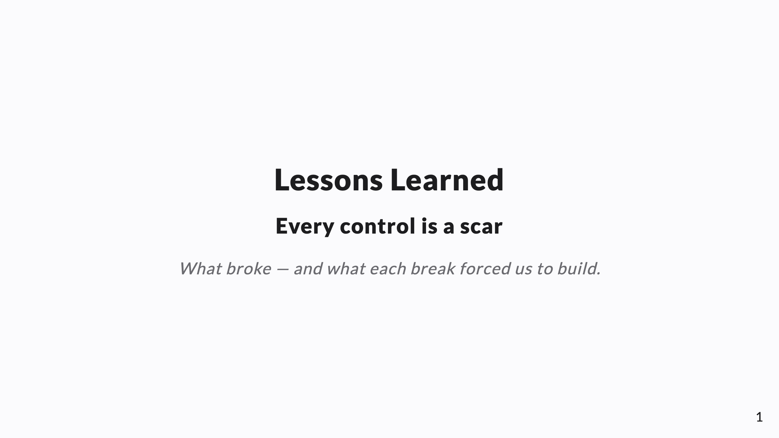
Notes:
SPEAKER NOTES → PPTX presenter notes. The retrospective / closer for the set. Knowledge-share framing, project-agnostic. Through-line: the system wasn't designed, it accreted — every control is a scar from a real failure. Lead with candor; it reads as honest, not salesy.

Slide 2
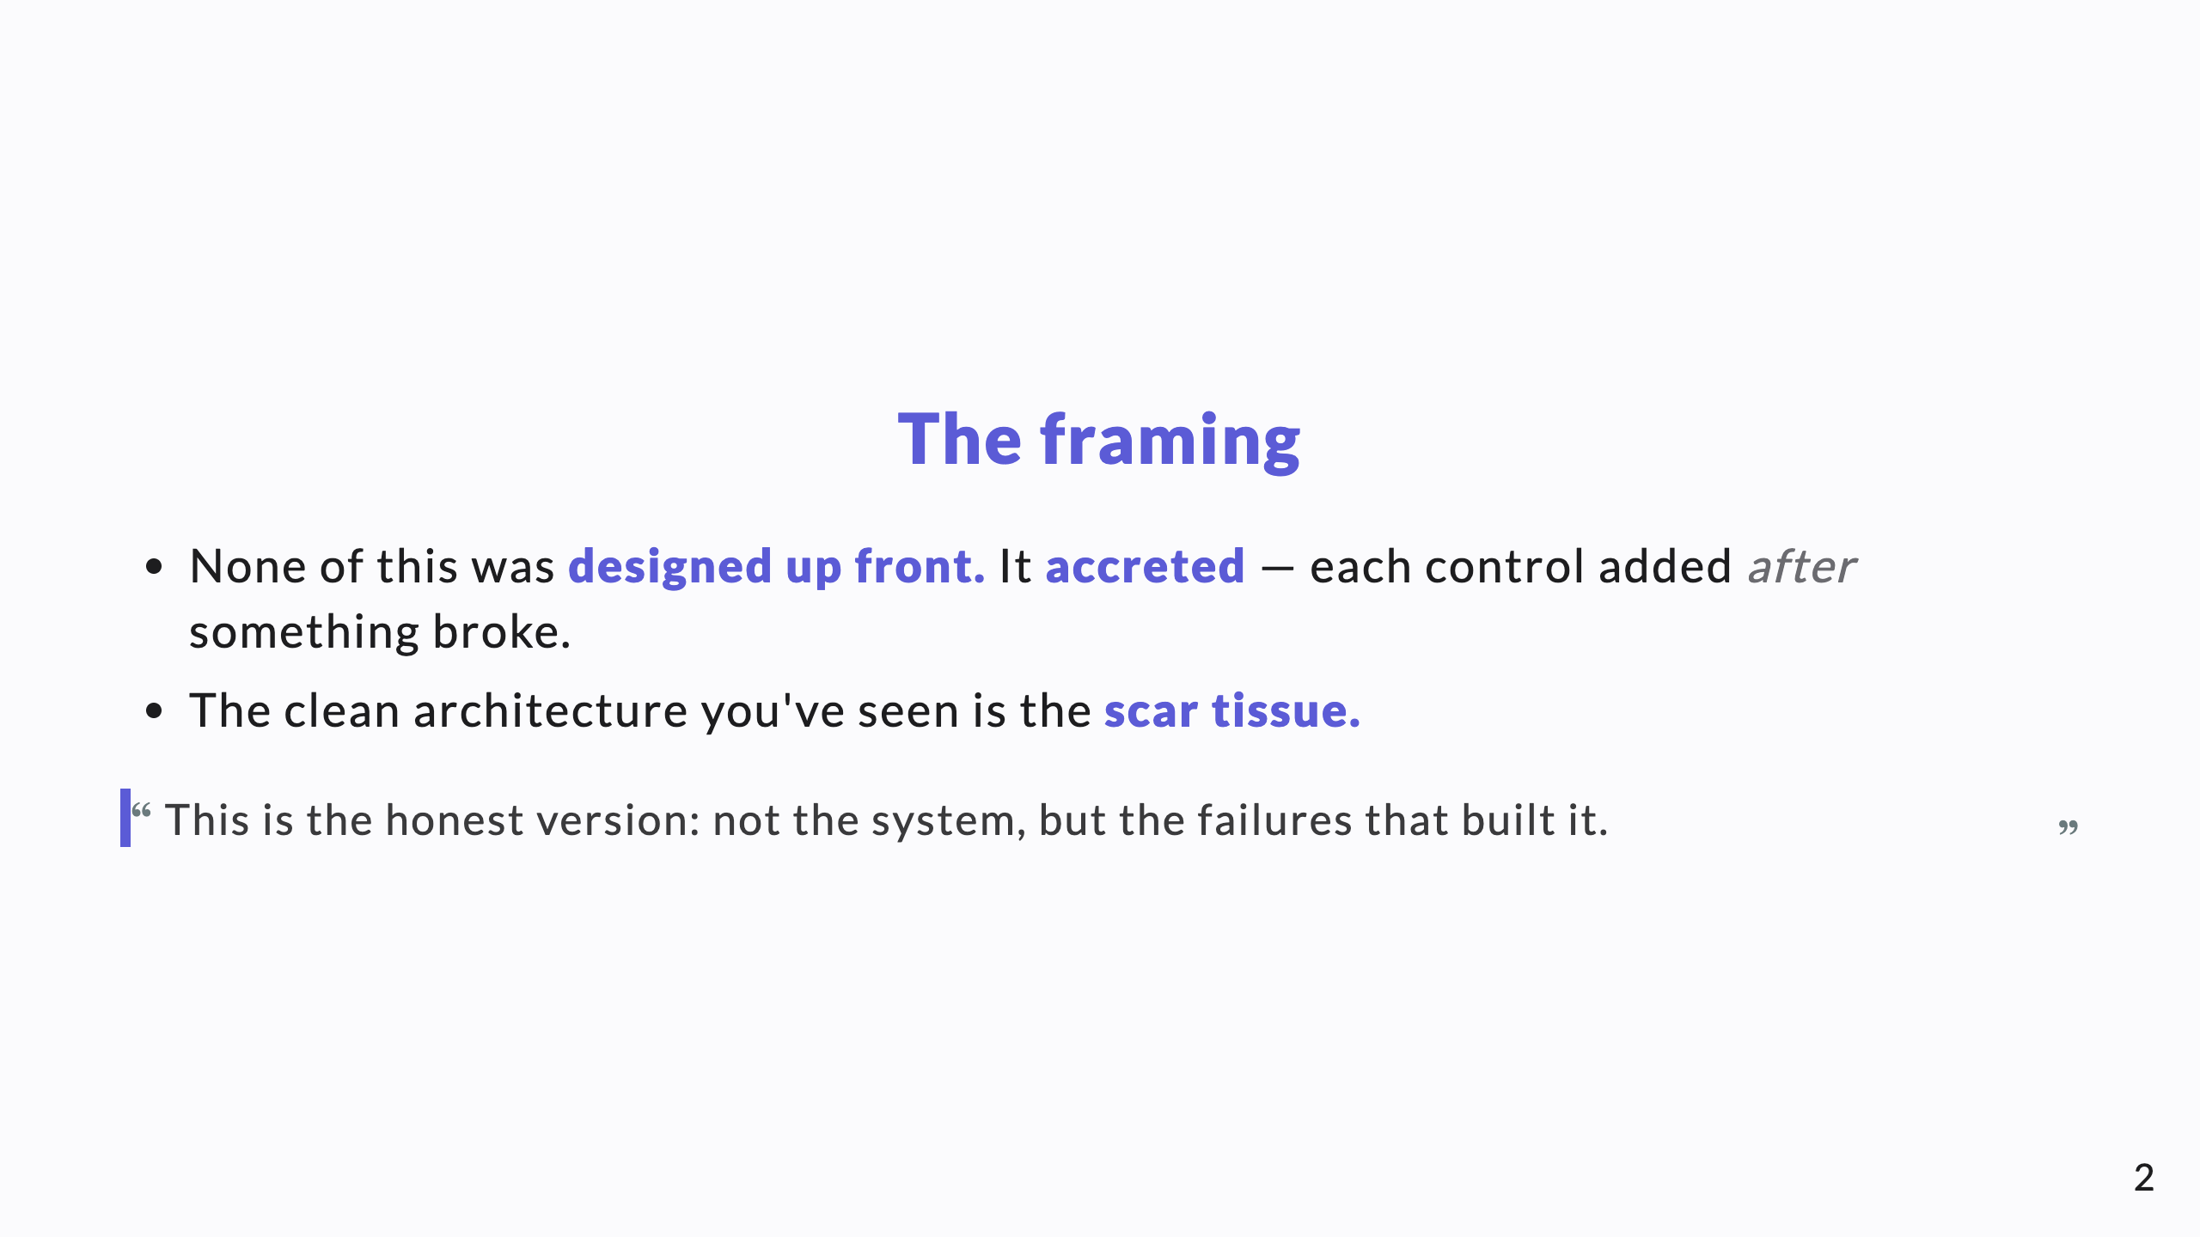
Notes:
Disarm the room. A scar story is more credible than a success story. Say plainly: we didn't plan this; we kept fixing what broke.

Slide 3
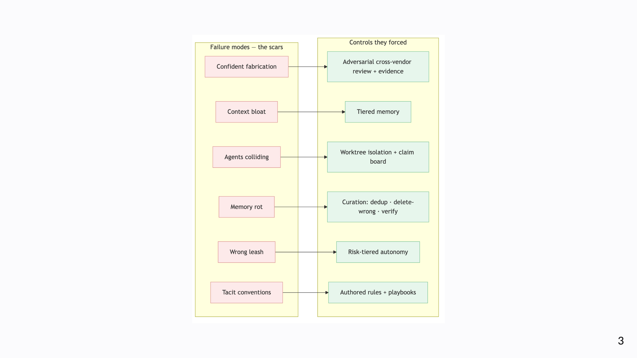
Notes:
Diagram A — the scar map. Don't read it as architecture; read it as a list of things that went wrong. The green column exists only because of the red one. This single slide is the spine of the talk.

Slide 4
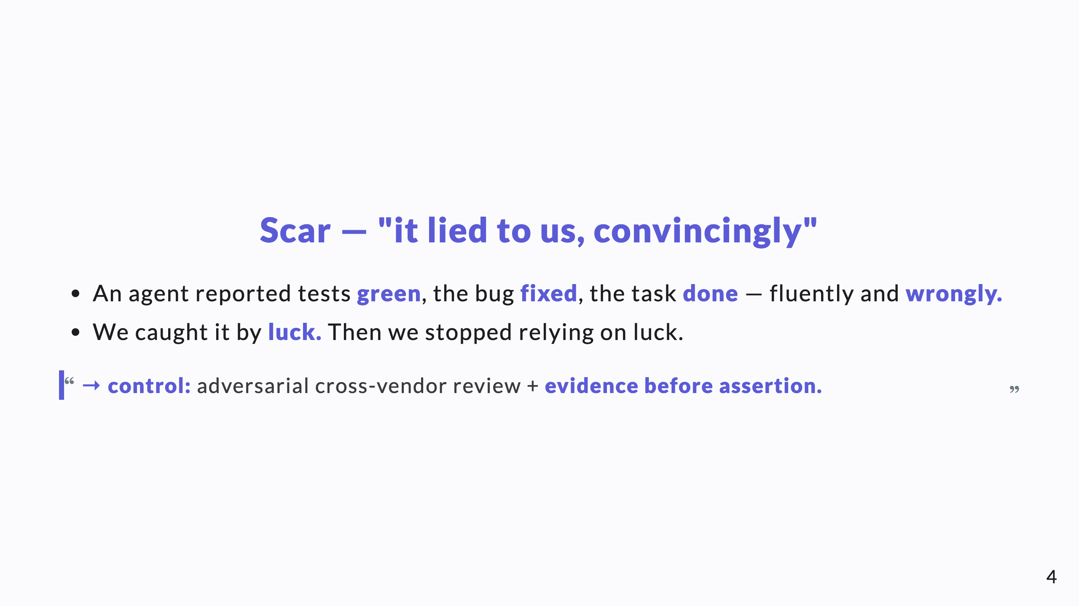
Notes:
The founding scar. The emotional beat: the moment you realize fluent output can be confidently false. Everything in the verification layer descends from this.

Slide 5
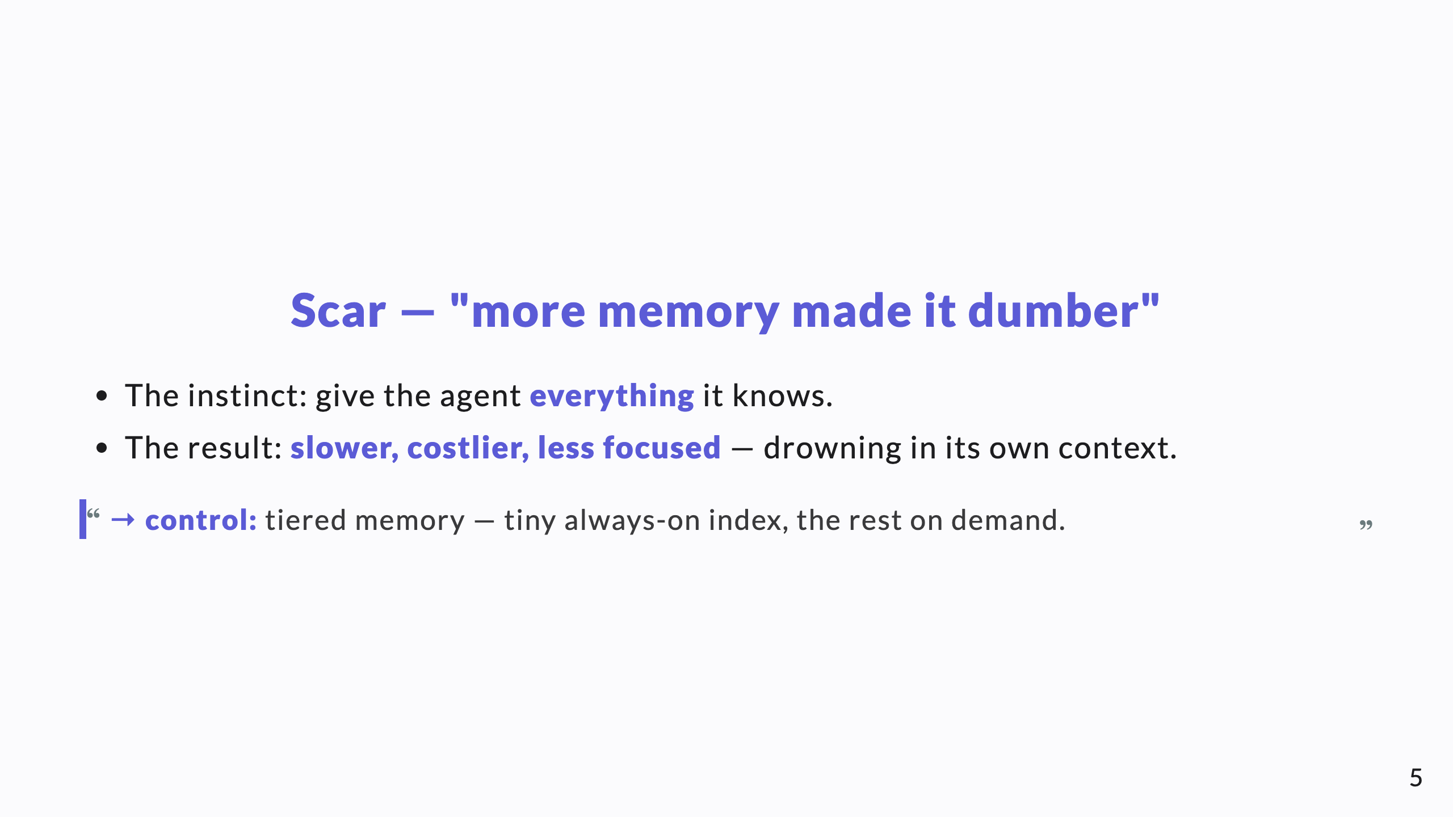
Notes:
Counterintuitive, so worth saying out loud: more context is not strictly better. This is the scar behind the whole memory architecture.

Slide 6
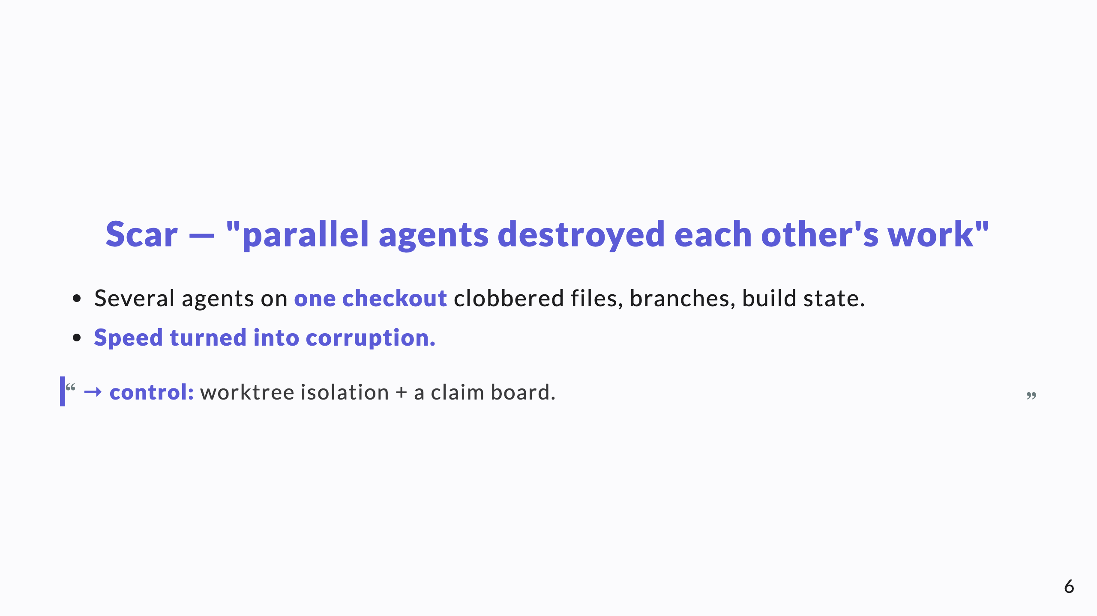
Notes:
Parallelism was supposed to be the win; unmanaged, it was the fastest way to corrupt work. The isolation layer is the scar.

Slide 7
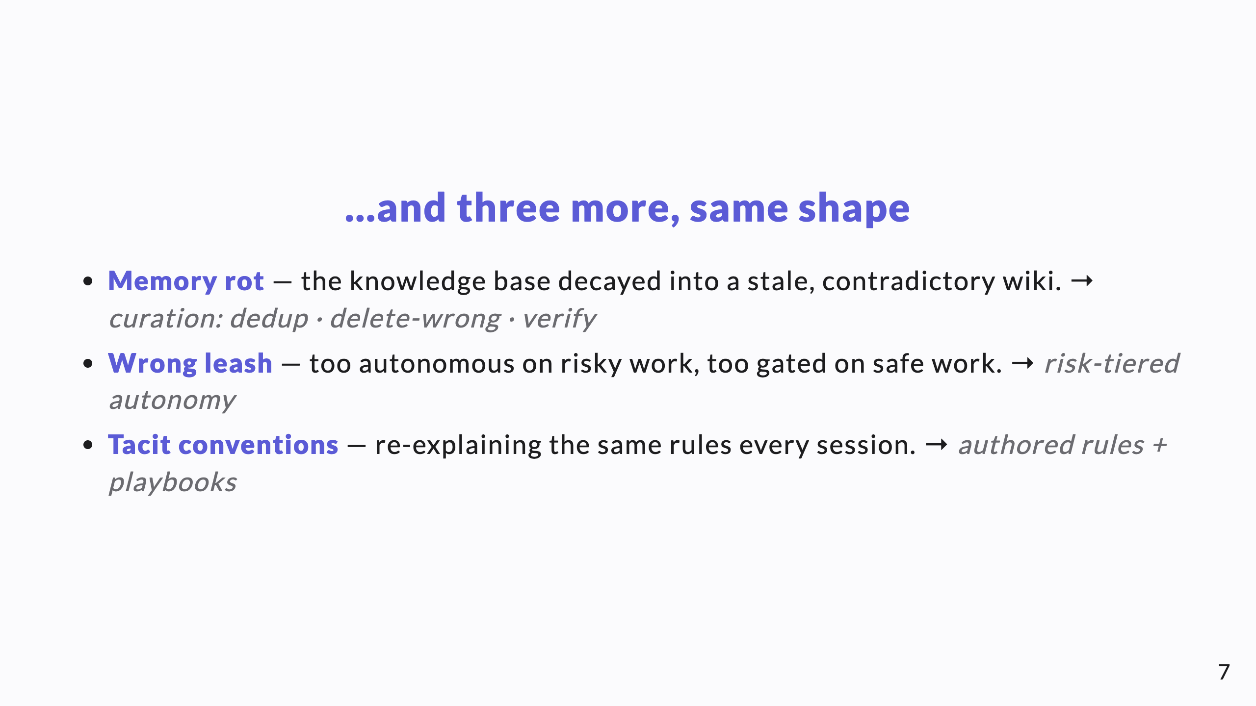
Notes:
The map already showed these; here just name the failure and the fix quickly. Don't re-teach the other decks — this is a retrospective, not a recap.

Slide 8
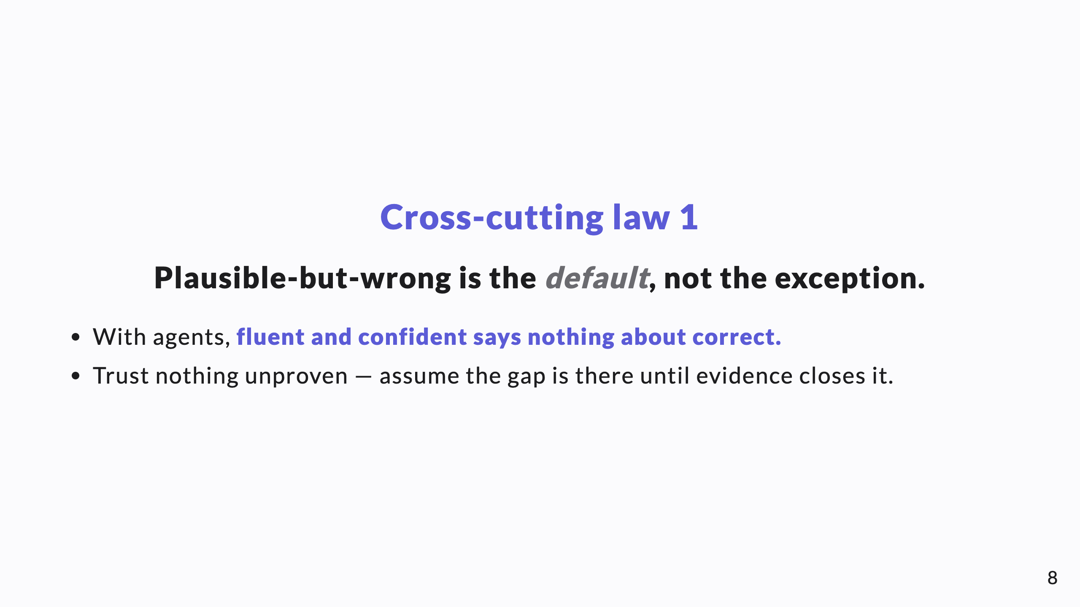
Notes:
The first of three laws that aren't in any other deck. This is the mindset shift the whole system is built around.

Slide 9
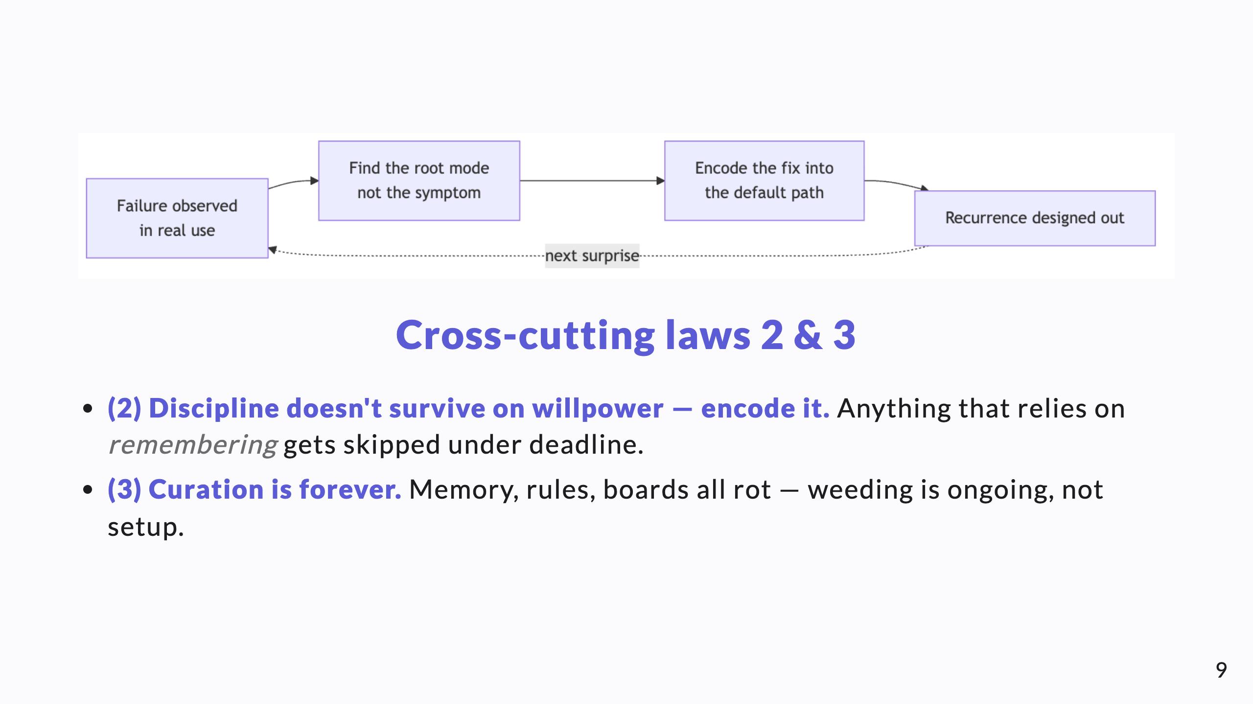
Notes:
Diagram B shows law 2 in action: a fix only counts once it's in the default path. Law 3 is the reason none of this is "done" — it's maintained.

Slide 10
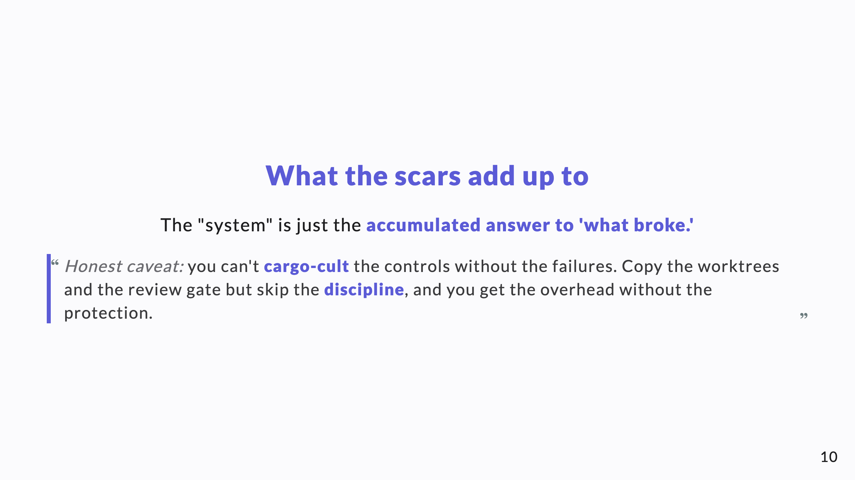
Notes:
The most useful slide for another team. The controls are worthless detached from the lessons that earned them. Keep the lesson attached to the fix.

Slide 11
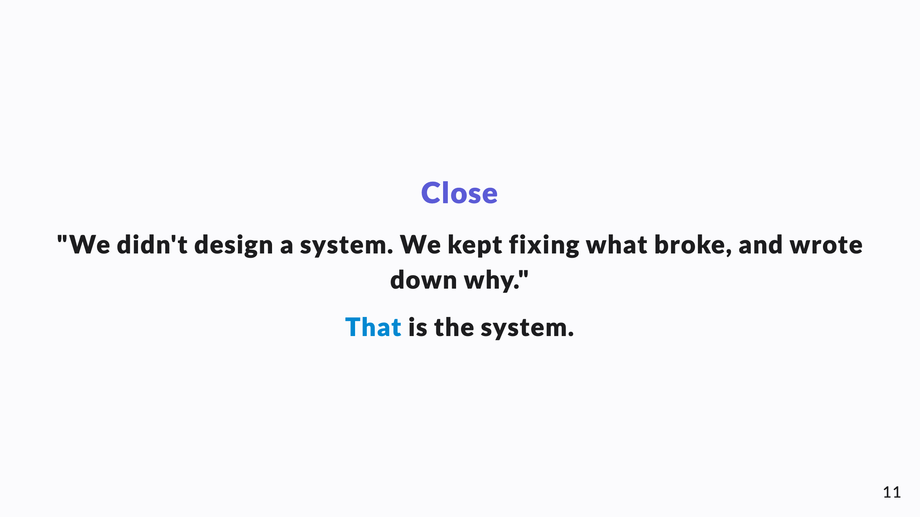
Notes:
End on the thesis. If this is the closer for the set, this is the last thing they hear: the system is a maintained record of failures and fixes, not a clever architecture.

