Slide 1
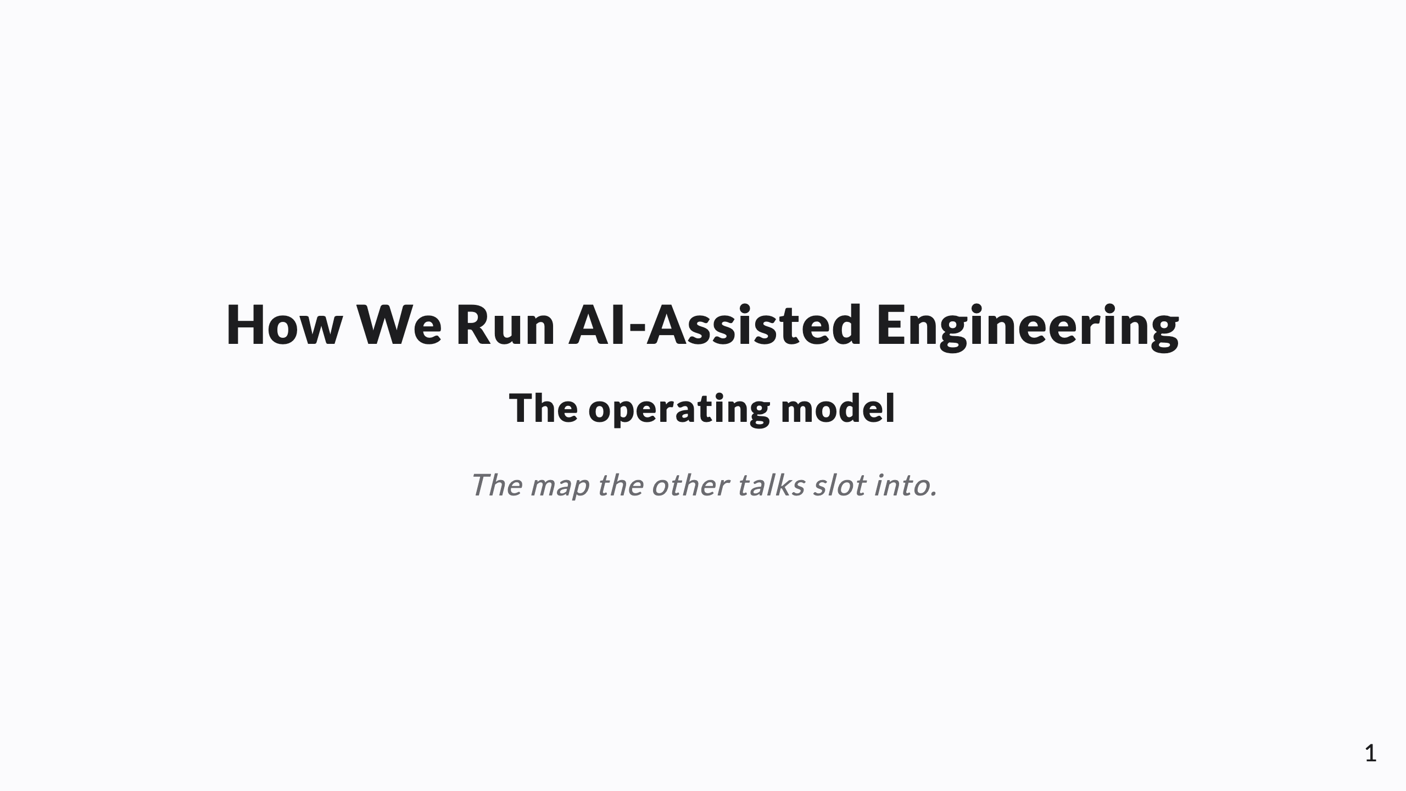
Notes:
SPEAKER NOTES in HTML comments → export to PPTX presenter notes. This is the CAPSTONE / index deck — opener or closer for the set of five. Through-line: AI-assisted engineering is a thin operating layer (rules, memory, coordination, verification) around an unchanged SDLC. Each layer is its own companion talk.

Slide 2
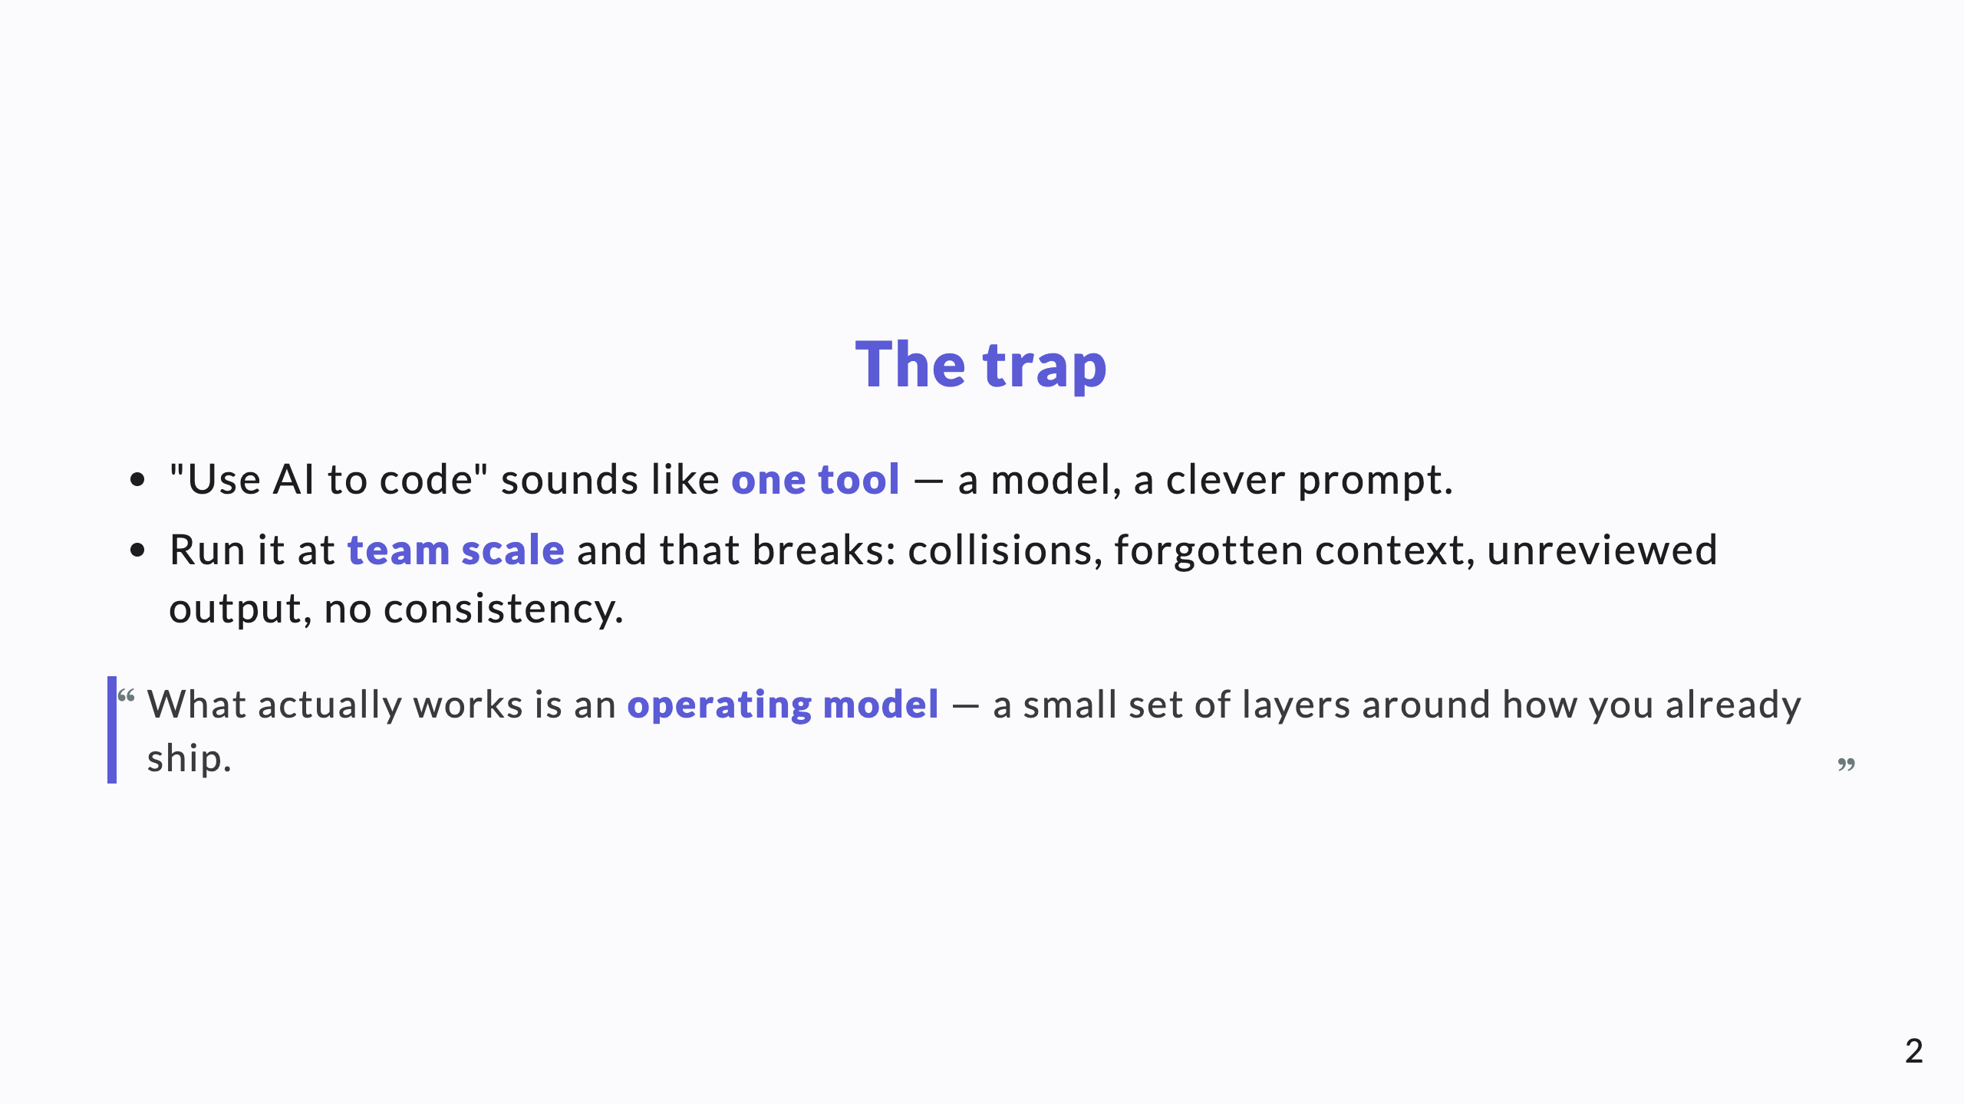
Notes:
Don't oversell a tool; sell a system. The CTO has seen "AI coding tool" demos. The pitch is that the demo isn't the hard part — running it as an operation is.

Slide 3
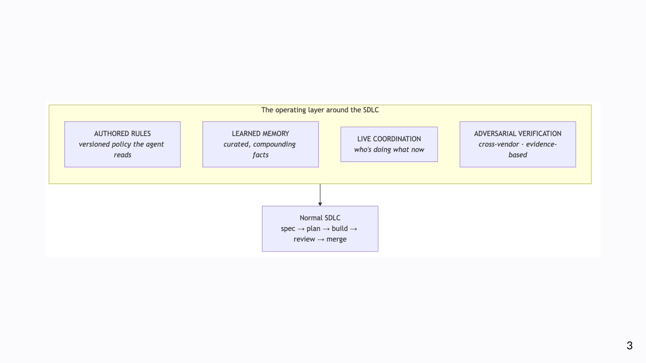
Notes:
Diagram A. The SDLC in the middle is unchanged — spec, plan, build, review, merge. The four layers wrap it. The point of the slide: we didn't reinvent software delivery; we wrapped it.

Slide 4
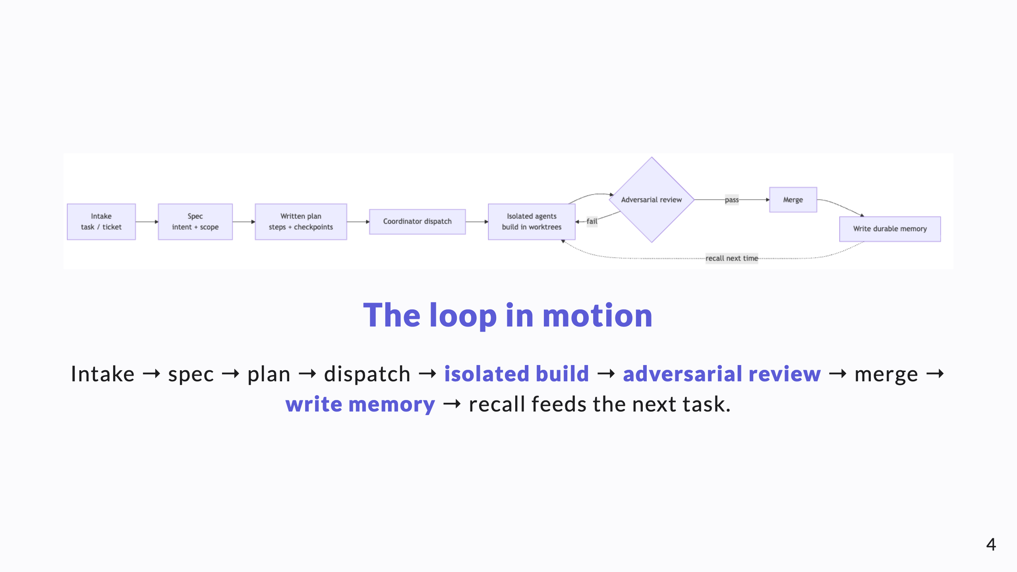
Notes:
Trace one task end to end. Nothing exotic in the steps; the layers just make each step safe for an autonomous agent.

Slide 5
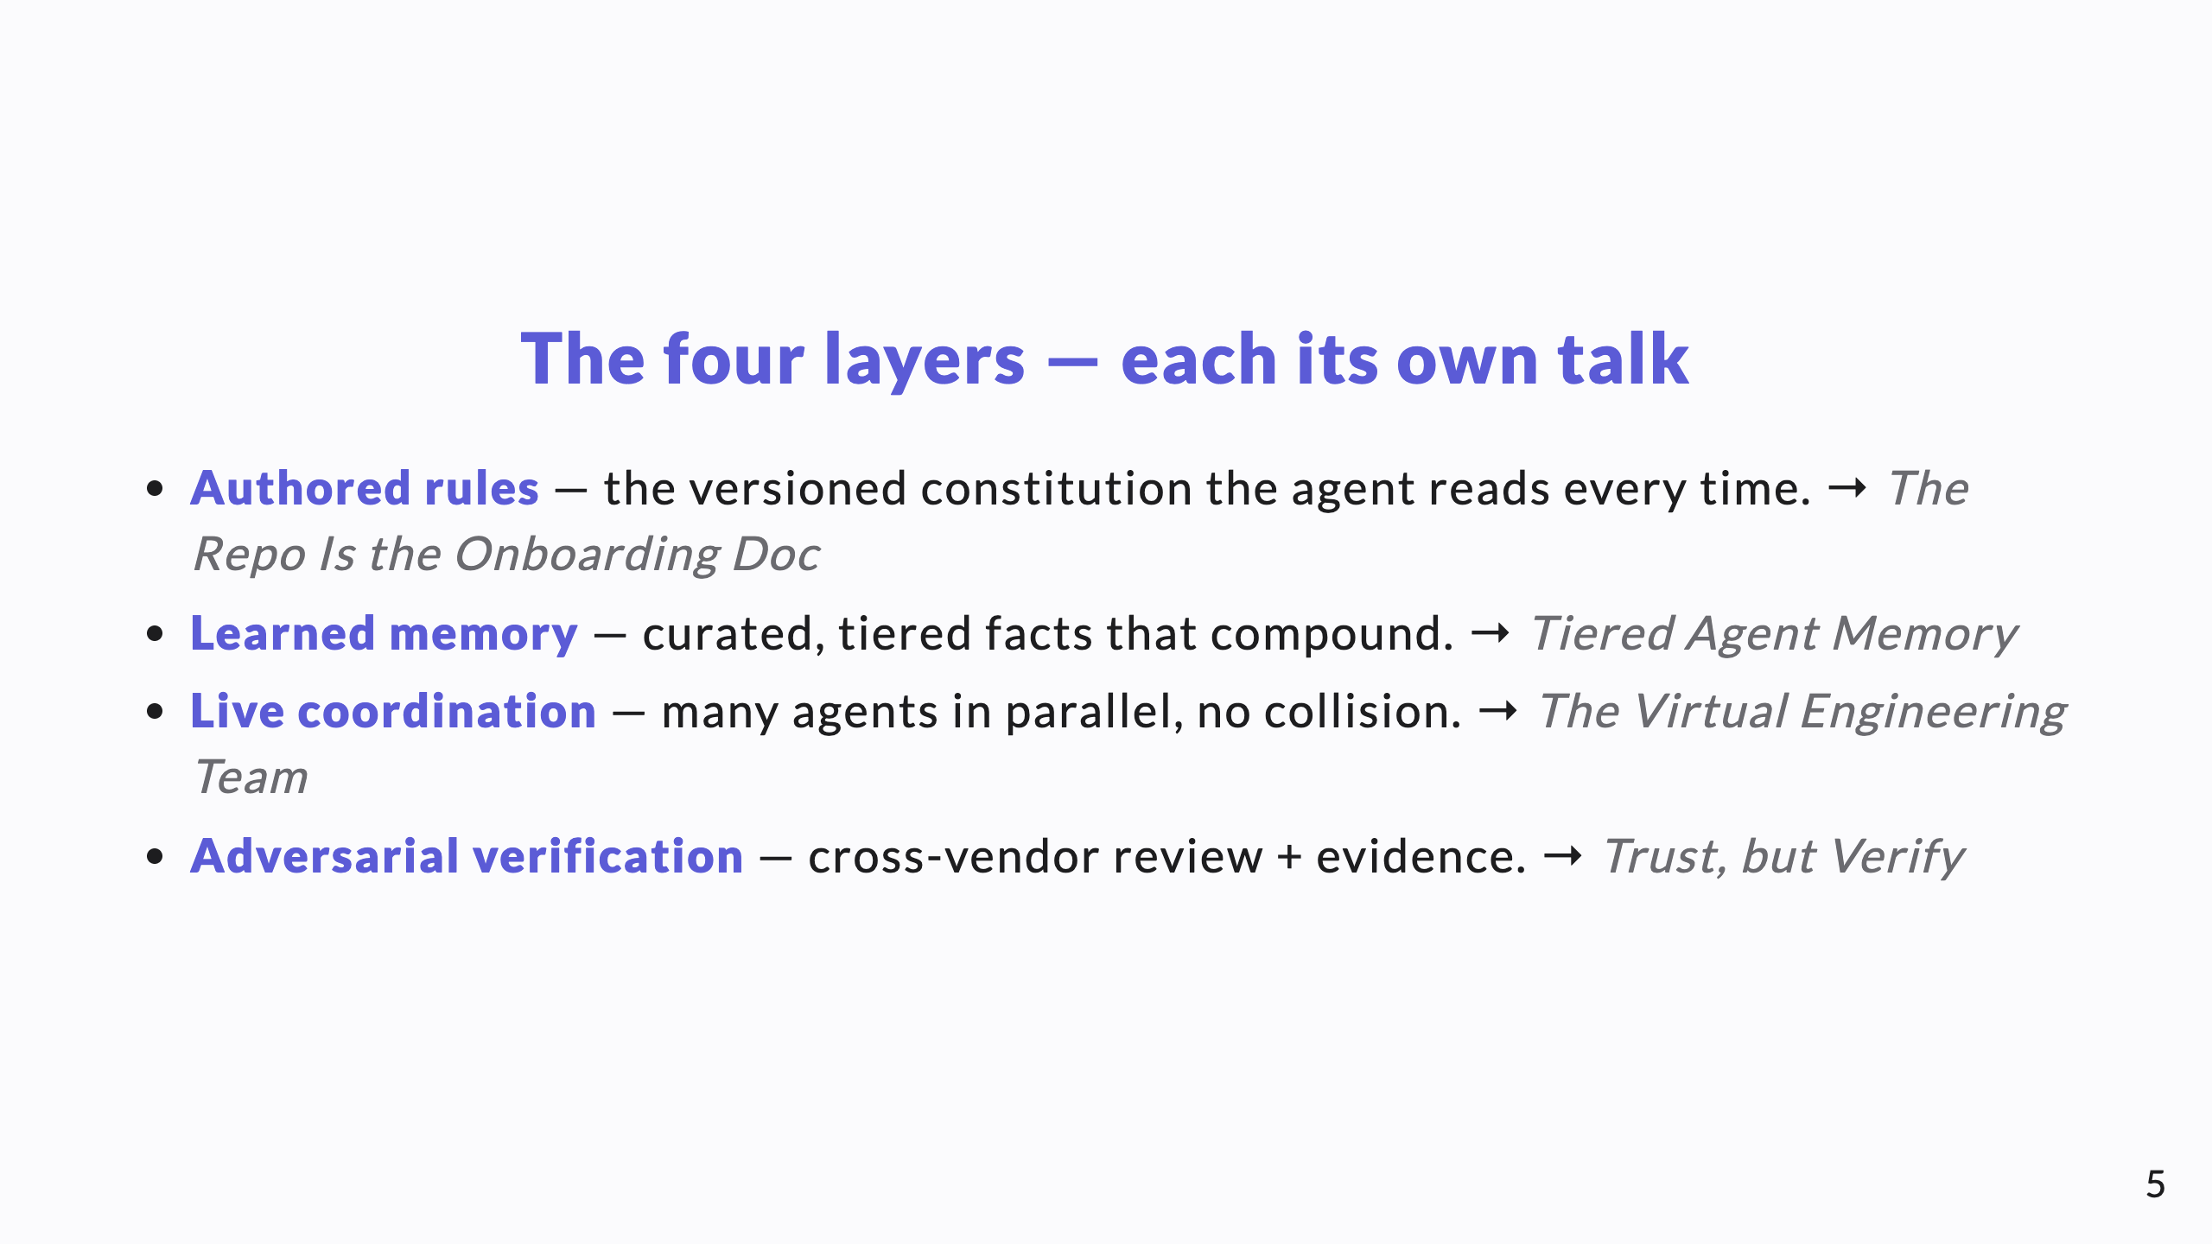
Notes:
This slide is the table of contents for the whole set. Name each layer, name its talk, move on.

Slide 6
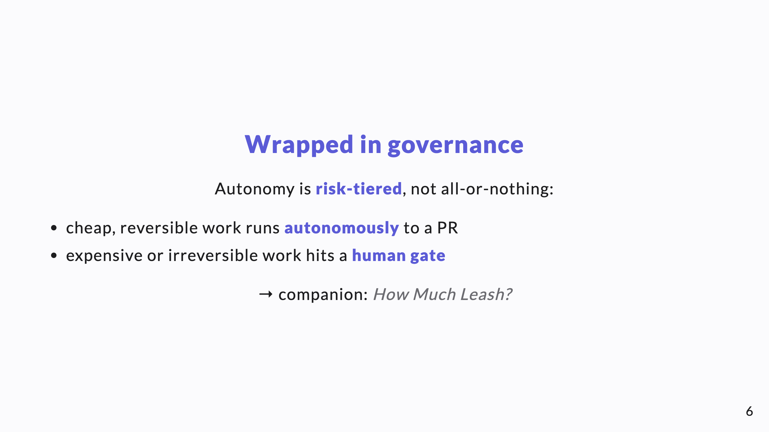
Notes:
The governance ring sits outside all four layers. It decides how much an agent may do before it has to ask. This is the slide a risk-conscious CTO leans into.

Slide 7
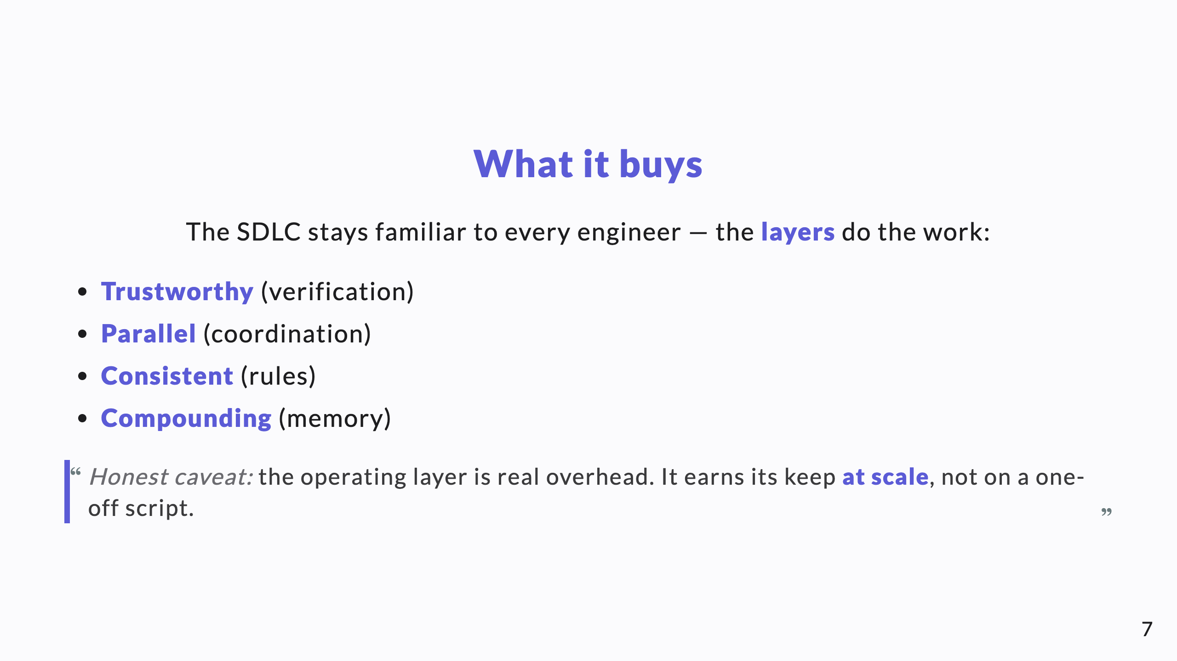
Notes:
End on value, then the honest cost. The caveat keeps the knowledge-share credible.

Slide 8
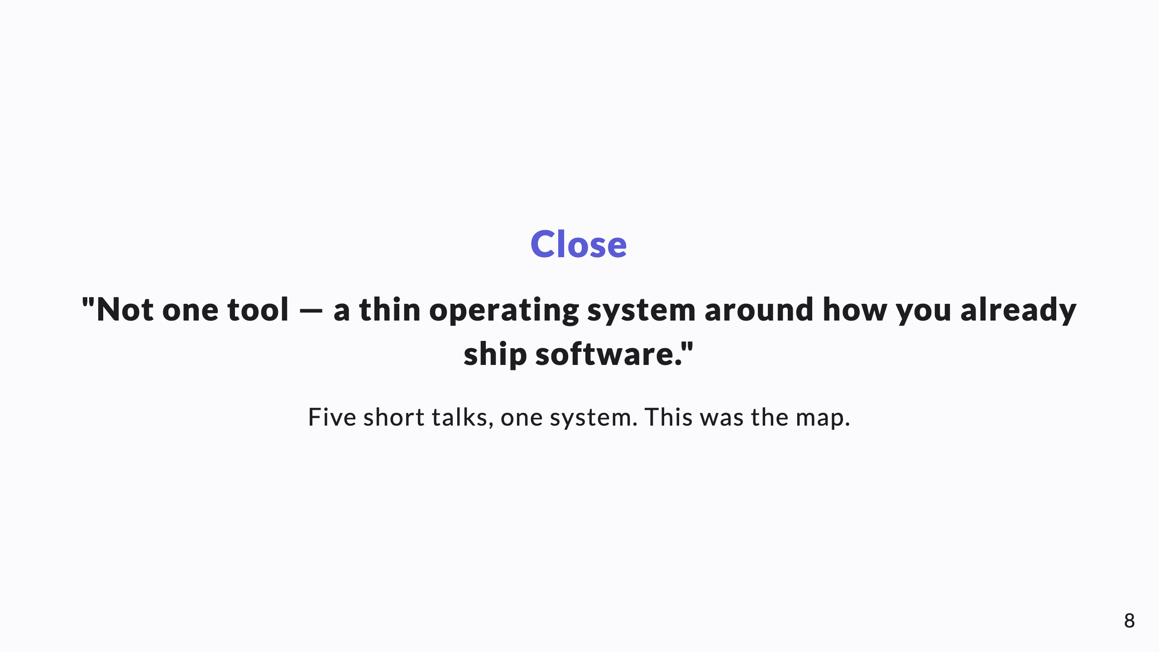
Notes:
If this is the opener, end with "let's walk each layer." If the closer, end with "that's the whole system." Either way: it's a system, not a gadget.

