Slide 1
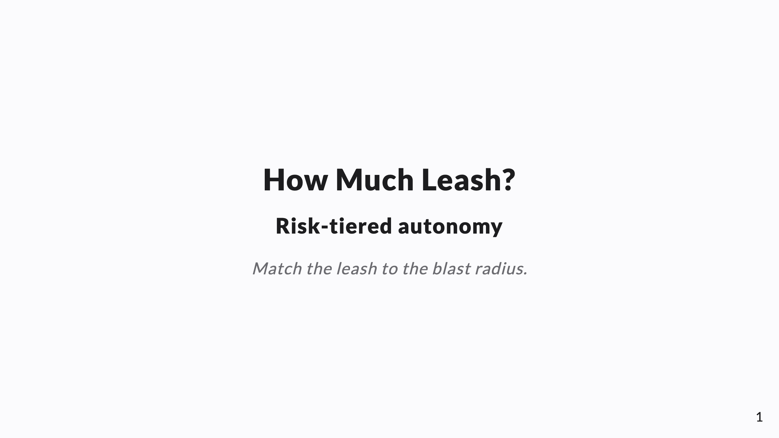
Notes:
SPEAKER NOTES → PPTX presenter notes. The governance ring of the operating model. Knowledge-share framing. Through-line: autonomy is per-task, routed by blast radius × reversibility — not a global on/off. Autonomous still means "to a PR, not to prod."

Slide 2
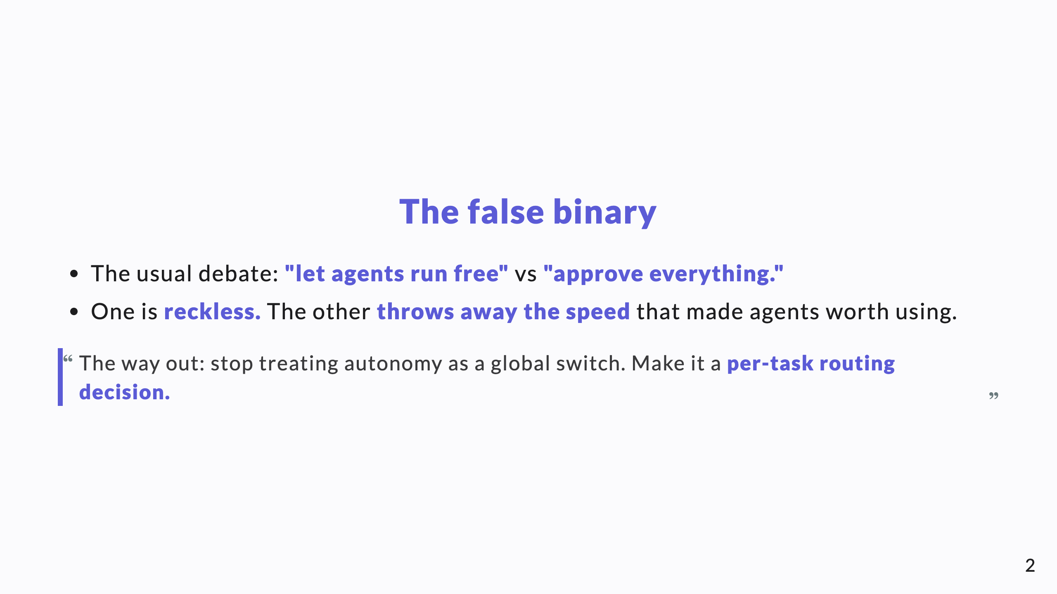
Notes:
Every CTO has heard this binary. Dismantling it in the first 60 seconds earns the room.

Slide 3
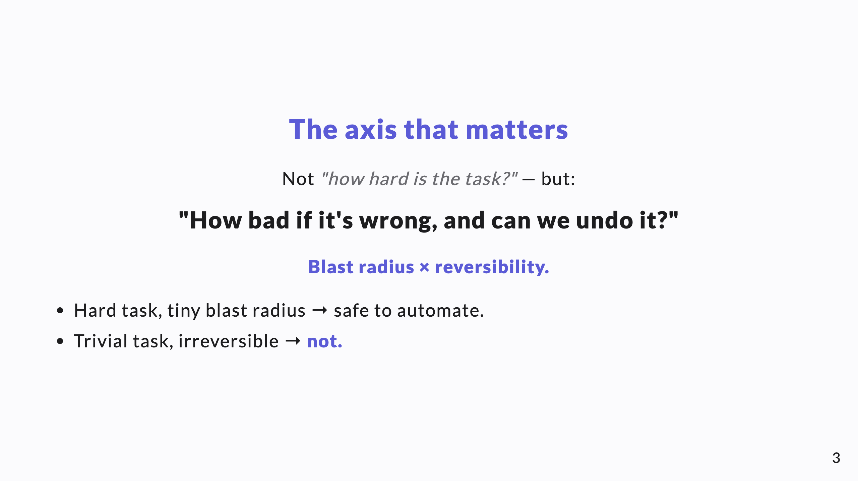
Notes:
This reframing is the core idea. Difficulty is the wrong axis; consequence-of-error and reversibility are the right ones. Drive this home before showing the spectrum.

Slide 4
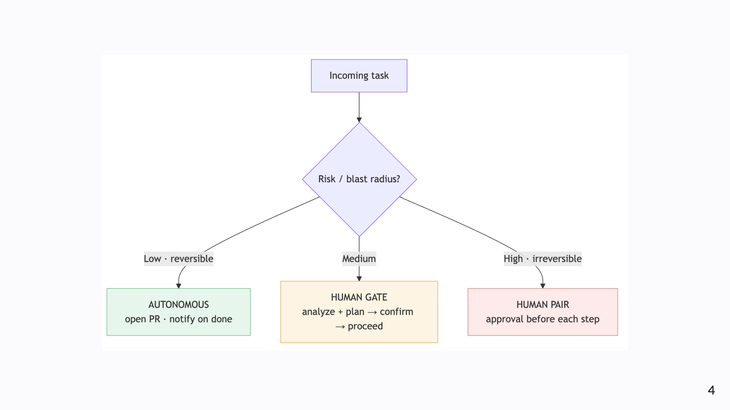
Notes:
Diagram A — the spectrum. Green: low + reversible runs autonomously. Amber: medium hits a human gate. Red: high + irreversible gets a human pair. The traffic-light coloring does the talking.

Slide 5
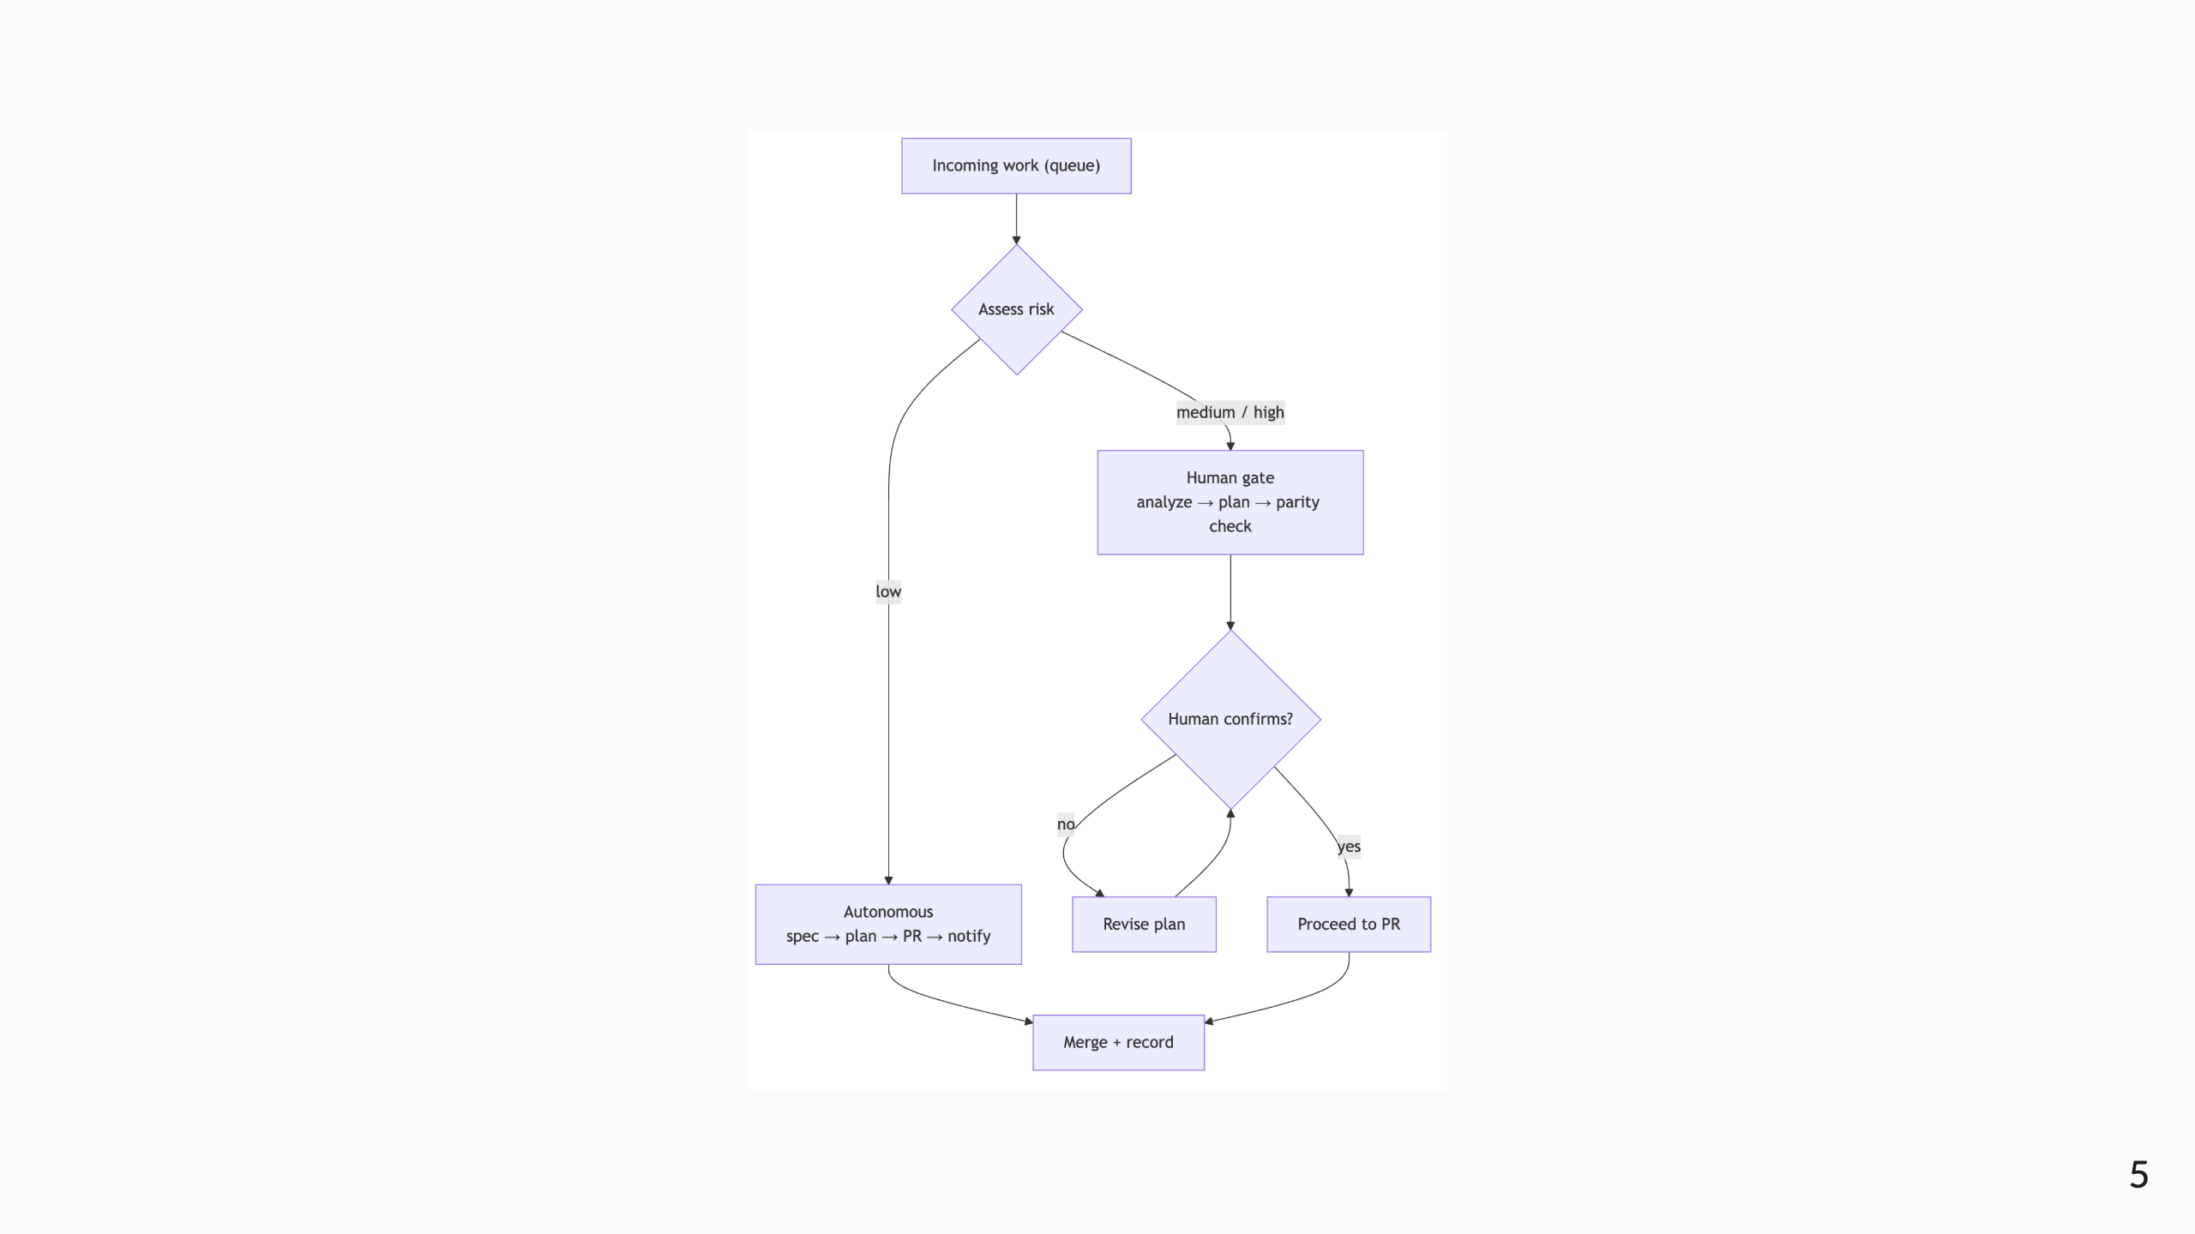
Notes:
Diagram B — routing in practice. Incoming work is risk-assessed, then low goes spec→plan→PR→notify, while medium/high goes analyze→plan→human-confirm before proceeding.

Slide 6
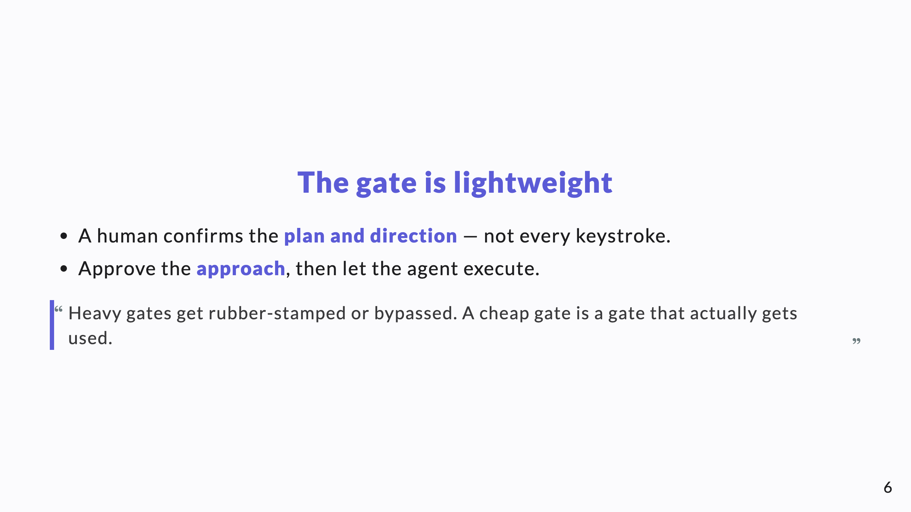
Notes:
The failure mode of gating is making it so heavy people route around it. Confirm direction, not detail.

Slide 7
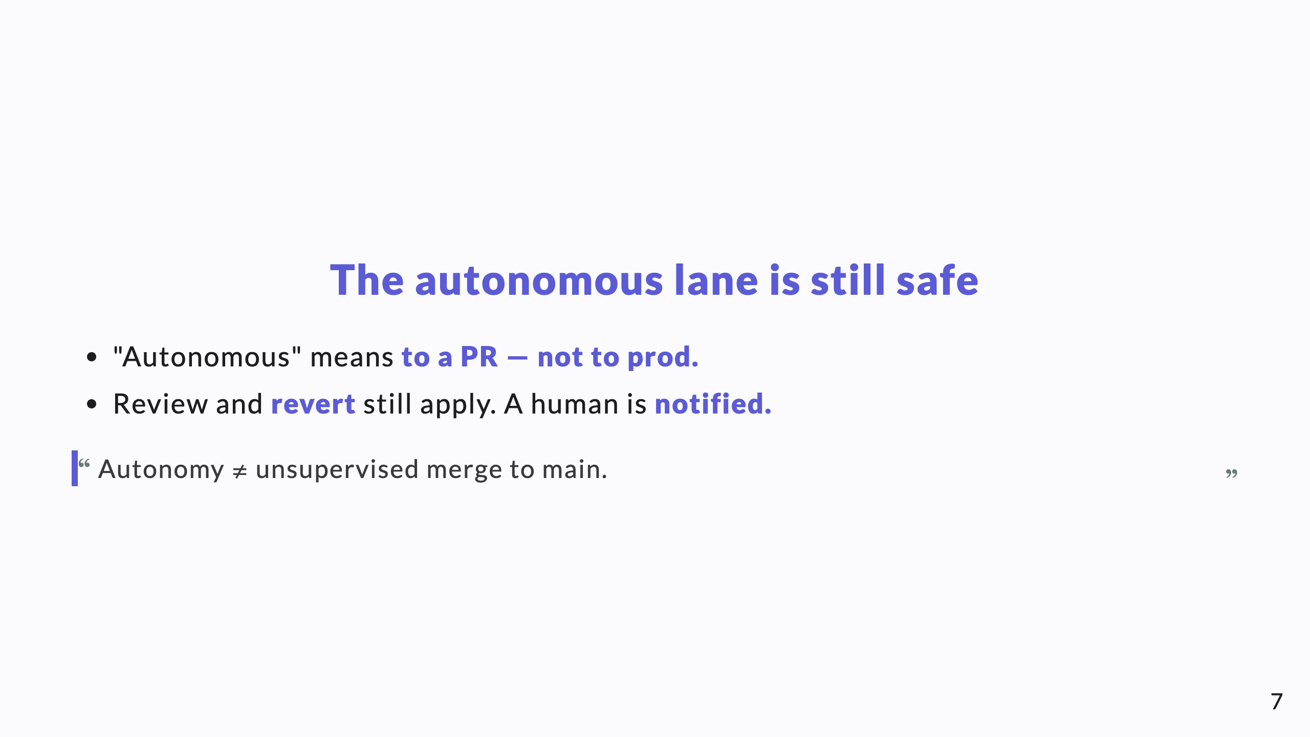
Notes:
This single clarification defuses most of the fear. Autonomous agents aren't pushing to production; they're opening pull requests like any engineer.

Slide 8
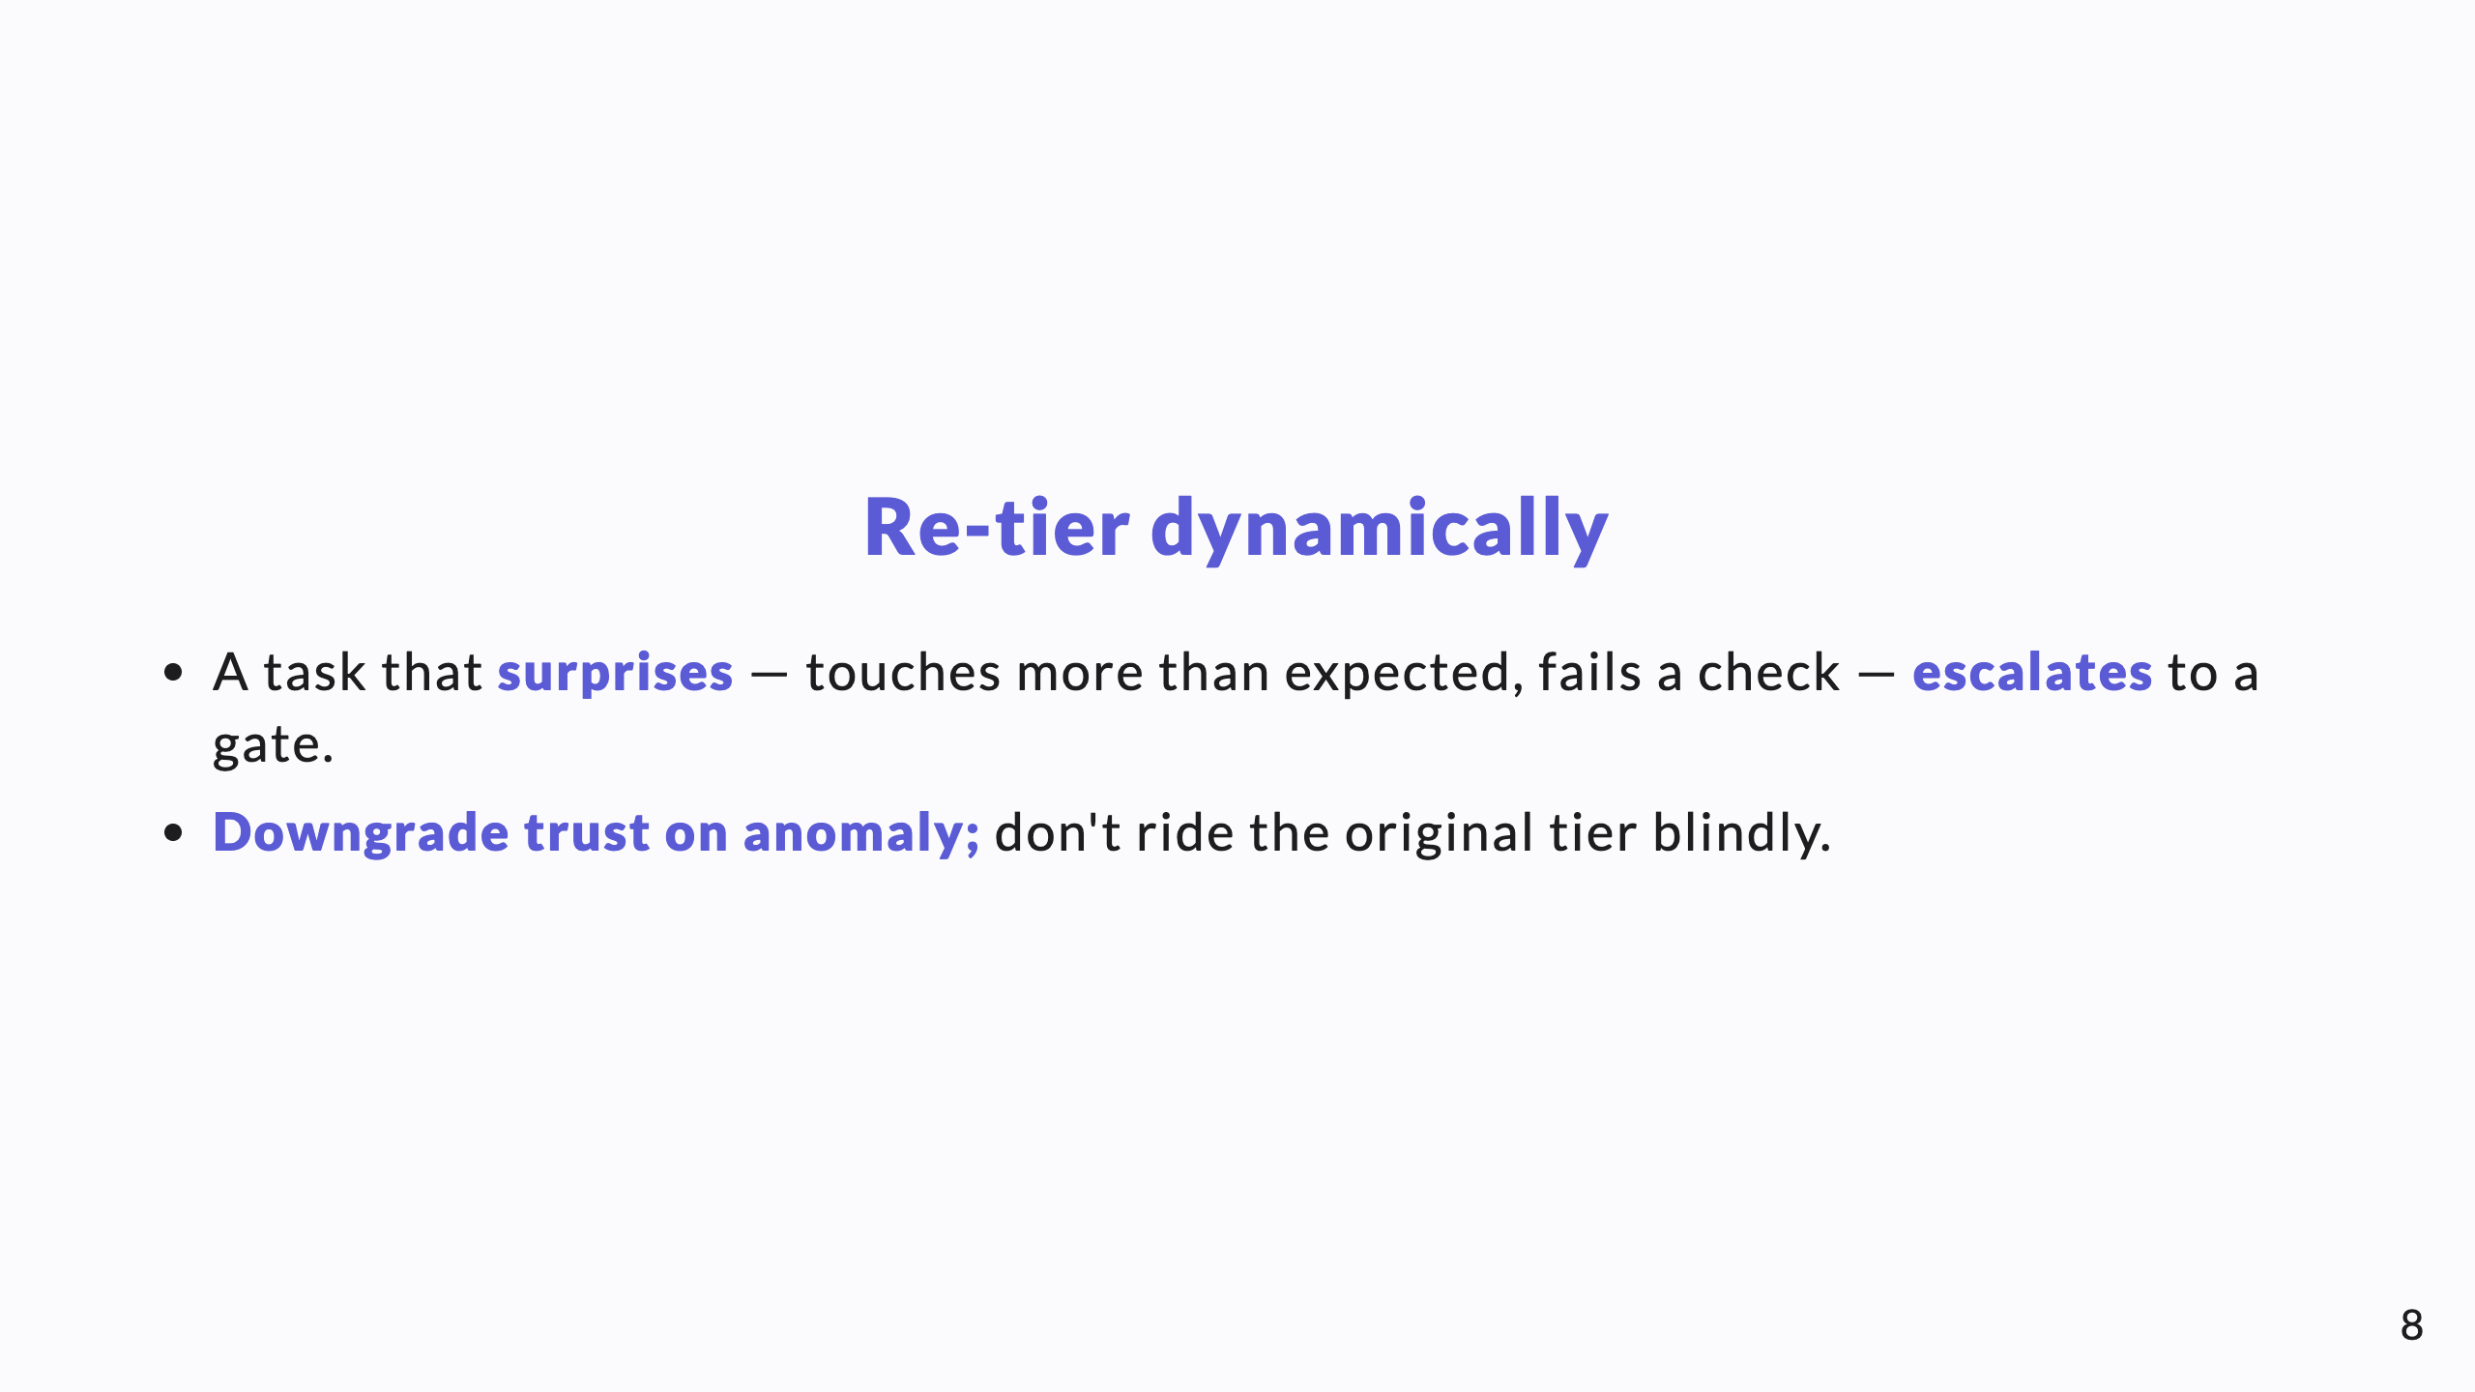
Notes:
Tiers are assigned up front but not frozen. The moment reality diverges from the estimate, the leash shortens automatically.

Slide 9
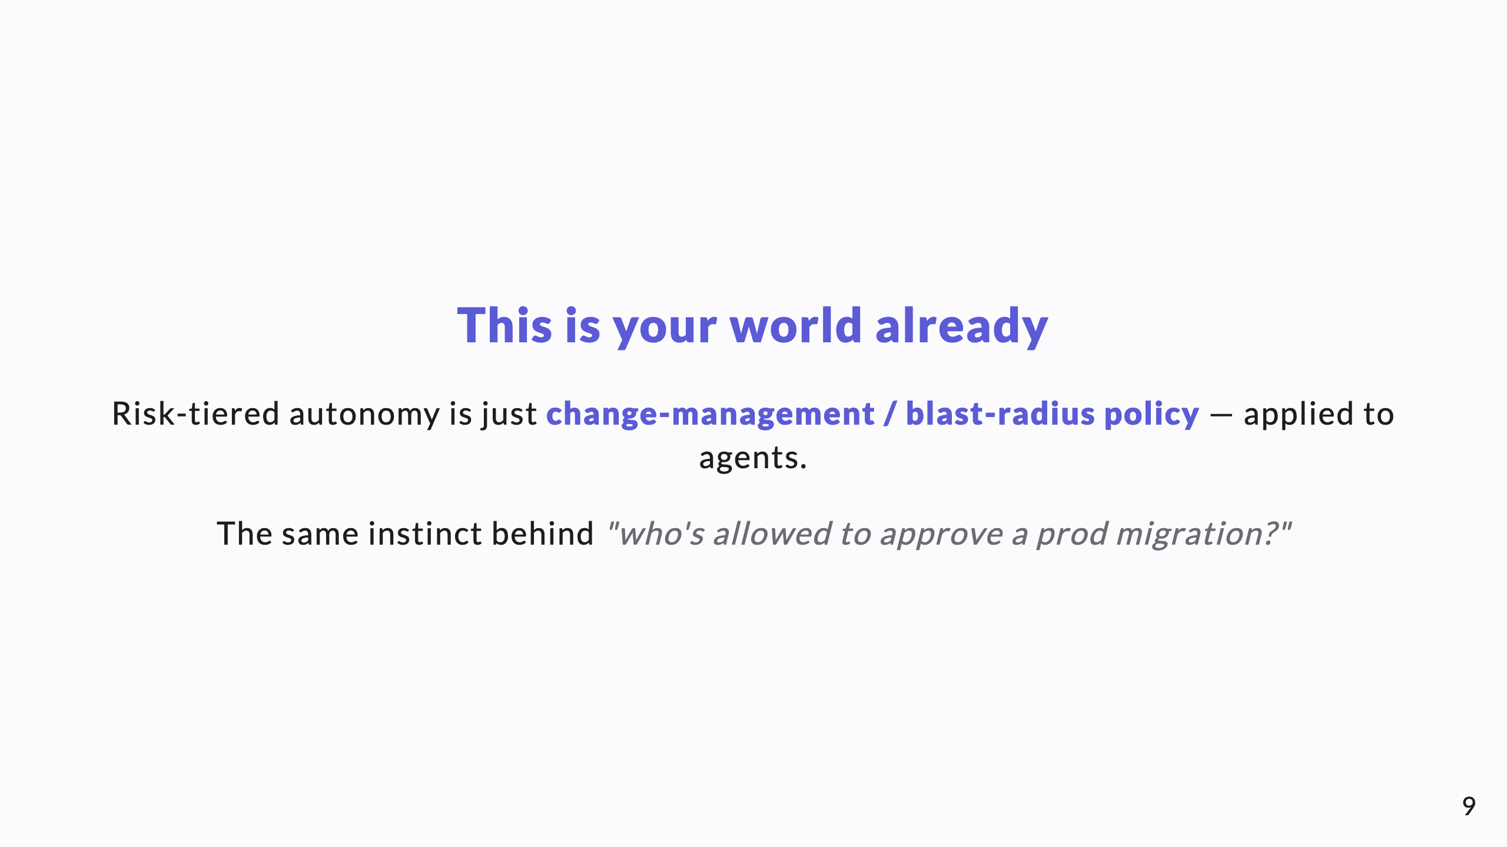
Notes:
Anchor it in something the CTO already does for humans. You're not inventing governance; you're extending it to a new kind of worker.

Slide 10
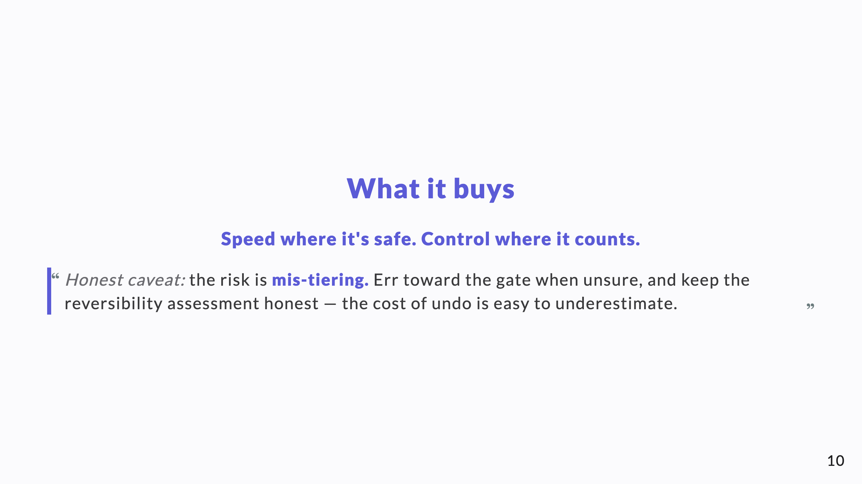
Notes:
Value, then the honest failure mode. Mis-tiering is the whole risk; conservatism on the reversibility call is the mitigation.

Slide 11
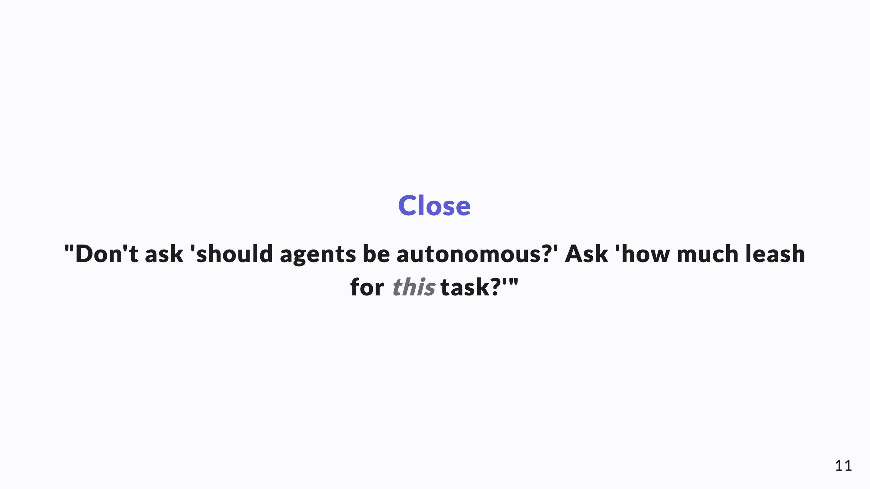
Notes:
The reframe, one more time, as the takeaway line.

