Slide 1
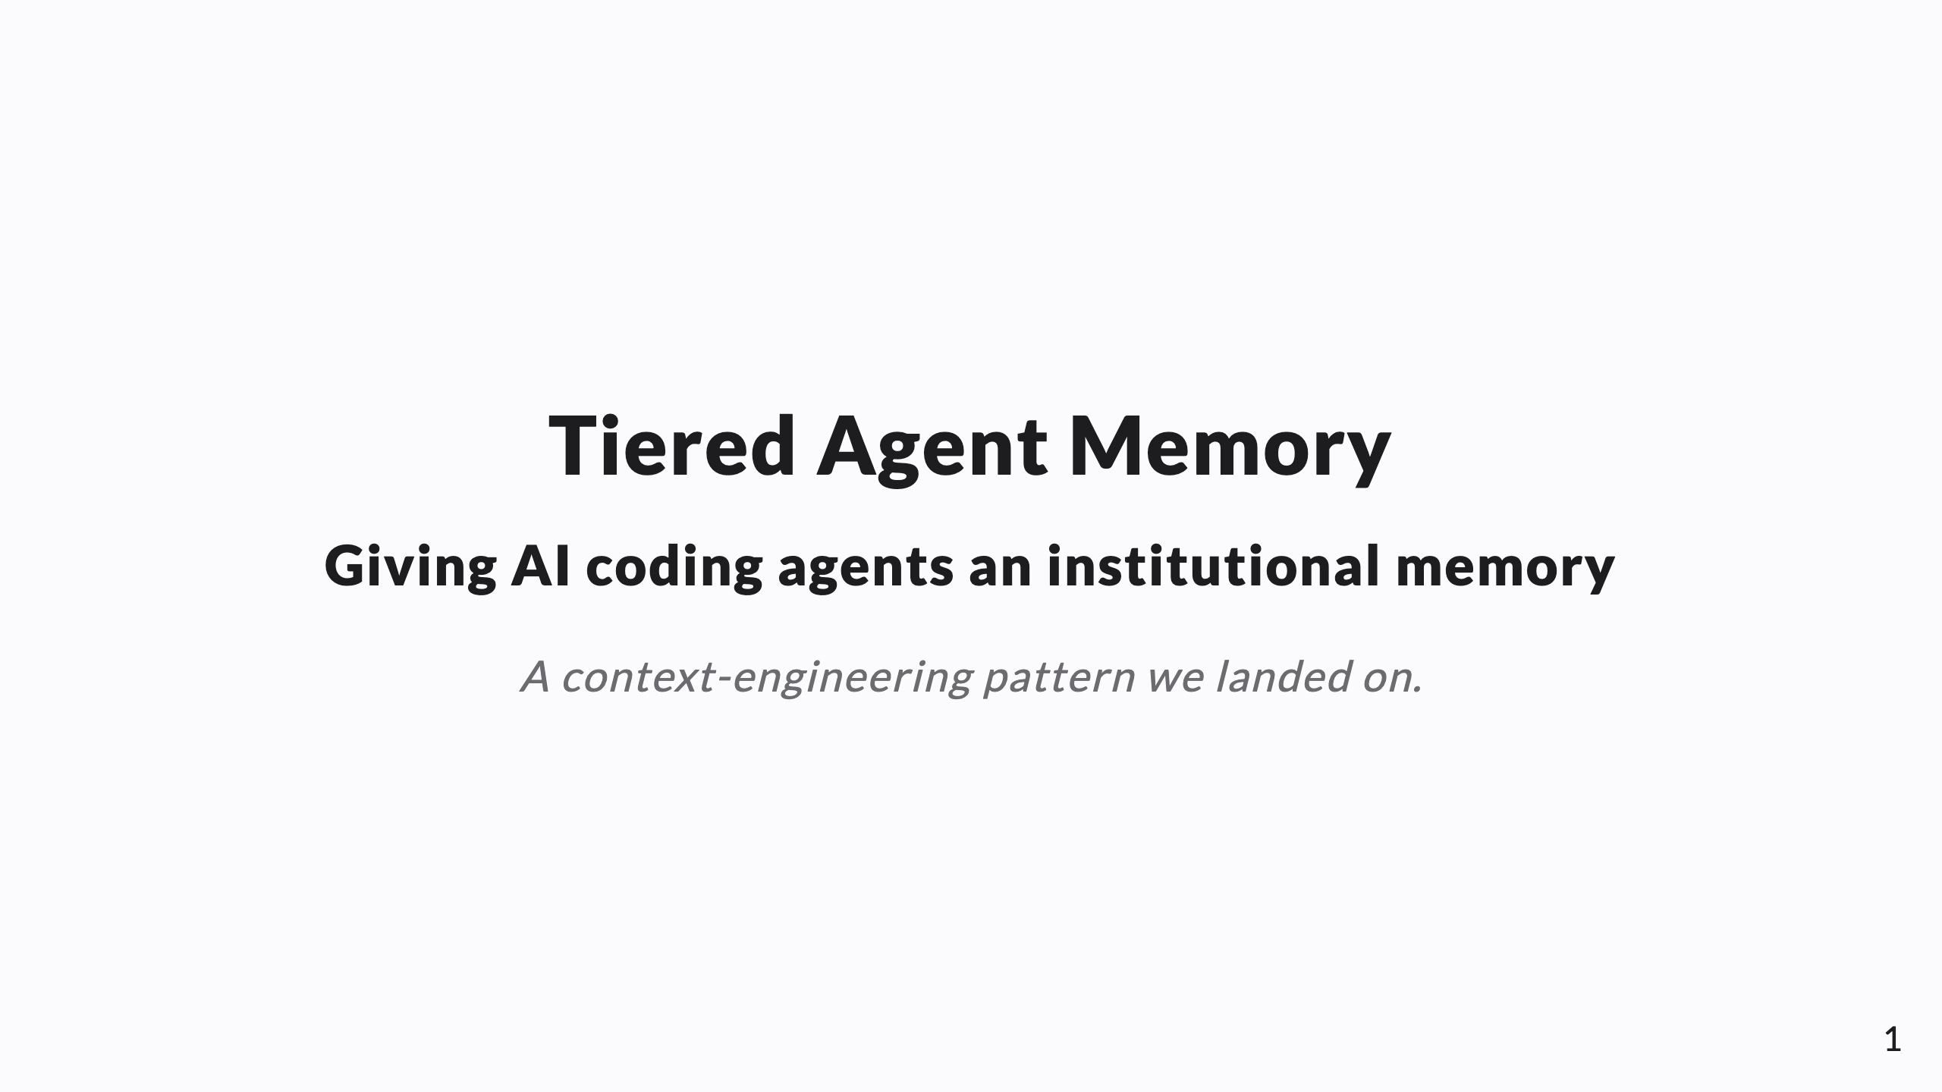
Notes:
SPEAKER NOTES live in these HTML comments and export into PPTX presenter notes. This deck is framed as a knowledge-share — "a pattern we landed on," not a pitch. Through-line: agents have amnesia + a finite, costly attention budget; tier memory like a CPU cache and curate it so it never rots.

Slide 2
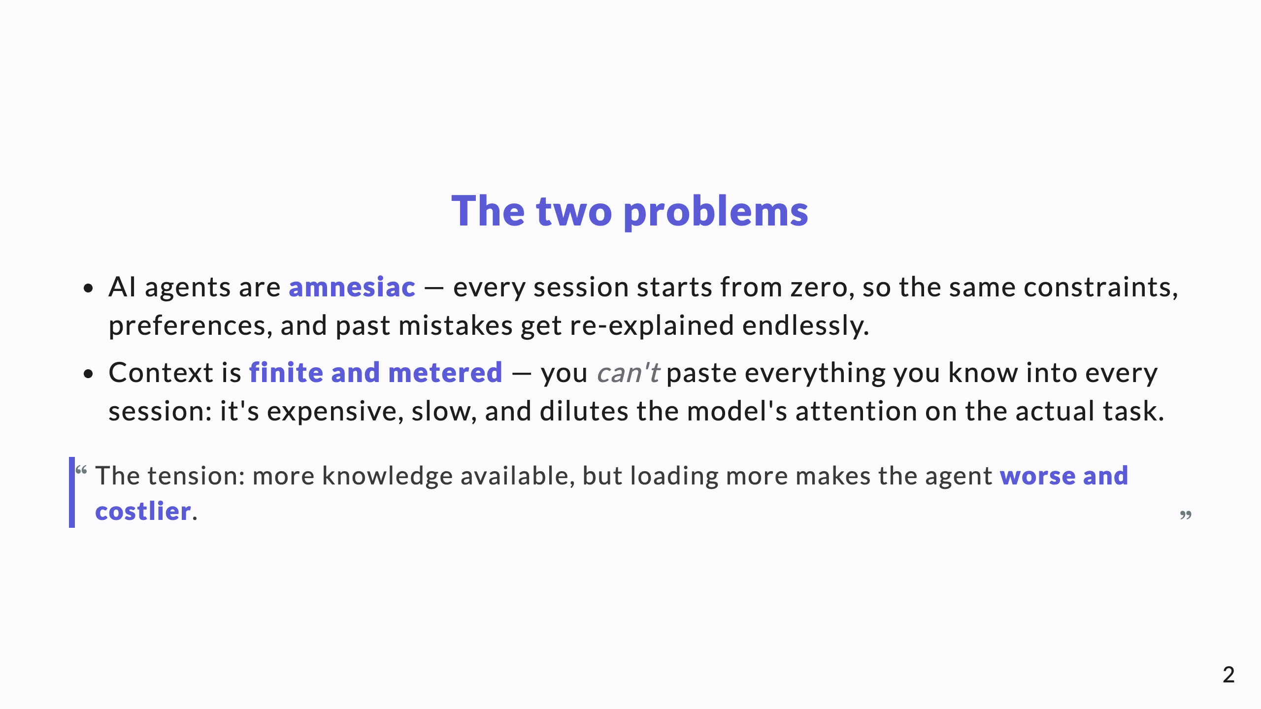
Notes:
Open on the tension, not the files. Every CTO feels this: AI tools that forget, and the cost/latency of stuffing context. Name both problems before any solution.

Slide 3
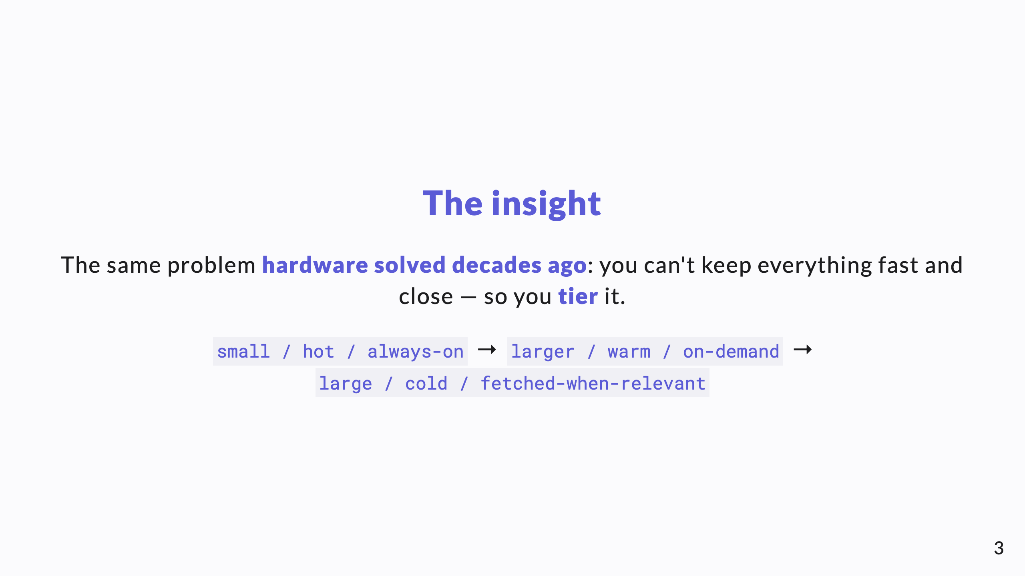
Notes:
Land the cache analogy here. It lets a technical leader assess soundness in seconds, and it carries the rest of the talk.

Slide 4
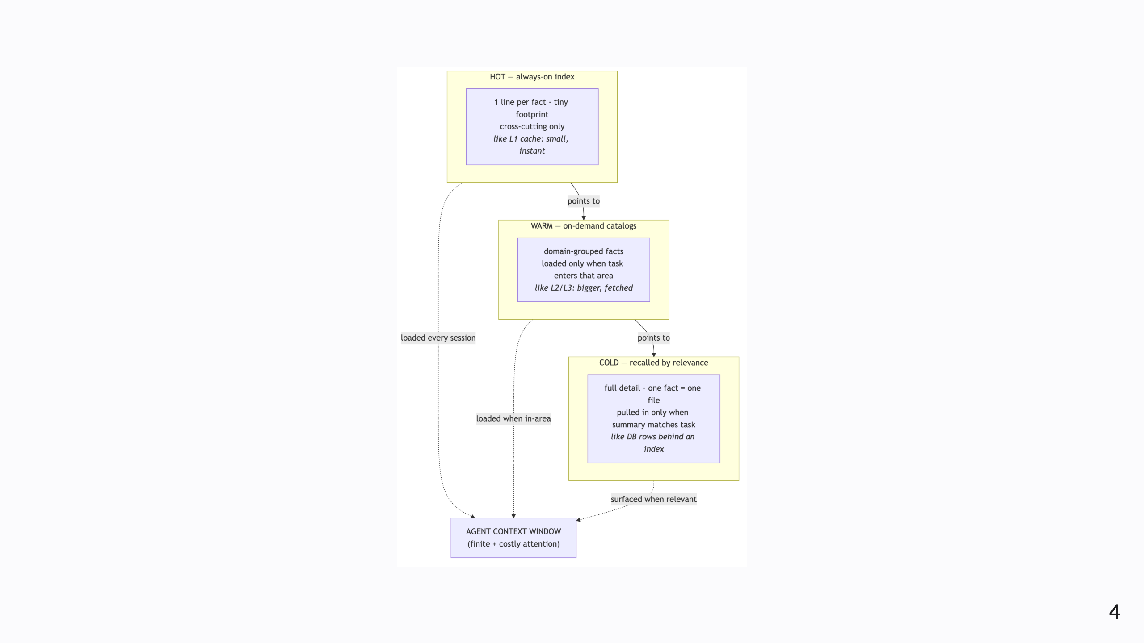
Notes:
Diagram A — the memory hierarchy. Walk top to bottom: the HOT index is loaded every session and is tiny; WARM catalogs load only in-area; COLD facts surface only when their one-line summary matches the task. Only the relevant slice ever reaches the context window.

Slide 5
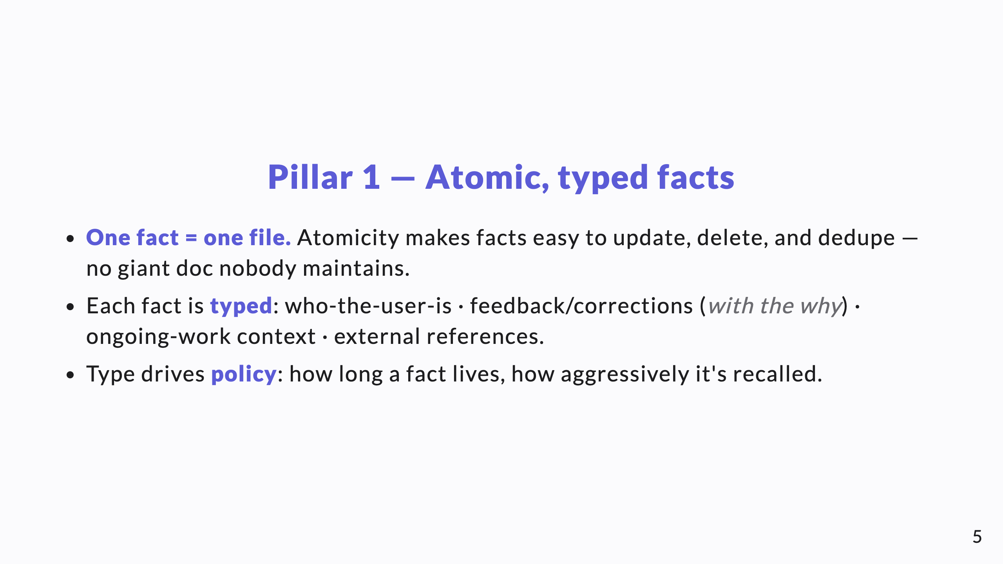
Notes:
The atomic unit is the whole trick for maintainability. Typing is what lets recall and retention be policy-driven instead of one undifferentiated blob.

Slide 6
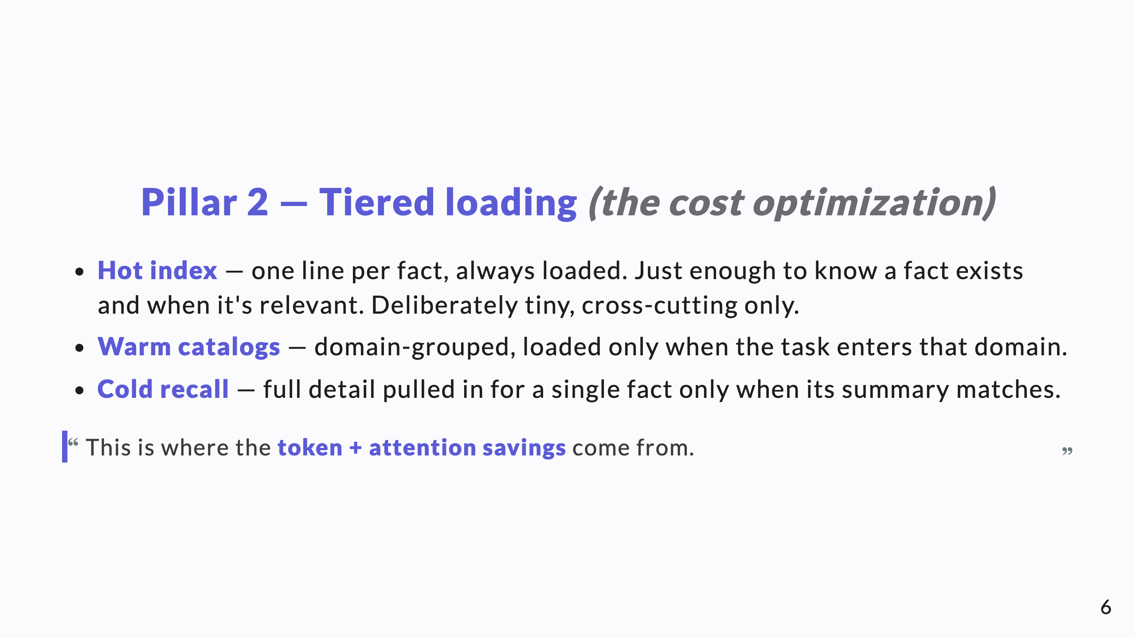
Notes:
This is the slide that answers "why not just load everything?" The always-on footprint stays flat as the knowledge base grows. Cost scales with relevance, not with size.

Slide 7
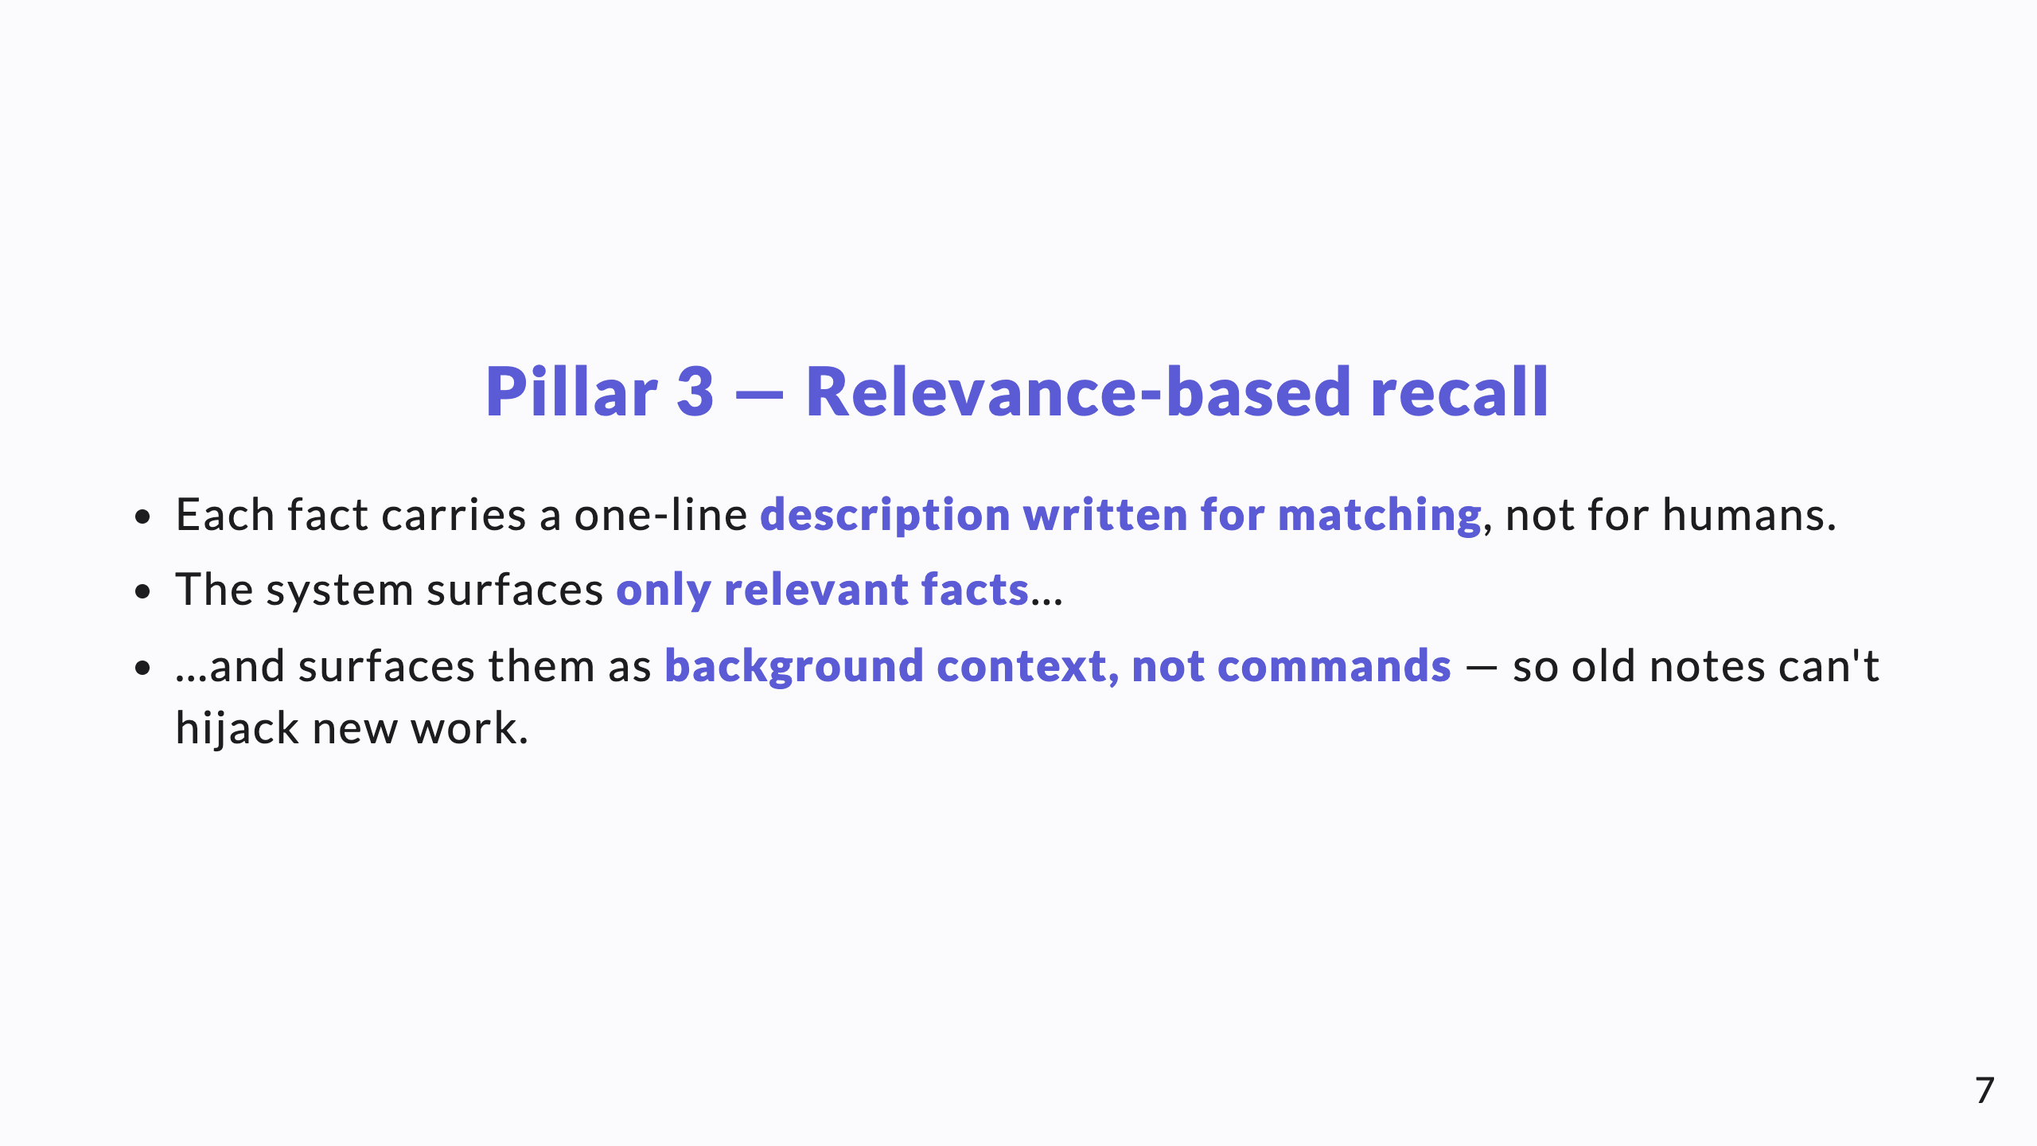
Notes:
The "context not commands" detail matters: a recalled fact informs, it doesn't override the current task. That's what keeps a growing memory from causing drift.

Slide 8
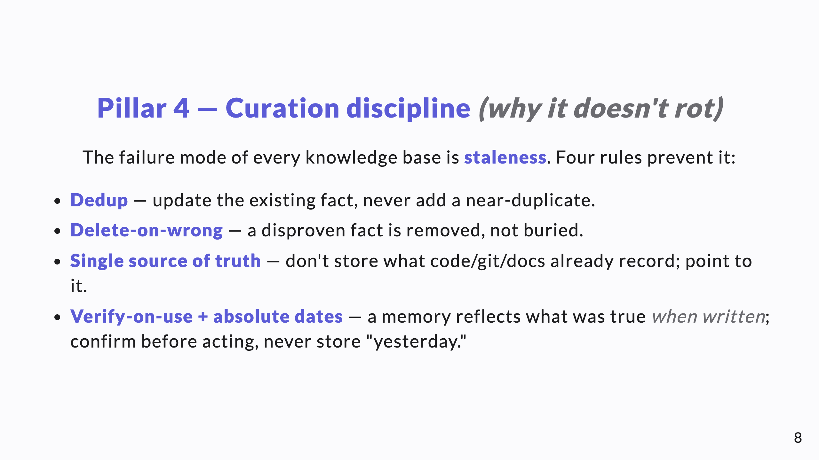
Notes:
Be honest here: this discipline is ongoing work. That candor is what makes a knowledge-share credible. The rules are the product — the files are just where they're written down.

Slide 9
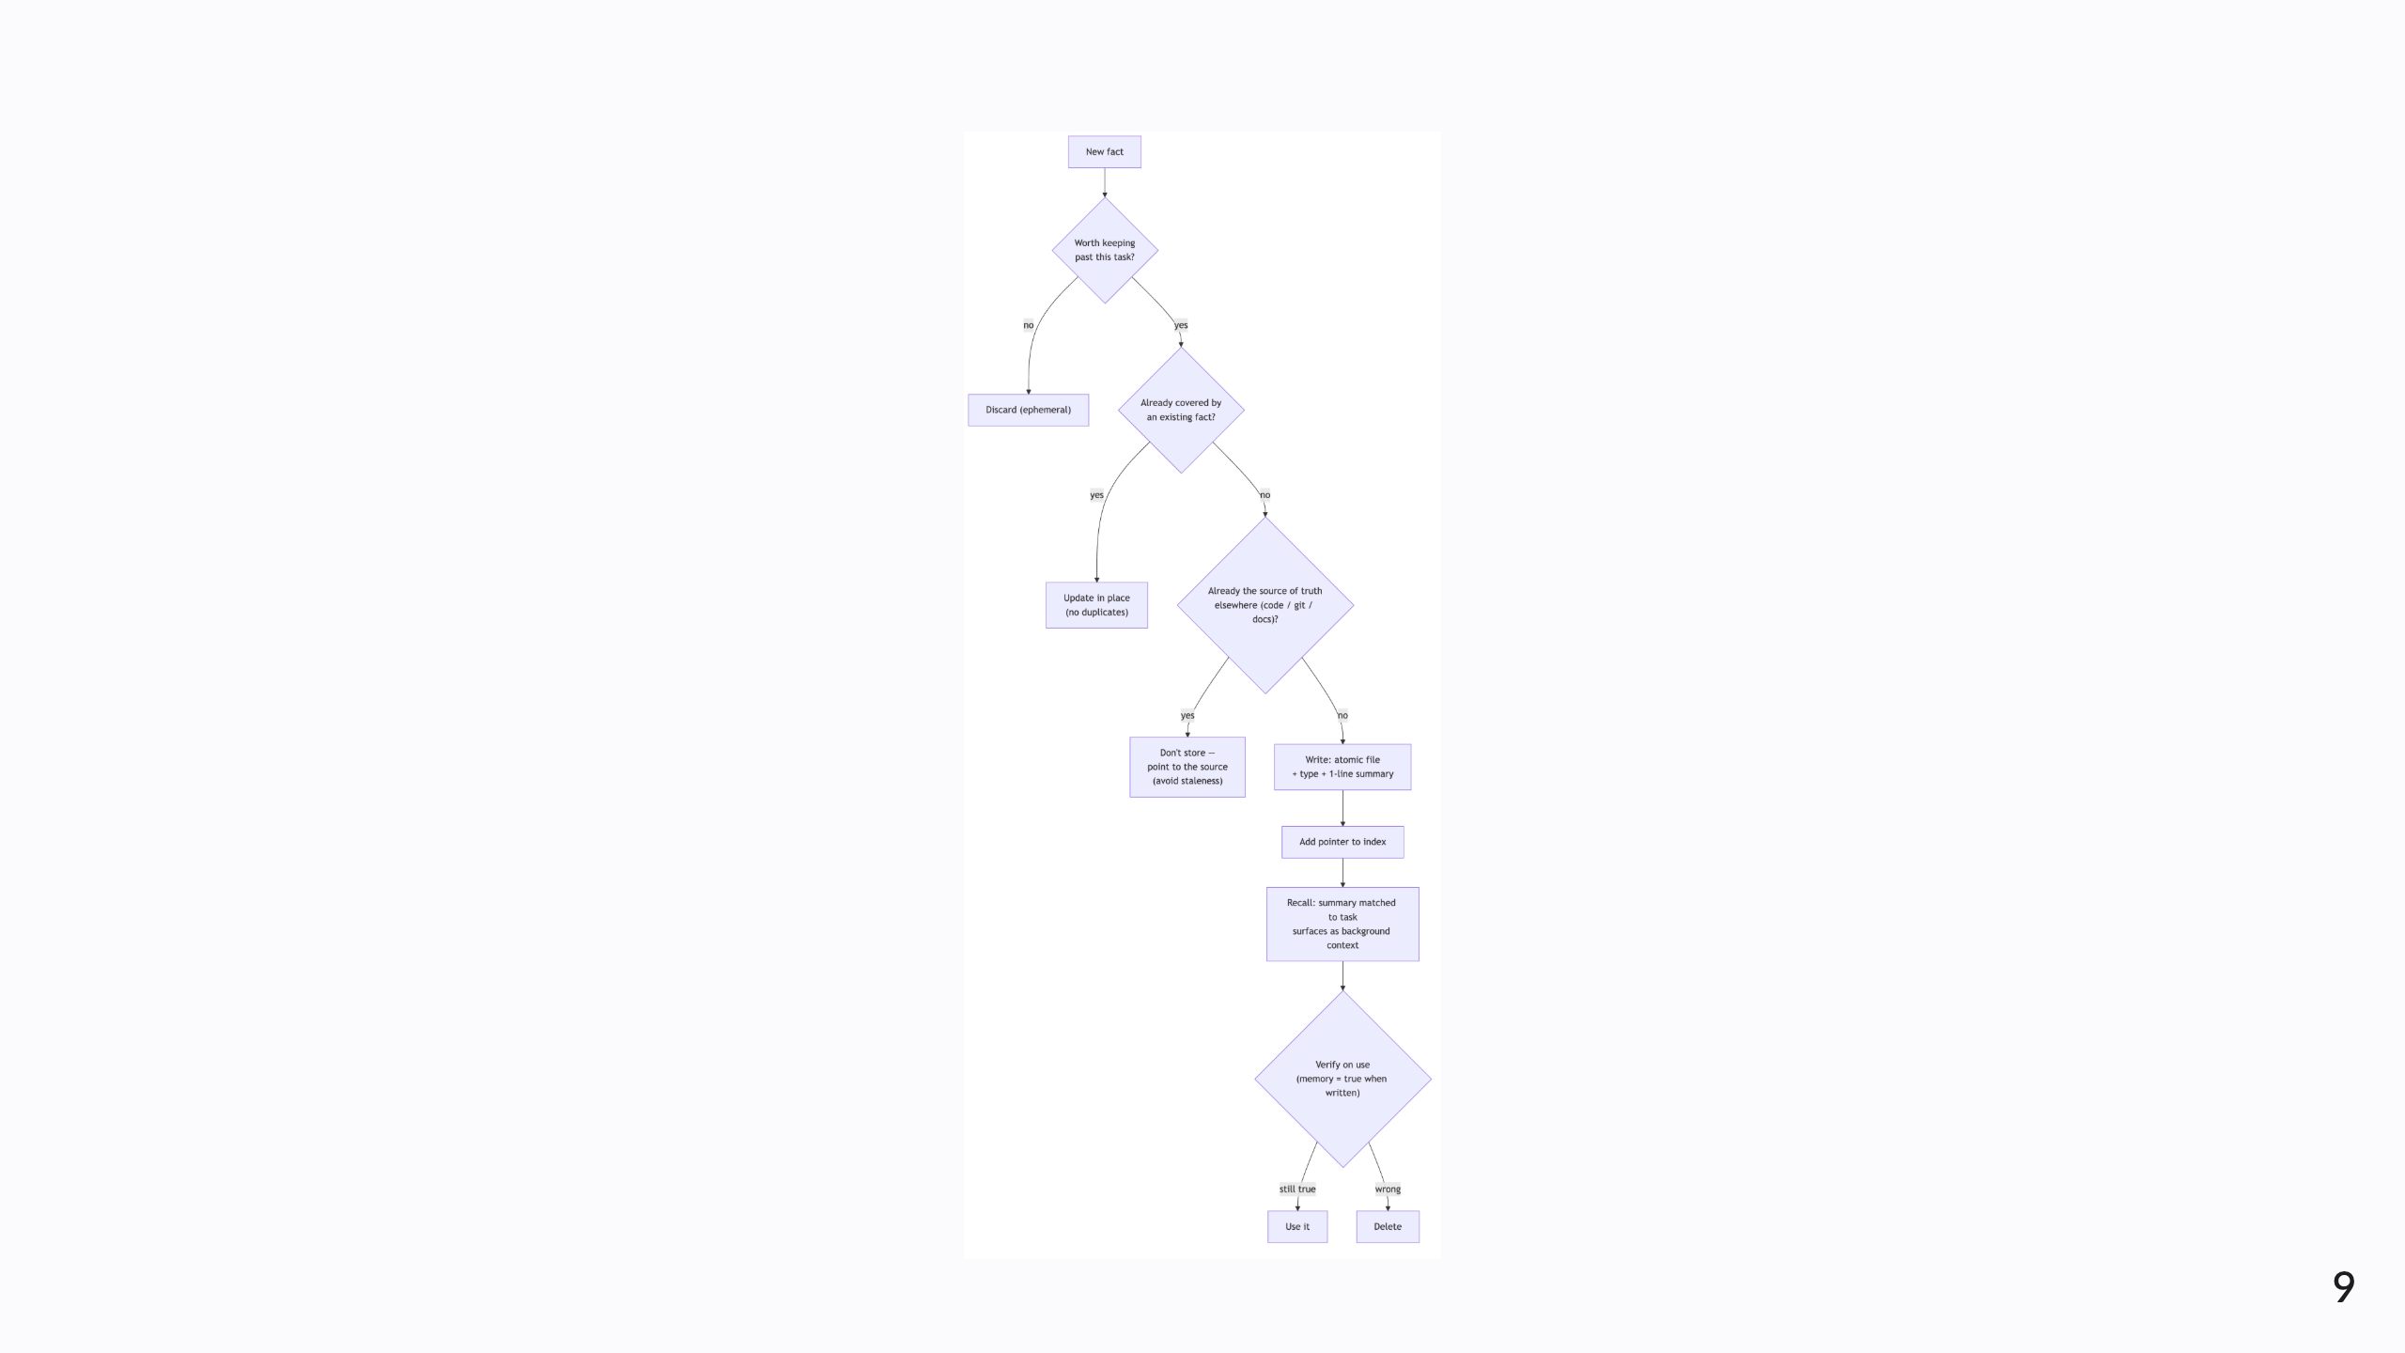
Notes:
Diagram B — the fact lifecycle. Note the three gates before anything is written (worth-keeping? already-covered? already-a-source-of-truth?) and the verify-on-use gate that ends in either "use it" or "delete." This flow is the curation discipline made concrete.

Slide 10
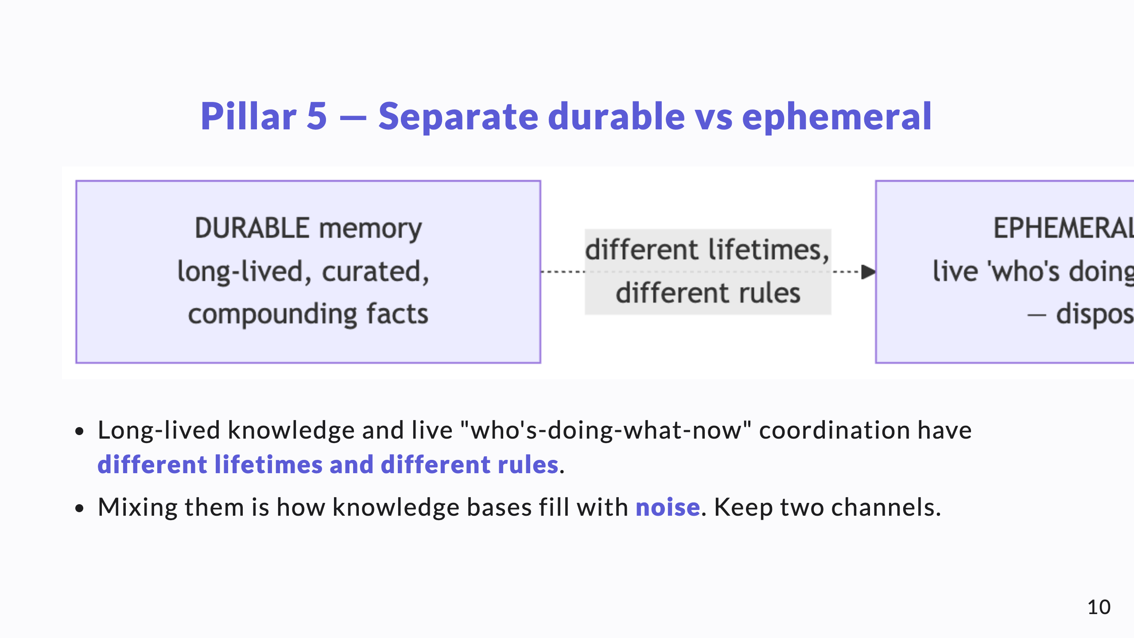
Notes:
Durable memory is curated and compounding; the ephemeral board is disposable live state. Keeping them apart is what keeps the durable store clean.

Slide 11
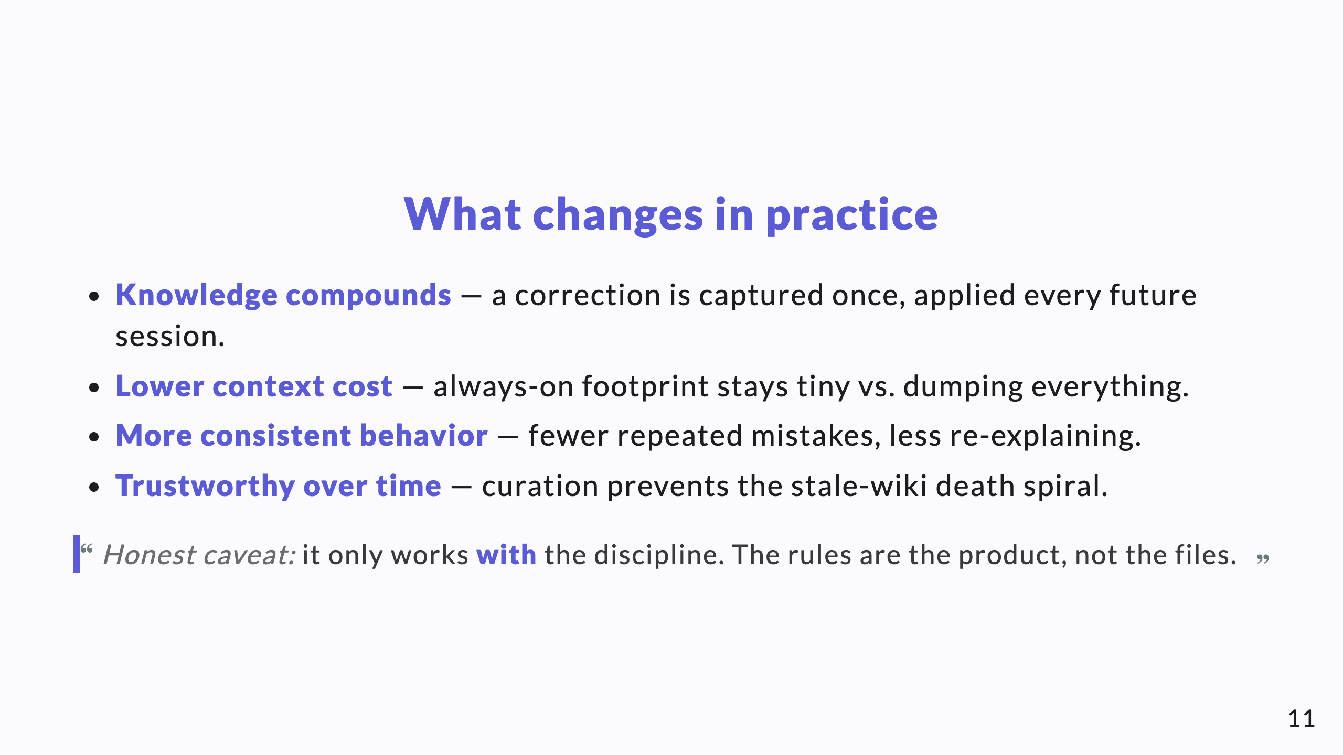
Notes:
Outcomes, stated plainly and honestly. Resist over-claiming — the caveat earns trust.

Slide 12
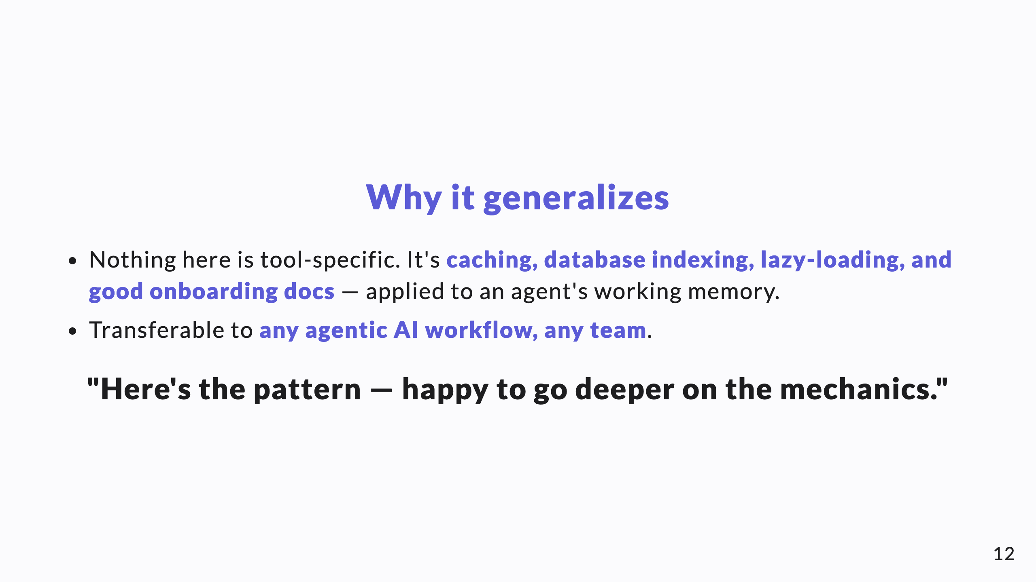
Notes:
Close open, no ask. Knowledge-share goal: leave them with the mental model and an offer, not a decision to make.

