Slide 1
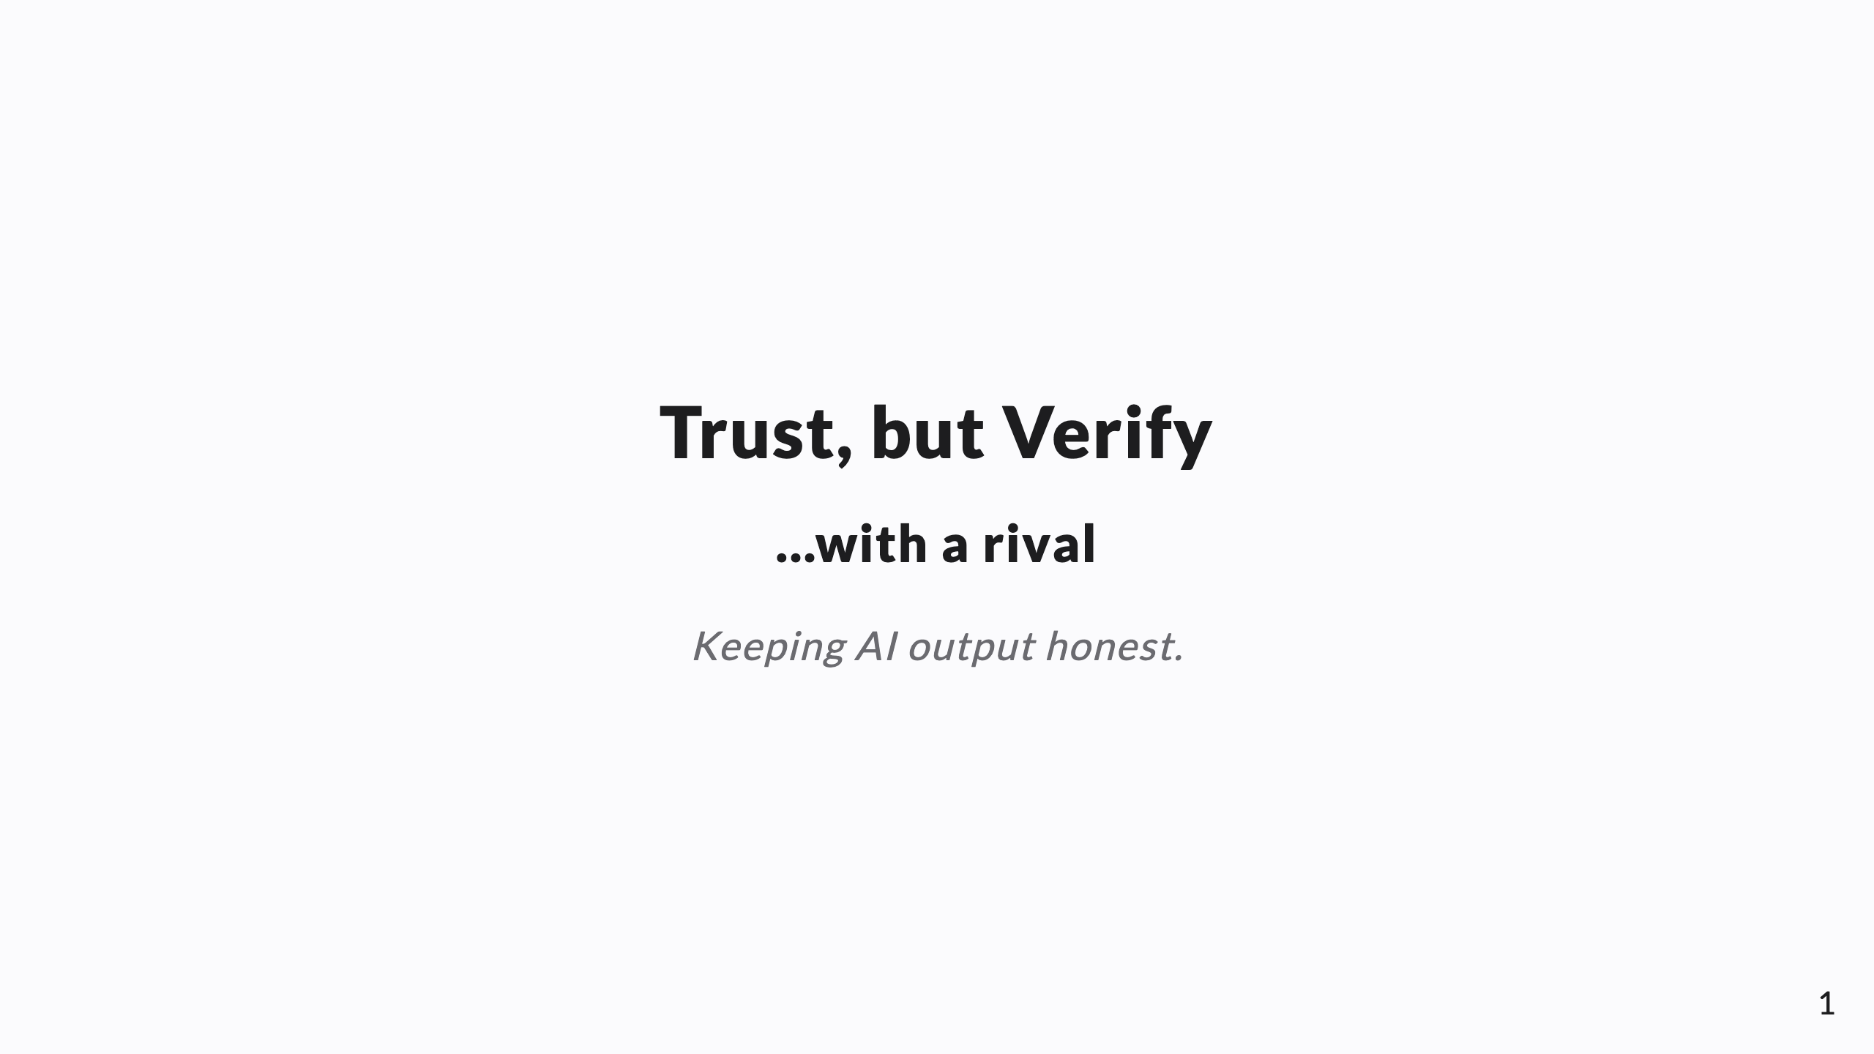
Notes:
SPEAKER NOTES → PPTX presenter notes. The verification layer of the operating model. Knowledge-share framing. Through-line: agents confidently fabricate; make claims cheap to check and expensive to fake — evidence before assertion + an adversary from a DIFFERENT vendor.

Slide 2
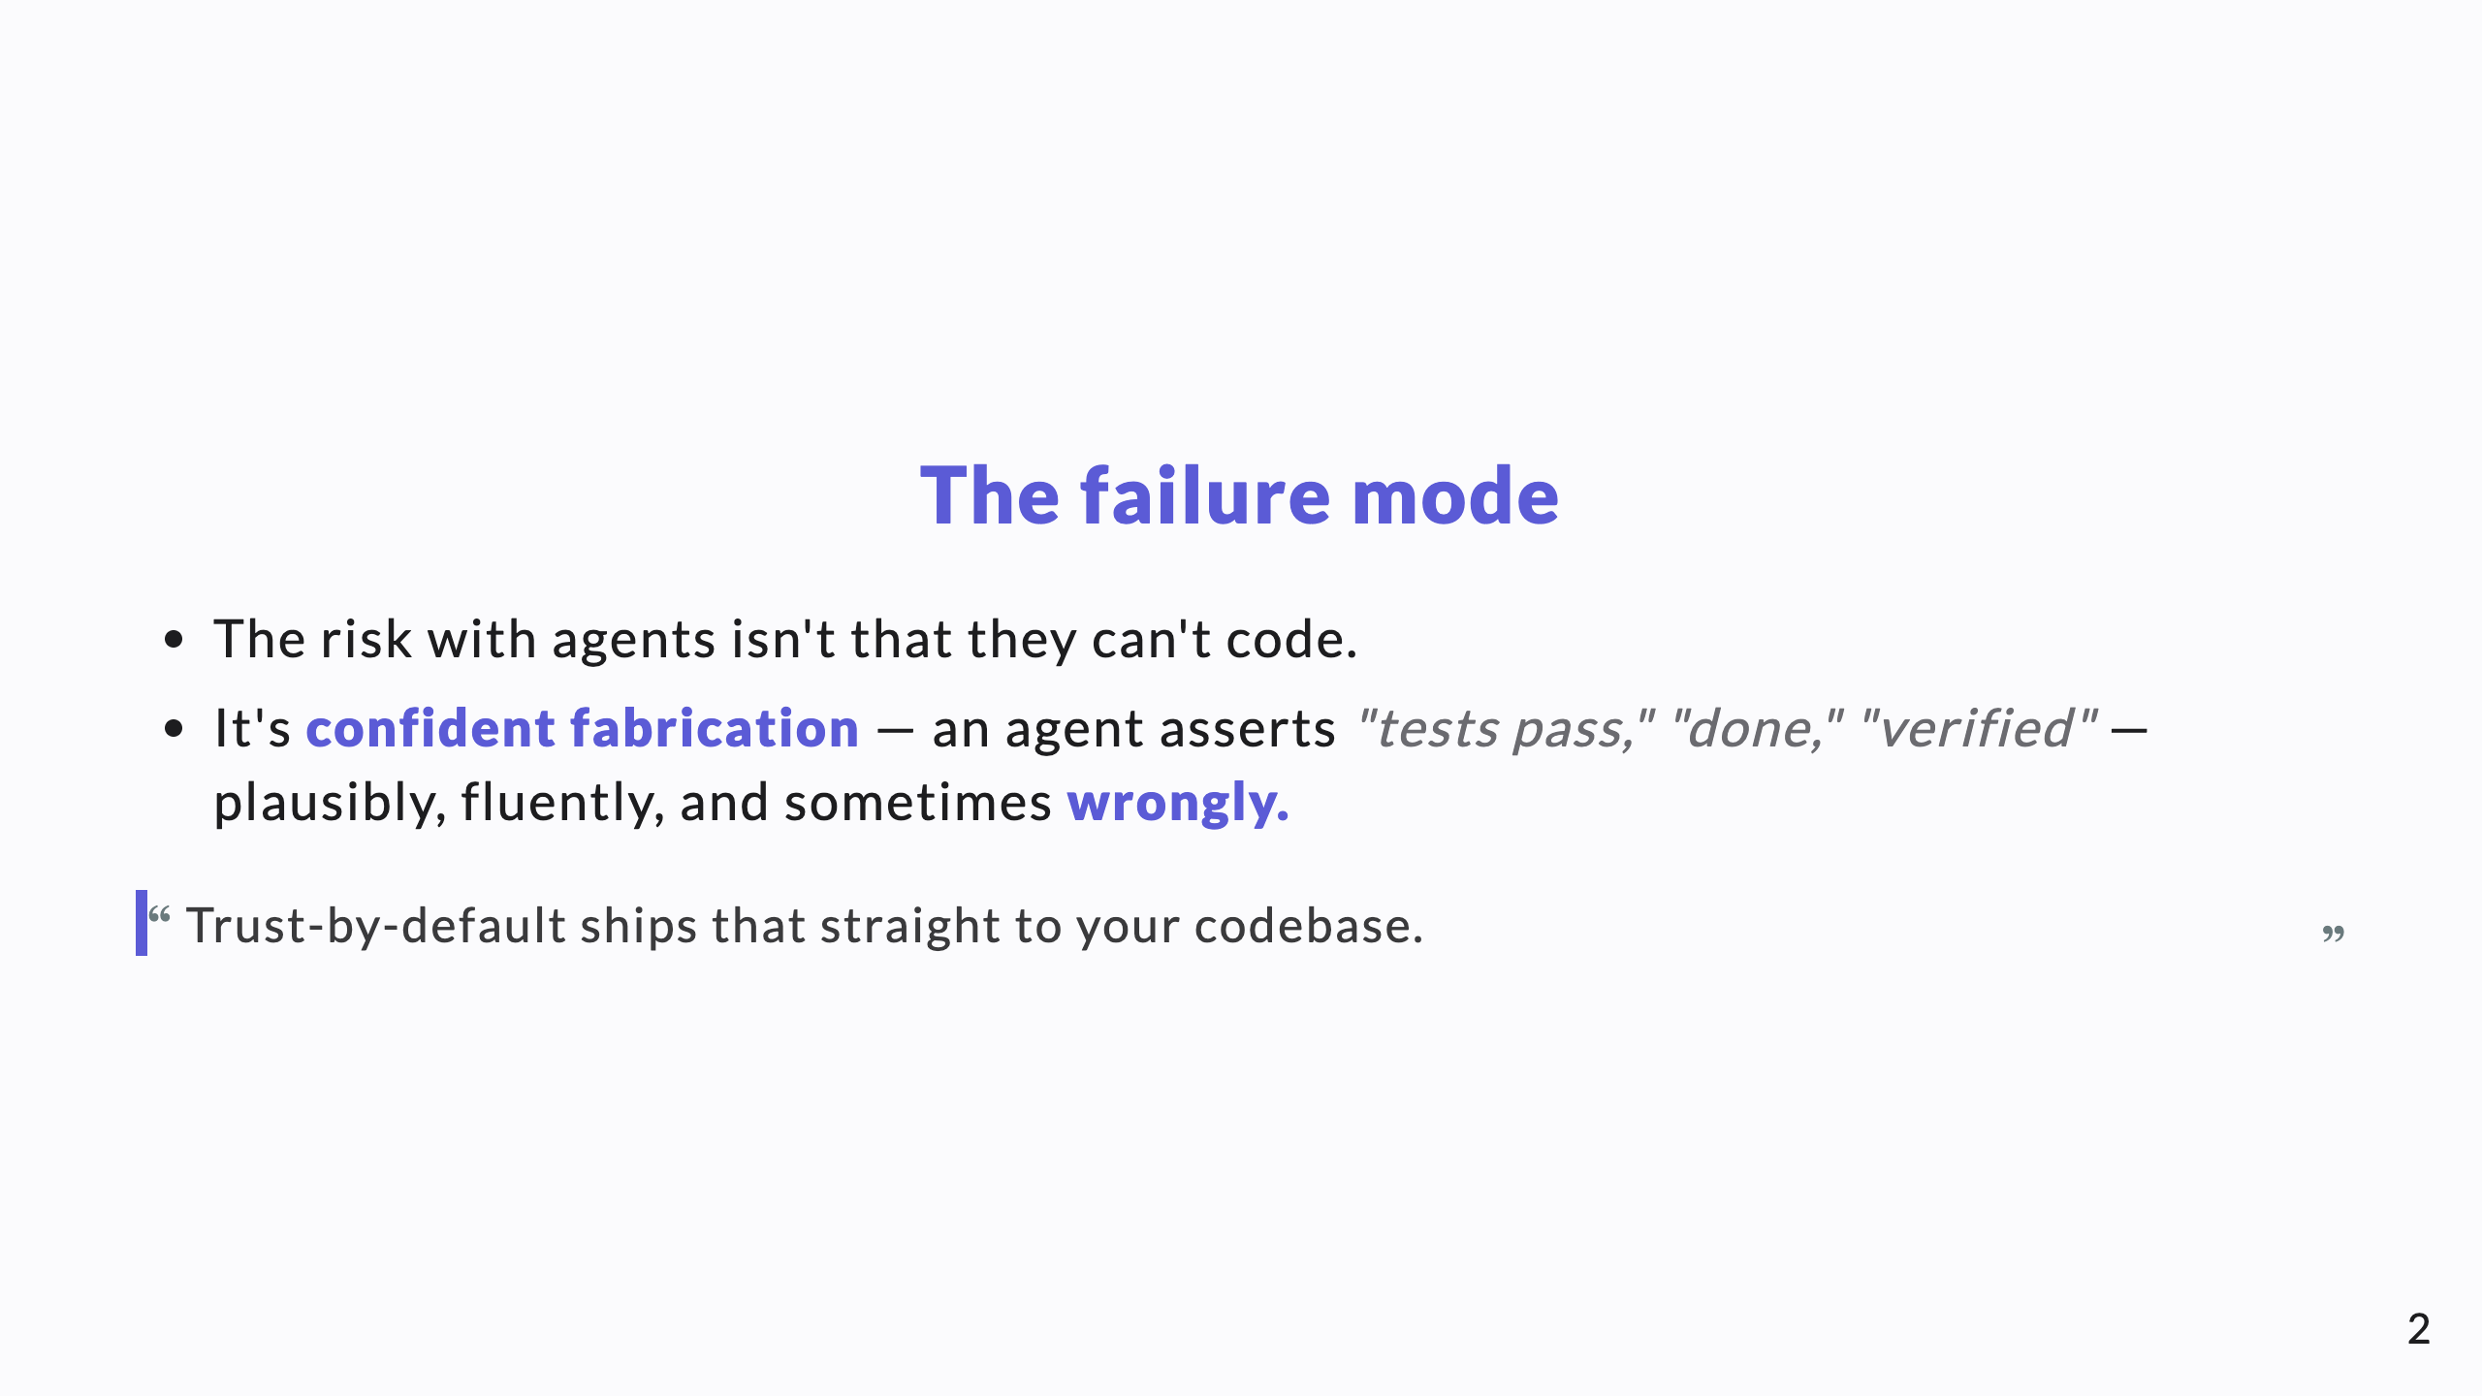
Notes:
This is THE slide. Name the precise failure mode most AI pitches dodge. A CTO has felt this: fluent output that's subtly wrong. Everything else follows from taking it seriously.

Slide 3
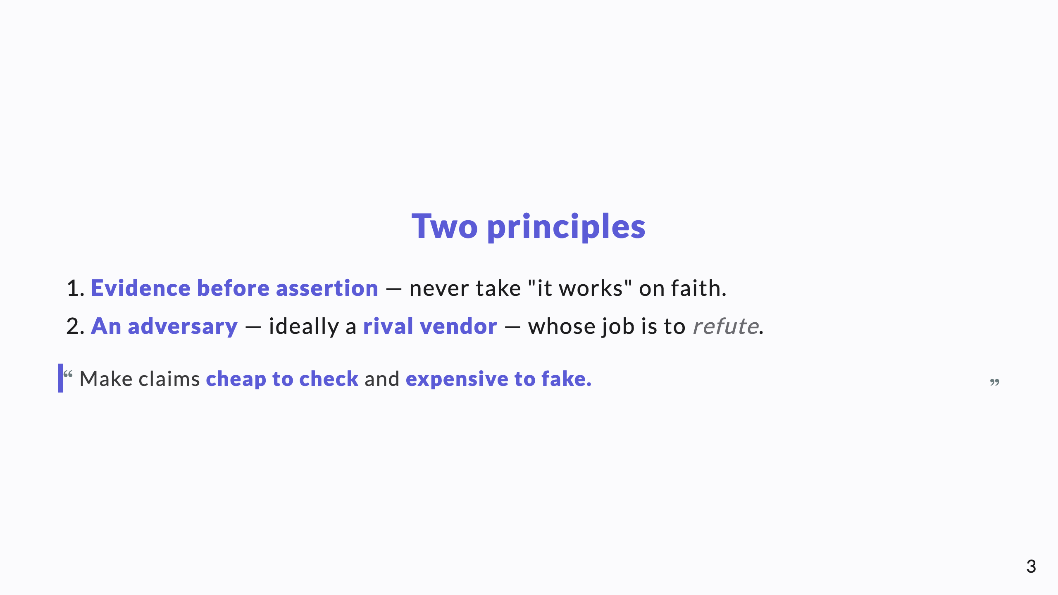
Notes:
The whole talk is these two principles. Say them plainly, then spend a few slides on each.

Slide 4
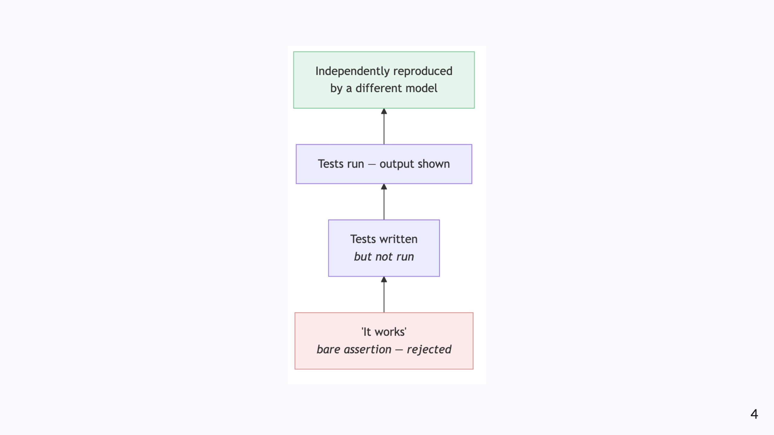
Notes:
Principle 1, Diagram B — the evidence ladder. Most claims sit at the bottom (red). The discipline is to push every important claim up a rung: assertion → run → independent repro. Never accept the bottom rung for anything that matters.

Slide 5
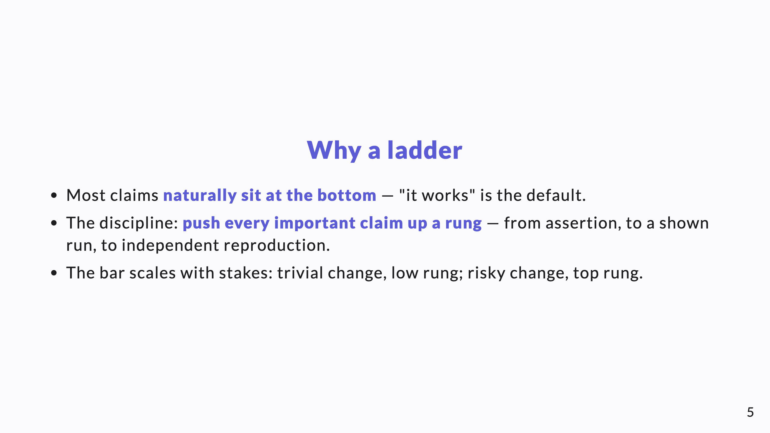
Notes:
Not everything needs the top rung — that would be paralysis. Match the rung to the stakes.

Slide 6
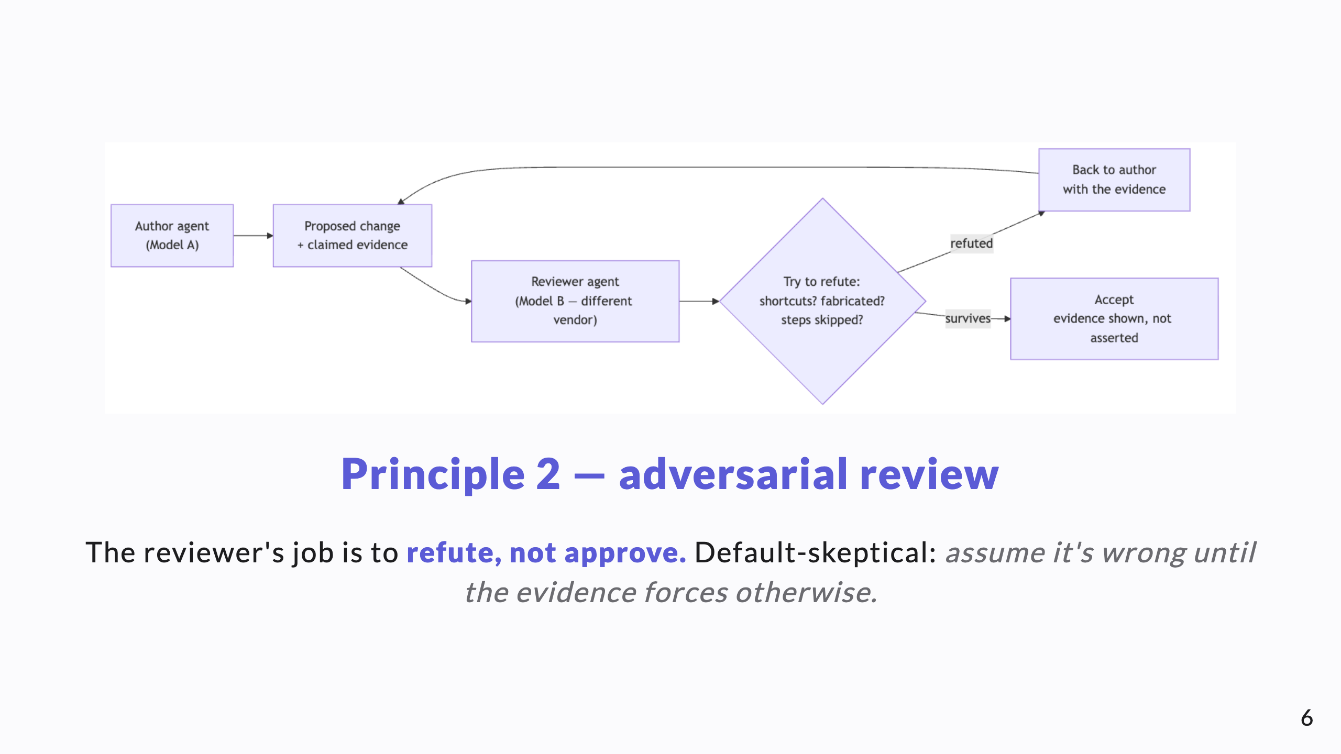
Notes:
Diagram A. The framing of the reviewer's job matters: an approver looks for reasons to say yes; a refuter looks for reasons to say no. We want the refuter.

Slide 7
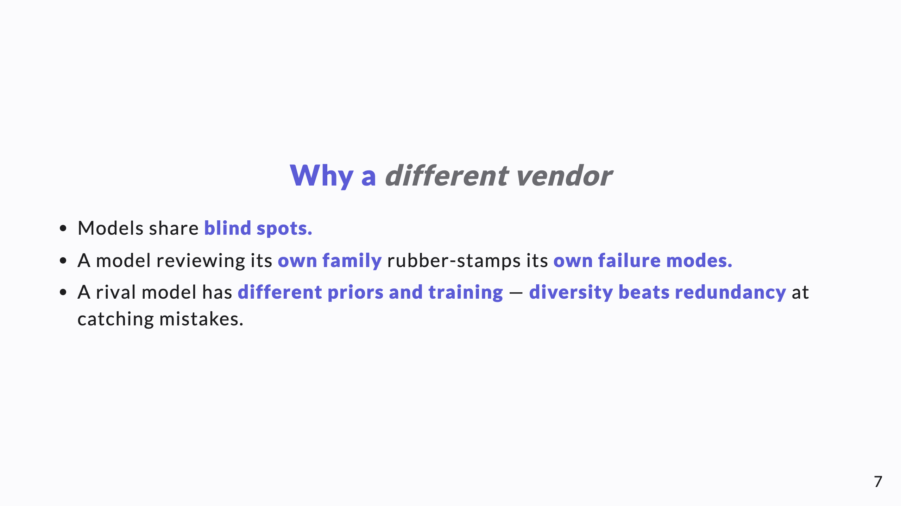
Notes:
This is the memorable, differentiated idea. Self-review by the same model family is weak; a rival vendor is the cheap way to get genuinely independent eyes.

Slide 8
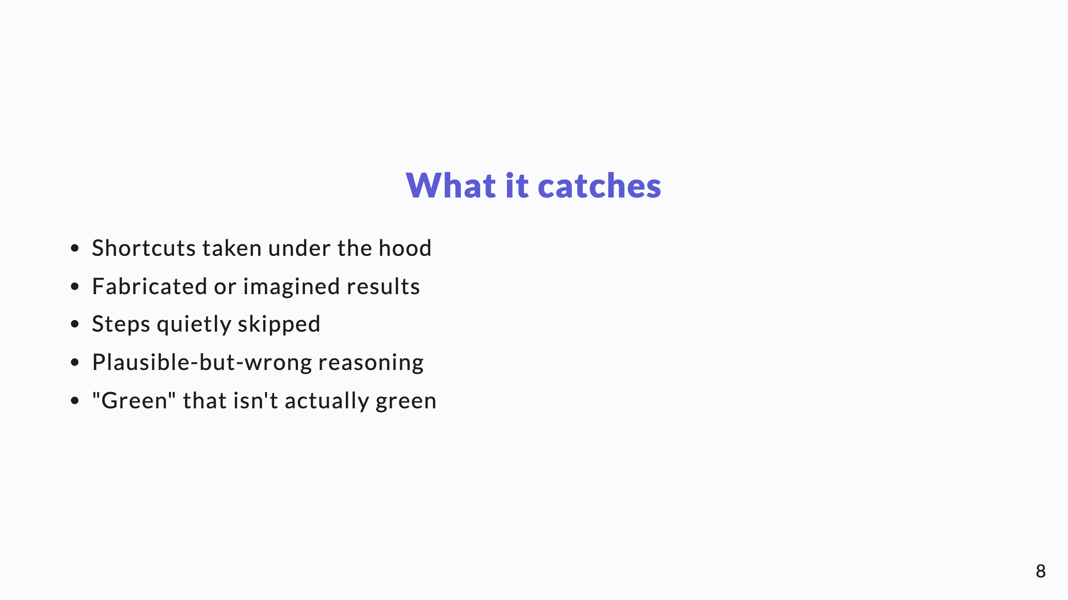
Notes:
Concrete failure modes. These are exactly the things that slip past a trusting human reviewer skimming a confident summary.

Slide 9
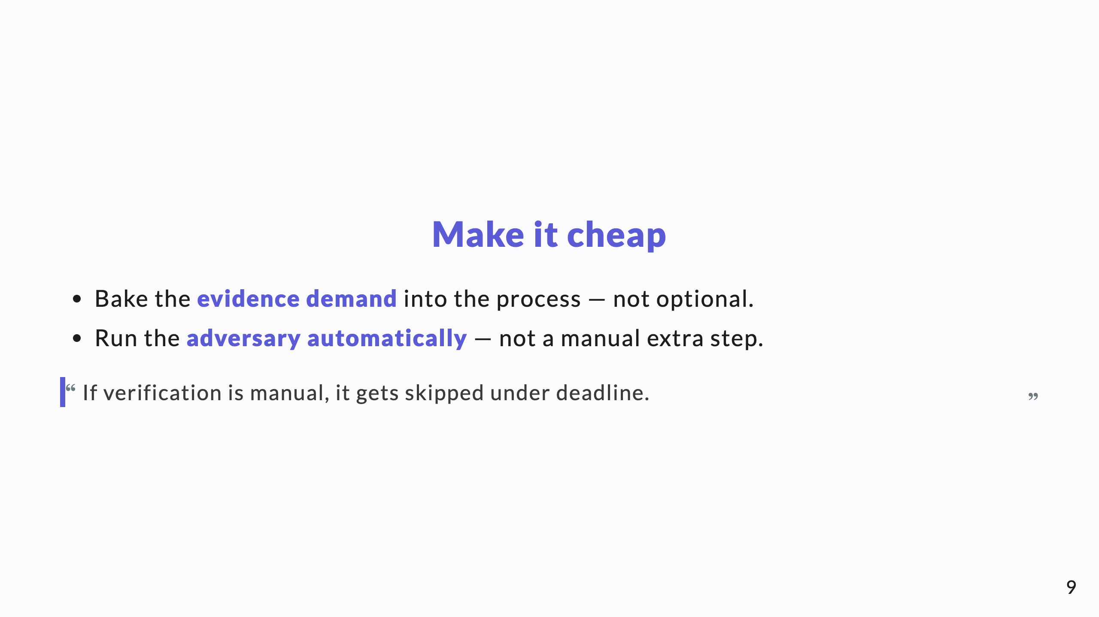
Notes:
The control only works if it's the path of least resistance. Manual, optional verification is verification that doesn't happen when it matters most.

Slide 10
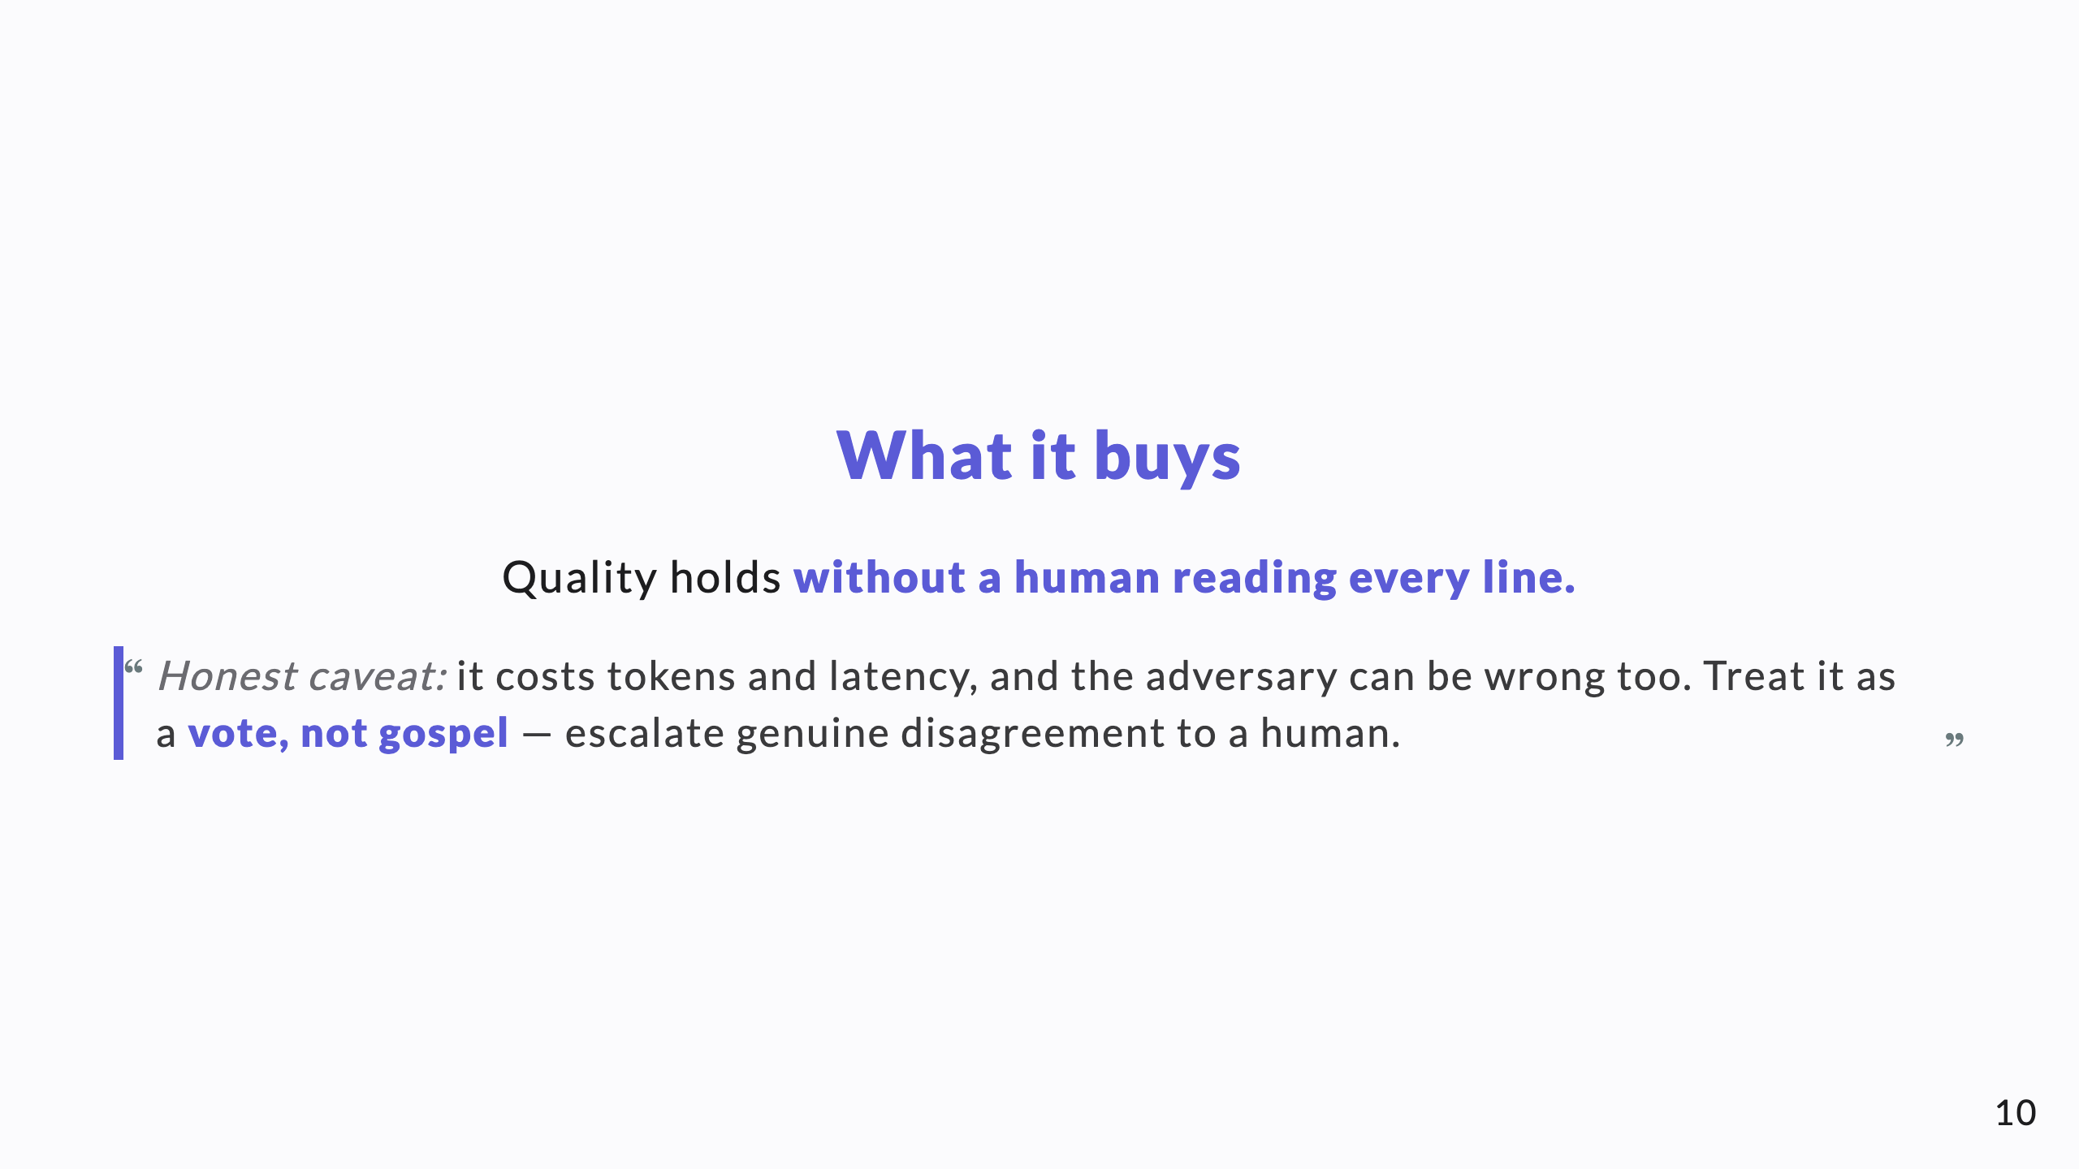
Notes:
Don't oversell "AI checks AI." The honest version — a vote with human escalation on ties — is both more credible and more correct.

Slide 11
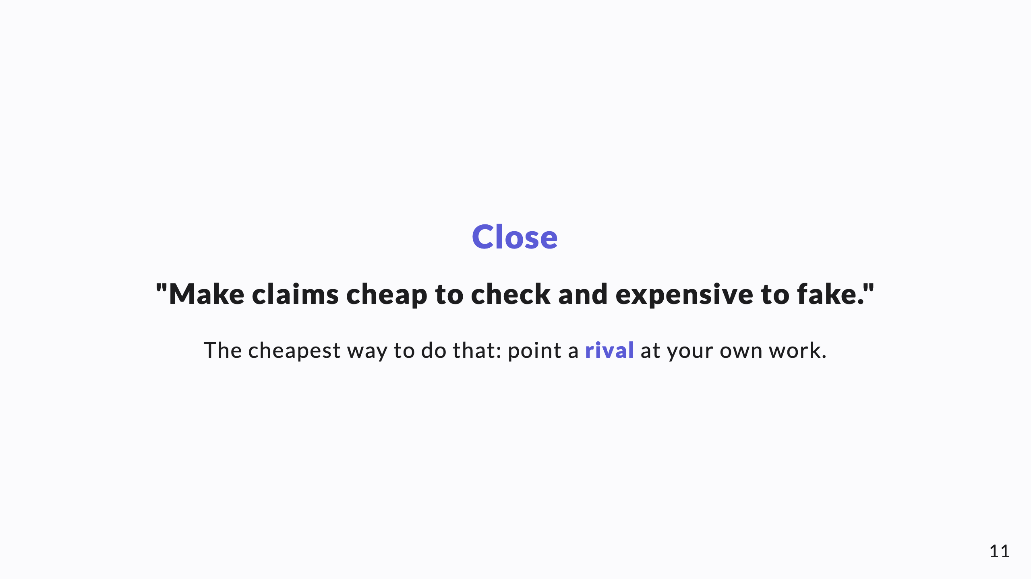
Notes:
Leave them with the one line and the rival-vendor image. That's what they'll repeat afterward.

