Slide 1
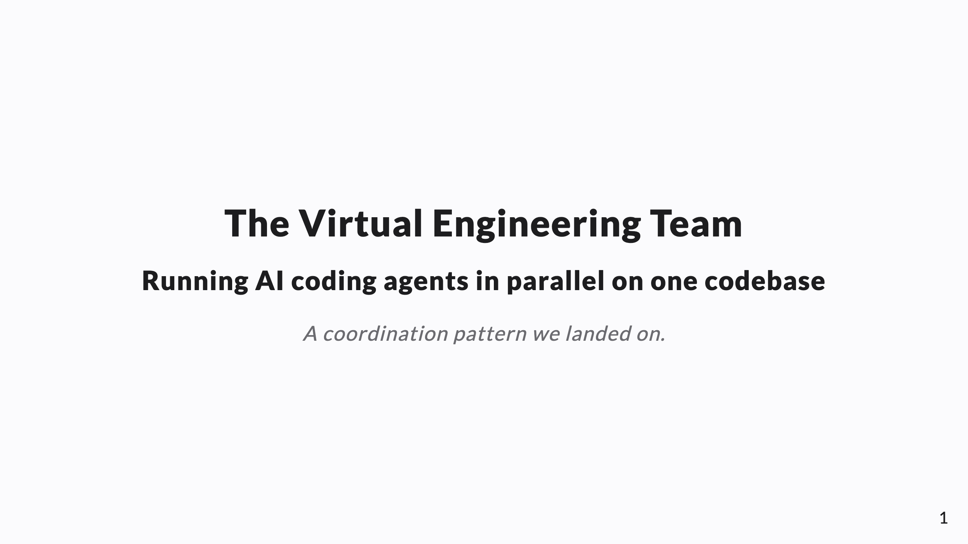
Notes:
SPEAKER NOTES live in these HTML comments and export into PPTX presenter notes. Knowledge-share framing — "a pattern we landed on," not a pitch. Through-line: N agents on one codebase = a distributed eng team, but stateless and prone to confident fabrication. Port the org chart + SDLC onto agents; encode rules where they read them. Companion to the "Tiered Agent Memory" deck (the durable-knowledge channel).

Slide 2
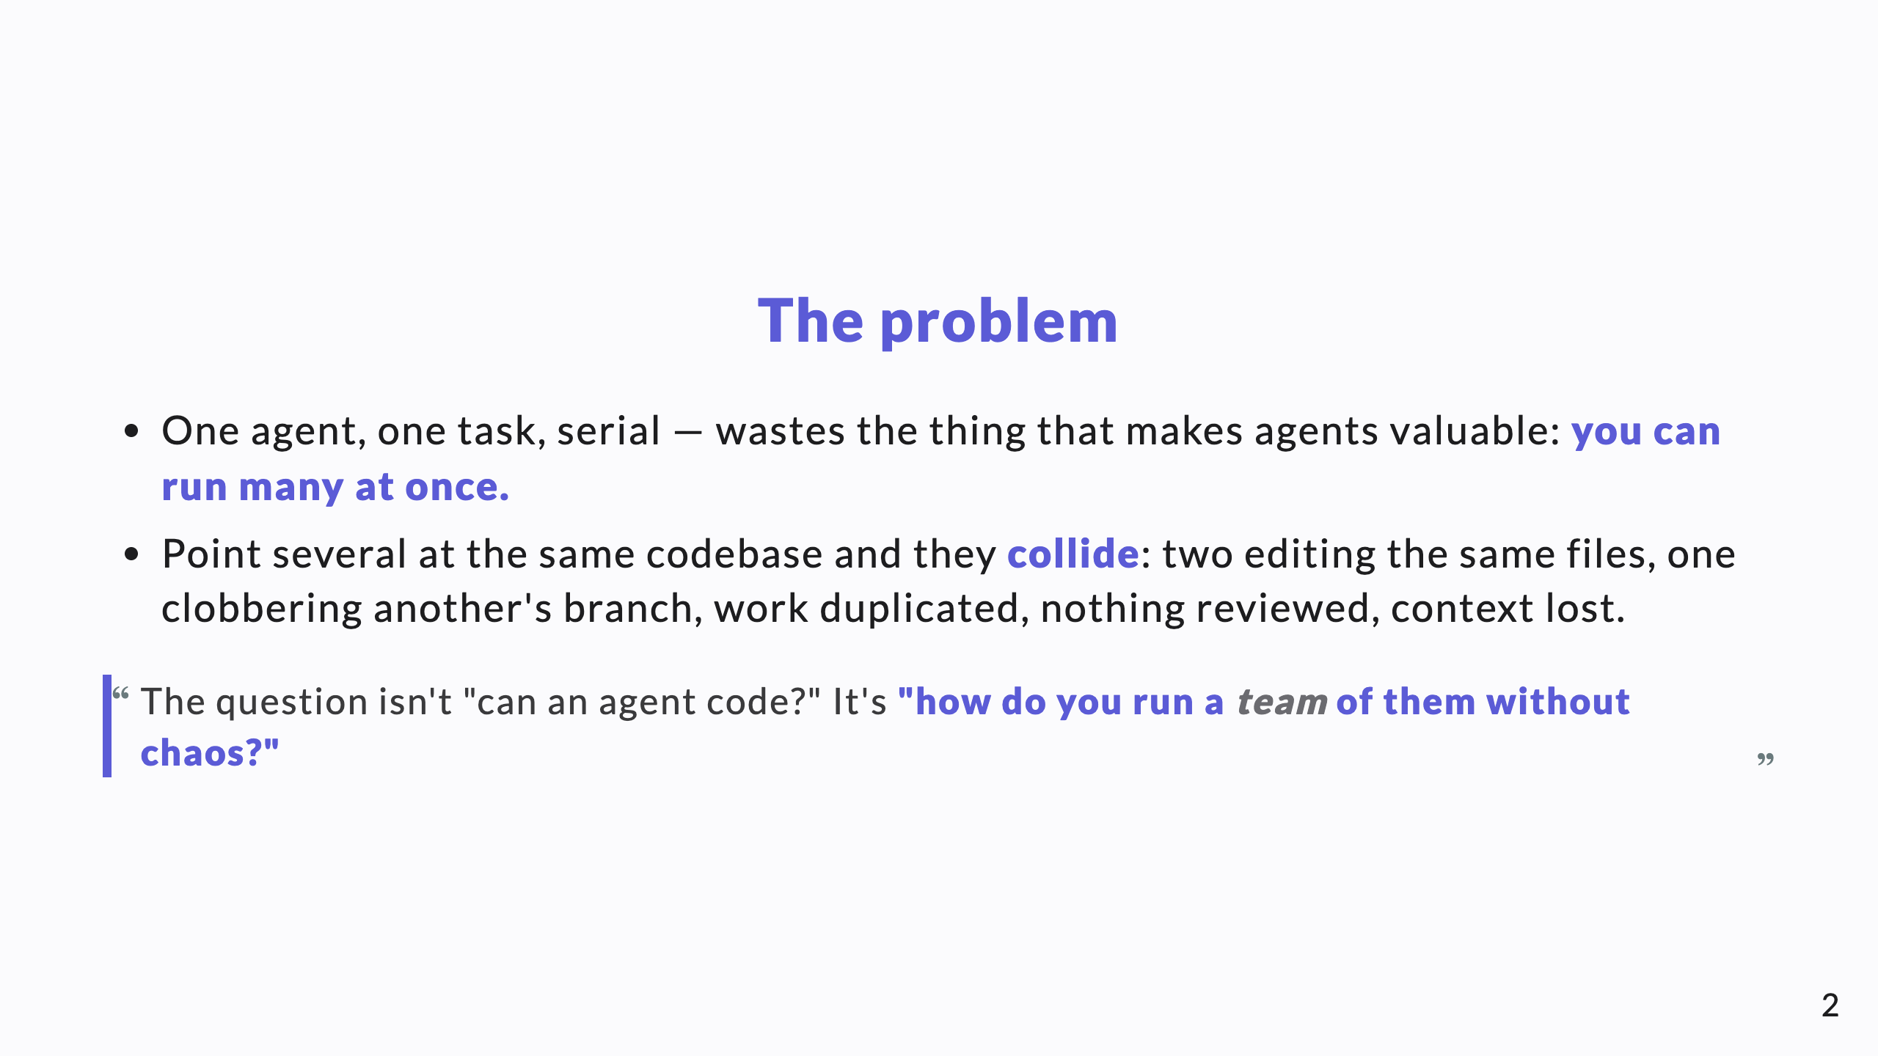
Notes:
Open on the chaos. Every CTO recognizes these failure modes from human teams: merge conflicts, lost work, unreviewed code. That recognition is the hook.

Slide 3
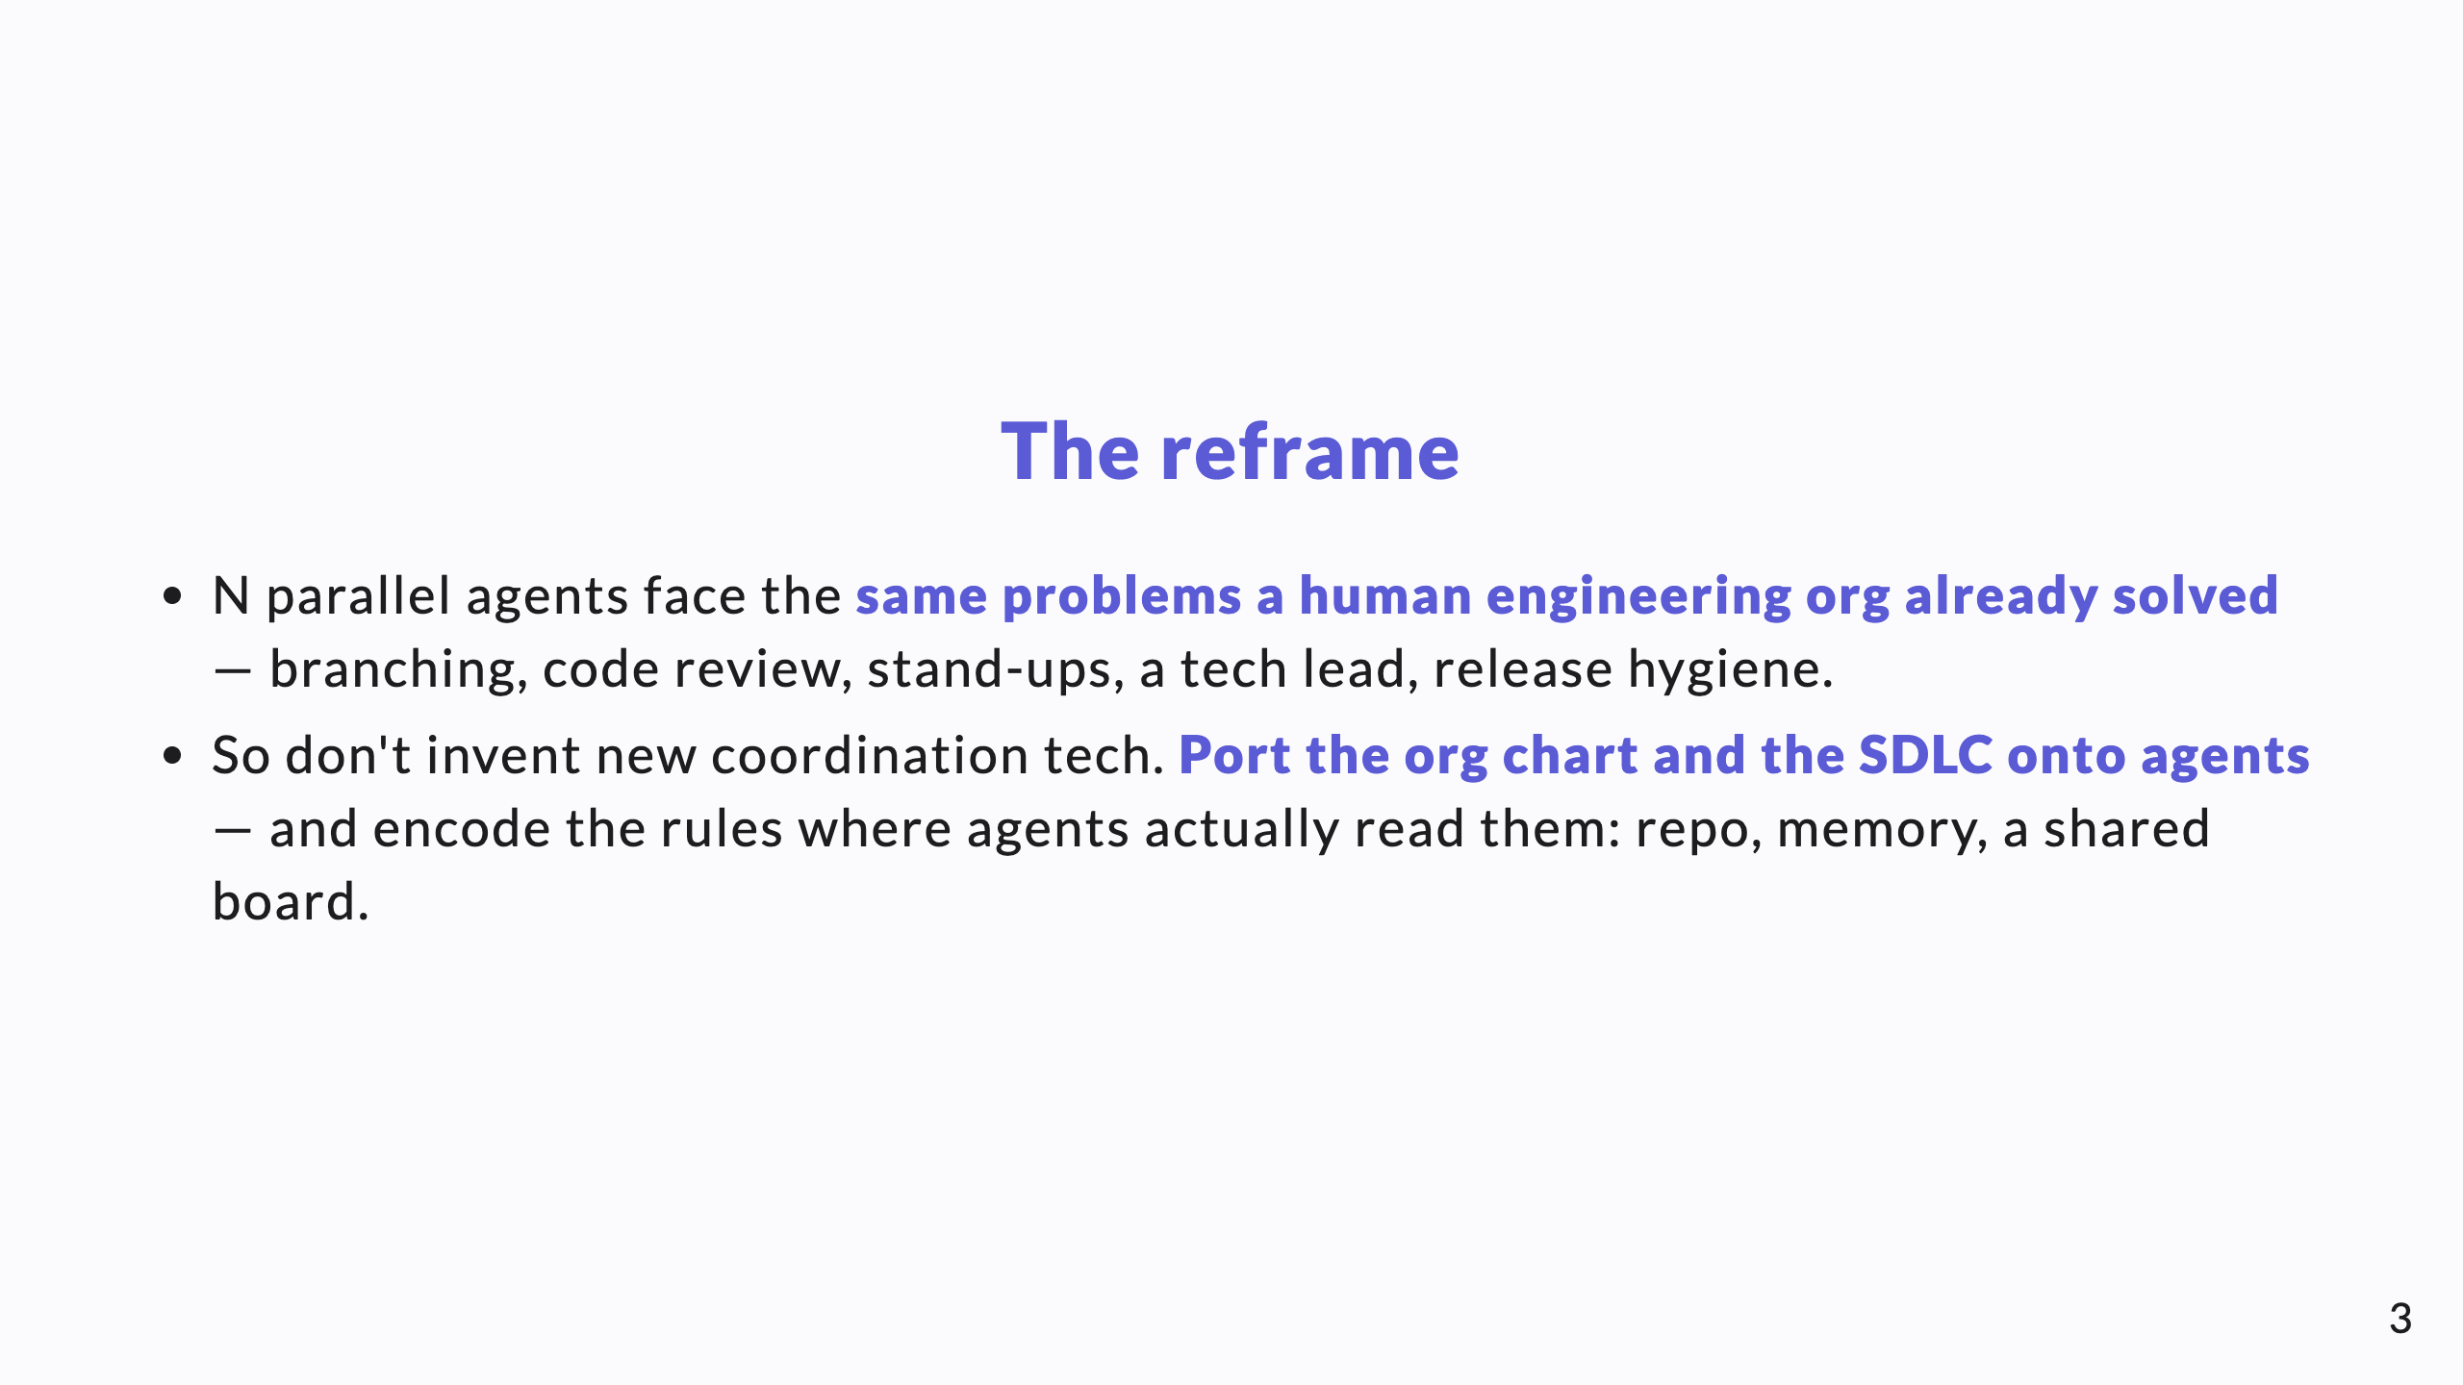
Notes:
This is the spine of the whole talk. We're not building novel infrastructure; we're adapting 40 years of how humans ship software, plus two AI-specific twists (revealed later).

Slide 4
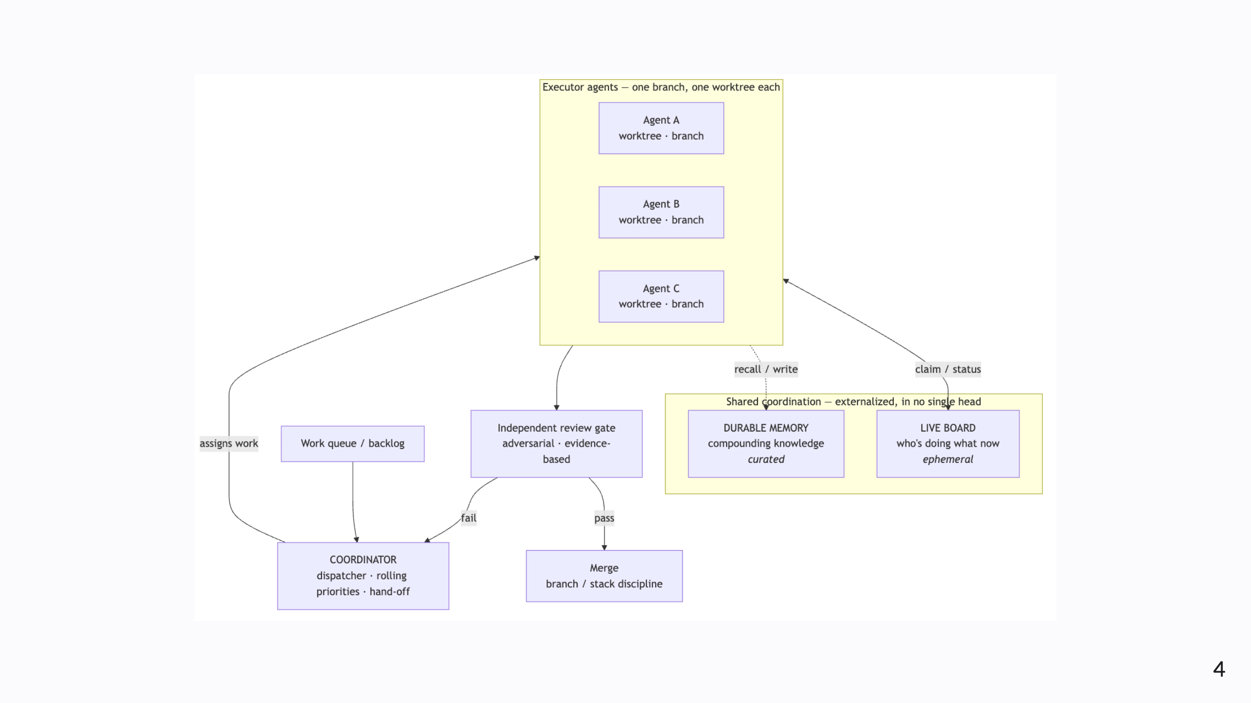
Notes:
Diagram A — the topology. Walk it: work queue → coordinator assigns → isolated executors (one worktree each) → they share a live board + durable memory → independent review gate → merge on pass, loop back to the coordinator on fail.

Slide 5
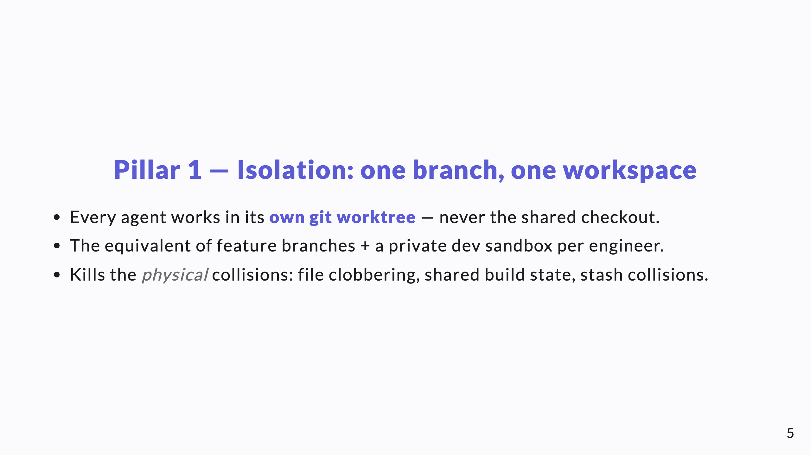
Notes:
Isolation is the floor. Without it, nothing else matters — two agents in one working directory will corrupt each other regardless of how good the coordination is.

Slide 6
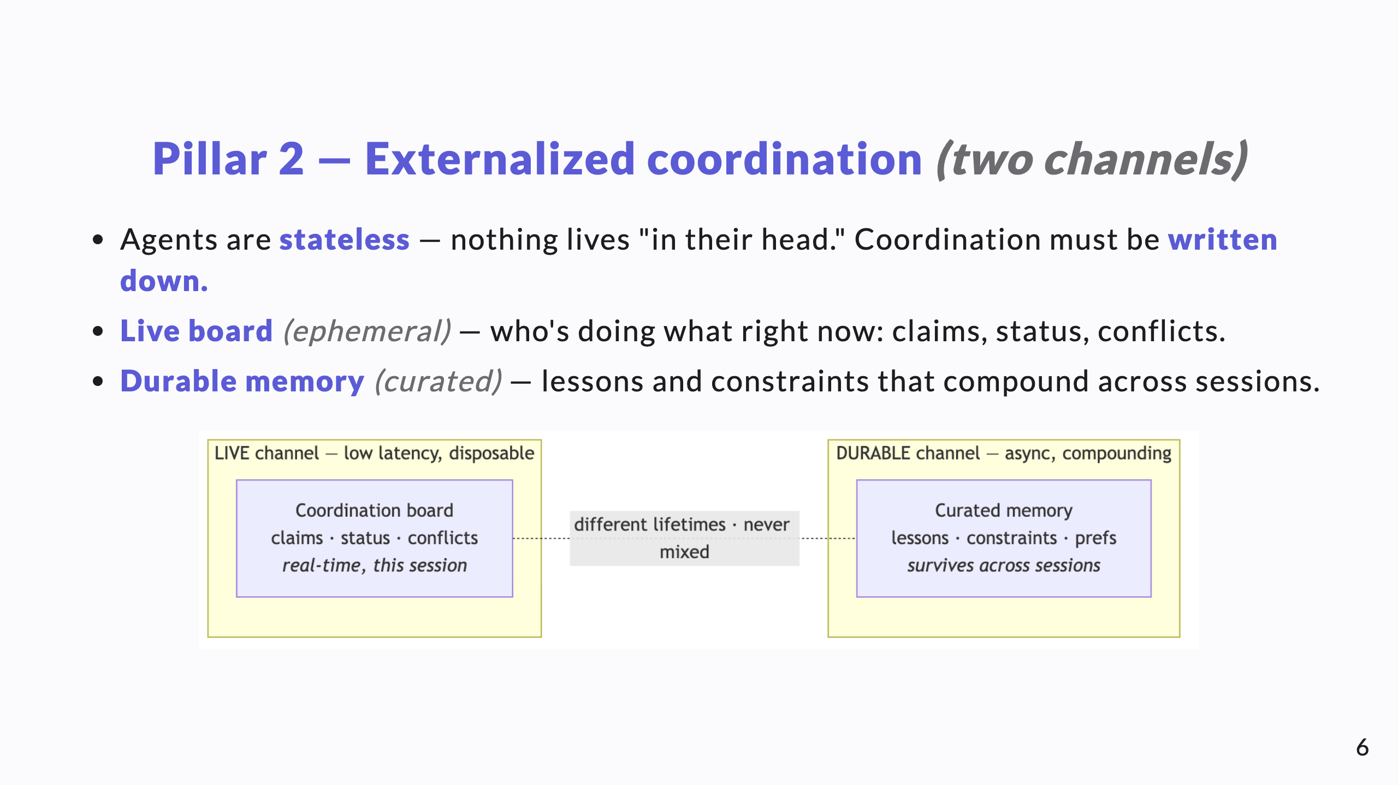
Notes:
The two channels have different lifetimes, so they stay separate. The durable channel is the subject of the companion "Tiered Agent Memory" deck — call that back here.

Slide 7
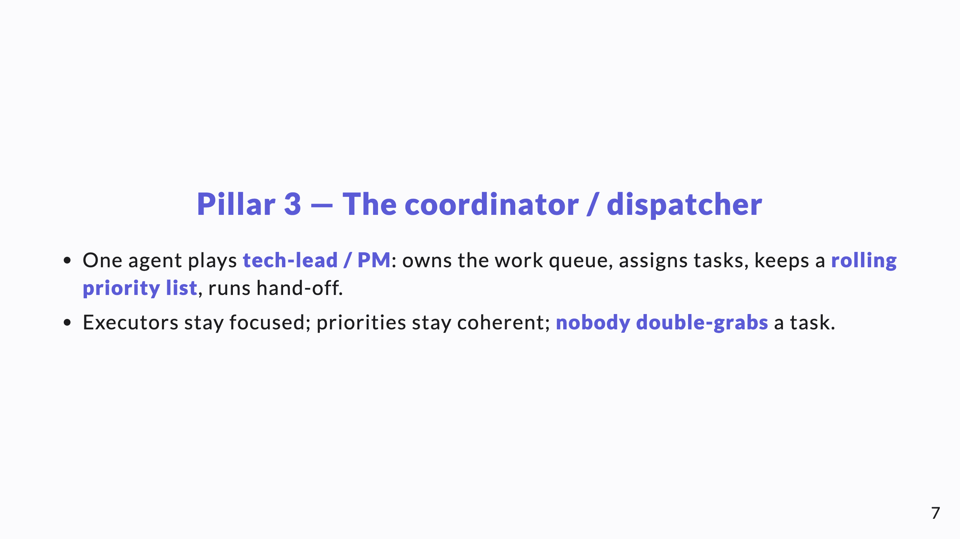
Notes:
The coordinator is what keeps N agents from each independently deciding "I'll do the most important thing" and all grabbing the same one.

Slide 8
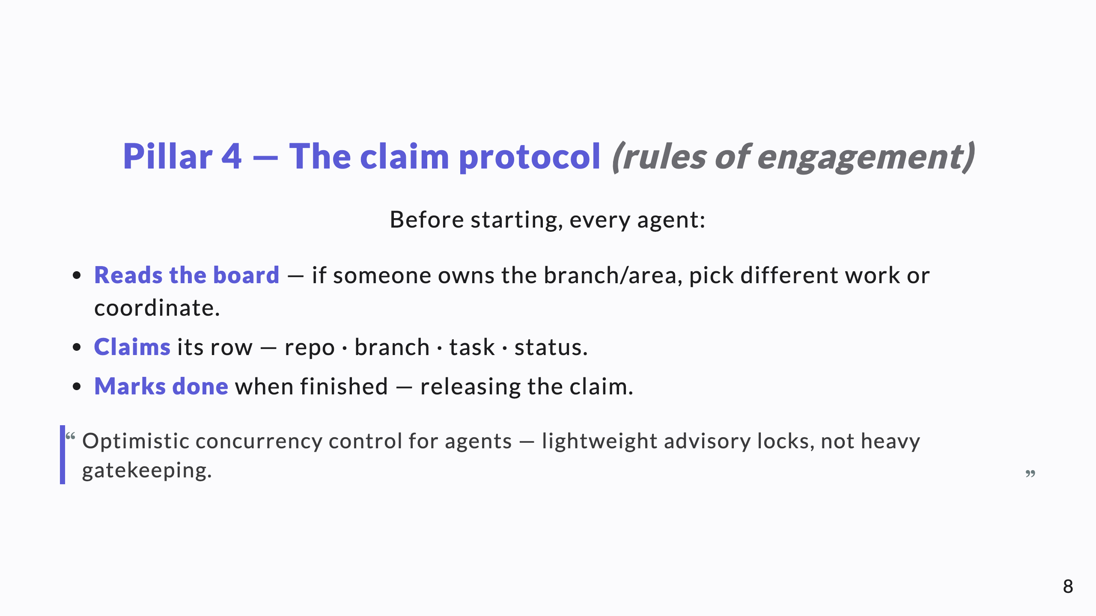
Notes:
Keep it lightweight. If the protocol is heavy, agents (and humans) route around it. The whole value is that it's cheap enough to always follow.

Slide 9
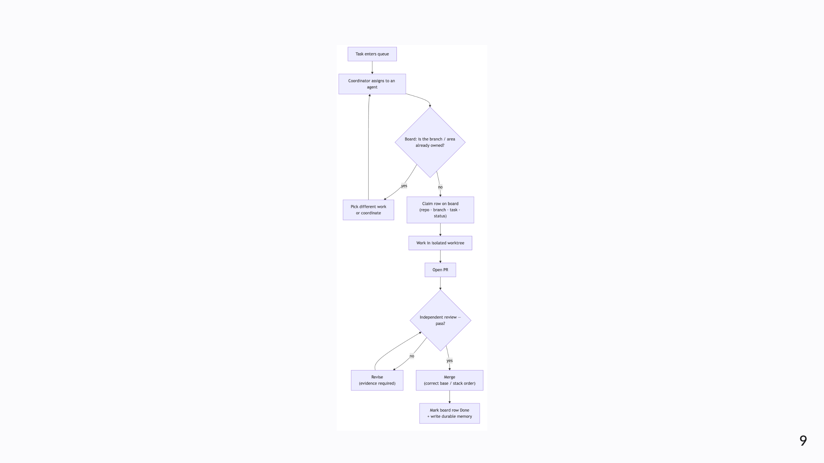
Notes:
Diagram B — one task's life across the fleet. Note the ownership gate before any work, the review pass/fail loop, and the close-out: clear the board row AND write the durable memory.

Slide 10
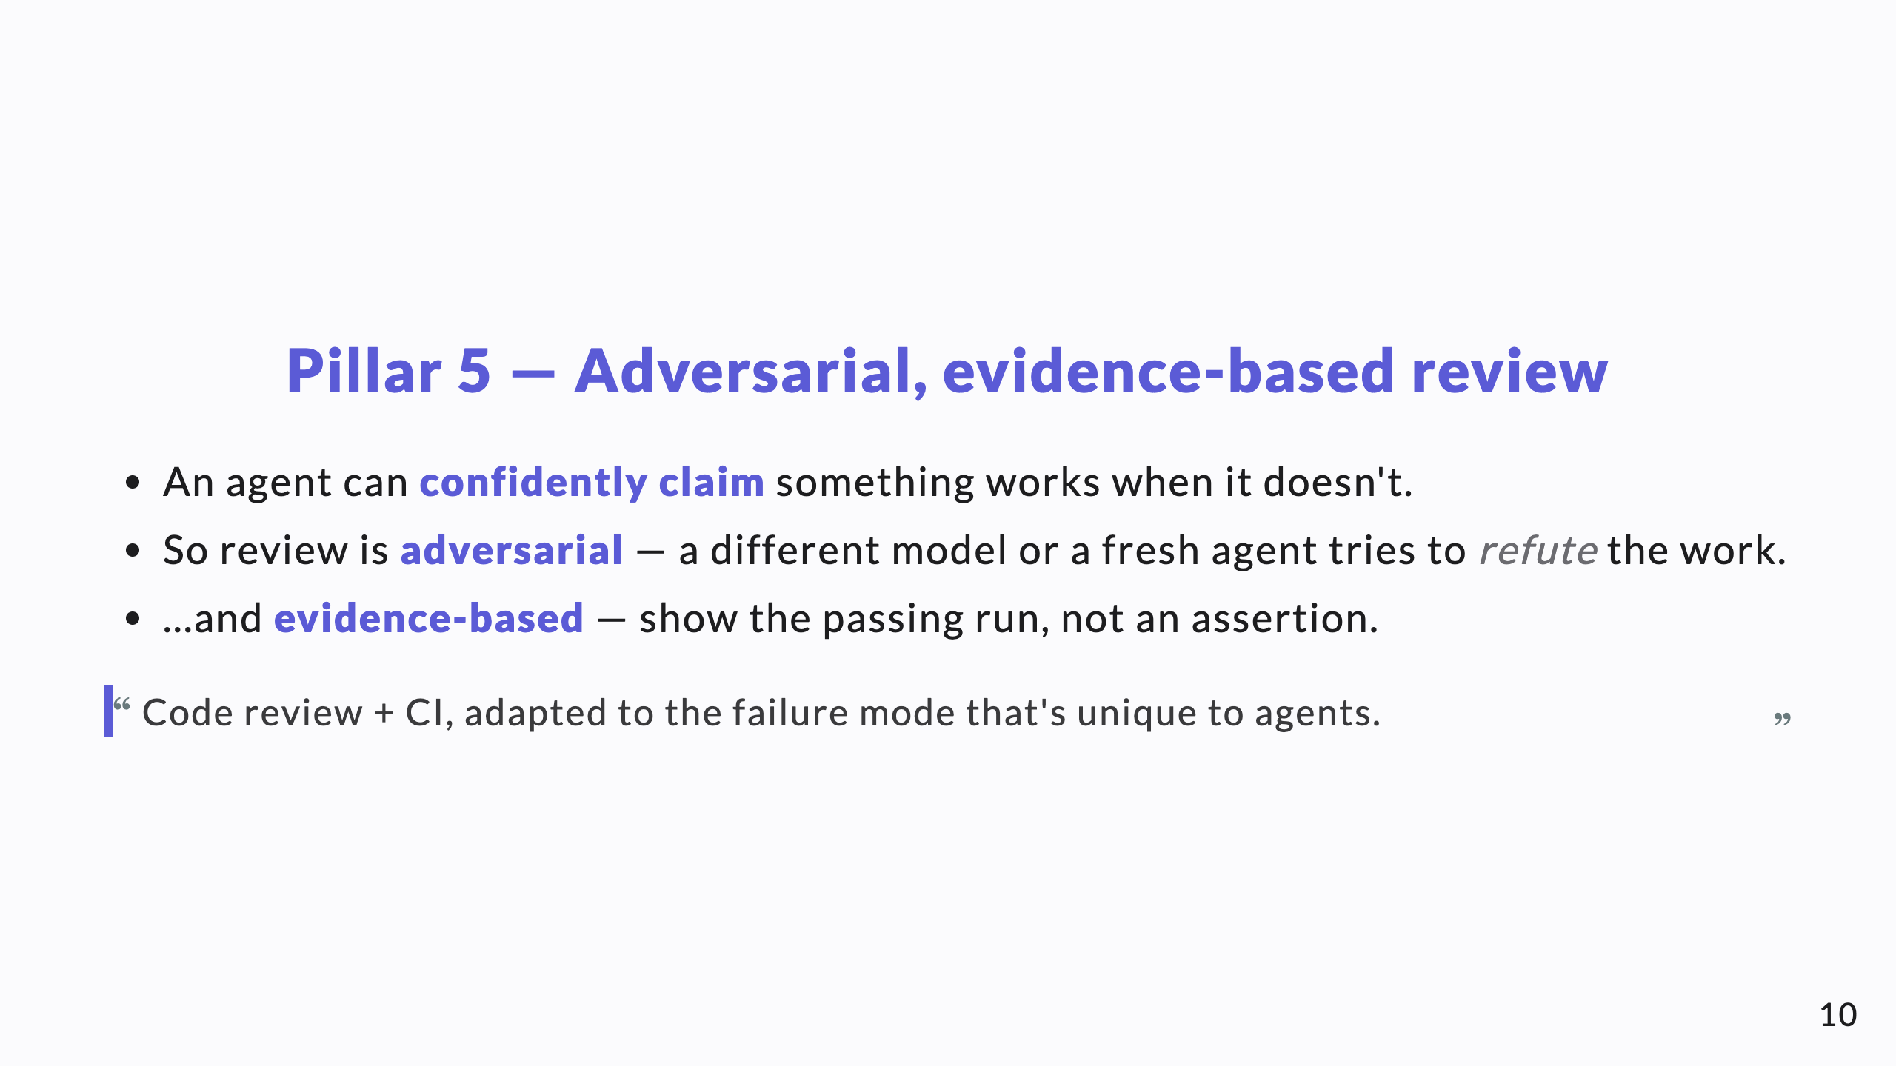
Notes:
This is the single most important AI-specific control. Plausible-but-wrong output is the default risk; an adversarial, evidence-demanding reviewer is the antidote.

Slide 11
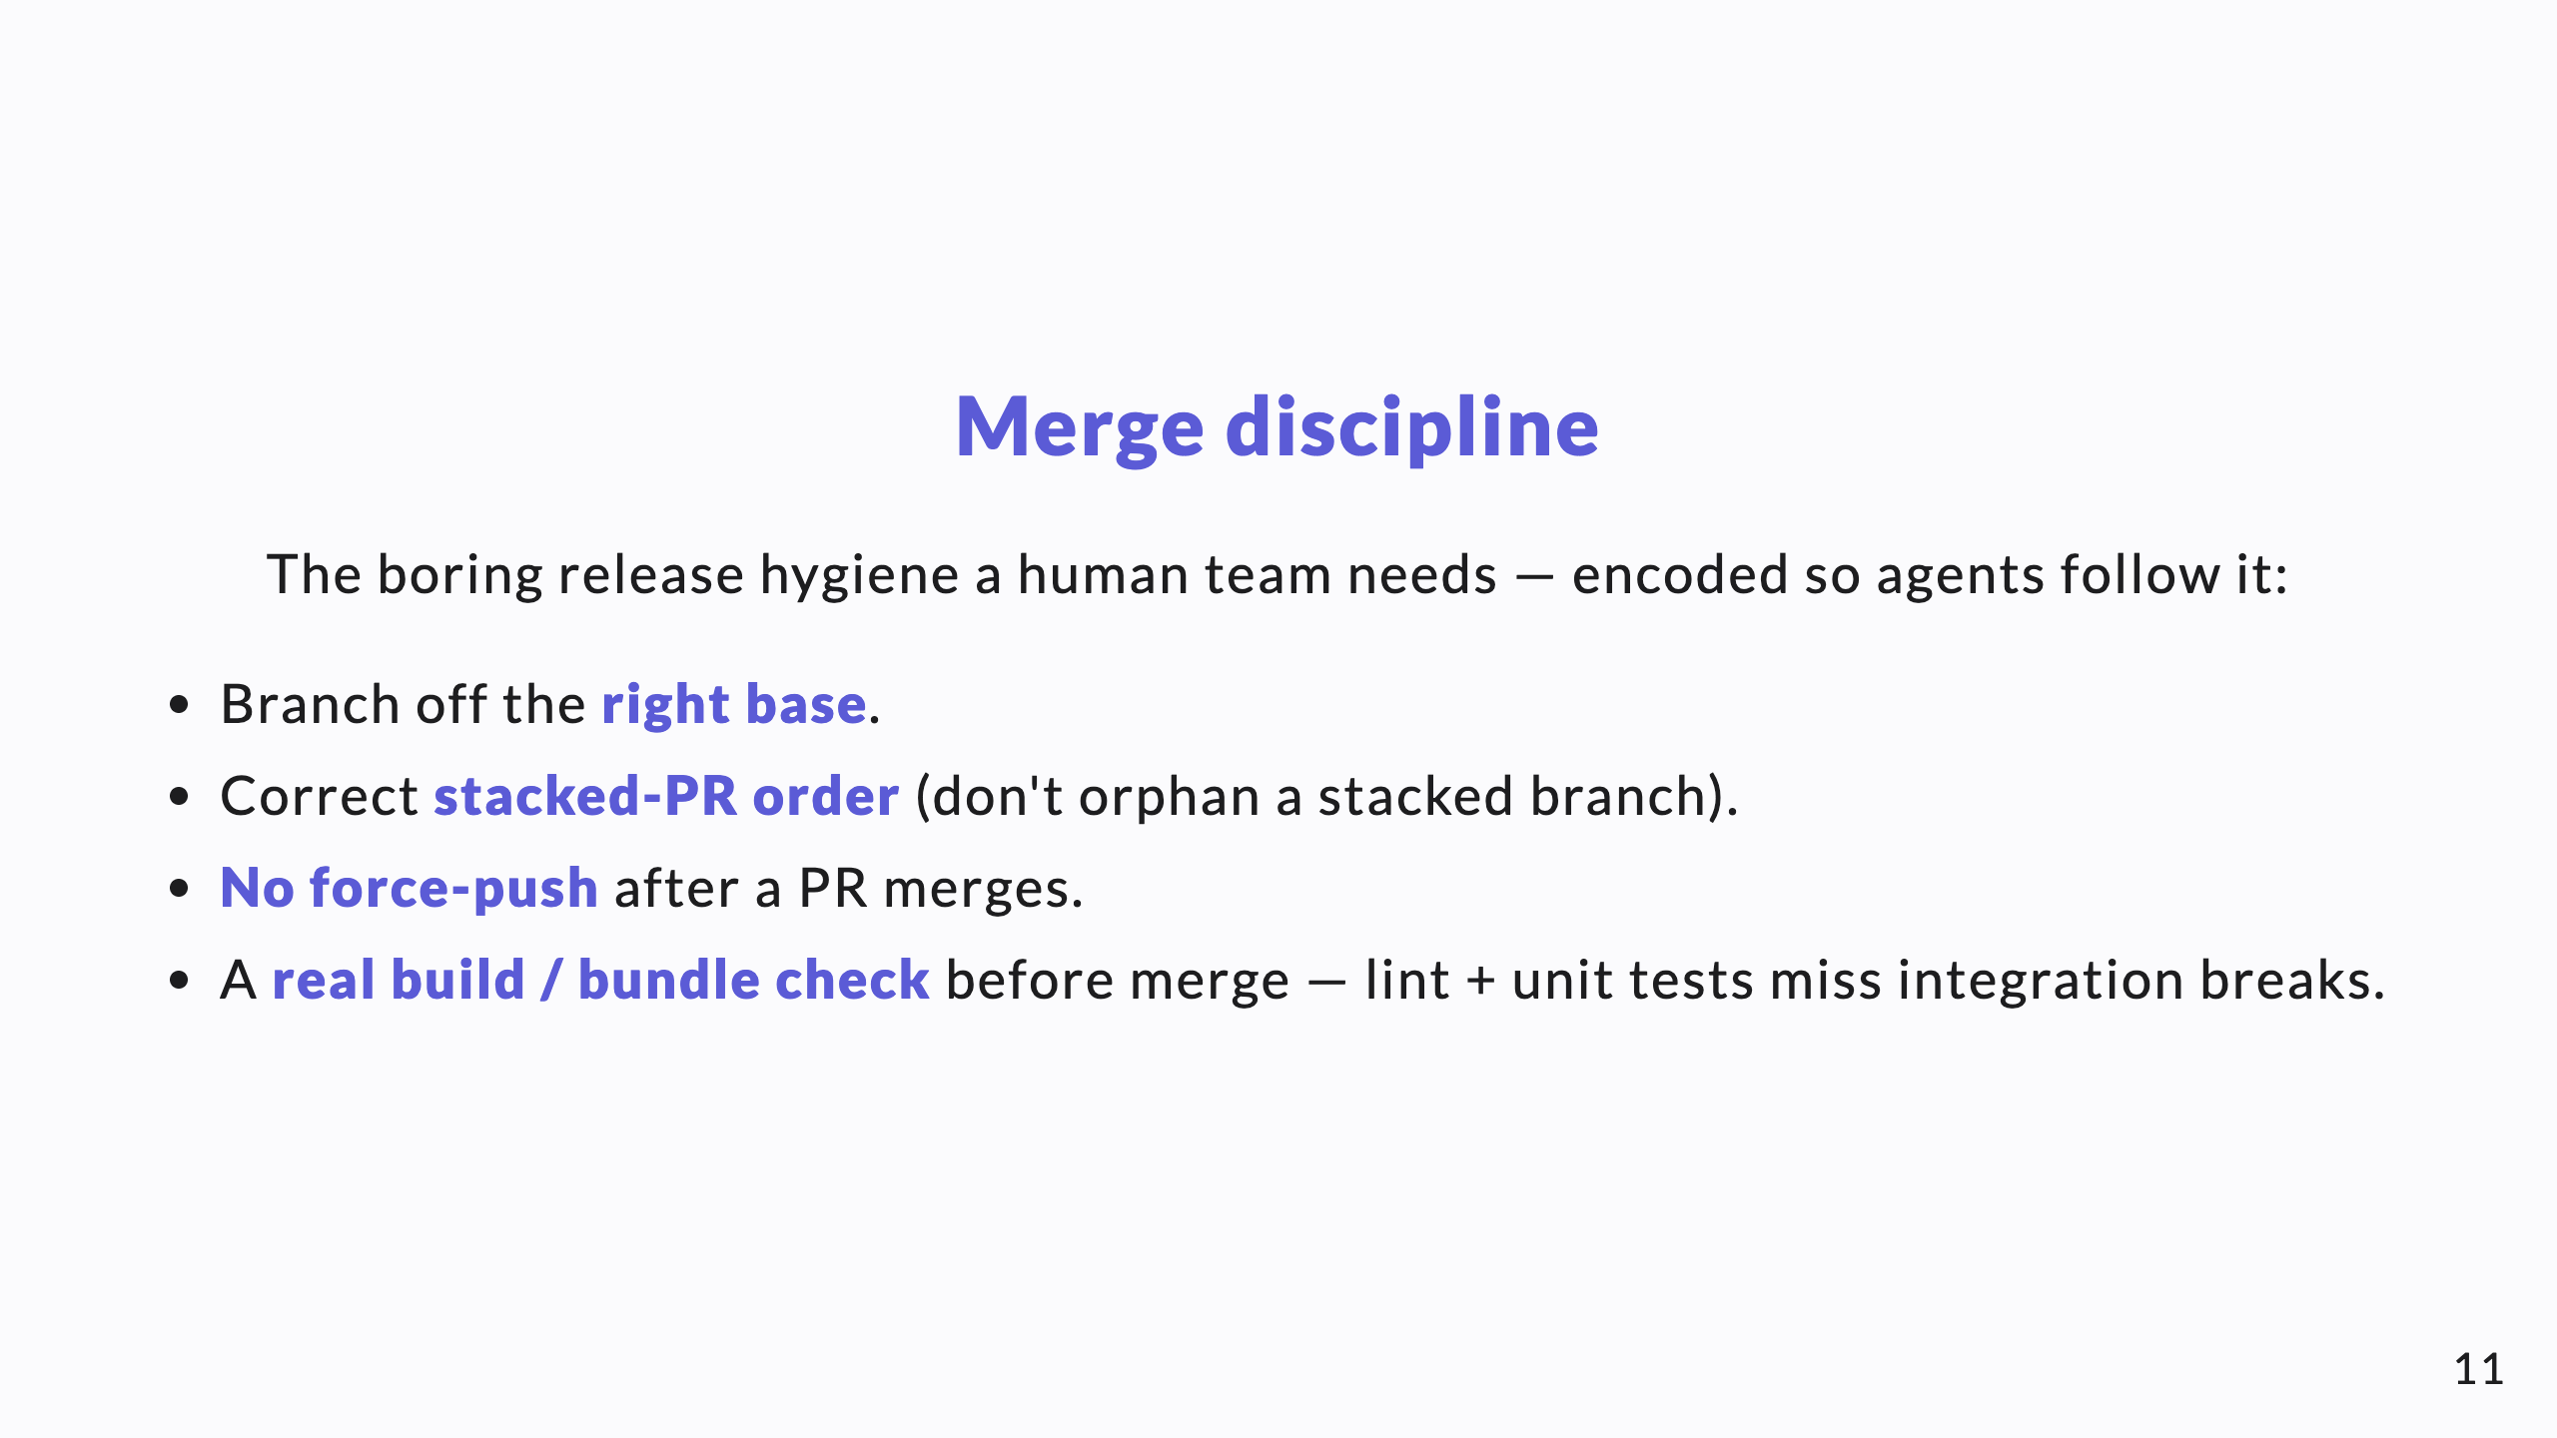
Notes:
Unglamorous but essential. These are the rules that, skipped, produce a green PR that breaks main. Encode them; don't assume them.

Slide 12
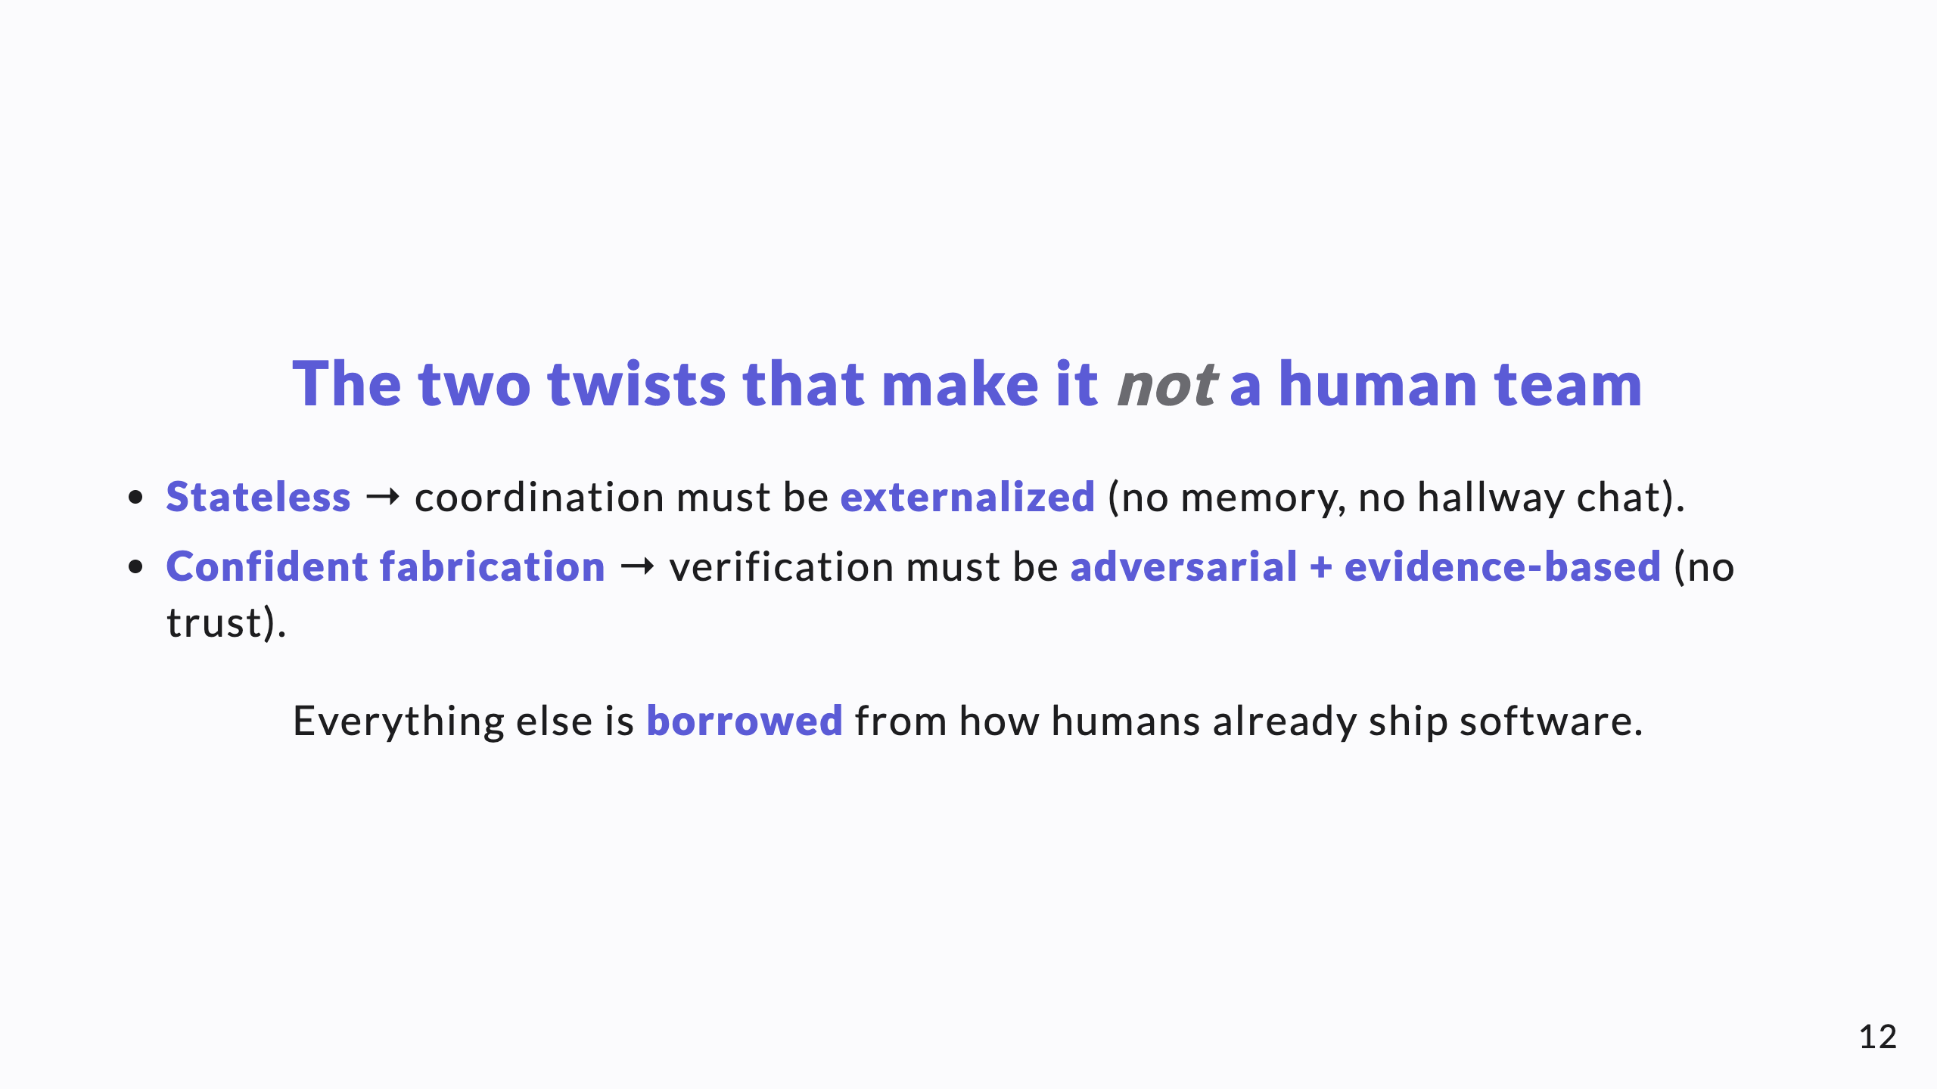
Notes:
This slide is the intellectual payoff. It tells the CTO exactly which two things you can't copy-paste from human process, and why.

Slide 13
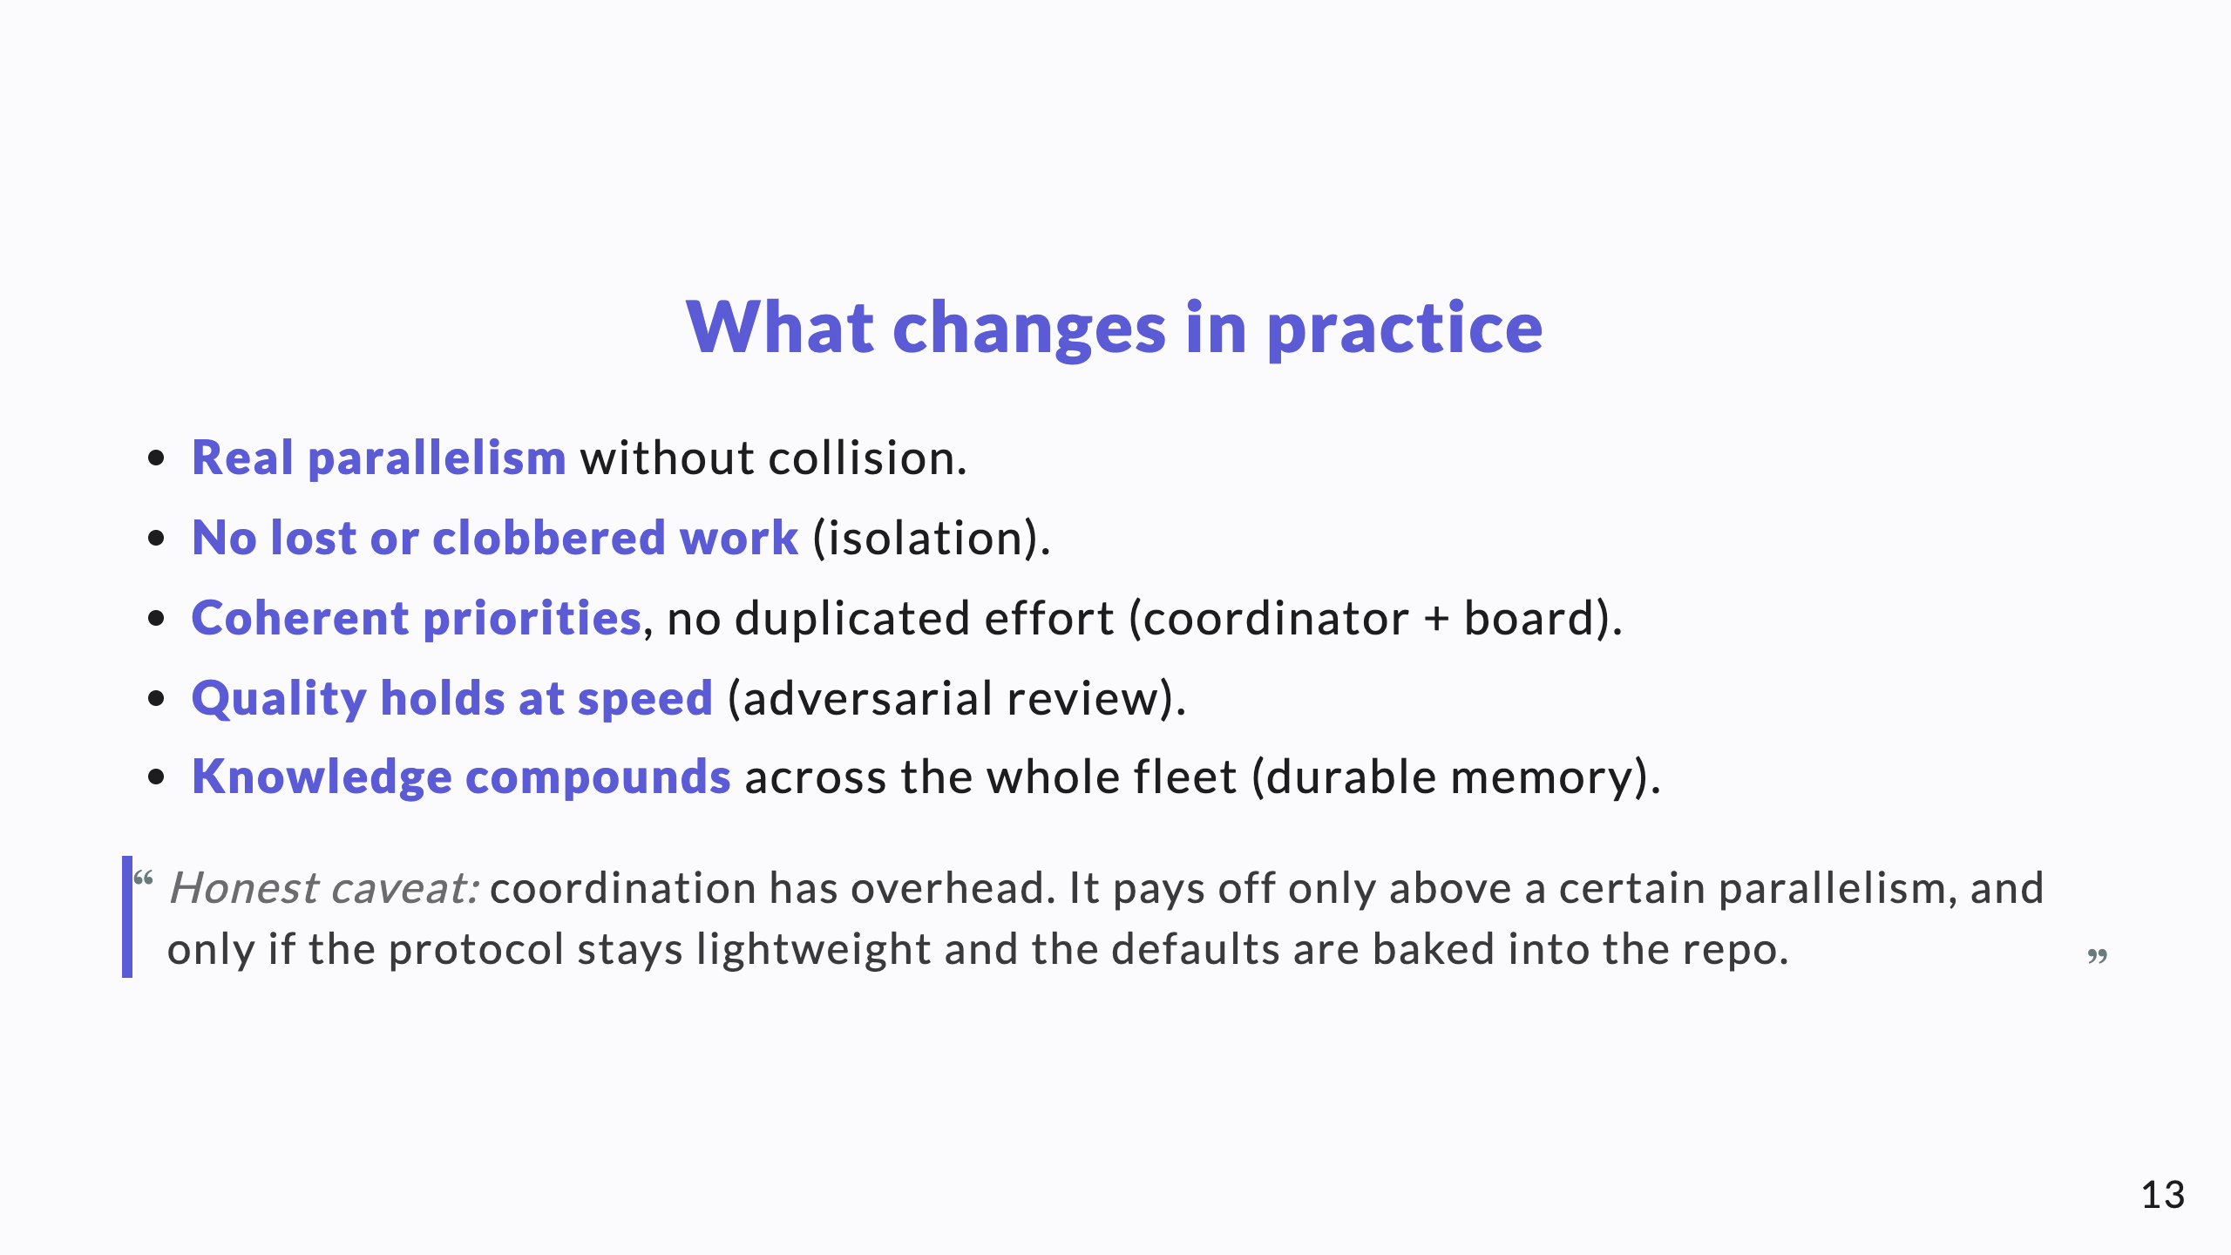
Notes:
Outcomes, then the honest cost. The caveat is what makes a knowledge-share credible.

Slide 14
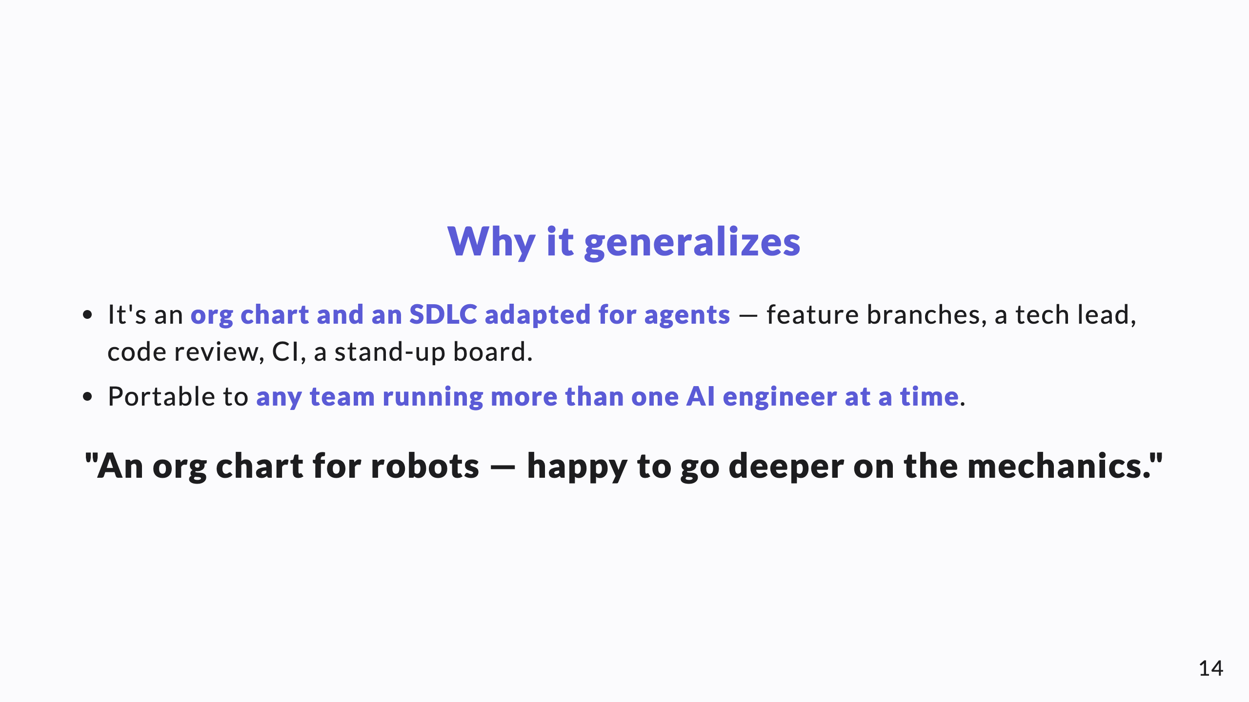
Notes:
Close open, no ask. Pair this with the memory deck to show one coherent system, not two gadgets.

