Slide 1
Energy Trading and Weather
How weather impacts energy prices

Slide 2
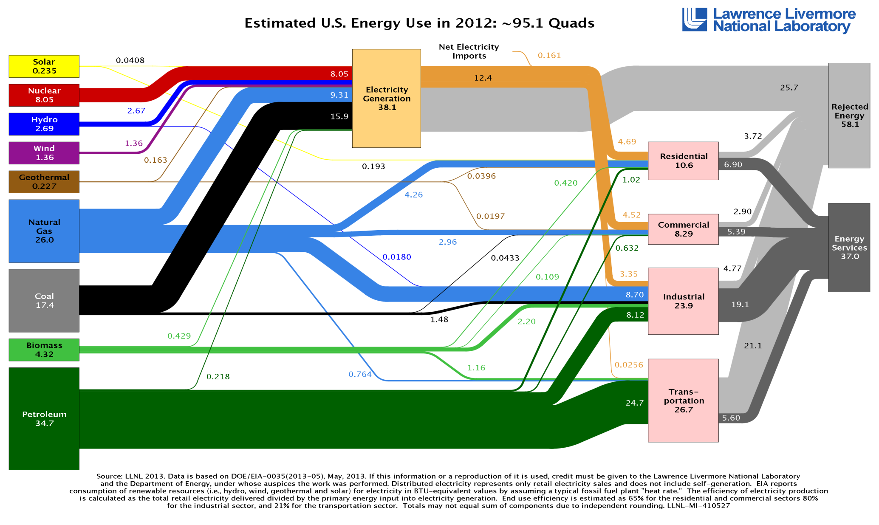
Energy Flow in US

Slide 3
Energy Sources
NG Wells
# of rigs
Cost of production
Pipelines capacity
Coal Mines
# of mines
Cost of production
Railroad capacity
Nuclear Fuel
?

Slide 4
Energy Storage
NG
Injected into storage during low demand season
Drawn from storage during high demand
Electricity
Cannot be stored directly

Slide 5
Energy Transformation
NG
Industrial use (fertilizers, chemicals etc)
Burn to produce electricity
Burn to warm up the dwellings

Slide 6
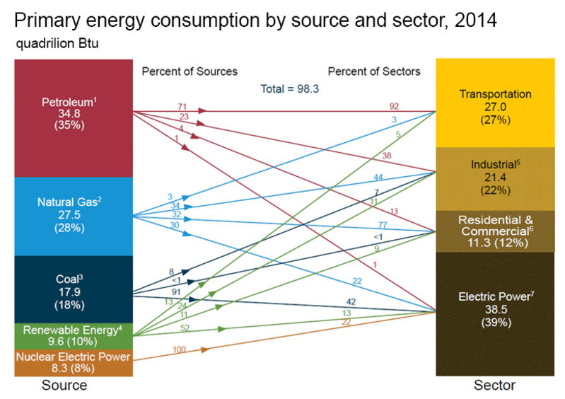
Energy Consumption

Slide 7
Notes
This paper focuses on Electricity
One big difference is that Electricity is not storable, therefore storage is not a factor in Electricity pricing. Therefore risk cannot be directly hedged away.

Slide 8
Models
Statistical
Limited success. For example, Brownian motion does not explain spikes. Jumps do not help, since after price jumped up, it reverts fairly quickly. Therefore we need stochastic process with jumps and mean-reversion and seasonality. This becomes cumbersome quickly.
Fundamental Hybrid
Model directly the price formation and demand mechanics based on real factors (directly or indirectly observable).

Slide 9
NG Price Factors
Supply (# rigs)
Transportation (pipes capacity)
Disruptions (hurricanes etc.)
Storage (level, cost)
Demand (weather is natural proxy for part of demand, that is directed to heating/cooling)

Slide 10
Electricity Price Factors
Fuel cost (NG, Coal, Nuclear)
Planned outages (generators maintenance)
Disruptions (fires, ice storms etc.)
Demand (weather is natural proxy for part of demand, that is directed to heating/cooling)

Slide 11
Electricity Spot Price Spikes
Distinct characteristic of Electricity Spot price is the presence of spikes

Slide 12
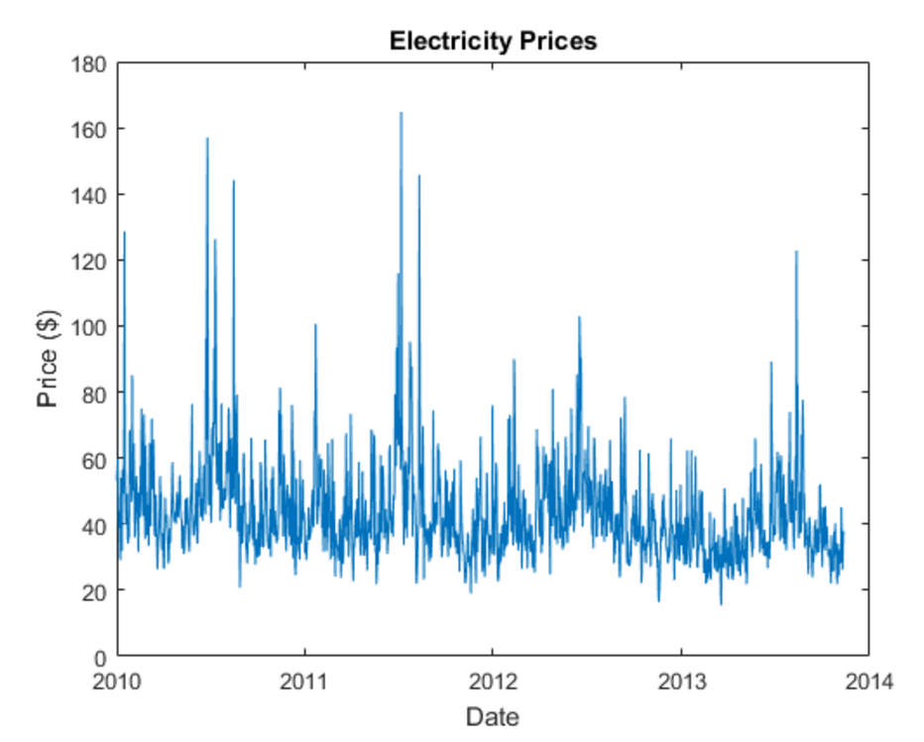

Slide 13
Note that Electricity markets are local, i.e. it cannot be transmitted over long distances due to energy loss (heat) – see next slide, how vastly different regional prices are.

Slide 14
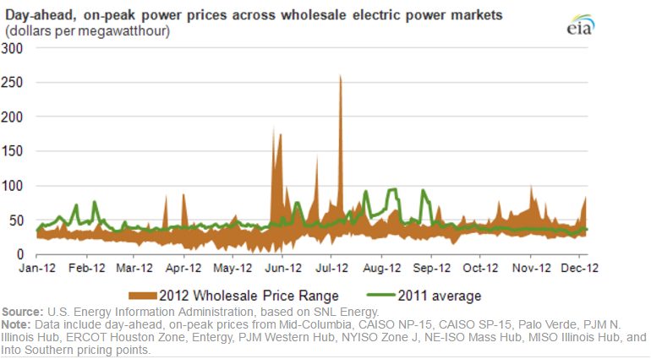

Slide 15
Electricity Spot Market – Price Formation
Spot price is determined during the uniform clearing auction (http://www.epsa.org/industry/primer/%3Ffa=prices)
Electricity generators submit bids
Market administrator sorts bids by price and fills bids from lowest price up until full demand is met
Last filled bid price becomes Spot price for that day and all generators are paid that price
This provides incentive for generators to submit lowest bids that reflect just the production cost

Slide 16
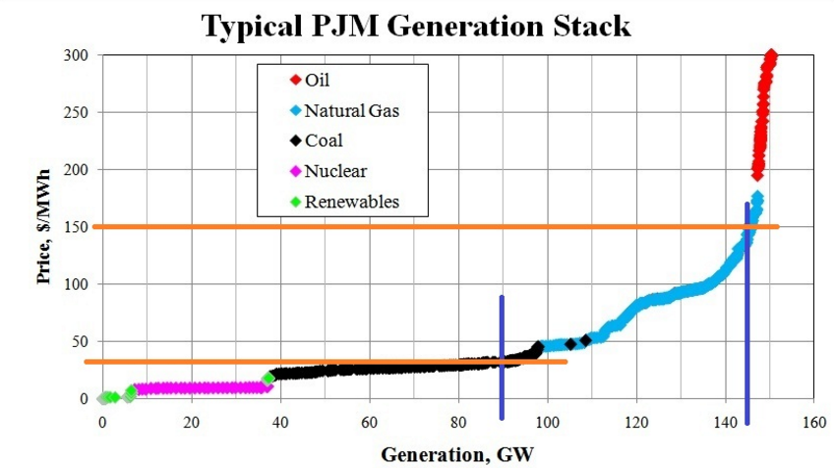
Pennsylvania/New Jersey/Maryland World’s largest Elect. wholesale mkt

Slide 17
Possible explanation for spikes
During the period of high demand (weather spells, Olympic games etc.), in order to fulfill all demand, the high price bids are getting filled which pushes the Spot price high
Remember that last filled bid becomes the Spot price
High price bids are probably not the reflection of greed, but the cost of bringing and keeping online additional generators running on more expensive fuel

Slide 18
Uncovering Bid Stack Structure
We can try modeling Spot price by trying to guess the structure of bid stack – volume and prices of each bid.
On one hand we know the Spot price (Y axes)
On the other hand we have a proxy for demand – weather (X axes: weather converted to demand, i.e. GW=f(temperature))
By comparing historical data for both we may be able to guess the bid stack structure and the point in demand (weather) at which high price bids kick in

Slide 19
Assume that price of electricity for the most part depends on demand (which in turn depends on weather)
Assumed slow moving factors
Fuel cost (generators are likely not buying fuel on spot market)
Outages (planned and random) can be accommodated by some average parameter
Generation Stack (changes as generators go off/on line and/or change their prices)

Slide 20
Next step – forecasting weather
After we guess or make assumptions about bid stack structure, we have to forecast the weather in order to make projection about the future price of electricity

Slide 21
Weather (temperature)
TODO insert reference to article showing that naïve historical estimate is as good as fancy models
Remove seasonality
See if we can do better than regressing on sin() (e.g. polynomials, splines)
Allow for variable amplitude each year: A(year)
Try to map A(year) to global climate events, like El Nino, groundhog appearance, “this is going to be a cold winter” etc.
Extract and analyze residuals. Try timeseries analysis, but most likely simple statistics will do

Slide 22
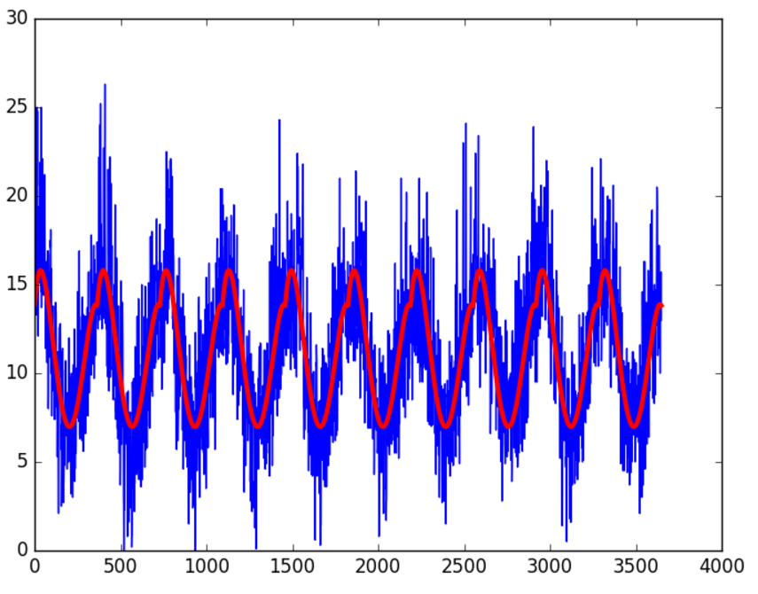
This in not sin()

Slide 23
Next step – translating weather into demand
After weather forecasted, we have to translate weather into demand
By analyzing the weather station locations, population structure in these locations, we have to come up with aggregation procedure that maps “population(loc) x weater(loc) x degree2GW(loc)” to “demand GW”
TODO: insert reference to Norwegian article that does something similar

Slide 24
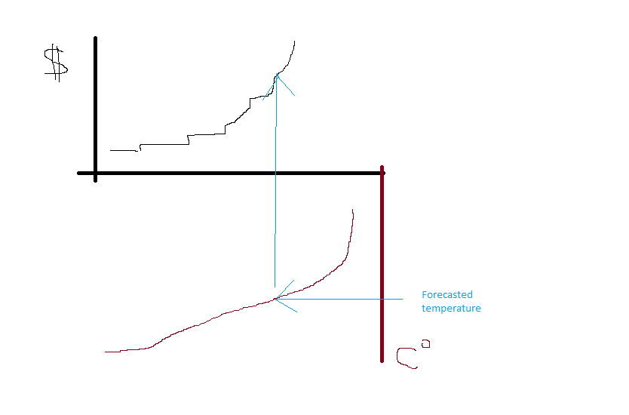
Summary

Slide 25
Summary
To find out expected price:
Determine generation bid structure – mapping demand (GW) to price
Determine function mapping weather (temperature) to demand (GW)
Fit historical temperatures into proper seasonal structure
To create price distribution/range
Estimate temperature residuals, generator outages and add this noise to average price

Slide 26
Weather/Power derivatives parity?
Is there a parity between weather and power derivatives? Cooling/heating days could be translated to power demand, which could be mapped to price
If yes, are there dislocations?
If yes, are they tradable?

