Slide 1
Energy Trading and Weather
Analysis of how weather impacts energy prices

Slide 2
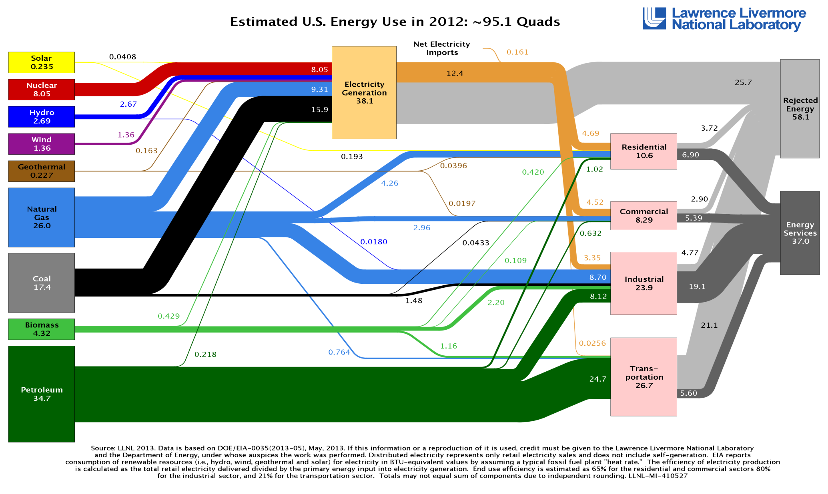
Energy Flow in US

Slide 3
Energy Sources
NG Wells
# of rigs
Cost of production
Pipelines capacity
Coal Mines
?
Nuclear Fuel
?

Slide 4
Energy Storage
NG
Injected into storage during low demand season
Drawn from storage during high demand
Electricity
Cannot be stored

Slide 5
Energy Transformation
NG
Industrial use (fertilizers, chemicals etc)
Burn to produce electricity
Burn to warm up the dwellings

Slide 6
Energy Consumption
Heating | NG | Electricity
Residential | ?% | ?%
Commercial
Industrial
Cooling | Electricity
Residential | ?%
Commercial
Industrial

Slide 7
Notes
This paper focuses on Electricity
One big difference is that Electricity is not storable, therefore storage is not a factor in Electricity pricing

Slide 8
NG Price Factors
Supply (# rigs)
Transportation (pipes capacity)
Disruptions (hurricanes etc.)
Storage (level, cost)
Demand (weather is natural proxy for part of demand, that is directed to heating/cooling)

Slide 9
Electricity Price Factors
Supply (NG, Coal, Nuclear fuel)
Power lines capacity
Disruptions (fires, ice storms etc.)
Demand (weather is natural proxy for part of demand, that is directed to heating/cooling)
Note that Electricity markets are local, i.e. it cannot be transmitted over long distances due to energy loss (heat)

Slide 10
Electricity Spot Price Spikes
Distinct characteristic of Electricity Spot price is the presence of spikes
Spot price is determined during the uniform clearing auction (http://www.epsa.org/industry/primer/%3Ffa=prices)

Slide 11
Electricity Spot Market
Electricity generators submit bids
Market administrator sorts bids by price and fills bids from lowest price up until full demand is met
Last filled bid price becomes Spot price for that day and all generators are paid that price
This provides incentive for generators to submit lowest bids that reflect just the production cost

Slide 12
Possible explanation for spikes
During the period of high demand (weather spells, Olympic games etc.), in order to fulfill all demand, the high price bids are getting filled which pushes the Spot price high
Remember that last filled bid becomes the Spot price
High price bids are probably not the reflection of greed, but the cost of bringing and keeping online additional generators

Slide 13
Uncovering Bid Stack Structure
It is interesting to try to model Spot price by trying to guess the structure of bid stack – volume and prices of each bid.
On one hand we know the Spot price
On the other hand we have a proxy for demand – weather
By comparing historical data for both we may be able to guess the bid stack structure and the point in demand (weather) at which high price bids kick in

Slide 14
Next step – forecasting weather
After we guess or make assumptions about bid stack structure, we have to forecast the weather in order to make projection about the future price of electricity

Slide 15
Weather (temperature)
TODO insert reference to article showing that naïve historical estimate is as good as fancy models
Remove seasonality
See if we can do better than regressing on sin() (e.g. polynomials, splines)
Allow for variable amplitude each year: A(year)
Try to map A(year) to global climate events, like El Nino, groundhog appearance, “this is going to be a cold winter” etc.
Extract and analyze residuals. Try timeseries analysis, but most likely simple statistics will do

Slide 16
Next step – translating weather into demand
After weather forecasted, we have to translate weather into demand
By analyzing the weather station locations, population structure in these locations, we have to come up with aggregation procedure that maps “population(loc) x weater(loc) x degree2kwhConv(loc)” to “demand kwh”
TODO: insert reference to Norwegian article that does something similar

Slide 17
Weather/Power derivatives parity?
Is there a parity between weather and power derivatives? Cooling/heating days could be translated to power demand, which could be mapped to price
If yes, are there dislocations?
If yes, are they tradable?

