Slide 1

Random Effects
& Repeated Measures
JACOB SEYBERT
10/15/09

Slide 2
SAS Syntax Overview
Similar to what we’ve done:
    This is not accurate for all cases, just a basic example.
PROC GLM data=Data1;
Class IV1(random) IV2(fixed);
Model DV=IV1 IV2 IV1*IV2;
Random IV1 IV2 IV1*IV2 /test;
Test h=IV1 e=IV1*IV2;
Run;
List Random IVs (including when they are interactions) to compute expected mean squares and test.
Specify what effect is being tested and what error term is to be used. This is when you want to use one other than residual

Slide 3
Single & two-factor random effects
PROC GLM data=Data1;
Class IV1 IV2;
Model DV=IV1 IV2 IV1*IV2;
Random IV1 IV2 IV1*IV2/test;
Title ‘Two-Way Random Effects ANOVA’;
Run;
As both variables are random effects, here you can easily test influence of the factors.

Slide 4
Example1
“RandomEffectsTwoWayANOVA.sas”
PROC GLM data=Data1;
Class order Administrator;
Model Responses=order Administrator order*Administrator;
Random order Administrator order*Administrator/test;
Title ‘Two-Way Random Effects ANOVA’;
Run;

Slide 5
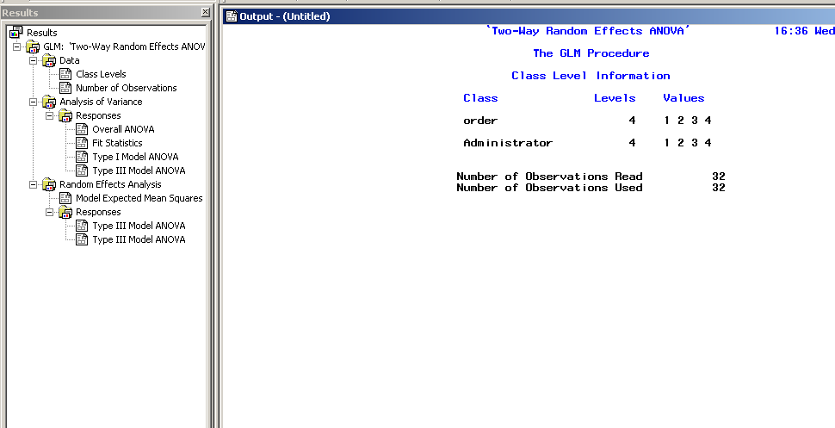
Example 1 Output

Slide 6
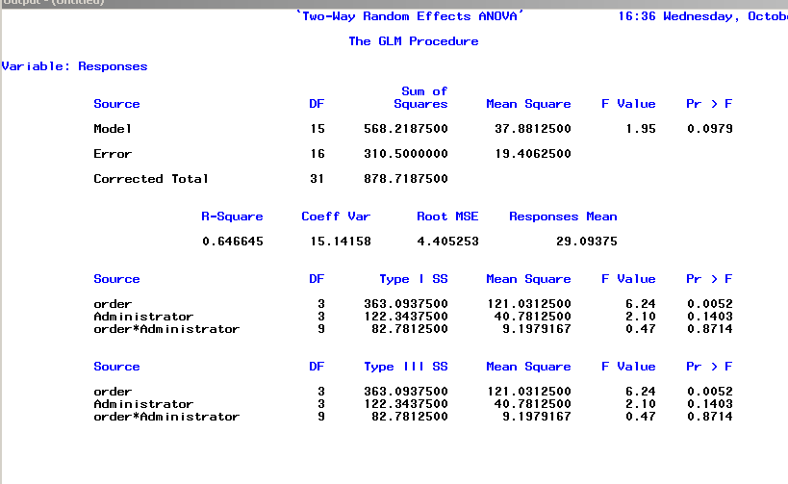
Example 1 Output Continued..
F Values =
MS A
MS Error

Slide 7
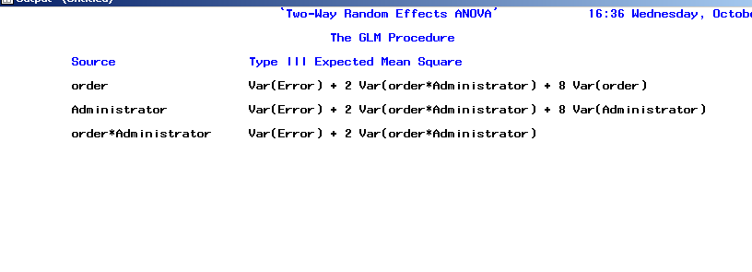
Example 1 Output Continued..
Tells us what the expected mean squares are for our random effects. Look at Hays pg. 543, see how these match. Also Lecture 13 Slide 10.

Slide 8
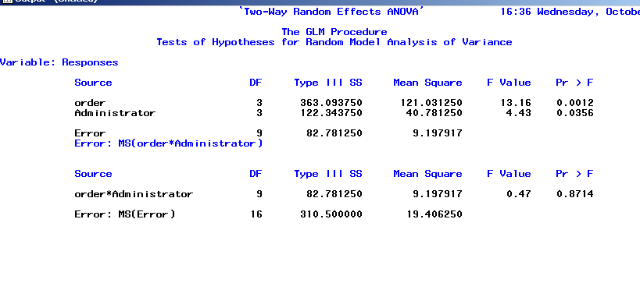
Example 1 Output Continued..
F Values =
MS A
MS A*B
F Values =
MS A*B
MS Error

Slide 9
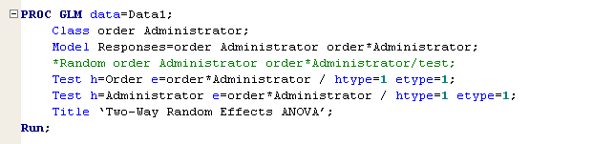
Alternatively
You can set SAS to calculate these manually, through the Test statement.
The point to all these statements is to cause the F values to be calculated correctly.

Slide 10
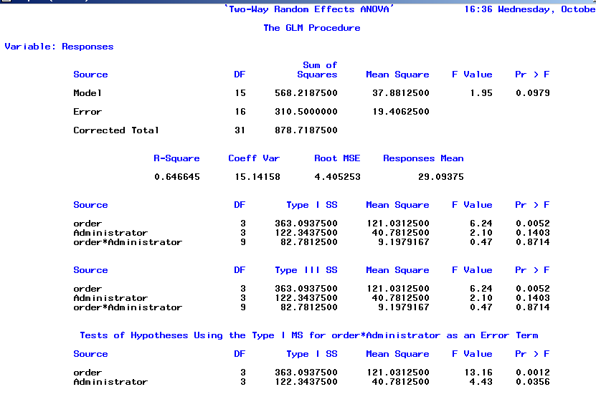
Alternative Output

Slide 11
Mixed Effects
Hays, pg. 554
Common to encounter experiments in which one or more factors have fixed levels and the levels of the remaining factors are sampled (random).
Children’s muscular tension:
3 Types of tasks -Fixed
6 classrooms randomly selected -Random

Slide 12
Example2
“MixedEffectsANOVA.sas”
PROC GLM data=Data1;
Class Classroom Task;
Model Tension=Task Classroom Task*Classroom;
*Random Classroom Classroom*Task /test;
*Test h=Task e=Task*Classroom / htype=1 etype=1;
Means Task Classroom Task*Classroom;
Title ‘Mixed Effect ANOVA’;
Run;
Pick one!

Slide 13
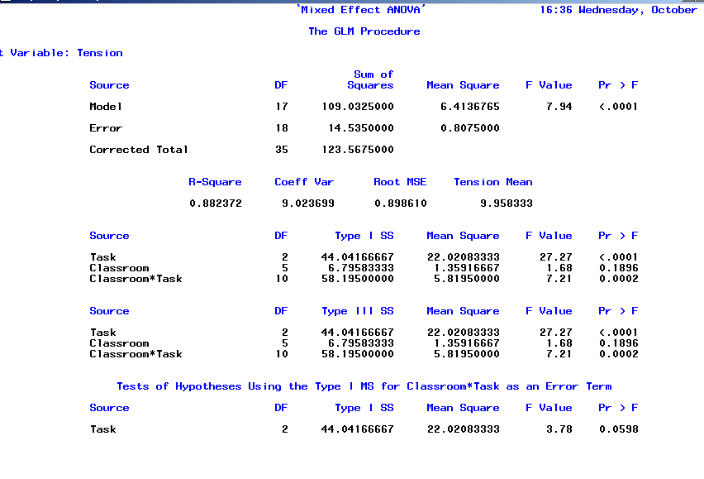
Example 2 Output

Slide 14
Example 2 Results:
No main effects for Task or Classroom.
Is a significant interaction effect, there is something about the combination of a particular task with a particular classroom that accounts for variance
  Within classrooms, task effects apparently exist, but are different for different classrooms.
Run post-hoc tests on cells (see last week).
Graph these! “MixedEffectGraph.xls”

Slide 15
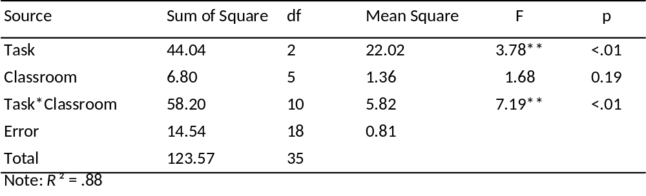
ANOVA Source Table
Same style as other tables, just be sure to add in all appropriate error terms.

Slide 16

Repeated Measures
“RepeatedANOVA-Slide21.sas”
PROC GLM data=Data1;
Class Person Drug;
Model Time=Person Drug Person*Drug;
Random Person Person*Drug; *Can delete this statement;
Test h=Drug e=Person*Drug;
Title ‘Repeated Measures ANOVA’;
Run;
The Test statement does this:

Slide 17
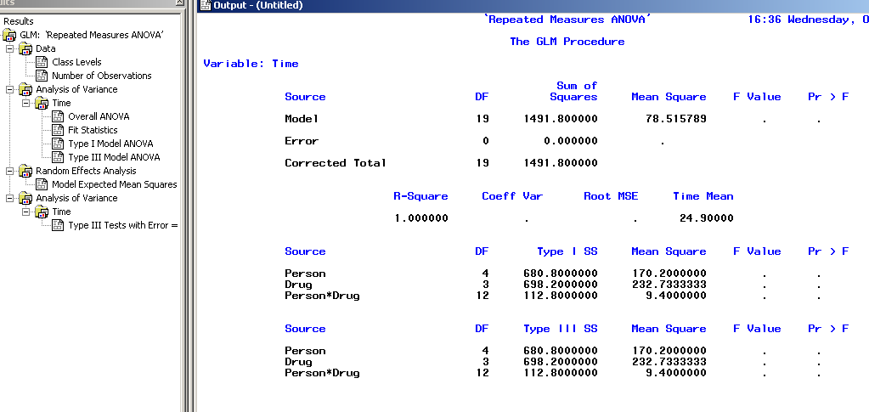
Example 3 Output
This is correct! There’s no df for error!

Slide 18
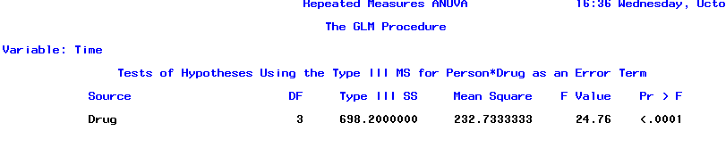
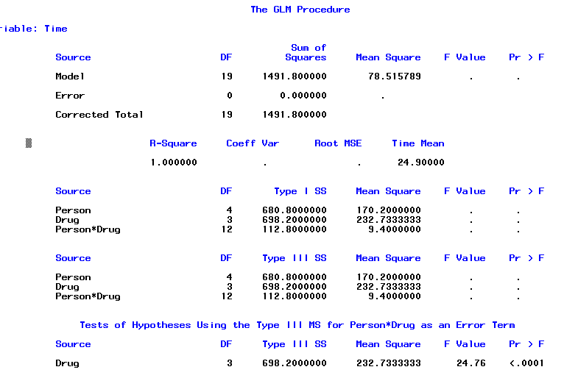
Example 3 Output Continued
OR

Slide 19
Summary
* From Lecture 13 Slide 25.
Total = 1491.8; Drugs = 698.2, People=680.8.
Residual = Total –(Drugs+People) = 1491.8-(698.2+680.8)
=112.8
Source | SS | df | MS | F
Between People | 680.8 | 4 | Nuisance variance
Within people (by summing) | 811.0 | 15
Drugs | 698.2 | 3 | 232.73 | 24.76
Residual | 112.8 | 12 | 9.40
Total | 1491.8 | 19 | Fcrit(.05) | =3.95

Slide 20
Block Design
From Hays, Exercise 13.9 (p. 591)– ability of children to solve different types of puzzles:
Groups of 6 children were blocked on IQ. 10 groups (‘block’s) selected at random. Puzzle type (‘puzzle’) is fixed.
Each child in block is given a different type of puzzle. DV (‘solved’) is number of puzzles solved out of 20, within a time period.

Slide 21
Example 4
“BlockANOVA.sas”
Proc GLM data=Data1;
Class block puzzle;
Model solved=block puzzle block*puzzle;
*Random block block*puzzle;
Test h=puzzle e=block*puzzle;
Run;
Tell SAS to use the block*puzzle error.

Slide 22
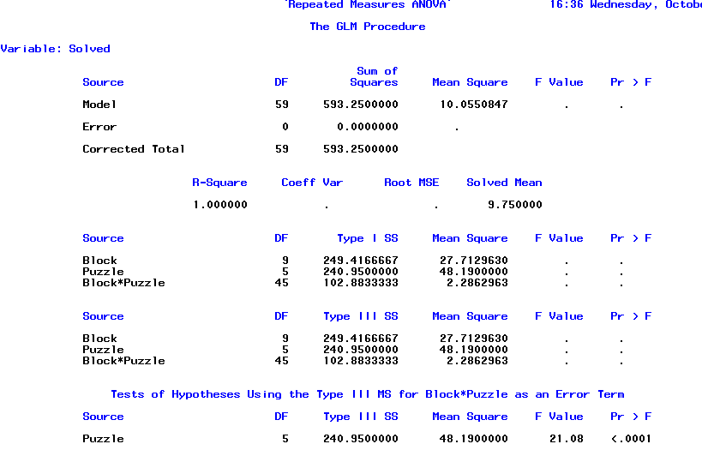
Example 4 Output
See page 1069 of Hays for the Source Table!

Slide 23
To Review
Provided you with templates for future research
Many other things I didn’t go over.
  See “Between-WithinANOVA.sas” from Tuesday’s lecture video and the SAS Manual.
Some resources for conceptual/program help:
  SAS Proc GLM Guide: http://support.sas.com/onlinedoc/913/getDoc/en/statug.hlp/glm_sect7.htm
  Online site:
  http://www.psych.utoronto.ca/courses/c1/chap14/chap14.html
  From my Master’s program:
  http://frank.mtsu.edu/~dkfuller/psy629/
  http://www.mtsu.edu/%7Edkfuller/psy629/notes/uni1wayrmd.pdf
  http://www.mtsu.edu/%7Edkfuller/psy629/notes/uni2wayrmd.pdf

