Slide 1
mean speed
IIV speed
-0.62
IIV speed
mean prey speed
mean prey speed
0.27
-0.01
IIV prey speed
-0.3
0.27
-0.46
IIV prey speed
mean success
-0.1
-0.18
-0.45
0.36

Slide 2
mean speed
IIV speed
-0.70
IIV speed
mean prey speed
mean prey speed
0.31
-0.14
IIV prey speed
-0.36
0.36
-0.47
IIV prey speed
mean success
-0.07
-0.07
-0.39
0.28

Slide 3
mean speed
IIV speed
-0.78
IIV speed
mean prey speed
mean prey speed
0.26
-0.16
IIV prey speed
-0.39
0.34
-0.58
IIV prey speed
mean success
0.05
-0.24
-0.48
0.26

Slide 4
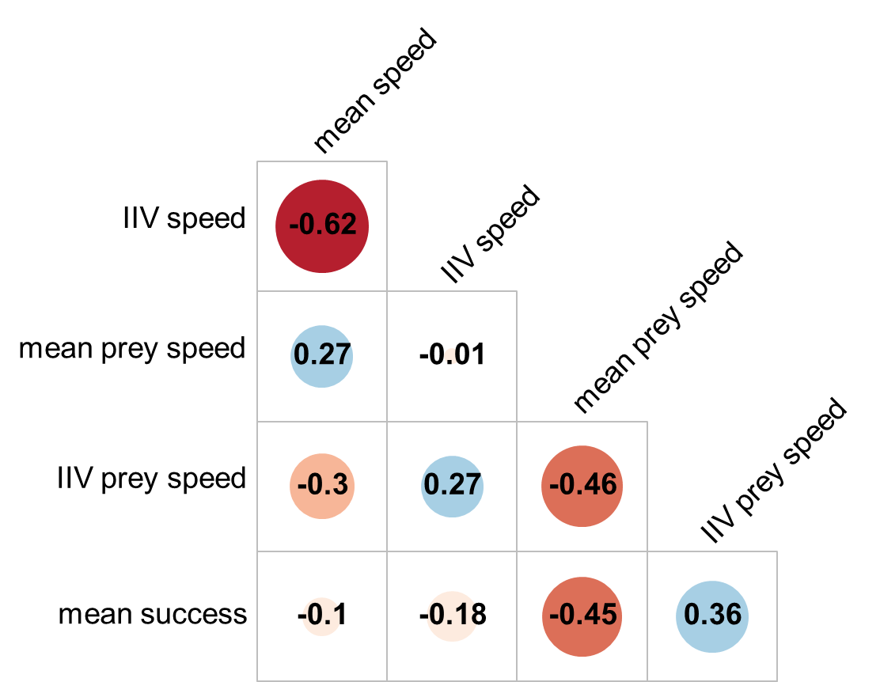
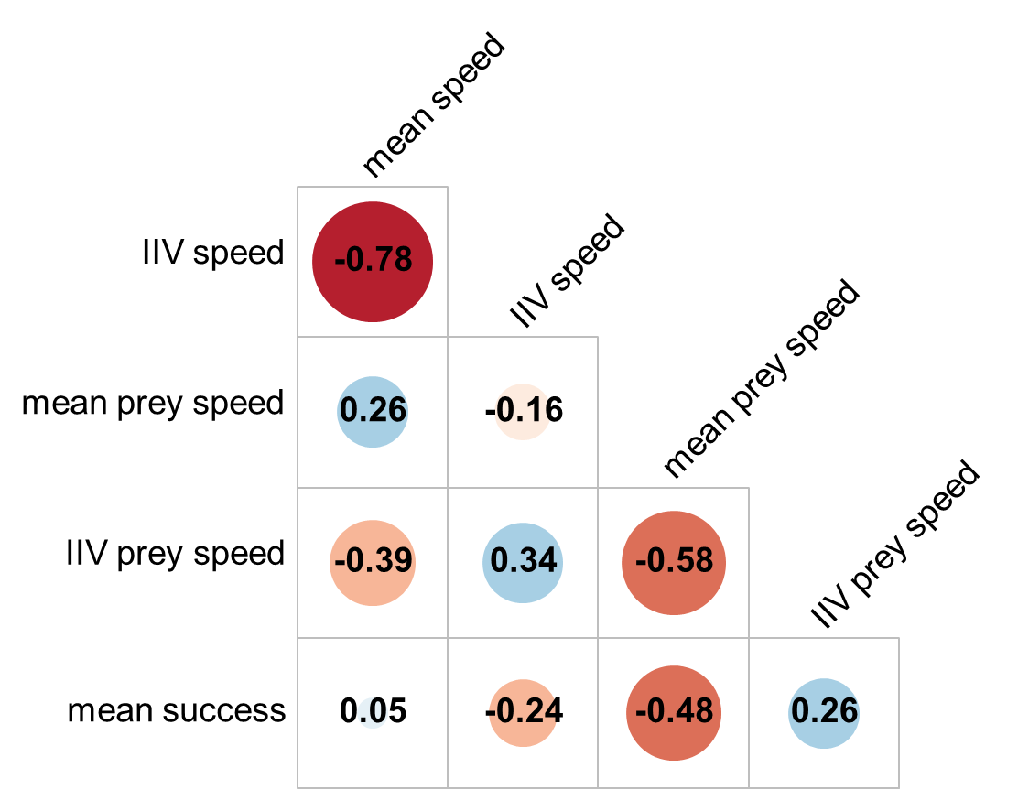
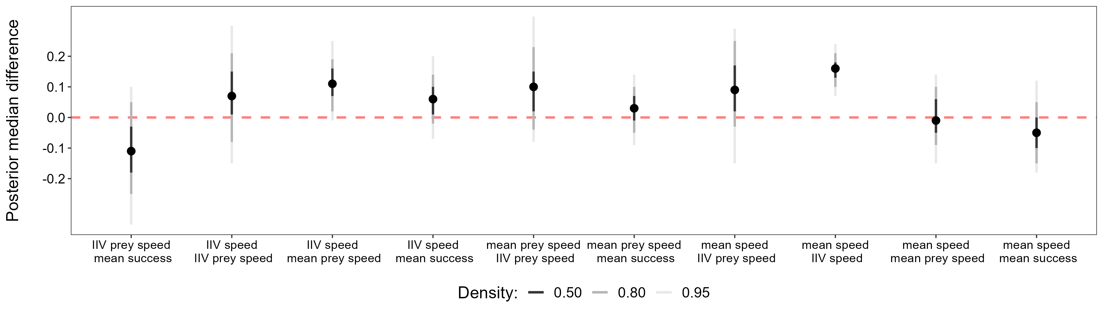
A) Novice
B) Advanced
-1
-0.8
-0.6
-0.4
-0.2
0
0.2
0.4
0.6
0.8
1
C) Advanced vs novice

Slide 5
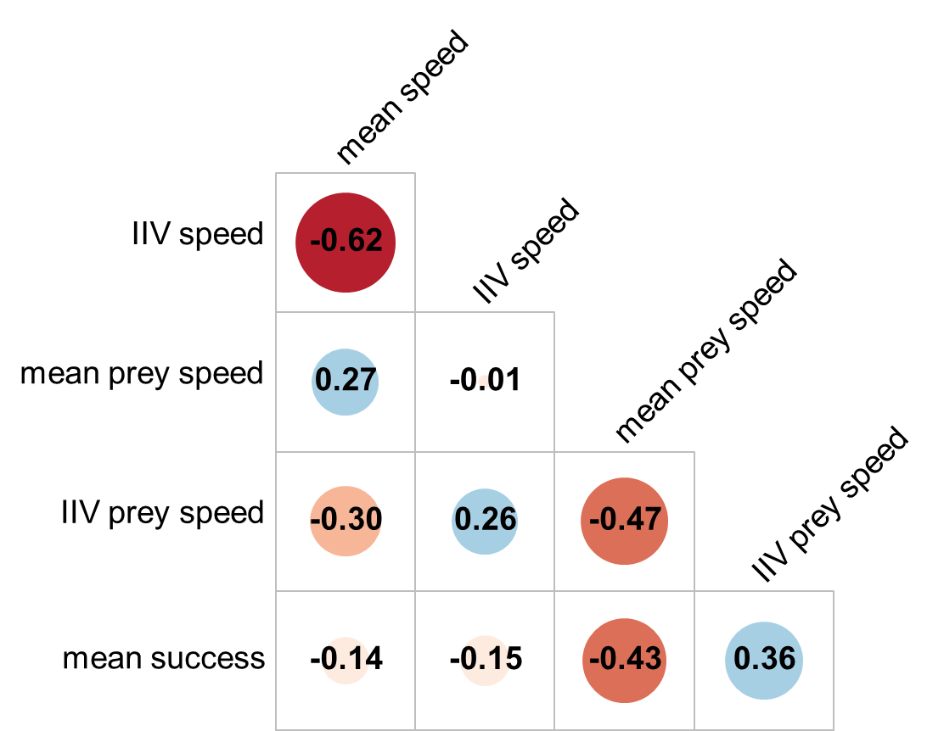
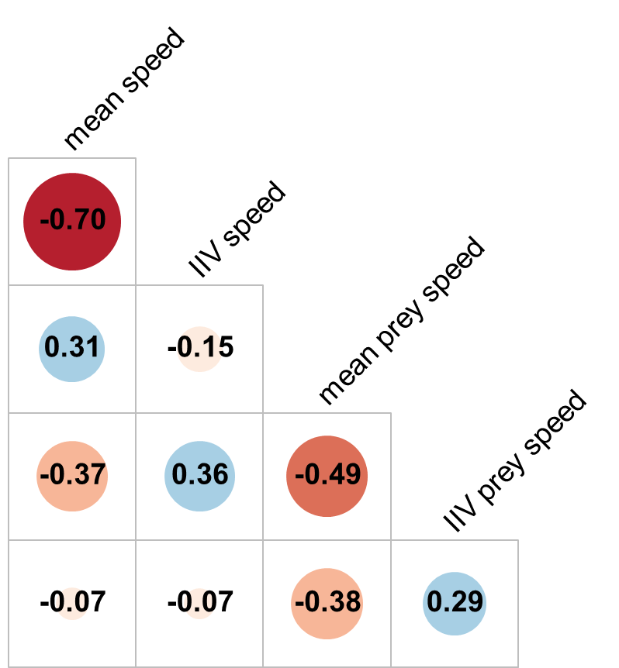
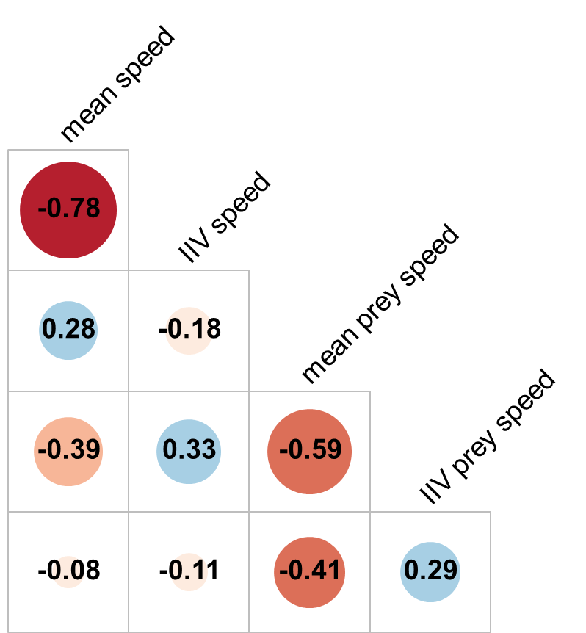
A) Novices
B) Intermediate
C) Advanced
-1
-0.8
-0.6
-0.4
-0.2
0
0.2
0.4
0.6
0.8
1

