Slide 1
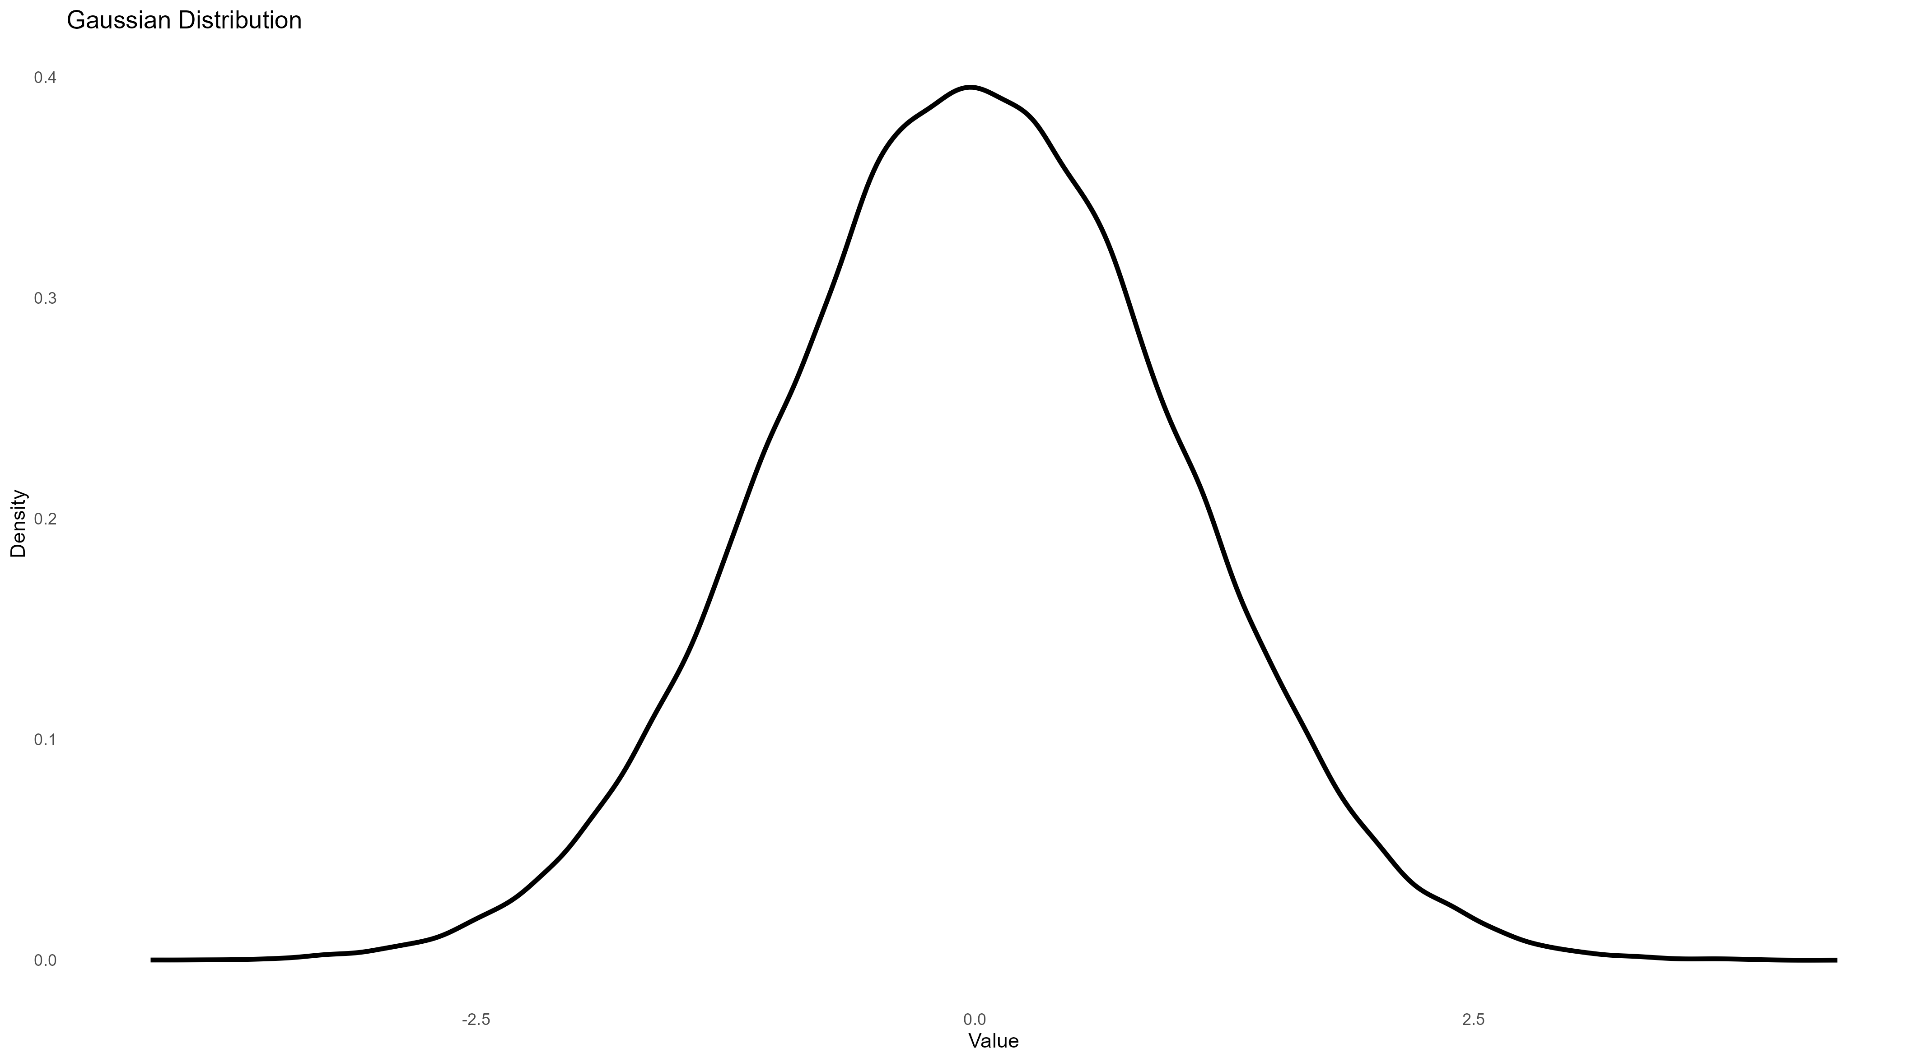
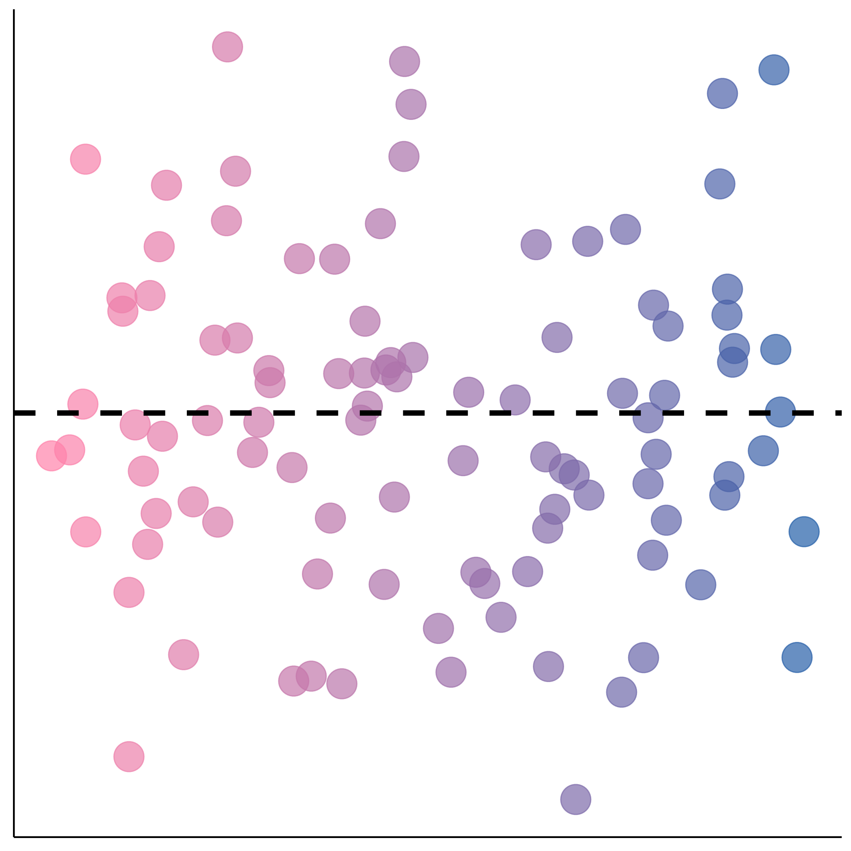
A
B
All predators encounter similar prey
All predators encounter diverse prey
Narrow population variance
Different means (tactics)
Similar IIV (specialisation)
Wide population variance
Different means (tactics)
Similar IIV (specialisation)
C
Some predators encounter similar prey, others encounter diverse prey
Learned to hunt according to prey
Hunting success
Did not learn to hunt according to prey
Specialist
IIV
Wide population variance
Different means (tactics)
Differences in IIV (specialisation)
Generalist

