Slide 1
speed
0.268
latency
-0.347
0.133
avg. prey speed
0.309
-0.178
0.073
var. prey speed
-0.198
-0.003
0.079
speed
latency
avg. prey speed
var. prey speed

Slide 2
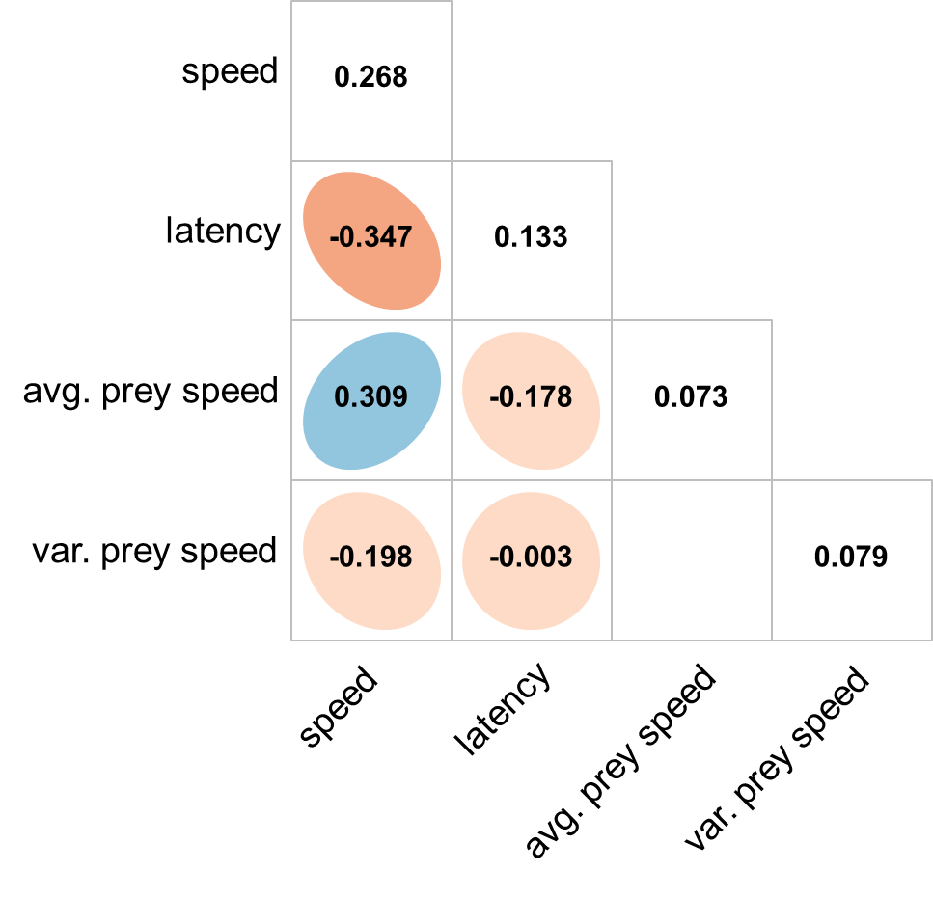

Slide 3
speed
0.317
latency
-0.441
0.167
avg. prey speed
0.394
-0.401
0.108
var. prey speed
-0.288
0.275
1.012
speed
latency
avg. prey speed
var. prey speed

Slide 4
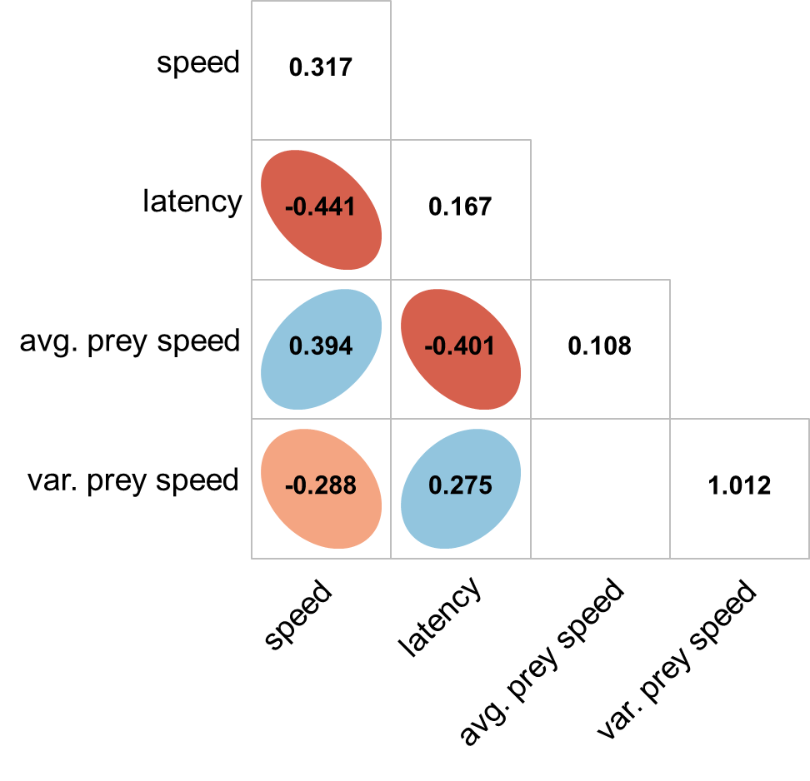

Slide 5
1
speed
0.328
0.8
0.6
0.4
latency
-0.349
0.225
0.2
0
avg. prey speed
0.125
-0.174
0.115
-0.2
-0.4
-0.6
var. prey speed
-0.426
0.309
0.345
-0.8
-1
speed
latency
avg. prey speed
var. prey speed

Slide 6
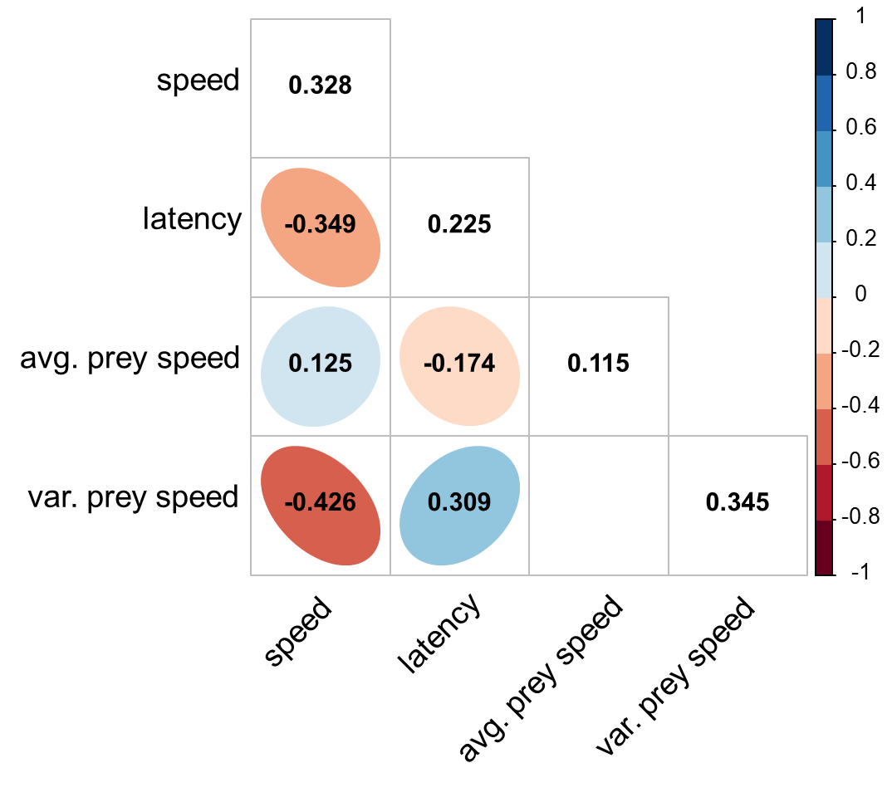

Slide 7
A) Novice state
B) Intermediate state
C) Advanced state

