Slide 1
mean speed
IIV speed
-0.62
IIV speed
mean prey speed
mean prey speed
0.27
-0.01
IIV prey speed
-0.30
0.27
-0.46
IIV prey speed
mean success
-0.10
-0.18
-0.45
0.36

Slide 2
mean speed
IIV speed
-0.70
IIV speed
mean prey speed
mean prey speed
0.31
-0.14
IIV prey speed
-0.36
0.36
-0.47
IIV prey speed
mean success
-0.07
-0.07
-0.39
0.28

Slide 3
mean speed
IIV speed
-0.78
IIV speed
mean prey speed
mean prey speed
0.26
-0.16
IIV prey speed
-0.39
0.34
-0.58
IIV prey speed
mean success
0.05
-0.24
-0.48
0.26

Slide 4
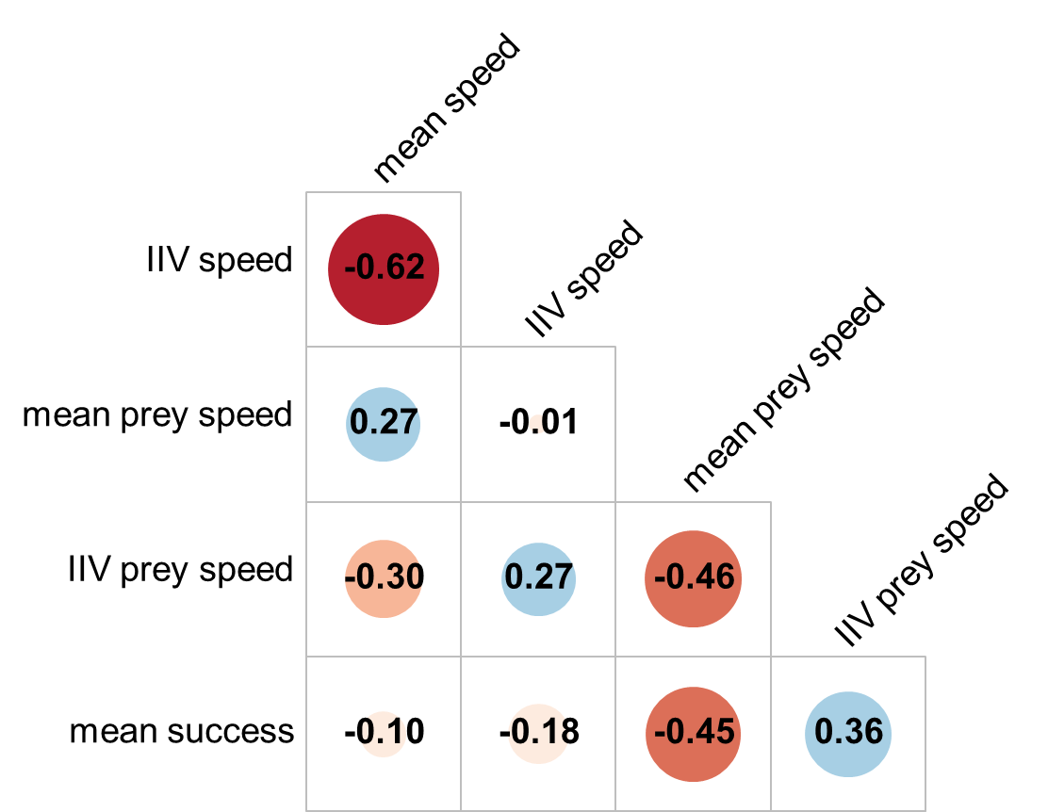
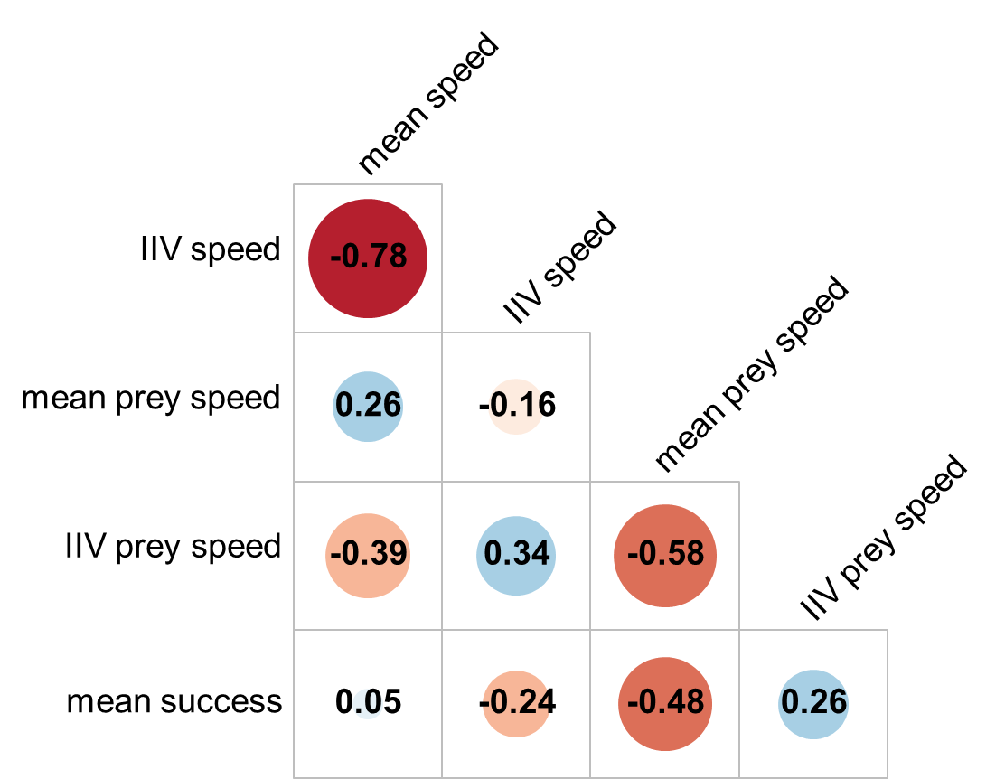
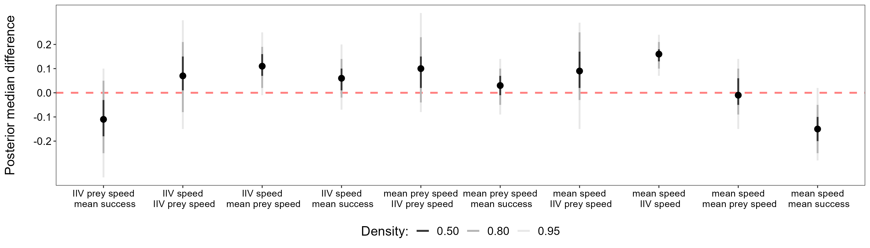
A) Novice
B) Advanced
-1
-0.8
-0.6
-0.4
-0.2
0
0.2
0.4
0.6
0.8
1
C) Advanced vs novice

Slide 5
mean speed
IIV speed
-0.62
(-0.70,-0.55)
IIV speed
mean prey speed
mean prey speed
0.27
(0.15, 0.38)
-0.02
(-0.14, 0.10)
IIV prey speed
-0.30
(-0.49,-0.13)
0.27
(0.11, 0.49)
-0.47
(-0.64,-0.30)
IIV prey speed
mean success
-0.10
(-0.22, 0.01)
-0.18
(-0.29,-0.07)
-0.45
(-0.55,-0.35)
0.37
(0.20, 0.56)

Slide 6
mean speed
IIV speed
-0.78
(-0.83,-0.72)
IIV speed
mean prey speed
mean prey speed
0.26
(0.16, 0.38)
-0.16
(-0.27,-0.04)
IIV prey speed
-0.39
(-0.52,-0.26)
0.35
(0.21, 0.47)
-0.58
(-0.69,-0.45)
IIV prey speed
mean success
0.05
(-0.06, 0.16)
-0.24
(-0.35,-0.14)
-0.48
(-0.57,-0.38)
0.26
(0.13, 0.41)

Slide 7
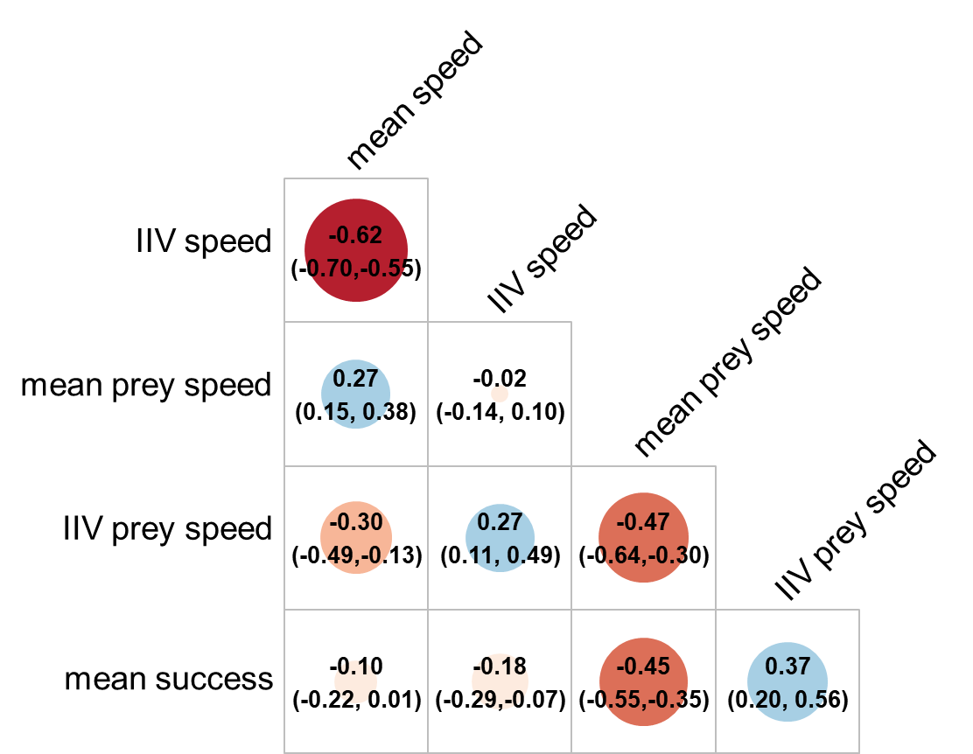


A) Novice
B) Advanced
-1
-0.8
-0.6
-0.4
-0.2
0
0.2
0.4
0.6
0.8
1
C) Advanced vs novice

Slide 8
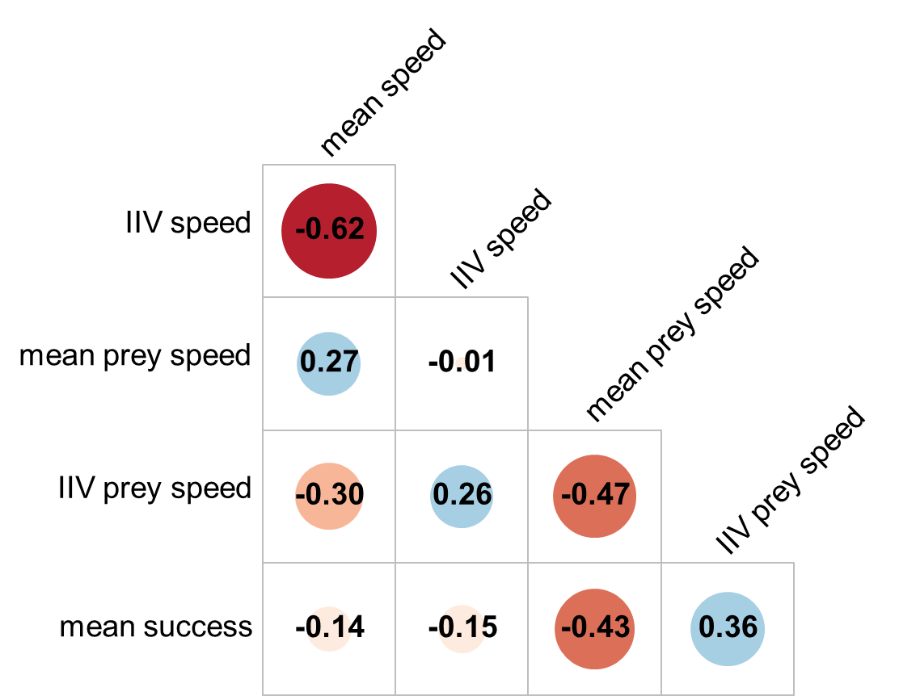
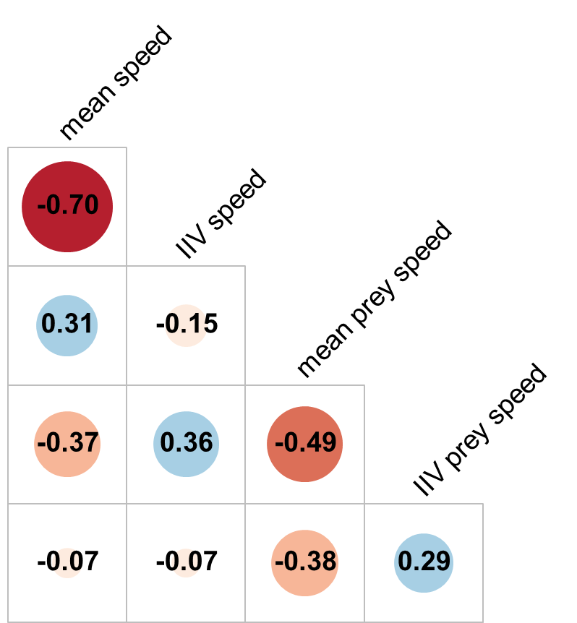
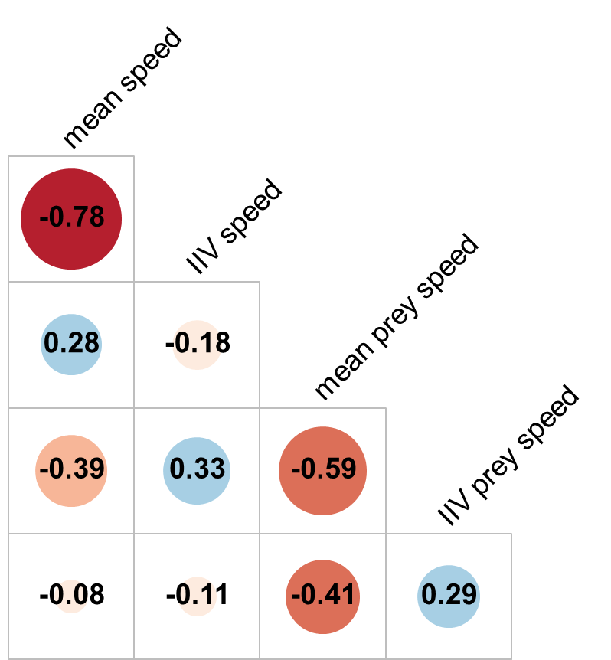
A) Novices
B) Intermediate
C) Advanced
-1
-0.8
-0.6
-0.4
-0.2
0
0.2
0.4
0.6
0.8
1

