Slide 1
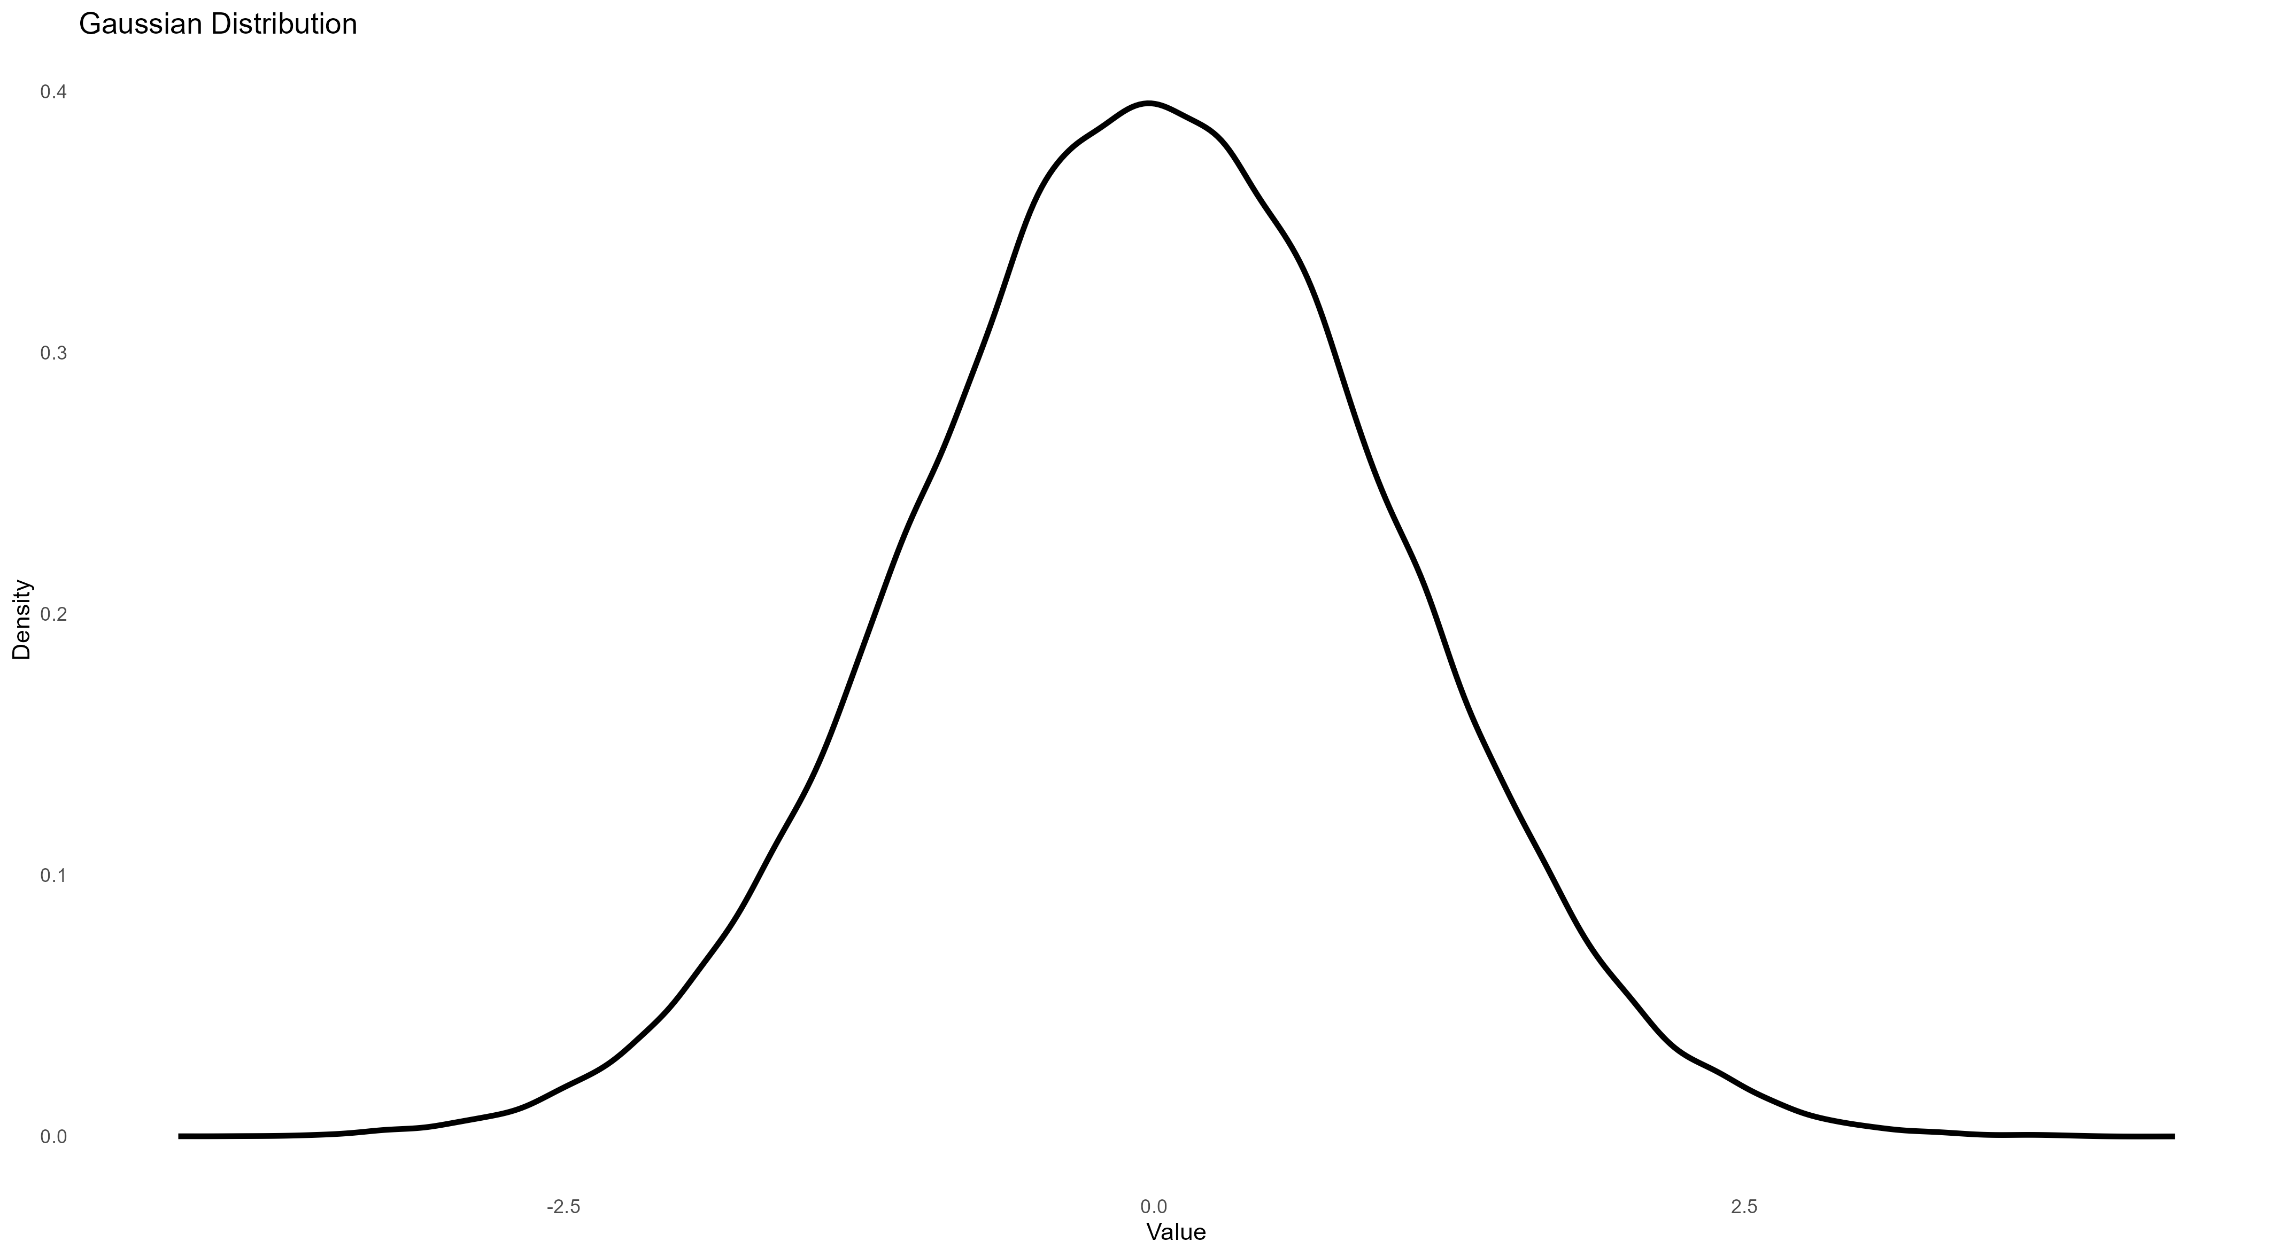
A
B
All predators encounter similar prey
All predators encounter diverse prey
Narrow population variance
Different means (tactics)
Similar IIV (specialisation)
Wide population variance
Different means (tactics)
Similar IIV (specialisation)
C
Some predators encounter similar prey, others encounter diverse prey
Wide population variance
Different means (tactics)
Differences in IIV (specialisation)

