Slide 1
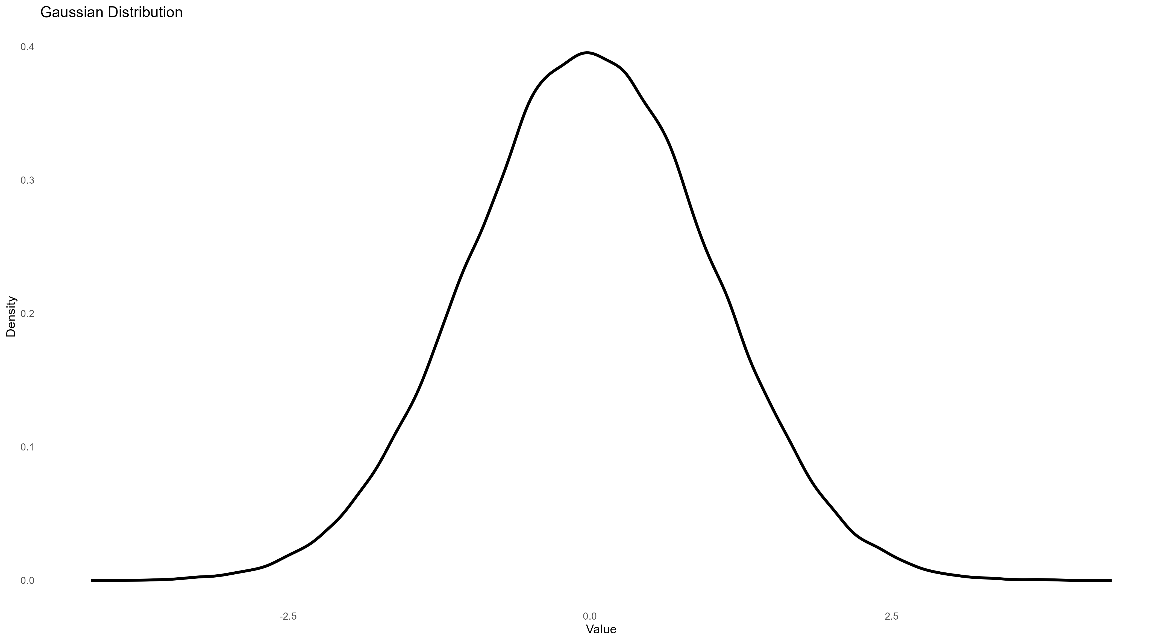
A
B
All predators encounter similar prey
All predators encounter diverse prey
Narrow population variance
same IIV
Wide population variance
same IIV
C
Some predators encounter similar prey, others encounter diverse prey
Wide population variance
Differences in IIV

