Slide 1
mean speed
IIV speed
-0.62
IIV speed
mean prey speed
mean prey speed
0.27
-0.01
IIV prey speed
-0.30
0.26
-0.47
IIV prey speed
mean success
-0.13
-0.15
-0.43
0.36

Slide 2
mean speed
IIV speed
-0.71
IIV speed
mean prey speed
mean prey speed
0.35
-0.17
IIV prey speed
-0.41
0.38
-0.53
IIV prey speed
mean success
-0.07
-0.07
-0.36
0.24

Slide 3
mean speed
IIV speed
-0.72
IIV speed
mean prey speed
mean prey speed
0.41
-0.18
IIV prey speed
-0.40
0.34
-0.59
IIV prey speed
mean success
0.03
-0.11
-0.26
0.25

Slide 4
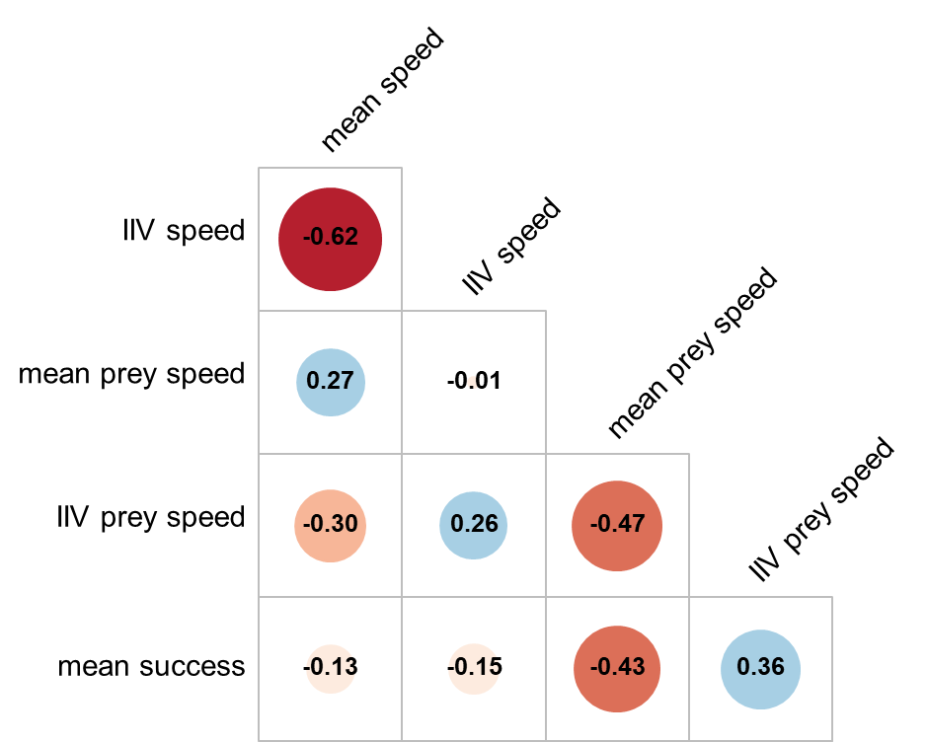
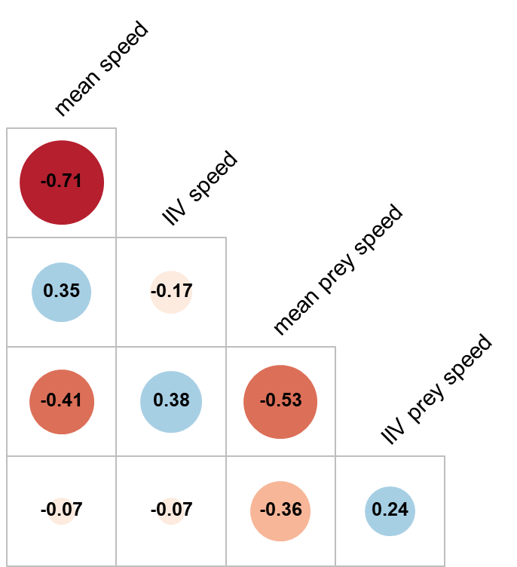
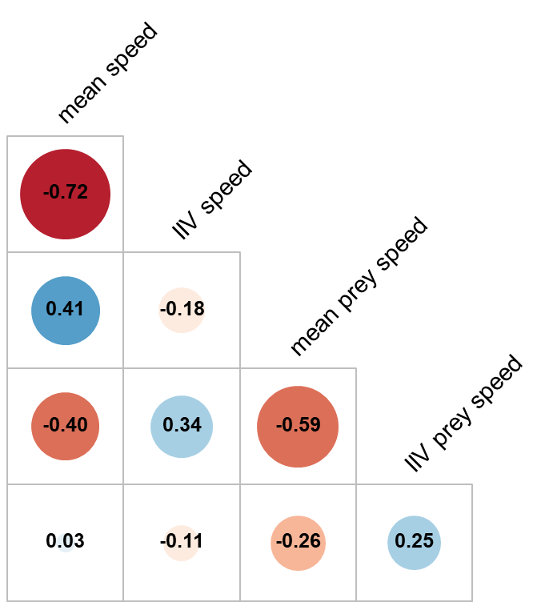
A) Novices
B) Intermediate
C) Advanced
-1
-0.8
-0.6
-0.4
-0.2
0
0.2
0.4
0.6
0.8
1

