Slide 1
1
speed
0.379
0.8
0.6
ambush
-0.007
0.224
0.4
0.2
latency
-0.315
-0.099
0.212
0
-0.2
avg. prey speed
0.289
-0.139
-0.176
-0.4
-0.6
var. prey speed
-0.148
-0.018
-0.056
-0.8
-1
speed
ambush
latency
avg. prey speed
var. prey speed

Slide 2
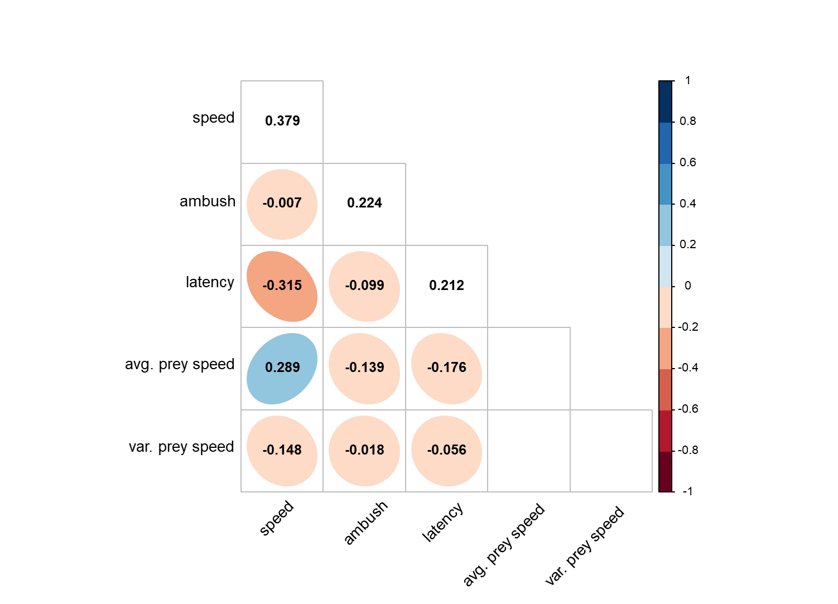

Slide 3
1
speed
0.608
0.8
0.6
ambush
-0.057
0.322
0.4
0.2
latency
-0.449
-0.075
0.36
0
-0.2
avg. prey speed
0.459
-0.098
-0.443
-0.4
-0.6
var. prey speed
-0.317
0.064
0.308
-0.8
-1
speed
ambush
latency
avg. prey speed
var. prey speed

Slide 4
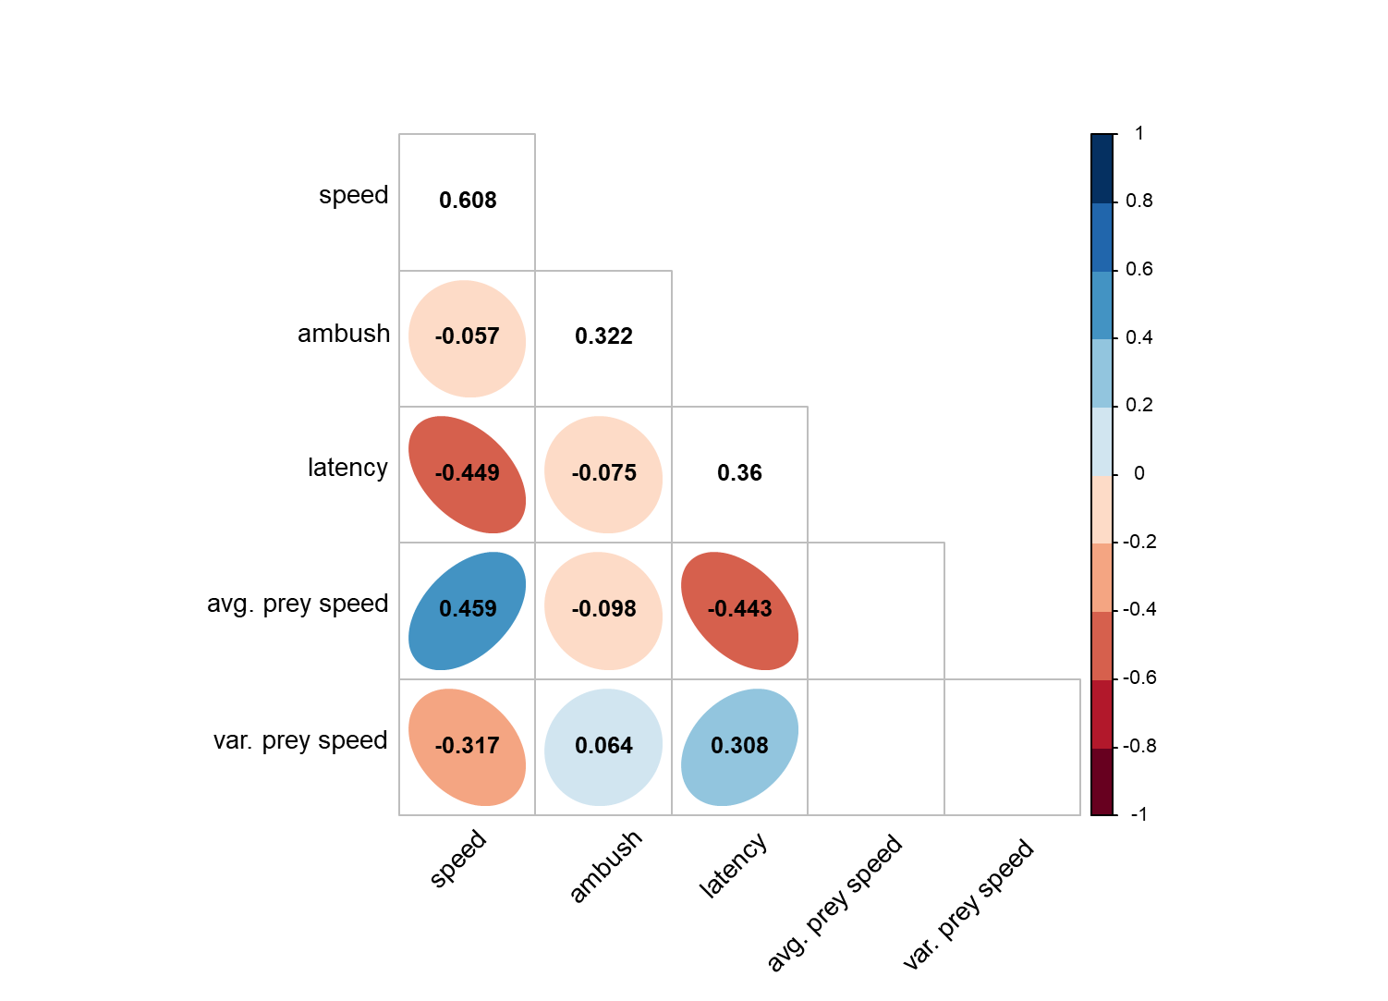

Slide 5
1
speed
0.504
0.8
0.6
ambush
0.076
0.23
0.4
0.2
latency
-0.387
-0.113
0.383
0
-0.2
avg. prey speed
0.164
-0.004
-0.175
-0.4
-0.6
var. prey speed
-0.333
-0.206
0.174
-0.8
-1
speed
ambush
latency
avg. prey speed
var. prey speed

Slide 6
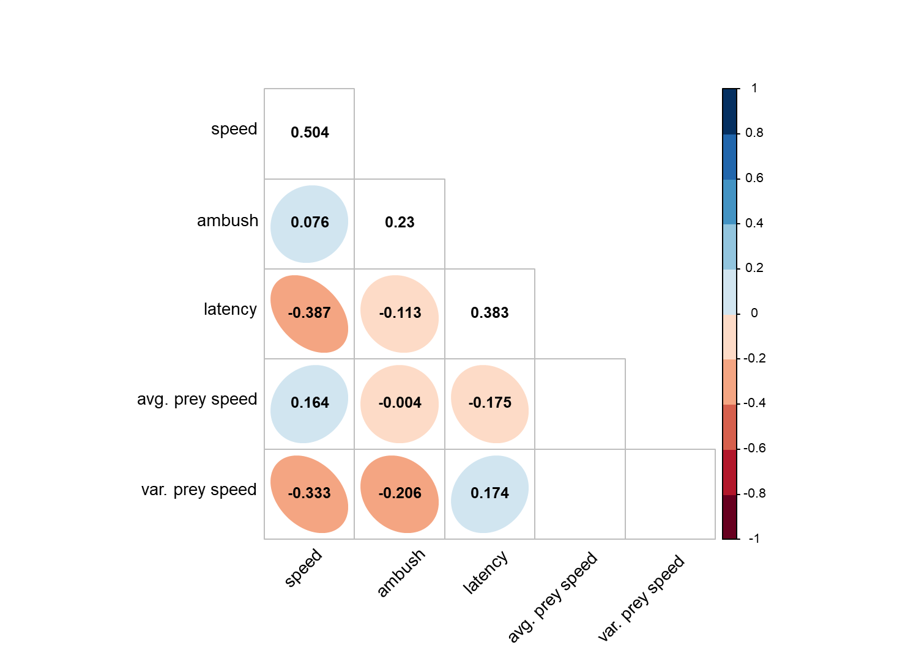

Slide 7
A) Novice state
B) Intermediate state
C) Advanced state

Slide 8
