Slide 1
1
speed
0.268
0.8
0.6
ambush
0.116
0.141
0.4
0.2
latency
-0.347
-0.433
0.133
0
-0.2
avg. prey speed
0.309
-0.022
-0.178
0.073
-0.4
-0.6
var. prey speed
-0.198
-0.028
-0.003
0.079
-0.8
-1
speed
ambush
latency
avg. prey speed
var. prey speed

Slide 2
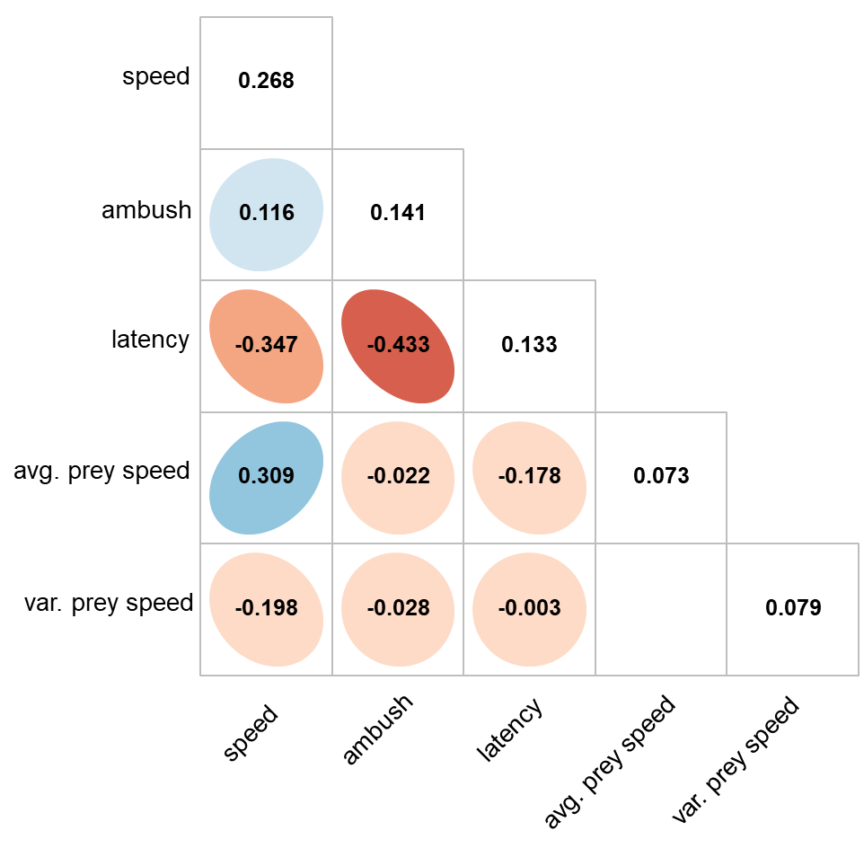

Slide 3
1
speed
0.317
0.8
0.6
ambush
0.159
0.163
0.4
0.2
latency
-0.441
-0.343
0.167
0
-0.2
avg. prey speed
0.394
0.016
-0.401
0.108
-0.4
-0.6
var. prey speed
-0.288
-0.052
0.275
1.012
-0.8
-1
speed
ambush
latency
avg. prey speed
var. prey speed

Slide 4
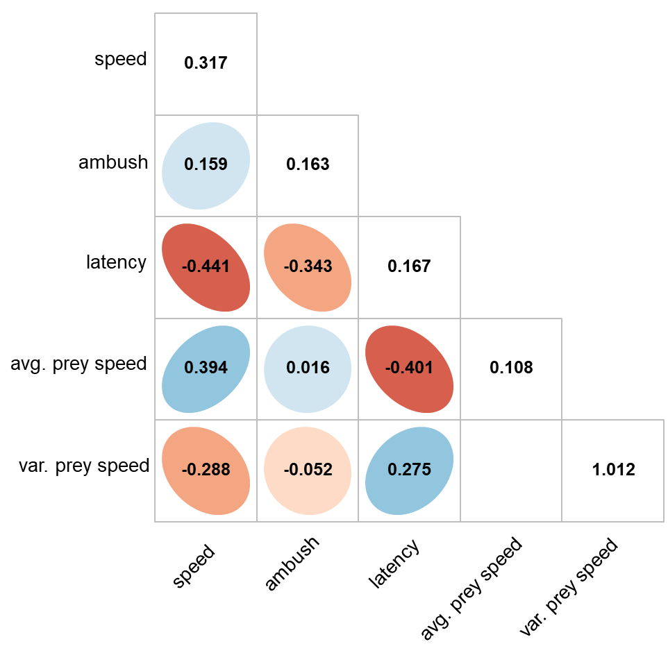

Slide 5
1
speed
0.328
0.8
0.6
ambush
0.361
0.177
0.4
0.2
latency
-0.349
-0.464
0.225
0
-0.2
avg. prey speed
0.125
0.11
-0.174
0.115
-0.4
-0.6
var. prey speed
-0.426
-0.237
0.309
0.345
-0.8
-1
speed
ambush
latency
avg. prey speed
var. prey speed

Slide 6
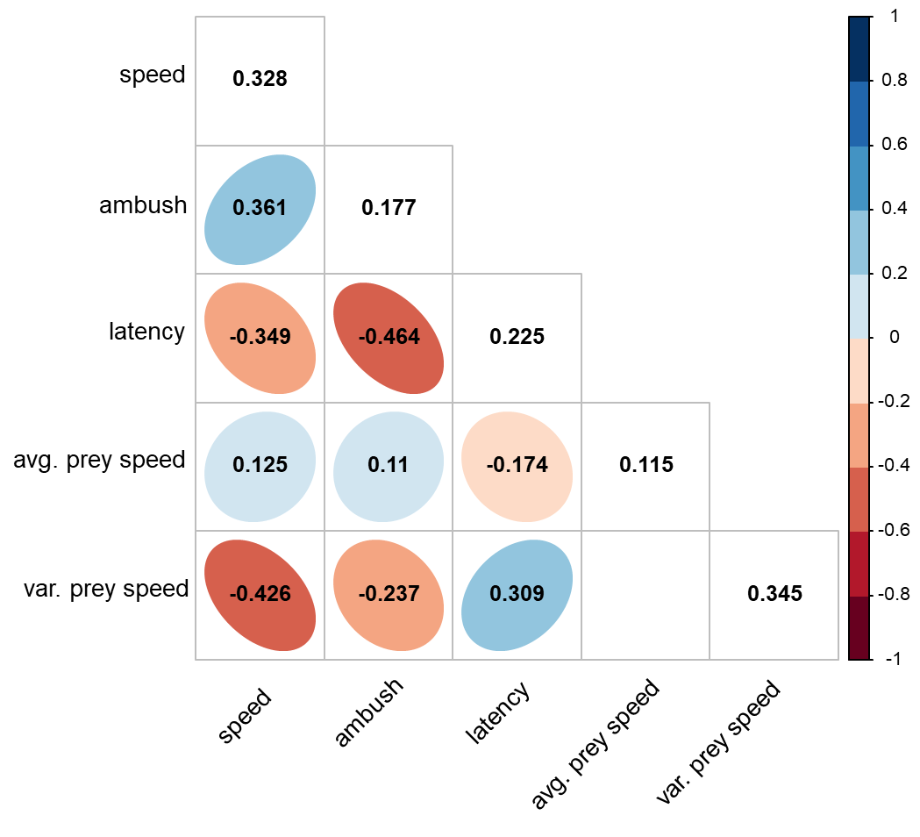

Slide 7
A) Novice state
B) Intermediate state
C) Advanced state

