Slide 1
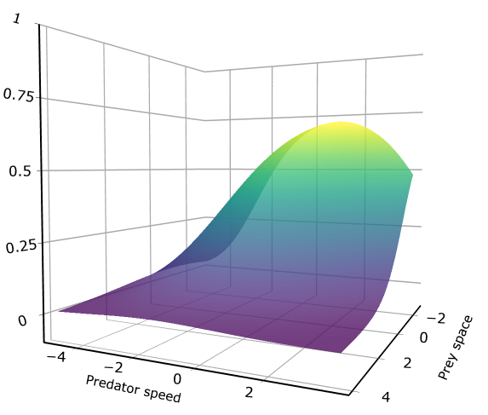
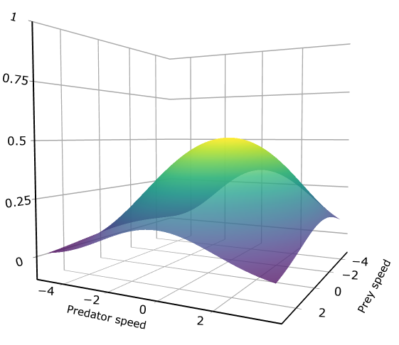
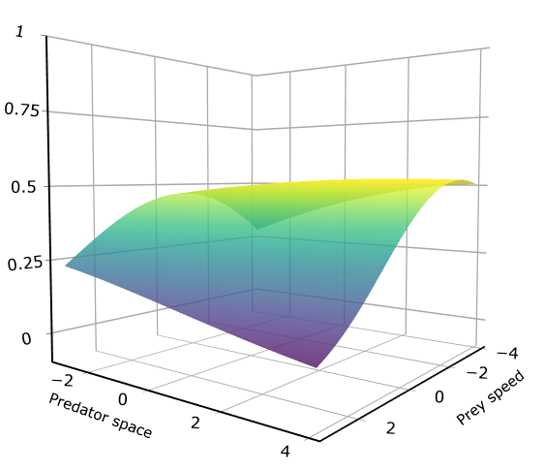
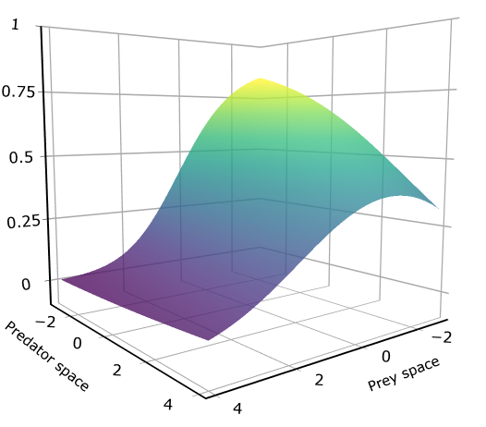
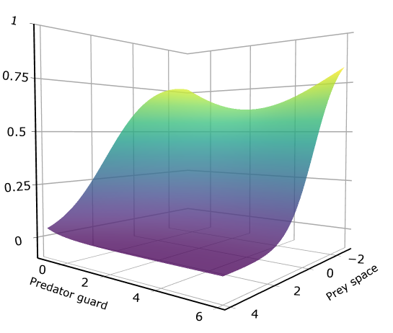
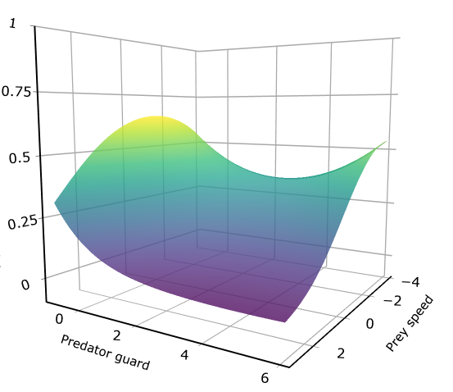
A)
B)
C)
Hunting success
Prey
space
Prey
speed
Prey
speed
Predator
speed
Predator
speed
Predator
space
D)
E)
F)
Hunting success
Predator
space
Prey
space
Predator
ambush
Prey
space
Predator
ambush
Prey
speed

Slide 2
(A)
(B)
(C)
Hunting success
Prey
space
Prey
speed
Prey
speed
Predator
speed
Predator
speed
Predator
space
(D)
(E)
(F)
Hunting success
Predator
space
Prey
space
Predator
ambush
Prey
space
Predator
ambush
Prey
speed

Slide 3
(A)
(B)
(C)
Hunting success
Prey
space
Prey
speed
Prey
speed
Predator
speed
Predator
speed
Predator
space
(D)
(E)
(F)
Hunting success
Predator
space
Prey
space
Predator
ambush
Prey
space
Predator
ambush
Prey
speed

Slide 4
