Slide 1
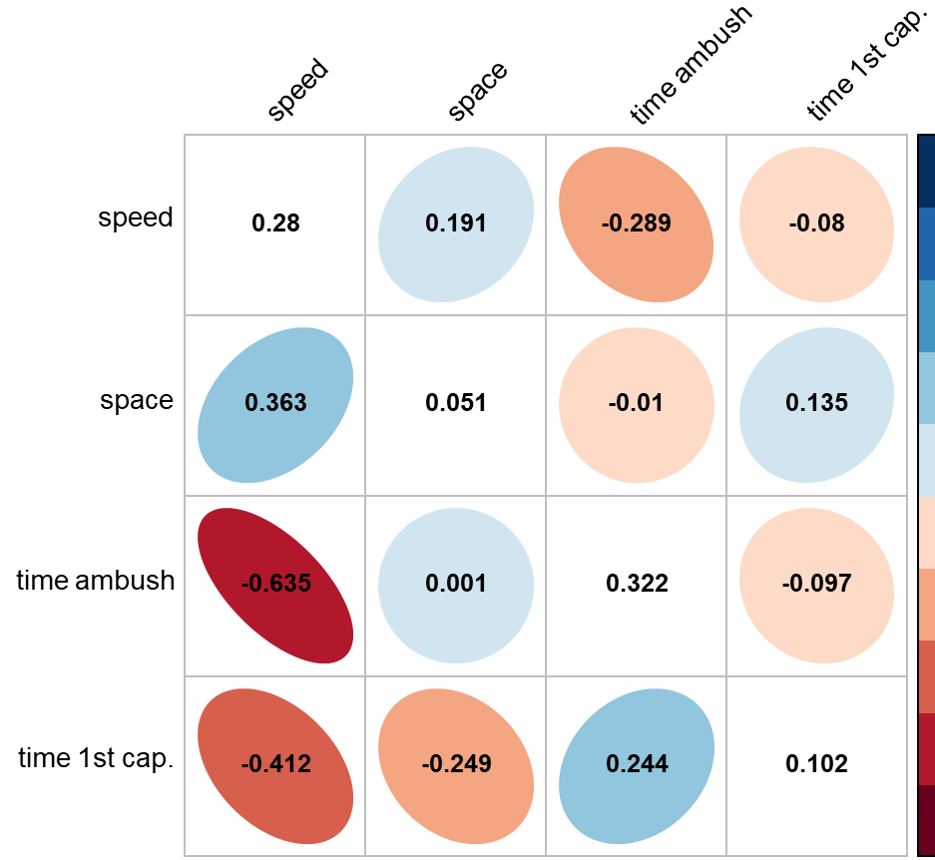
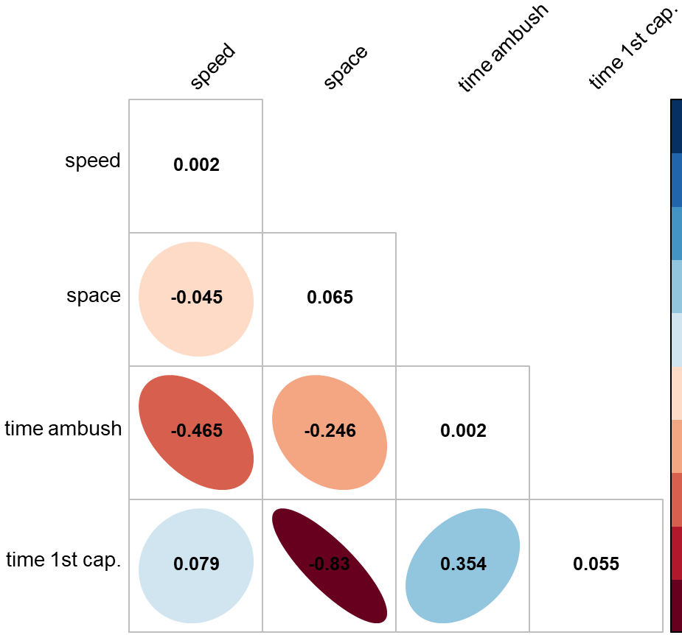
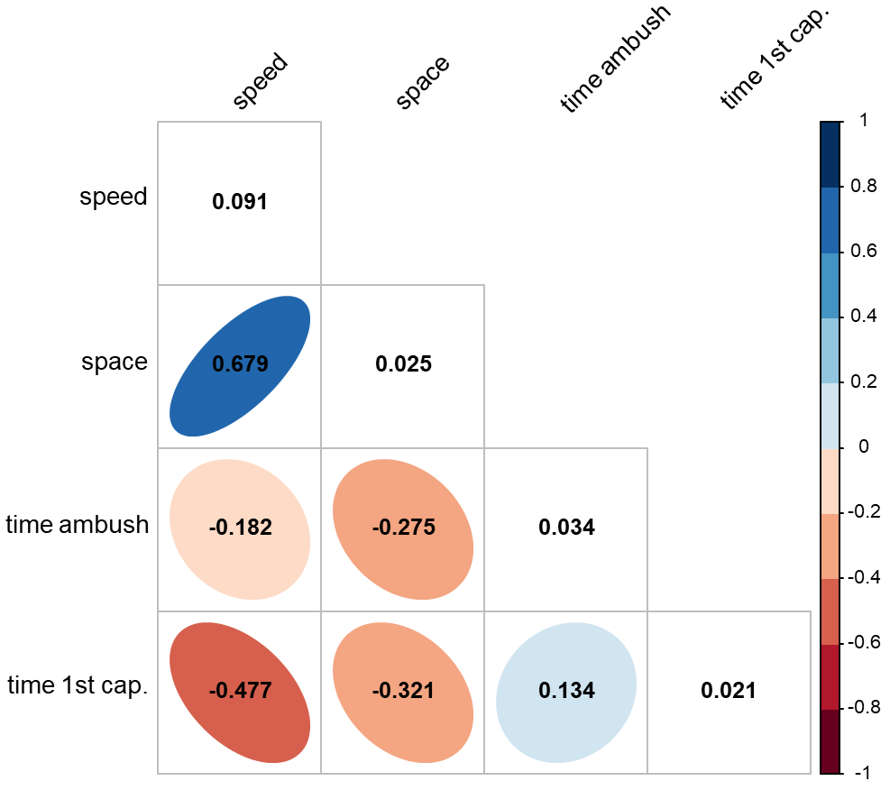

Slide 2
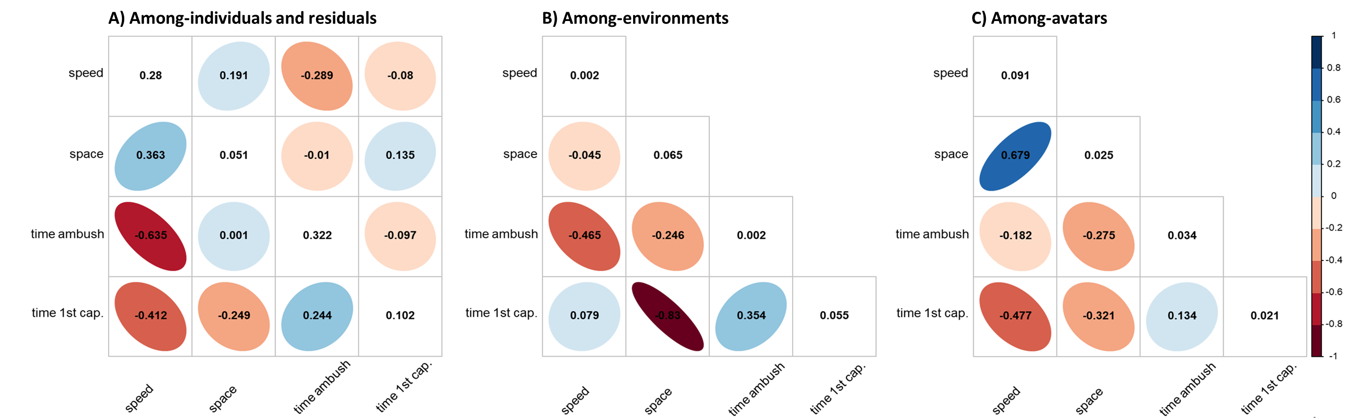

Slide 3
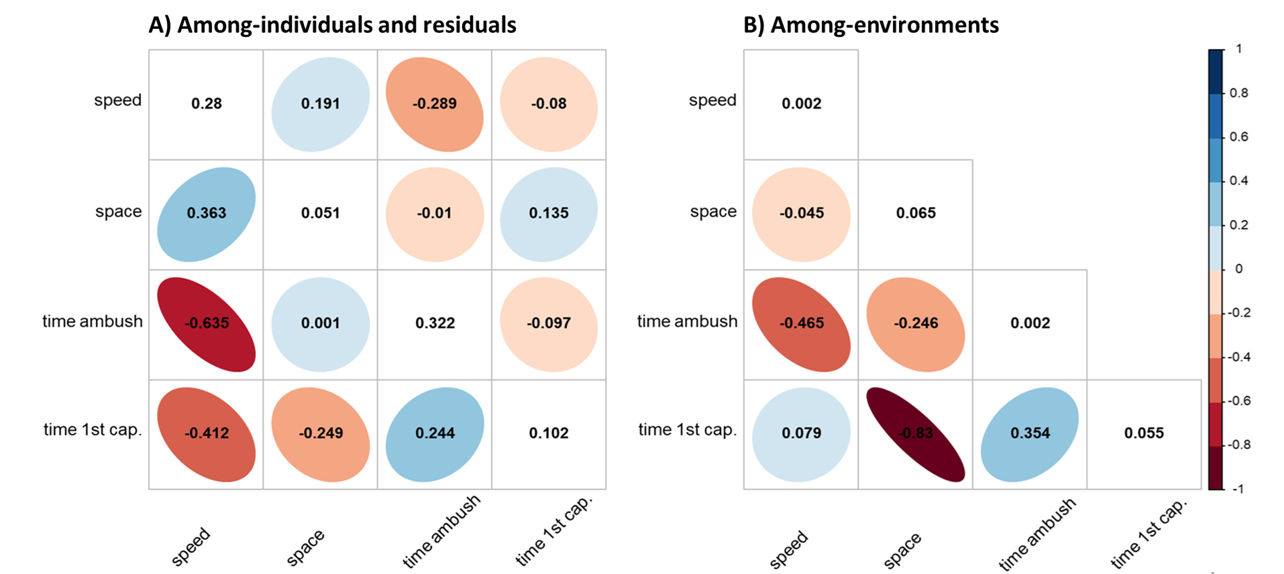

Slide 4
1
speed
0.280
0.191
-0.289
-0.080
speed
0.002
space
0.363
0.051
-0.010
0.135
space
-0.045
0.065
0
time in ambush
-0.635
0.001
0.322
-0.097
time in ambush
-0.465
-0.246
0.002
time 1st cap.
-0.412
-0.249
0.244
0.102
time 1st cap.
0.079
-0.830
0.354
0.055
speed
space
-1
time in ambush
time 1st cap.
speed
space
time in ambush
time 1st cap.

Slide 5
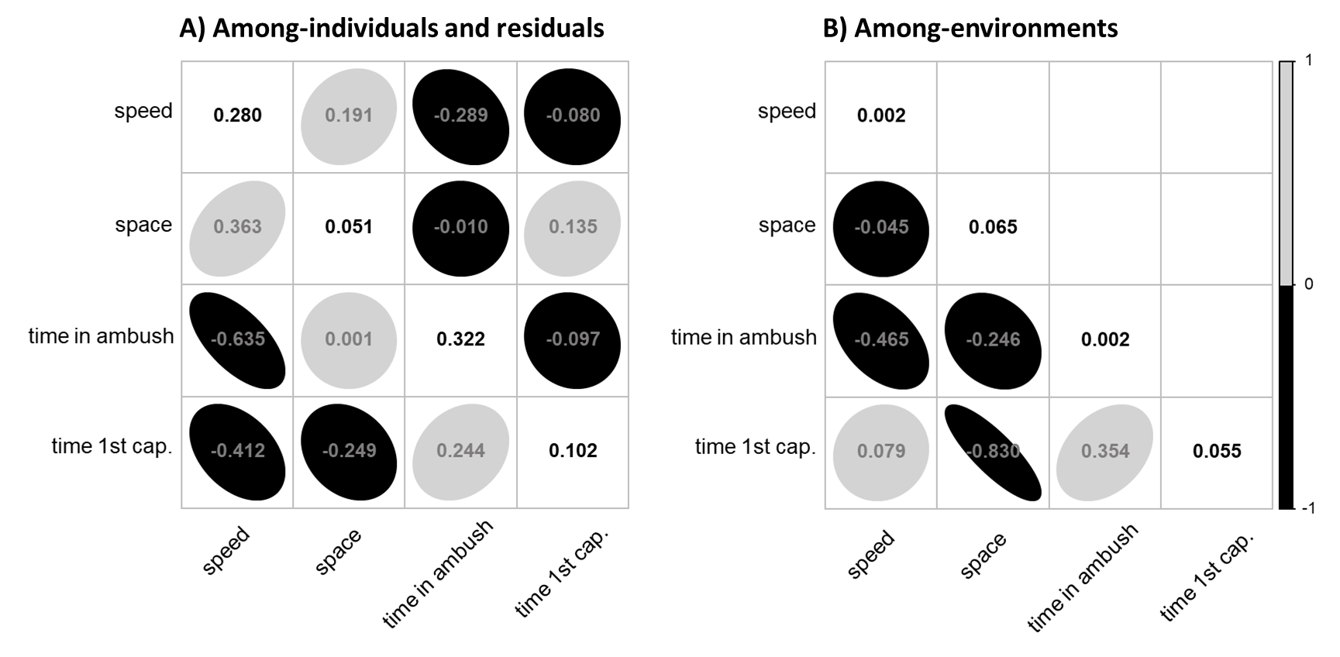

Slide 6
1
speed
0.280
0.191
-0.289
-0.080
speed
0.002
space
0.363
0.051
-0.010
0.135
space
-0.045
0.065
0
ambush time
-0.635
0.001
0.322
-0.097
ambush time
-0.465
-0.246
0.002
time 1st cap.
-0.412
-0.249
0.244
0.102
time 1st cap.
0.079
-0.830
0.354
0.055
speed
space
-1
ambush time
time 1st cap.
speed
space
ambush time
time 1st cap.

Slide 7
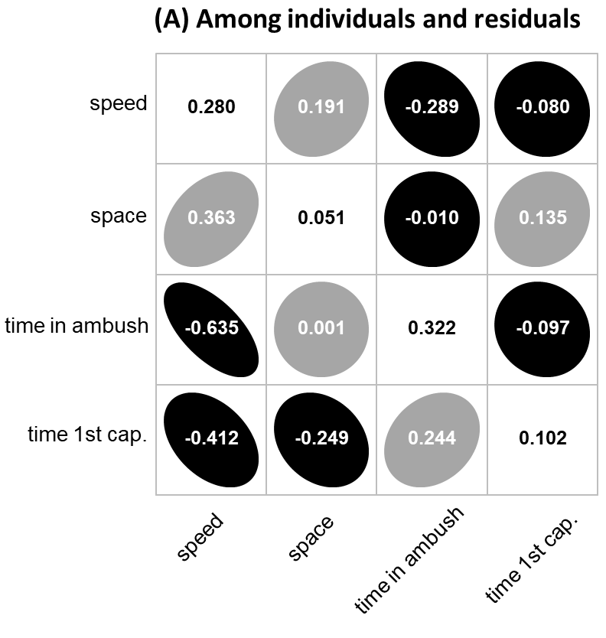
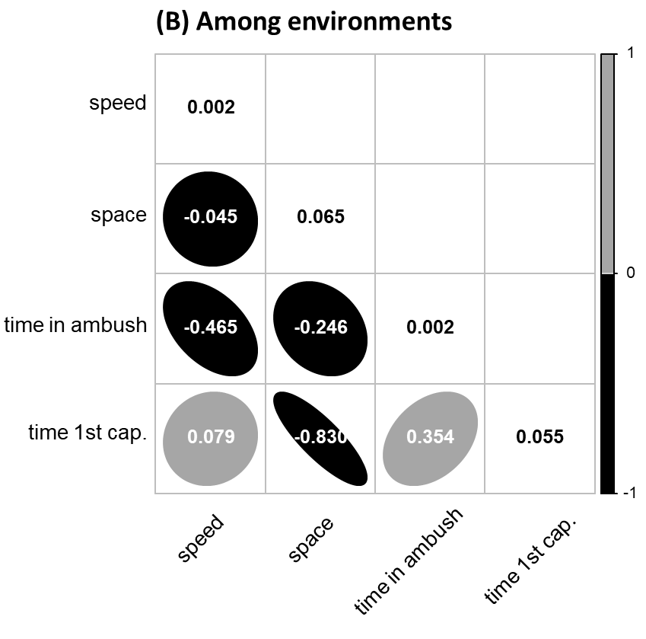

Slide 8
