Slide 1
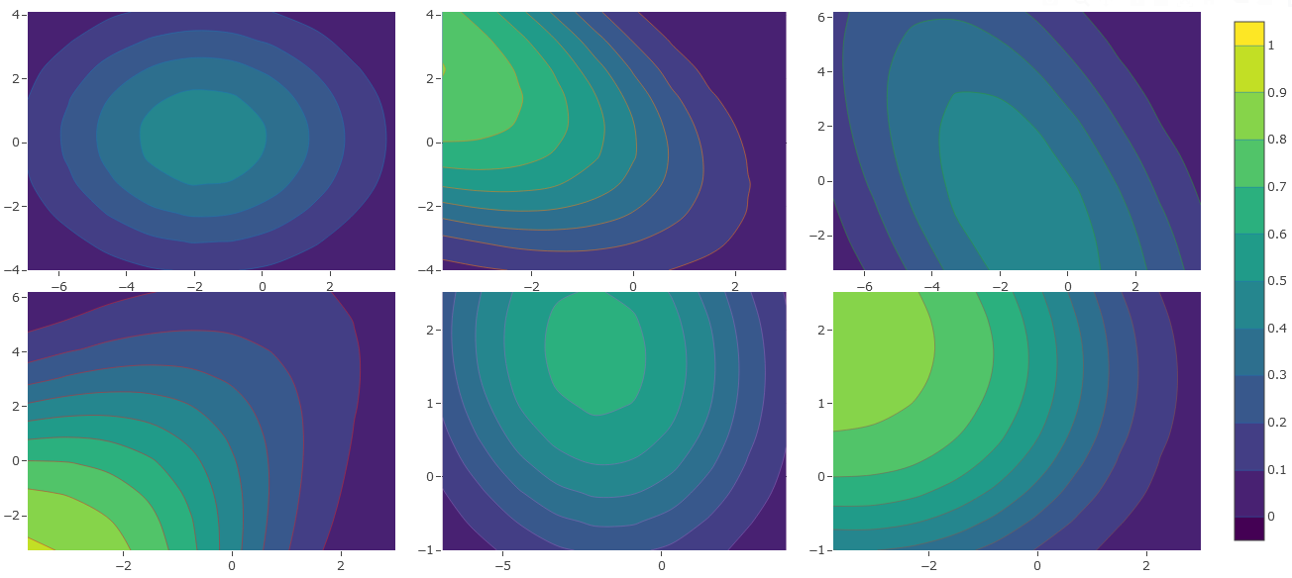
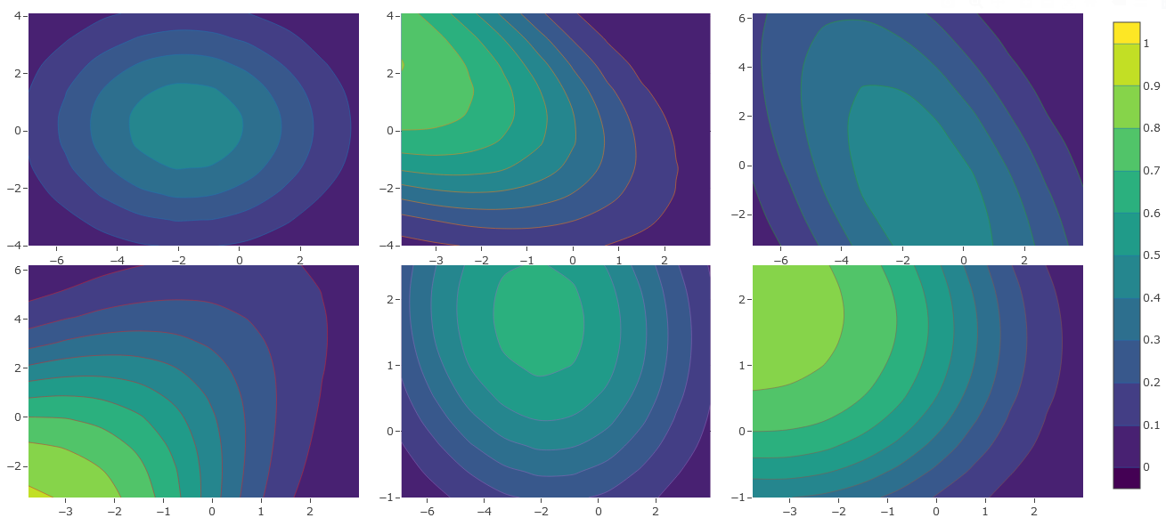
(A)
(B)
(C)
Hunting success
Travel speed
Travel speed
Rate of space covered
Prey travel speed
Prey rate of space covered
Prey travel speed
(D)
(E)
(F)
Rate of space covered
Time spent guarding
Time spent guarding
Prey rate of space covered
Prey travel speed
Prey rate of space covered

