Slide 1
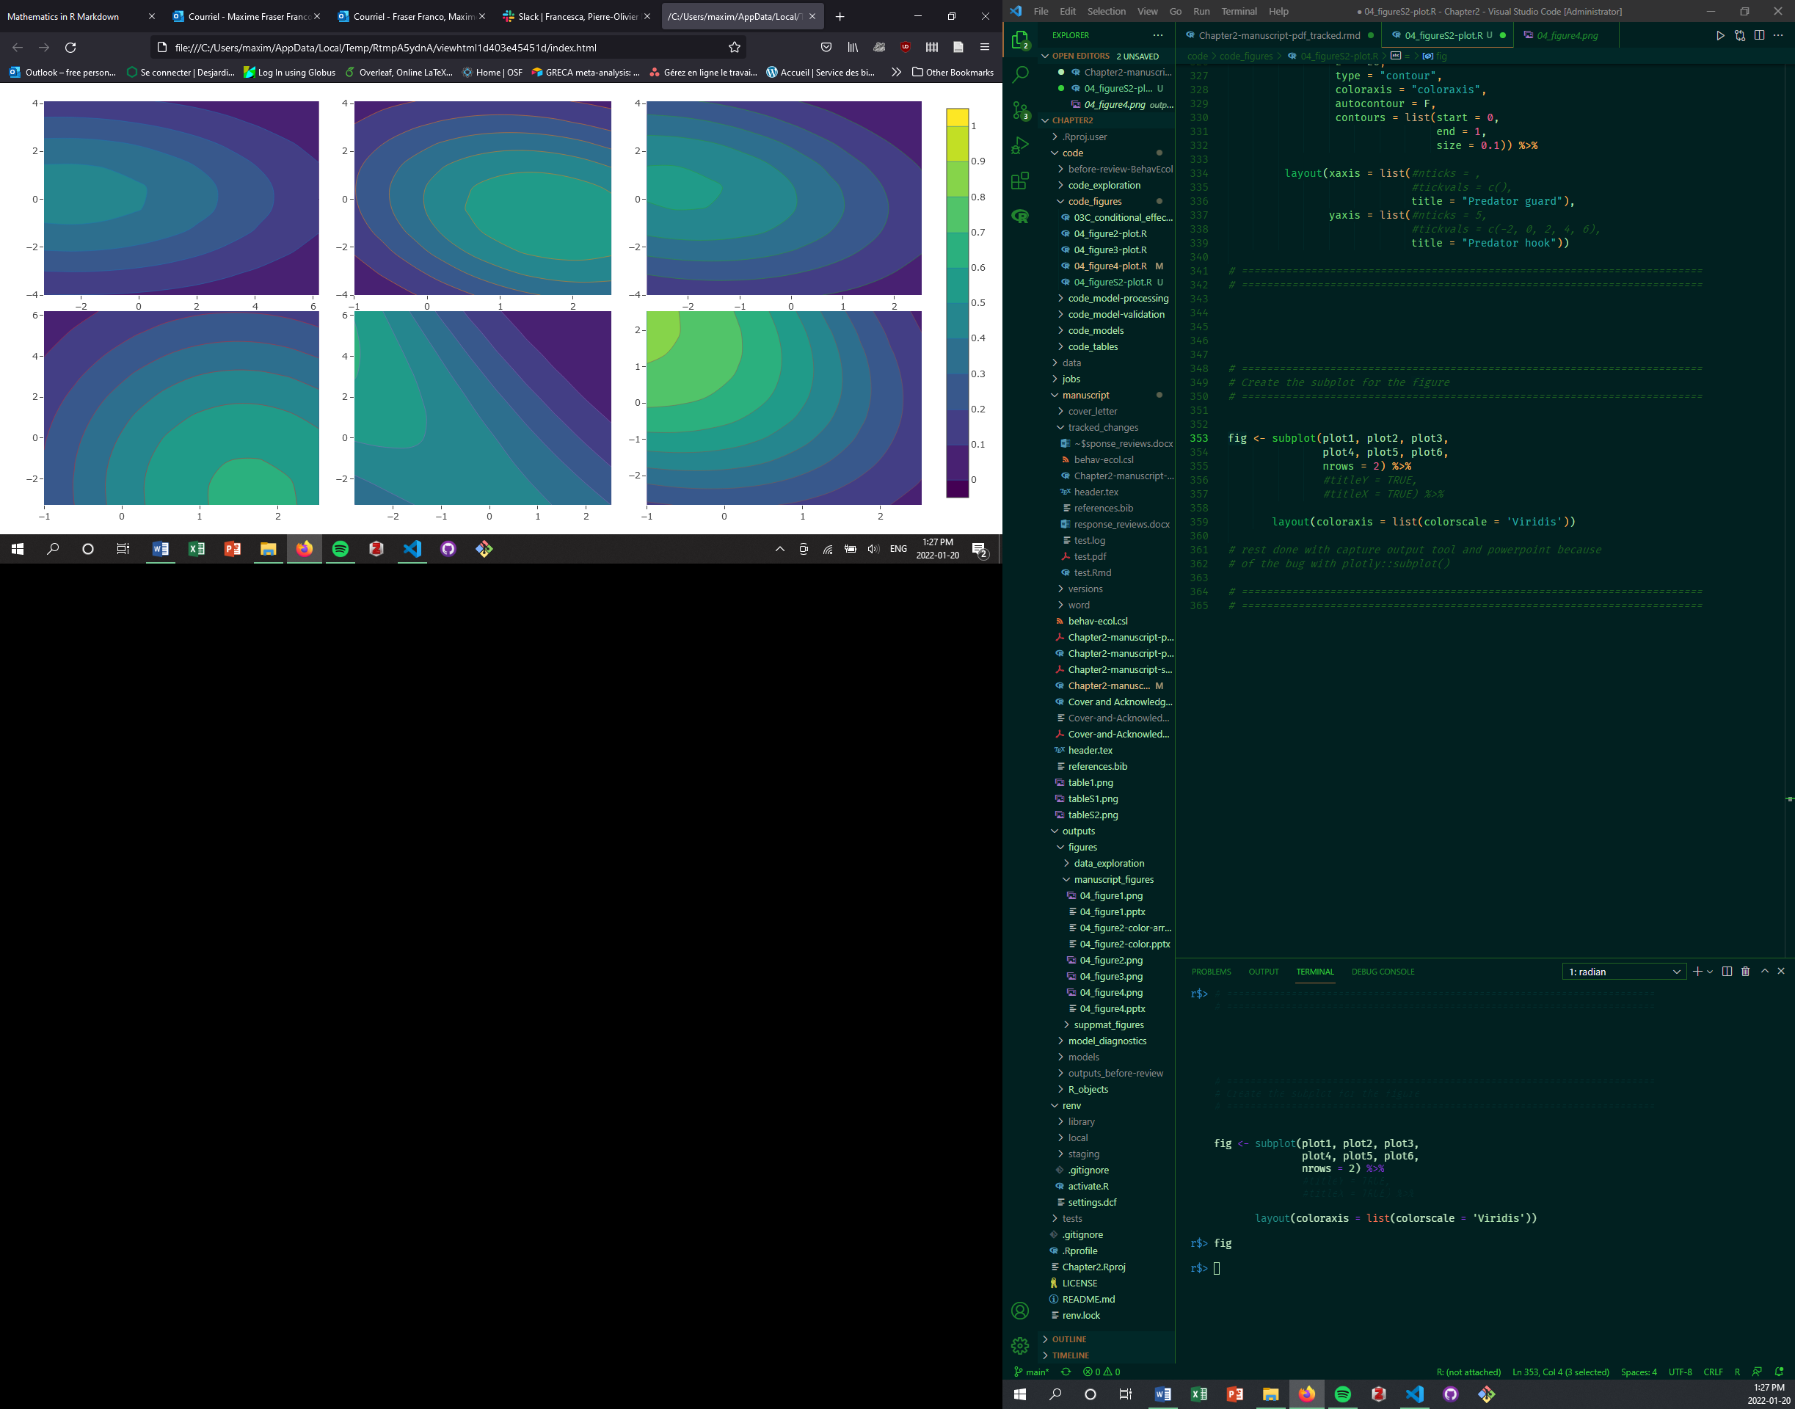

Slide 2
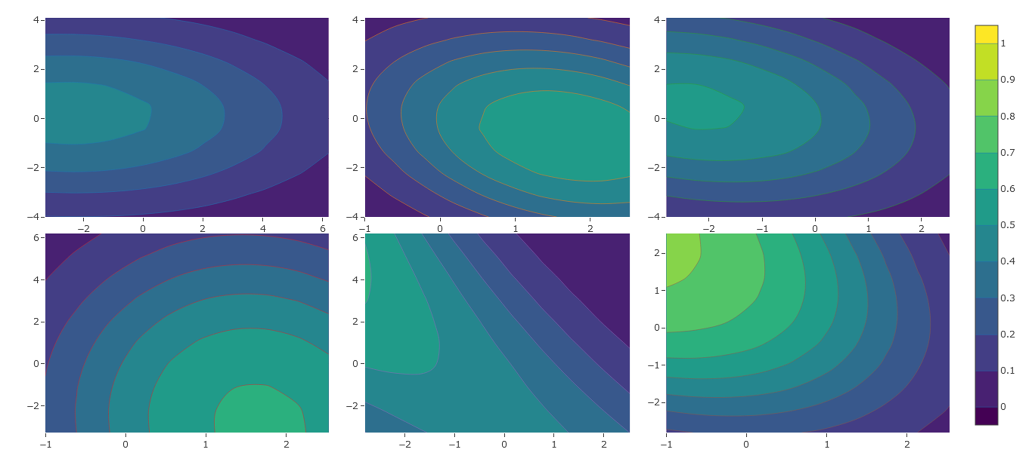
(A)
(B)
(C)
Hunting success
Travel speed
Travel speed
Travel speed
Rate of space covered
Time spent guarding
Time for 1st capture
(D)
(E)
(F)
Rate of space covered
Rate of space covered
Time spent guarding
Time spent guarding
Time for 1st capture
Time for 1st capture

