Slide 1
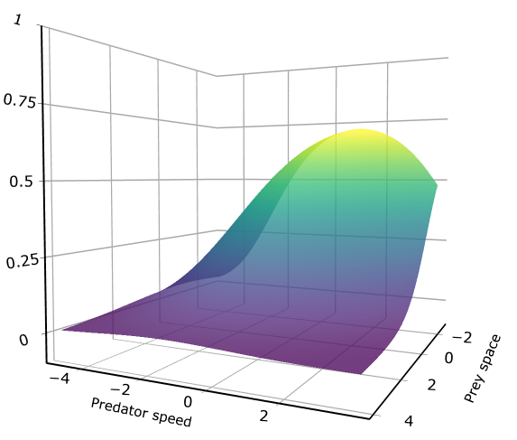
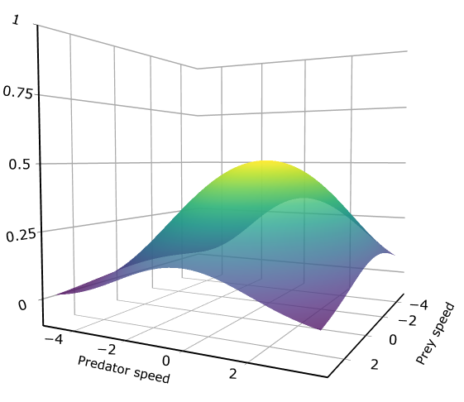
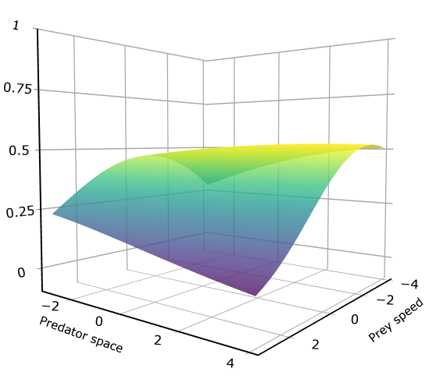
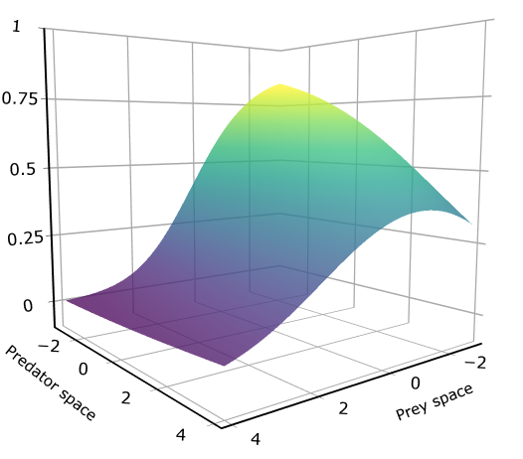
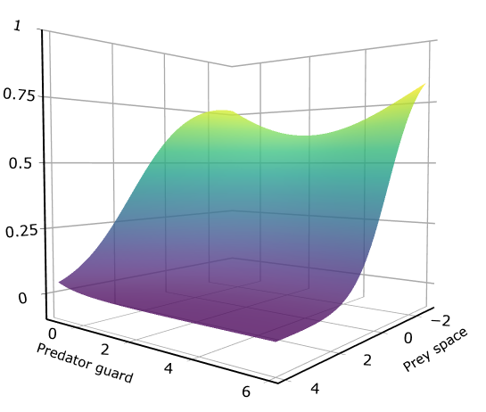
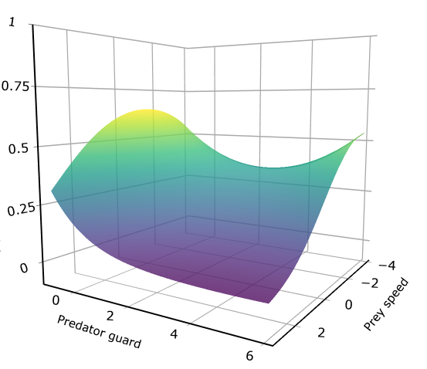
A)
B)
C)
Probability of capturing 4 prey
Prey
space
Prey
speed
Prey
speed
Predator
speed
Predator
speed
Predator
space
D)
E)
F)
Probability of capturing 4 prey
Predator
space
Prey
space
Predator
ambush
Prey
space
Predator
ambush
Prey
speed

Slide 2
A)
B)
C)
Probability of capturing 4 prey
Prey
space
Prey
speed
Prey
speed
Predator
speed
Predator
speed
Predator
space
D)
E)
F)
Probability of capturing 4 prey
Predator
space
Prey
space
Predator
ambush
Prey
space
Predator
ambush
Prey
speed

Slide 3
