Slide 1
prey guarding
time 1st cap.
speed
space
1
speed
0.277
0.264
-0.039
-0.099
0.8
0.6
0.4
space
0.44
0.057
-0.157
0.014
0.2
0
prey guarding
0.018
0.052
0.263
-0.409
-0.2
-0.4
-0.6
time 1st cap.
-0.441
-0.137
-0.616
0.211
-0.8
-1

Slide 2
1
speed
0.277
0.264
-0.039
-0.099
0.8
0.6
0.4
space
0.440
0.057
-0.157
0.014
0.2
0
prey guarding
0.018
0.052
0.263
-0.409
-0.2
-0.4
-0.6
time 1st cap.
-0.441
-0.137
-0.616
0.211
-0.8
-1
speed
space
prey guarding
time 1st cap.

Slide 3
1
speed
0.002
0.8
0.6
0.4
space
0.202
0.04
0.2
0
prey guarding
0.207
0.706
0.014
-0.2
-0.4
-0.6
time 1st cap.
0.013
-0.763
-0.876
0.022
-0.8
-1
speed
space
prey guarding
time 1st cap.

Slide 4
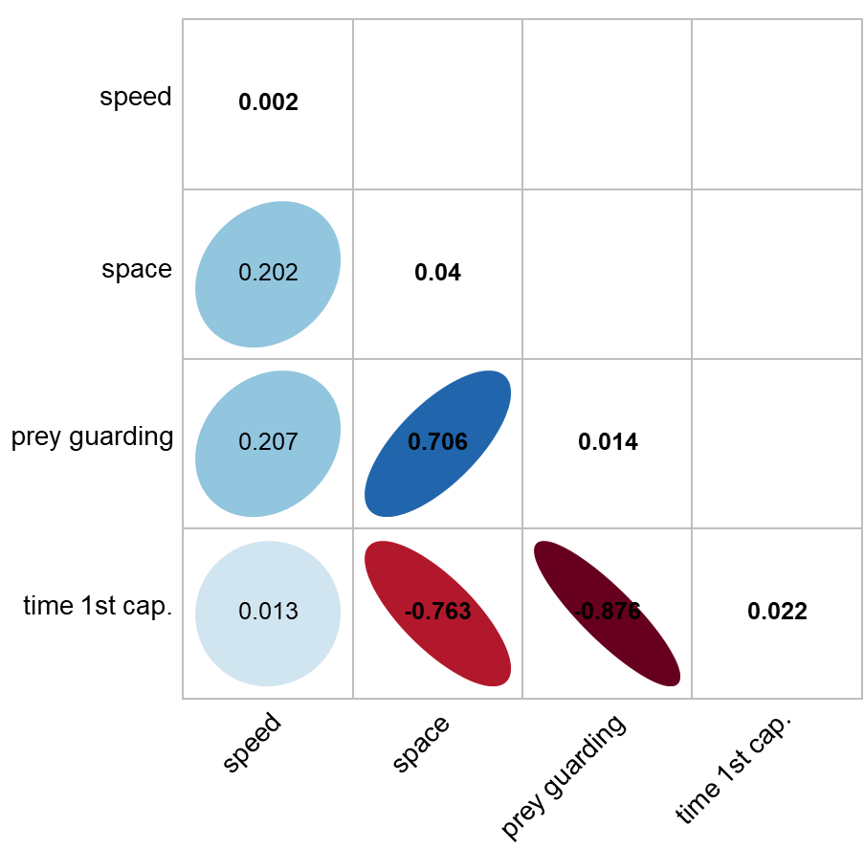
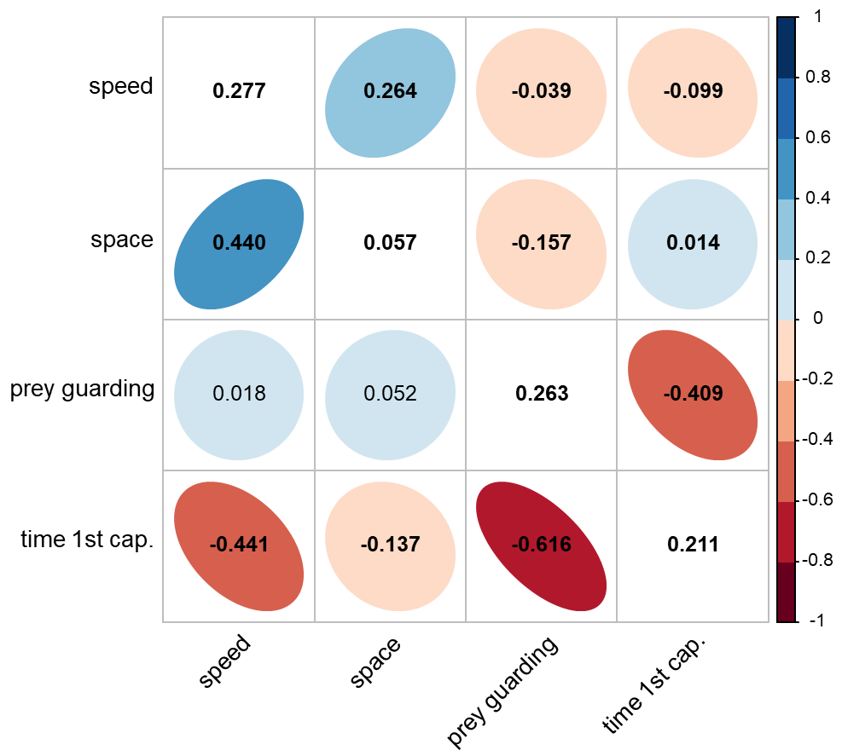
(A) Among environments
(B) Among individuals and residuals

