Slide 1
prey guarding
time 1st cap.
speed
space
1
speed
0.277
0.264
-0.039
-0.1
space
0.437
0.057
-0.158
0.014
0
prey guarding
0.017
0.046
0.262
-0.409
time 1st cap.
-0.439
-0.132
-0.617
0.211
-1

Slide 2
1
speed
0.277
0.264
-0.039
-0.1
space
0.437
0.057
-0.158
0.014
0
prey guarding
0.017
0.046
0.262
-0.409
time 1st cap.
-0.439
-0.132
-0.617
0.211
-1
speed
space
prey guarding
time 1st cap.

Slide 3
prey guarding
time 1st cap.
speed
space
1
speed
0.002
?
?
?
space
0.201
0.04
?
?
0
prey guarding
0.22
0.707
0.014
?
time 1st cap.
0.005
-0.761
-0.876
0.022
-1

Slide 4
1
speed
0.002
space
0.201
0.04
0
prey guarding
0.22
0.707
0.014
time 1st cap.
0.005
-0.761
-0.876
0.022
-1
speed
space
prey guarding
time 1st cap.

Slide 5
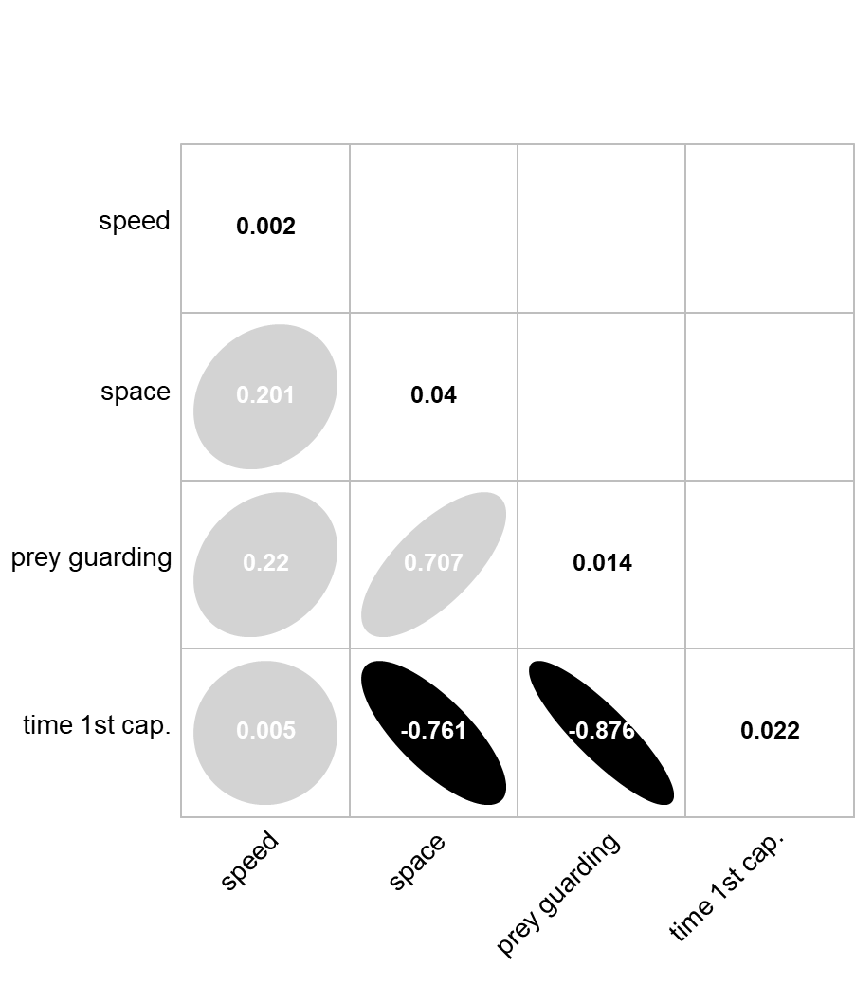
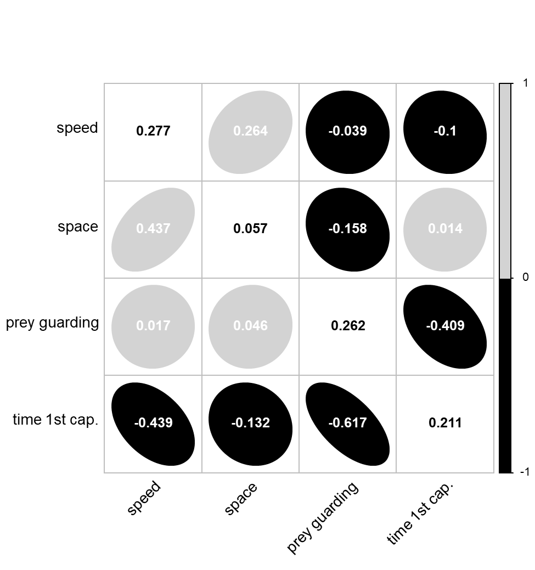
(A) Among environments
(B) Among individuals and residuals

