Slide 1
prey guarding
time 1st cap.
speed
space
1
speed
0.277
0.264
-0.039
-0.1
0.8
0.6
0.4
space
0.437
0.057
-0.158
0.014
0.2
0
prey guarding
0.017
0.046
0.262
-0.409
-0.2
-0.4
-0.6
time 1st cap.
-0.439
-0.132
-0.617
0.211
-0.8
-1

Slide 2
1
speed
0.277
0.264
-0.039
-0.100
0.8
0.6
0.4
space
0.437
0.057
-0.158
0.014
0.2
0
prey guarding
0.017
0.046
0.262
-0.409
-0.2
-0.4
-0.6
time 1st cap.
-0.439
-0.132
-0.617
0.211
-0.8
-1
speed
space
prey guarding
time 1st cap.

Slide 3
1
speed
0.002
0.8
0.6
0.4
space
0.201
0.04
0.2
0
prey guarding
0.220
0.707
0.014
-0.2
-0.4
-0.6
time 1st cap.
0.005
-0.761
-0.876
0.022
-0.8
-1
speed
space
prey guarding
time 1st cap.

Slide 4
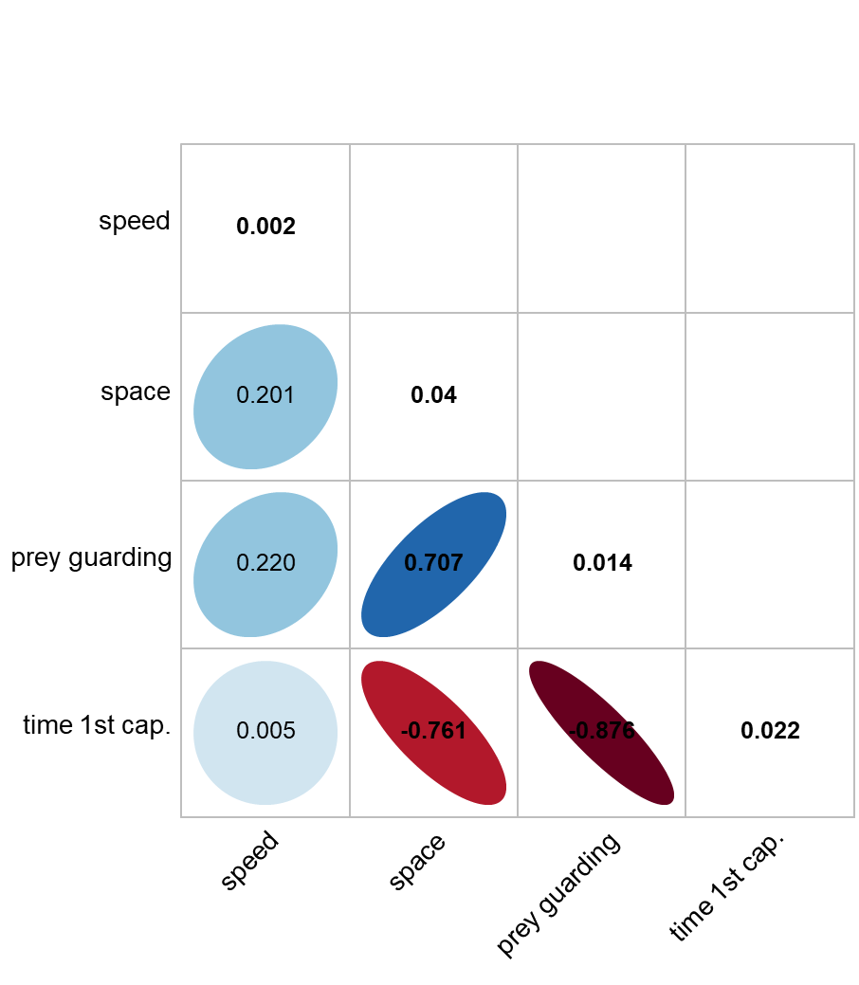
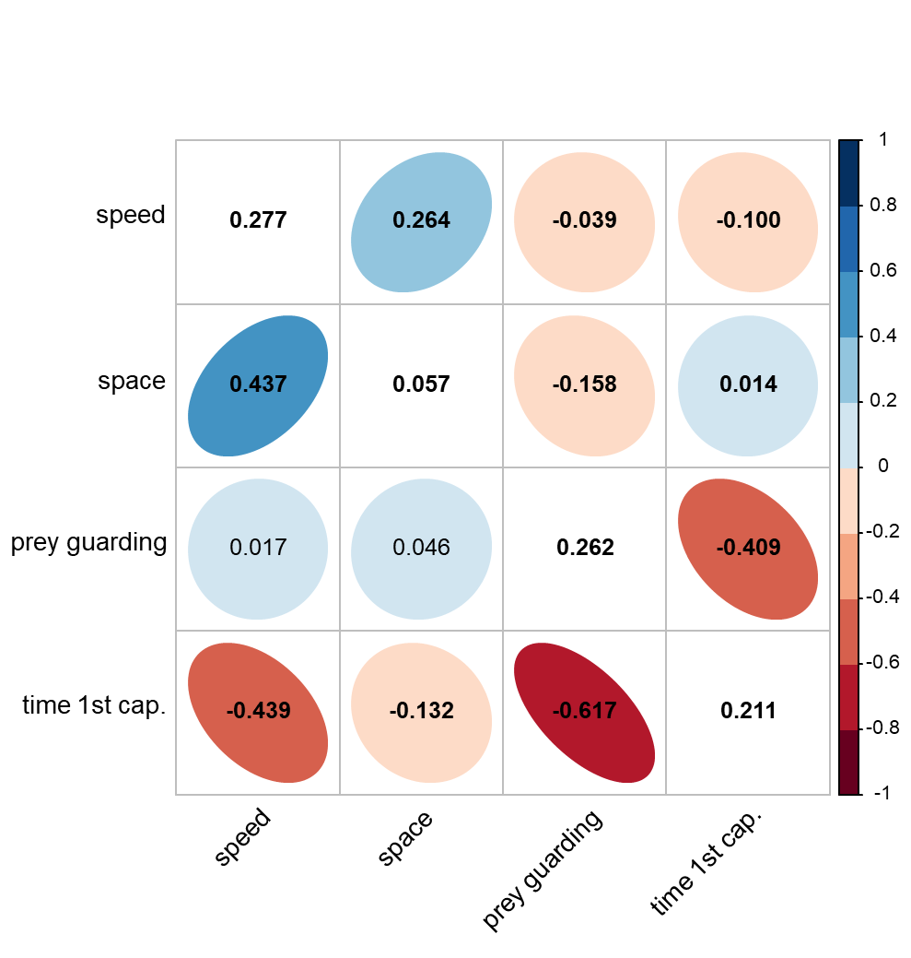
(A) Among environments
(B) Among individuals and residuals

