Slide 1

rainSTORM
MATLAB scripts for Localisation Microscopy
Eric Rees, Mark Deimund, Miklos Erdelyi, Daniel Metcalf, Alex Knight, Clemens Kaminski
4 May 2012
Laser Analytics Group, Department of Chemical Engineering and Biotechnology, University of Cambridge
Biophysics Group, National Physical Laboratory, Teddington
License: GNU Lesser General Public License, Version 3 or later

Slide 2
Summary
rainSTORM is a set of MATLAB scripts for localisation microscopy
It can be run as scripts, or compiled to run without needing a MATLAB license
It is operated using a simple GUI
It accepts a TIFF stack of PALM / STORM / dSTORM, etc images as input
It processes them using a “Segmentation and Fitting” algorithm; positions are found by an iterative Least Squares Gaussian method.
Thompson precisions of the localisations are estimated, for quality control. Other parameters can also be applied. Quality metrics can be graphed.
A super-resolution image is reconstructed. This is a fluorophore (localisation) density raster. It can be saved, along with metadata and a resolution estimate, with one click.
Localisations can also be analysed for particle tracking / drift correction.
All results are saved to the MATLAB workspace. This facilitates user access and add-ons.
Localisation parameters are available for the astigmatic method of 3D Localisation, and preliminary scripts to do this.

Slide 3
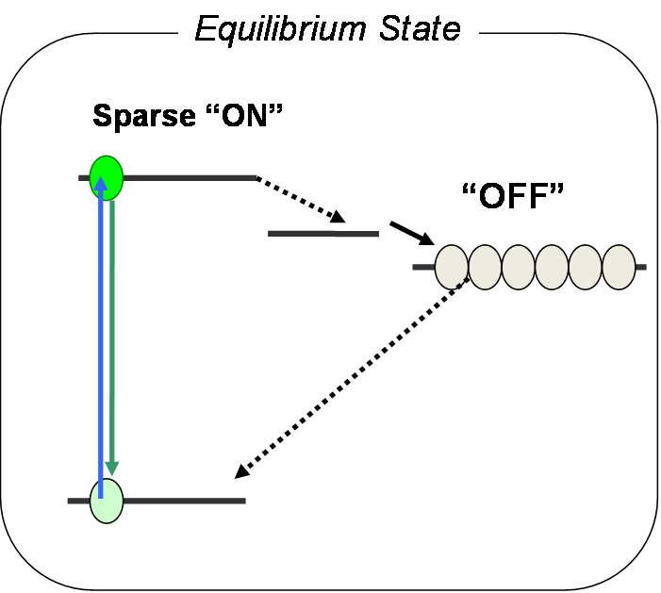
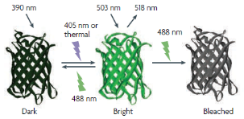
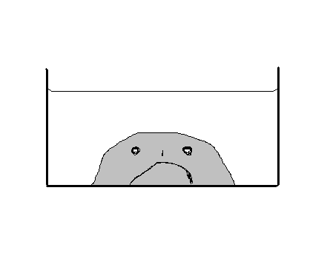
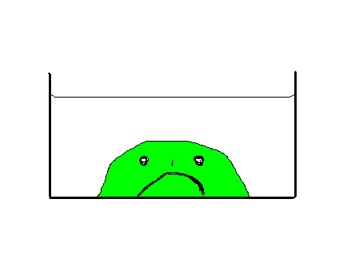
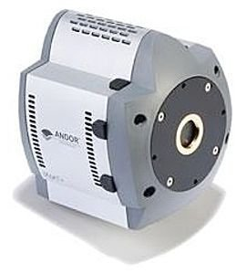
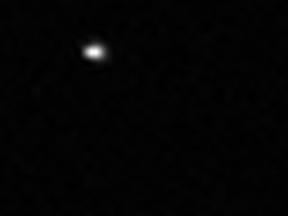
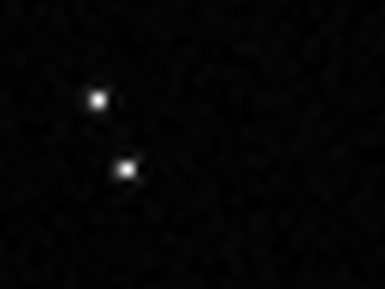
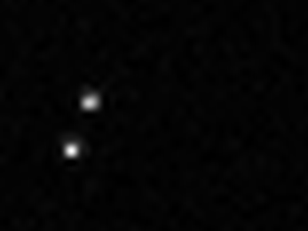
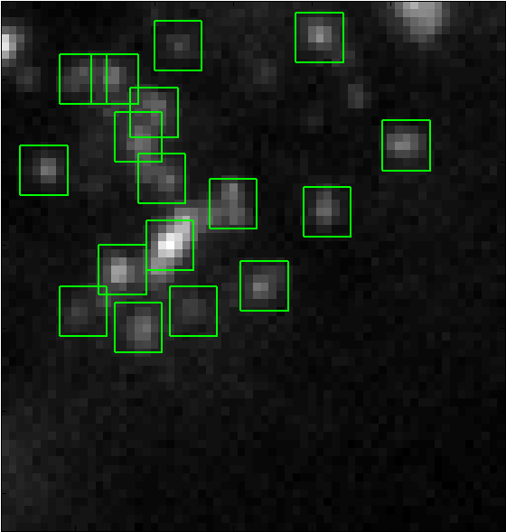


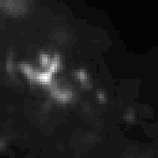
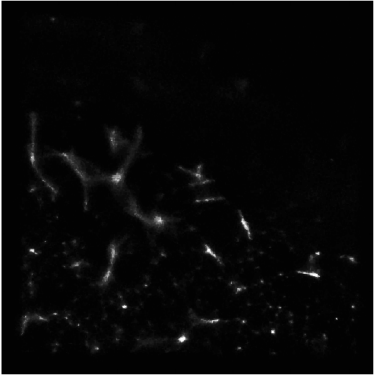
Localisation Microscopy:
Experimental Workflow
Find a
switchable fluorophore
Find a
switchable fluorophore
Label some living cells
Label some living cells
Capture ~10 000 images
Capture ~10 000 images
…
Localise fluorophores
Localise fluorophores
This rainSTORM Software does this:
Reconstruct
Hi-res image
Reconstruct
Hi-res image

Slide 4
Localisation Microscopy:
Image Processing Concepts
Localisation
Find candidate images of single fluorophores
Localise their positions
Reject imprecise or spurious localisations
Use accepted single molecule localisations to draw a representation of the object
– typically a super-resolution “image”
Quality Control
Visualisation

Slide 5
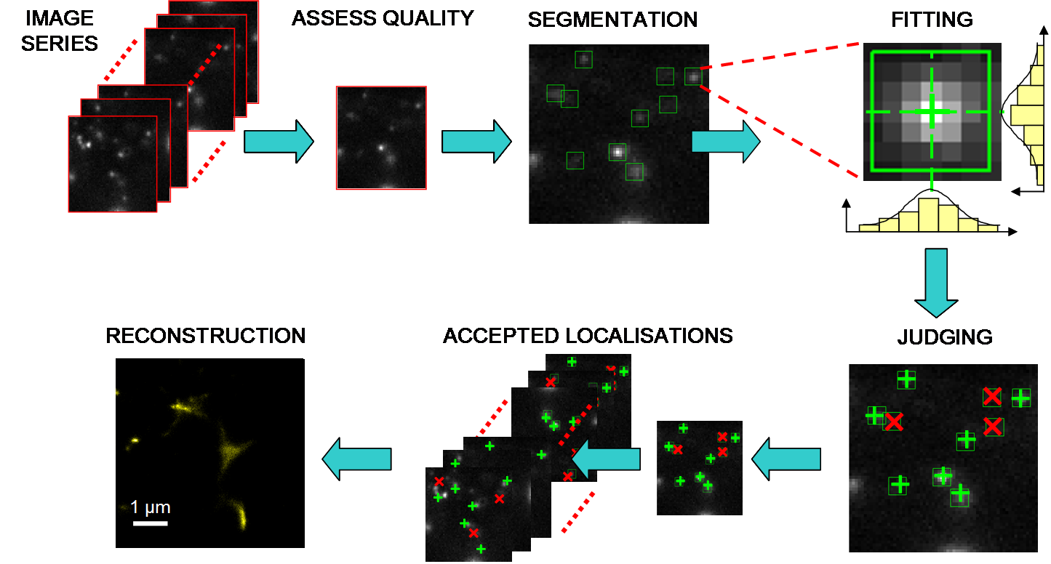
Localisation Microscopy: Tasks
(For a Segmentation and Fitting approach assuming spatially sparse single molecule images, and temporally independent frames - both assumptions are important)

Slide 6
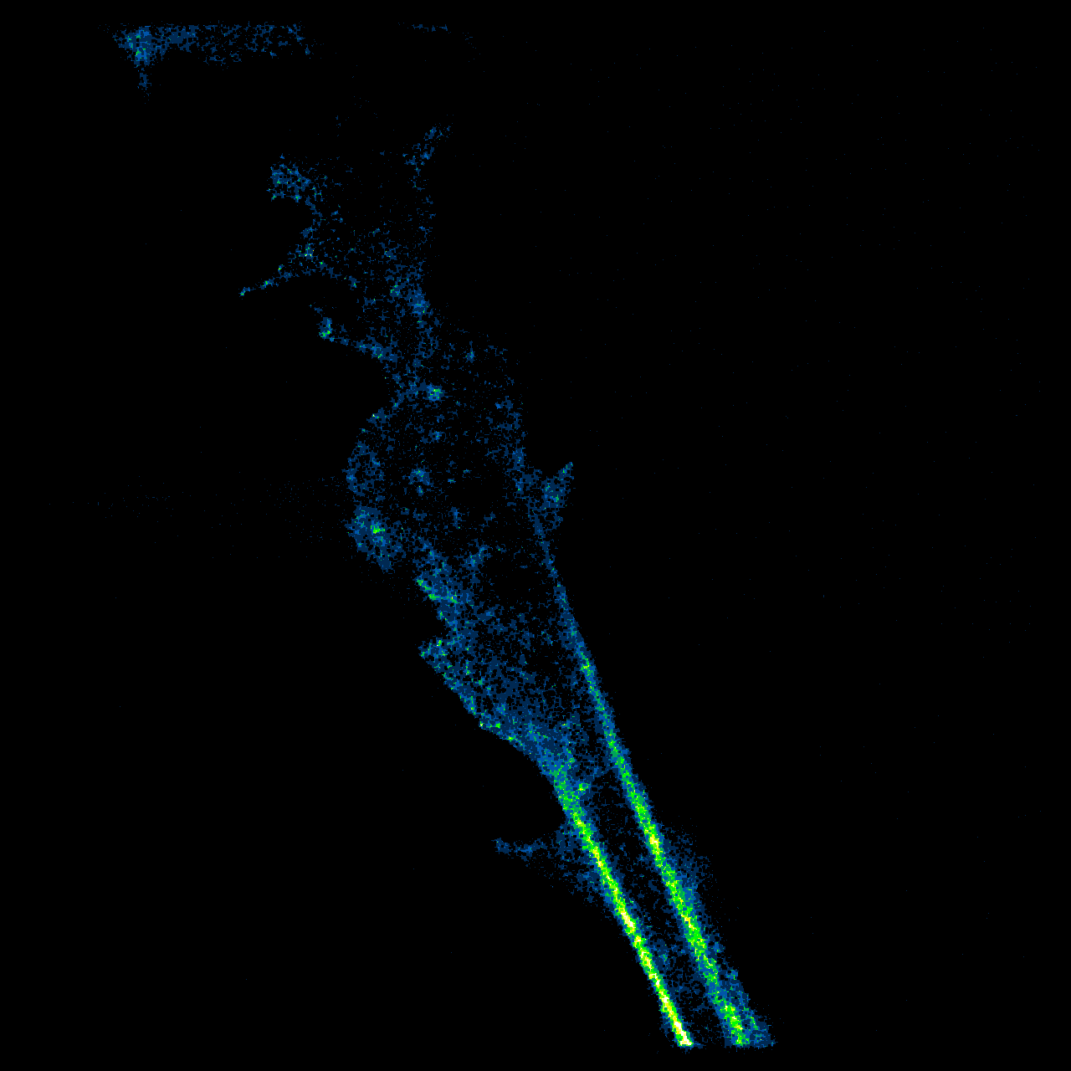
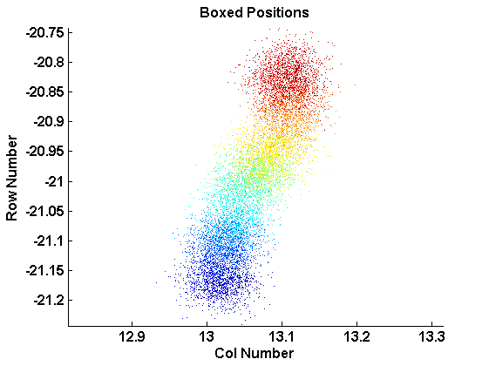
rainSTORM workflow
Raw Data
Search
Output
Pixel Size
Image Stack
Parameters
Localisations
rainSTORM
Reviewer
Visualisation
Photon calibration
Resolution
Precision Limit
Post-Processing

Slide 7
(Mostly Complete) List of scripts included in rainSTORM, version 2.22
rainSTORM_main | Creates GUI using rainSTORM.fig; calls script appropriate to input file, and available parallel kit (or none). Run this script to start the GUI. Requires Matlab 2009b or later.
rainSTORM_main_GUI_both | Image Processing method for normal serial (1 CPU) processing of TIF or RAW/XML
rainSTORM_main_GUI_tif | Image Processing method for TIF input data, if the parallel toolkit is available
rainSTORM_avNMS | Segmentation find candidate spots by averaging and finding maxima. Also thresholds.
rainSTORM_fitLocGF3 (Default Fit Algorithm) | Localisation of candidates, by Gaussian Fitting, subtracting background (local minimum) applies judging criteria (should be minimal), and halts frame after 3 rejections (fits are attempted in order of descending brightness of candidates) –
rainSTORM_fitLocGF (Alternative Fit Algorithm) | Localisation of candidates, by Gaussian Fitting, subtracting background (local minimum) applies judging criteria (should be minimal), and does not halt – tries all
rainSTORM_fitCoM | Absolutely not recommended, but included for comparison. Localisation of candidates, by finding “Centre of Mass” – i.e. 1st moment of spot intensity, and 2nd moment for radius.
rainSTORM_recon | Reconstructs a fluorophore density raster, for Visualisation as an image
rainSTORM_display | Plots Matlab figure of the super-resolution image.
rainSTORM_reviewer | Quality Control, applied via the Reviewer.fig GUI, which also controls visualisation, can display the localisation histograms, and can save images
rainSTORM_histograms | Plots histograms showing the quality control metrics of localisations
rainSTORM_precision | Called by reviewer to estimate Thompson Precision for Quality Control (note: still uncalibrated, and assumes an EM gain setting of 200 for the iXon DV887)
rainSTORM_xmlread | Called by …GUI_both to read XML meta data for opening NPL’s binary image files
rainSTORM_boxTracker | Draws scatterplot of localisations in user-defined area. With “_setAnchor“ and _undrift” corrects drift using a fiducial marker.
rainSTORM_extras_XXX | Various stand-alone scripts, not controlled by the GUI, in development or optional
Extras _zCal, zLoc, zView | For astigmatic z-localisation, including calibration and view as stack. Rather experimental.
rainSTORM_fitFB | Fluoro-Bancroft localisation – included as a non-maintained script for reference. Not working.
rainSTORM_extras_view | Obsolete. Creates some visualisations with image closure. Move to “extras”
rainSTORM_makeSTORMvideo | Post-processes localised fluorophore data, to create a progression of STORM reconstructions

Slide 8
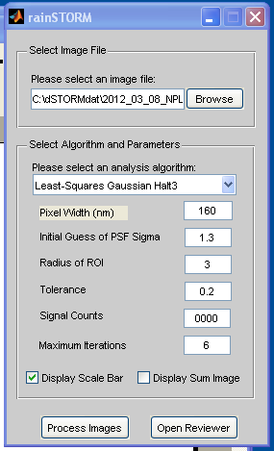
rainSTORM GUI
The rainSTORM GUI, with default selections
Getting Started
“Browse” to select an input file (which should be a .tif stack)
Make sure the “Pixel Width” is specified correctly
Check the “Display Scale Bar” box
Leave the other parameters at their default settings
Click “Process Images”

Slide 9
rainSTORM GUI details
The rainSTORM GUI, with default selections
Browse for the data filename (can type to edit)
Specify Search algorithm.
Specify pixel width on specimen. Default is 160 nm
Specify expected Point Spread Function std dev.
Specify fitting radius. 3 = 7x7 regions of interest
Fitting tolerance. Typically best at this permissive value
Candidate brightness threshold **
Least squares iterations. Try at least 4.
Specify desired visualisations. (Can edit flagSB, flagSum in Matlab base workspace later.)
Click to process the image file.
**Candidate brightness threshold. Rejects spots (possible fluorophore images) containing fewer camera counts that this their 3x3 central region. Can be safely left at 0 for the Wolter-type “halt3” algorithm, but needed for others to save CPU time.

Slide 10
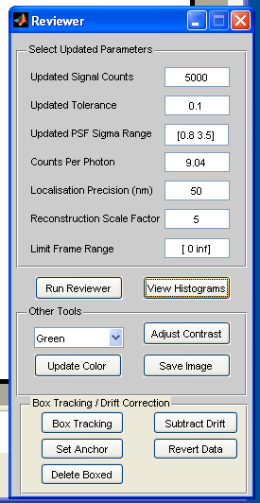
rainSTORM Reviewer GUI
The rainSTORM Reviewer GUI
Post-processing is important
Getting Started
Specify “Counts per photon” based on a camera calibration, if known – this may be specified by the camera manual, especially for EMCCDs.
Leave default parameters
Click “Run Reviewer”
Click “View Histograms”
Inspect the histograms. Amend parameters and re-run the Reviewer, if necessary
Adjust Contrast if necessary
Click “Save Image” – results are saved as PNG, alongside the raw data file.

Slide 11
rainSTORM Reviewer GUI
The rainSTORM Reviewer GUI
Specify minimum acceptable spot brightness (in 3x3 core region)
Specify maximum acceptable “fit badness” (residual)
Specify acceptable range of spot radii, in CCD pixel widths
Specify camera counts per photon. Needed for Thompson precision
Specify maximum acceptable Localisation Error (estimate) *
Specify number of “super-resolution” pixel widths per camera pixel
Specify acceptable frames of image data. [0 inf] means all frames
Click to evaluate and apply Quality Control, and Visualise data
Click AFTER “Run Reviewer” to view estimated localisation properties.
Edit and Save the Reconstructed image. Note Green means a black to green to white colour map
Analyse all localisations in a small region, to assess drift, and reverse drift using a fiducial marker, if available.
* Generally best to specify this parameter at e.g. 50 nm, and leave the other Quality Control parameters as the default, permissive values.
Other parameters are useful for fun, or if a photon calibration isn’t known, in which case set Counts Per Photon = 1, and Localisation Precision =10 000.

Slide 12
Algorithm Descriptor – rainSTORM GUI 2.22
Alternatives
Algorithm: Sparse Least Squares Gaussian
Assumptions: Spatially sparse images
Temporally independent frames
File input: Reads multi-page TIFFs efficiently, or RAW+XML (for NPL)
Segmentation: Average then find maxima. Threshold
Background: Subtract minimum of ROI before fit
Fit: Try ROI by descending intensity, until 3 are rejected
Least squares Gaussian (2 X 1-D), 7x7 ROIs
6 Iterations of Newton-Gauss
Fit width as a variable.
Apply (-0.5,-0.5) pixel to positions, for image registration.
Quality Control: Applied intensity threshold in Segmentation
Can Reject high residuals
Can Reject drifted fits; too-wide / too-narrow fits
Estimate Thompson precision and apply a limit
Reconstruction: Raster by elementwise binning (fluorophore density map)
No vertical flip applied to reconstruction
Centre of Mass
fread binary image data with XML metadata
Subtract frame median (generally worse)
Don’t halt after 3 failed fits (halting is faster but risky as rejection on high residuals, etc. can fail on strong backgrounds or dense objects)
Often best to use only Thompson precision
CLAHE (adaptive hist eq, makes more sparkly)
Department of Chemical Engineering and Biotechnology, University of Cambridge
Notes:
Here is a standard descriptor box which facilitates comparison of algorithms.

Slide 13
Getting Started with the rainSTORM GUI
Start Matlab (version 2009b or later is required)
Run the script rainSTORM.m, to start the image processing GUI
Use the GUI to locate a file of input data – which should be a multi-page TIFF
Use the default image processing parameters, but correct the “pixel width” from its default value of 160 nm if necessary
Click “Process Images”
Click “Open Reviewer”
Try leaving the default (fairly permissive) Quality Control parameters. But note that the “Camera counts per photon” is important for estimating localisation precision. If this value is unknown, then you can work around it, but the localisation precision estimations will not be meaningful. If you do need to work around this, try setting 1 Count per photon, and a localisation precision limit of 10000, for example.
Click “Run Reviewer” – IMPORTANT: Don’t Forget to Run This!
Click “View Histograms”
Use “Adjust Contrast” if required.
“Update” colormap if required
Click “Save Image”
“Box tracking” can be used to inspect a reconstructed image.
To use “Box tracking” first use “Run Reviewer”
Click “Box Tracking”
Select a rectangular area of the reconstructed image
Wait 2-10 seconds for a scatterplot to appear, showing localisations colour coded by time
This is useful to diagnose “motion blur” or drifts, and to inspect for artifacts.
The Box tracking can also measure fiducial marker positions, for 2D drift correction
To do this, use Box Tracking on a fiducial marker; then Set Anchor; then Subtract Drift, then Run Reviewer. You may Delete Boxed to exclude the marker from the super-resolved image, then Run Reviewer again. For 2-colour Drift correction, use Set Anchor on the first colour data, and Subtract Drift normally, then Box Track the same marker in the next colour channel, and Subtract Drift on that colour channel without finding a new Set Anchor position.
Localise fluorophores
Get a preliminary super-res image
Apply quality control
Save a final super-res image, plus meta-data
Inspect the localisation data to assess for drift
Use a marker to correct drift

Slide 14
Instructions for using the rainSTORM GUI
Image orientation. Is “vertical flip” checked in SOLIS software?
Start Matlab (version 2009b or later is required, to open multi-page TIFFs efficiently)
Run the script rainSTORM.m, which calls up the image processing GUI
Use the GUI to locate a file of input data – select “TIF” or “RAW” as appropriate. (“RAW” files need their “XML” companion, following NPL / Knight layout)
Set image processing parameters to search for all plausible localisations, typically:
Click “Process Images”
Click “Open Reviewer”
Click “Run Reviewer” – IMPORTANT: Don’t Forget to Run This
View histograms to assess localisation (note that the precision estimates assumes Camera Counts per Photon is set correctly in the Reviewer. These estimates are heuristic, and are only an approximate guide to the localisation accuracy.)
Set quality control parameters (note candidates must pass all tests), typically:
Use “Adjust Contrast” if required.
“Update” colormap if required
Click “Save Image” to save myFilename-STORMdataImage.png (raw localisation data) and myFilename-processed.png (adjusted colormapped image with scalebar) – the latter saves the most recent MATLAB figure with a reconstructed image, and may be distorted by manual figure resizing. Also saves, if available, “myFilename-hists.png”, with localisation parameter histograms, “myFilename-info.txt”, with some metadata on the reconstruction, and “”, myFilename-sum.png
Least-Squares Gaussian Halt3
Pixel width, e.g. 160 nm
Initial PSF = 1.3 (approx guess)
Radius of ROI = 3 (7x7 boxes)
Tolerance 0.2 (permissive)
Signal Counts = 0 (permissive)
Max Iterations = 6
Updated signal counts = 5000 (or 0)
Updated tolerance = 0.1
Updated PSF range = [0.8 3.5]
Counts per photon = 9 (for example)
Precision Limit (nm) = 50 (typical)
Reconstruction Scale Factor = 5
Limit Frame Range = [0 inf] (no limit)
For Quality Control, try to use the Localisation Precision (Thompson Precision) limit on its own, for maximum simplicity. Set other parameters permissively, as shown by default, to do this.
The Thompson Precision estimate needs a photon calibration estimate. If this is unknown, work around its absence by setting the Localisation Precision limit to (e.g.) 1000, and the Counts per Photon to 1.
A colorbar, of localisation density, could be added to the processed image

Slide 15
Results generated in the Matlab Workspace
The crucial results are positions for each localisation (stored in “SupResPosits”, a Nx2 matrix containing a row and col position for each accepted localisation), and some corresponding parameters (“SupResParams”).
The Quality Controlled data are stored in equivalent “reviewedPosits” and “reviewedParams” arrays. The Box Tracker generates equivalent “boxedPosits and “boxedParams” arrays.
SupResPosits
SupResParams
Row
Col
Spot counts
(3x3 approx)
Residual
Spot counts
(7x7),
-background
SigRow
SigCol
Background
estimate
Frame #
4.531 5.678
12.433 8.992
… …
Fit error (as a fraction of the signal norm)
(e.g. from 1 to 10 000)
Width (Gaussian std dev)
Std(myFrame(:) may overestimate standard deviation of Poisson-distributed pixel noise, and/but neglects autofluorescent background
Approx magnitude of the signal, used for initial thresholding
For estimating the number of photons measured for this localisation – may slightly overestimate count number!
Width (Gaussian std dev)
Hopefully accurate to 1 decimal place
Units: Camera pixel widths
Astigmatism + Parameters…
Z-position

Slide 16
Developer Comments
The rainSTORM_main scripts begin with important comments, and other scripts are commented.
For Version 2-22 onwards, nearly all variables are passed via the MATLAB “base” workspace, using “assignin()” and “evalin()”. This is to facilitate user access to the data – for plotting the data, developing user add-ons, or for editing parameters without using the GUI. Of course it is a risky programming technique, because the variables are exposed to external editing – but this is intentional.
The “Super-Resolution Image” produced by rainSTORM is a fluorophore (localisation) density raster. See for example [Wolter Journal ofMicroscopy, Vol. 237, Pt 1 2010, pp. 12–22 doi: 10.1111/j.1365-2818.2009.03287.x].This visualisation is somewhat different to the “Gaussian Blob Plotting” of, for example [McEvoy et al. BMC Biology 2010, 8:106 http://www.biomedcentral.com/1741-7007/8/106]. The “Blob Plotting” method is in some ways better because it visualises the uncertainty of the fluorophore (localisation) density measurement – it is also pixel-hungry, and not noticeably better if the raster is done well (EJR). The raster approach does require some expertise to use, however – set the reconstruction pixel size equal to the mean Thompson Precision (or smaller) or else the reconstruction raster will itself Nyquist-limit the resolution of your image! A small Gaussian blur can improve the visual results of a simple histogram image.
The “Save Images” button saves two super-resolution image files. The first is “NAME-STORMdataImage.png” which is a 16 bit greyscale PNG storing the number of localisations in each pixel of the fluorophore (localisation) density raster. This image can be opened in ImageJ; however Windows does not like 16-bit images and may display on a poor contrast scale, making them appear black. The second image is “NAME-processed.png” – this image is saved from the MATLAB figure. You can give it a scalebar, and a nice colourmap (known as a colormap, in American English and MATLAB). This image is captured from the screen, so resizing the figure will give you a distorted Super-Resolution image – and this is actually a serious MATLAB issue – use the STORMdataImage if in doubt.
Note that the “Green” colourmap is actually a Black-Green-White full colour map, and is not suitable for co-localisation overlay images. Use the STORMdataImage for that.

Slide 17
Comments
Localisation Microscopy is an inference method. The basic rainSTORM algorithm assumes the data contains spatially sparse images of single fluorophores, and temporally independent frames. There is a risk of artifacts if these assumptions fail (!); however there are some Quality Control methods to check the data quality, and together with some user-experience they can certainly support 50 nm resolution images, and possibly 20 nm.

