Slide 1


HACKATHON 2026
AVALON AI
The Women's Empowerment Intelligence Network
Empowering choices. Connecting opportunities. Supporting independence.
Team Name
QUANTIX
Team ID
DEX26180
Theme
Women Empowerment
PS Category
Software
Stronger Women > Stronger Families > A Stronger Society
Notes:
Title: AVALON AI by Team QUANTIX (DEX26180). Theme: Women Empowerment. Category: Software.

Slide 2








AVALON AI - Proposed Solution
The Women's Empowerment Intelligence Network
The Solution
How it solves it
What is unique
One AI-powered platform that connects a woman's goals, skills and challenges with the right resources and support.
The Pathway Engine understands goals, finds verified resources, builds an action plan and tracks progress.
6 connected modules, not isolated tools. Verified sources. Tamil + English. Action plans, not just information.
1. Financial Freedom AI
2. Career & Education AI
3. Health Access AI
Budgeting, income ideas, loan and fraud alerts
Skill gaps, courses and a career path
Plain-language health info, nearby care
6 barriers, 1 platform
Money, careers, health, rights, digital safety and opportunities are scattered today.
4. Rights & Equality AI
5. Digital Protection AI
6. Opportunity Connector
Schemes, legal aid, simple explanations
Scam checks, safety tips, alerts
Scholarships, jobs, verified support
Notes:
AVALON AI connects six modules through one Pathway Engine.

Slide 3






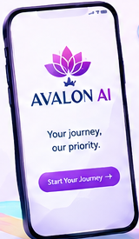
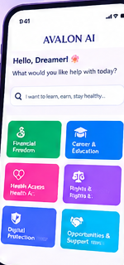





Technical Approach
Powered by AI. Guided by data. Built for you.
Python
Streamlit
Scikit-learn
Pandas
PostgreSQL
GitHub
Backend
Frontend
ML models
Data analysis
Database
Versioning
HOW IT WORKS
1. User Input
2. AI Analysis
3. Recommend
4. Action Plan
App preview
Goals, needs, profile
ML + NLP match
Ranked resources
Links + tracking
AI / ML features
Personalised recommendations
Scam text classification
Health + legal summaries
Semantic opportunity search
METHODOLOGY
Plan
Build
Test
Deploy
Notes:
Stack: Python, Streamlit, Scikit-learn, Pandas, PostgreSQL, GitHub.

Slide 4





Feasibility and Viability
Simple tools + smart logic = real impact
Feasibility
Challenges & Risks
Open-source stack: Python, Streamlit, Scikit-learn
Free datasets and reliable public sources
Prototype doable by a small team in hackathon time
Modular, scalable to mobile and more languages
Limited time for full development
Quality of data sources
Accuracy of AI/ML models
User adoption and trust
STRATEGIES TO OVERCOME
Focus on core modules first
Use verified, official sources only
Test models with sample data
Iterate on user feedback

Slide 5


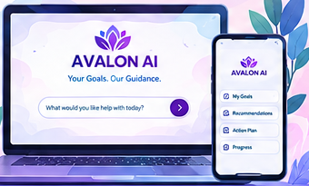

Business Canvas
Investing in women builds stronger families and communities
Mission
Vision
To empower every woman with the right information, resources and support to build a better future.
A world where every woman has equal access to knowledge, financial independence, healthcare and opportunities.
Market & Business
Financial Planning & Requirements
Users: students, professionals, entrepreneurs, homemakers. Existing apps are single-focus; AVALON AI is 6-in-1.
NGO and government partnerships
CSR funding and grants
Premium features (future)
Rs 50,000 - 1,00,000
Rs 10,000 - 20,000
Future revenue
Initial development
Operating cost: hosting and tools
Partnerships, premium features, CSR funding

Slide 6

Impact and Benefits
More than a platform - a movement for change
Potential impact on the target audience
Increases access to education, jobs and skills
Improves financial independence
Enhances health awareness and well-being
Builds legal and digital safety
Connects women to real opportunities and support
Social
Economic
Environmental
Mental
Target: students, working women, entrepreneurs, homemakers
Equality and inclusion
More income and growth
Sustainable communities
Confidence and well-being
Stronger Women > Stronger Families > A Stronger Society

Slide 7

Research and References
Ideas | Code | Impact
UN Women unwomen.org
Ministry of Women & Child Development wcd.nic.in
Government of India portal india.gov.in
World Health Organization who.int
World Bank (gender data) worldbank.org
Kaggle datasets kaggle.com
Scikit-learn documentation scikit-learn.org
GitHub Repository
github.com/<your-team>/avalon-ai
Thank You! Team QUANTIX | DEX26180

