Slide 1
A Case Study for Relative Value Volatility Vonstruction

Slide 2
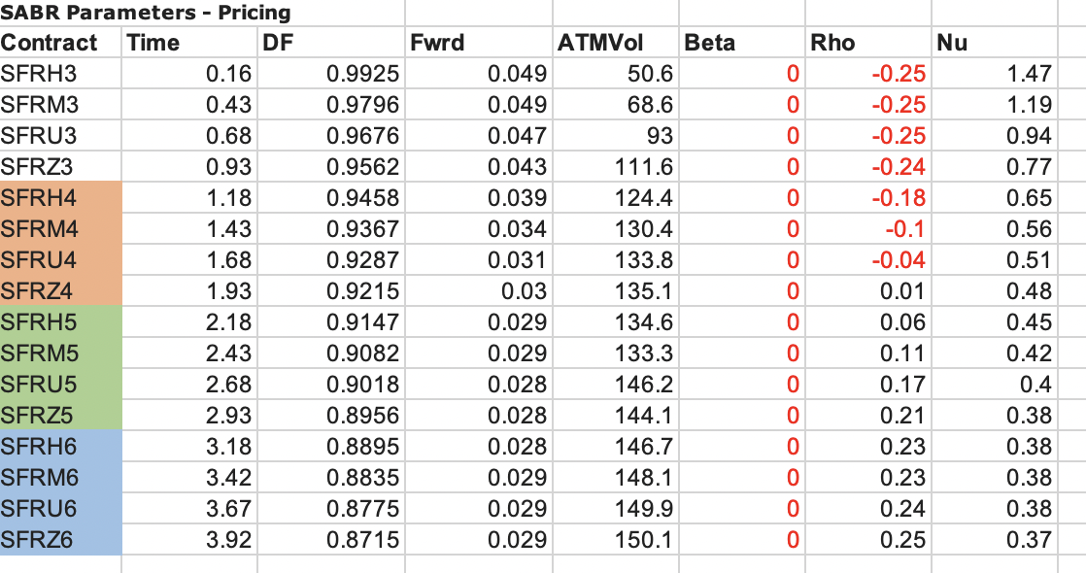
Data provided
The data provided is in SABR parameter space.
In particular to note is a clear term structure on the skew parameters.
There is a break and non-smoothness on the atm term structure

Slide 3
Idea
To do a statistically motivated calibration; as a basis to smooth out the fit.
Use the quality of the fit to come up with an optimal position management
Exemplify, why a good volatility model is beneficial to this process, and bring back some drawbacks of the most common models ➔ correlation – vol. of vol. trap

Slide 4
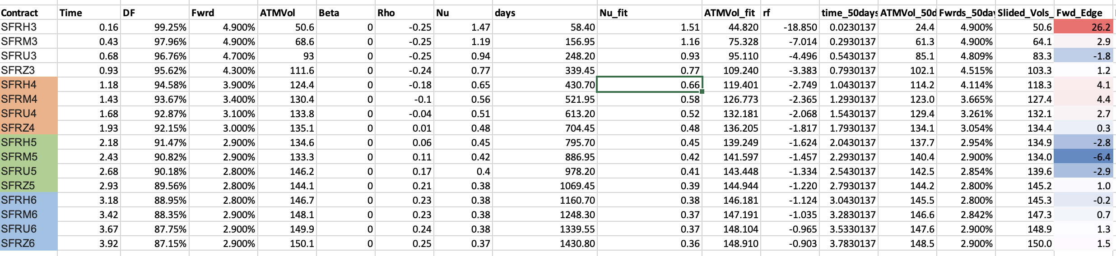
ATM Vol. Model Fit

Slide 5

Positioning
Positioning Problem for a given time horizon:
$$\min{Var\left[FwdEdge\right], s.t.E\left[FwdEdge\right]=f}$$
This is the same problem as the one for standard portfolio optimization ➔ Positioning is another form of portfolio management.
This requires the design of a correlation matrix ➔ Use the model parameters instead of the naked market ➔ Dimensionality reduction
$$Cov=\left(∇M^{T}\right)Cov_{modelParams}\left(∇M\right)$$

Slide 7
Further importance of the model
Numerical Stability: The more orthogonal the components of the matrix, the better behaved the covariance matrices are for numerical inversion.
Large range for fit: The more orthogonal the components of the matrix, the better behaved the correlations are
SABR type models satisfy the second condition but not the first

Slide 8
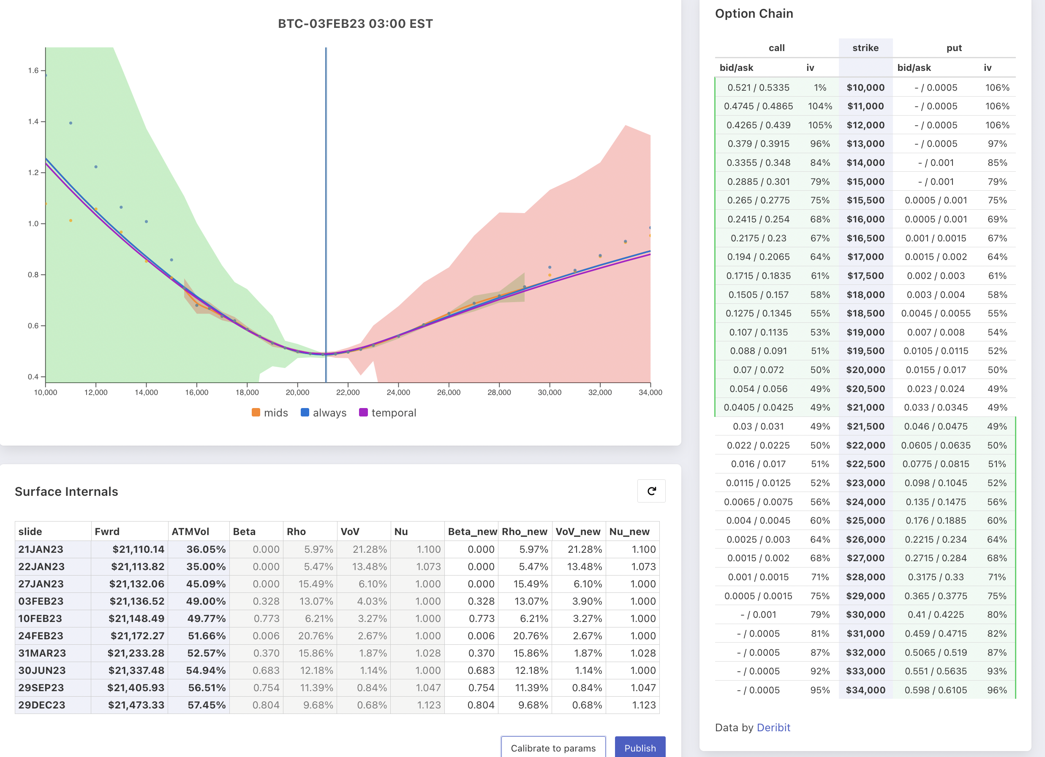
An example for the far tail

