Slide 1
Random Walks and Monte Carlo
WISER Quantum Projects 2025
Team Quantotto: Yevgeny Menaker
09 August 2025

Slide 2
Project Goals
Quantum Galton Board Implementation: Construct a quantum analogue of the n-level Galton Board to illustrate symmetric Gaussian distributions
State Preparation: Apply the Universal Statistical Simulator method (from research paper) to generate a range of distributions as a superposition of quantum states
Distribution Adjustment: Alter quantum pegs and coin parameters to produce various distributions, including Exponential and Hadamard Random Walk (Bi-Modal)
Noise-Resilient Optimization: Design a Galton Board-inspired method to load arbitrary distributions and demonstrate outcomes on noisy simulators using the IBM ibm_torino noise model
Performance and Depth Analysis: Evaluate circuit accuracy under noisy conditions and examine the relationship between circuit depth and the number of Galton Board levels
Real Backend Runs: Execute Resulting Circuits on physical QPUs and observe the results

Slide 3
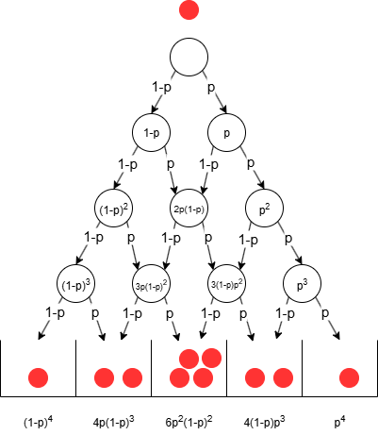
Galton Board as Decision DAG
Galton Board is a decision DAG (Directed Acyclic Graph)
If p=1/2, a symmetric normal distribution is achieved in the tally bins
Modifying the probability ( p ) will skew the distribution either to the left or right

Slide 4
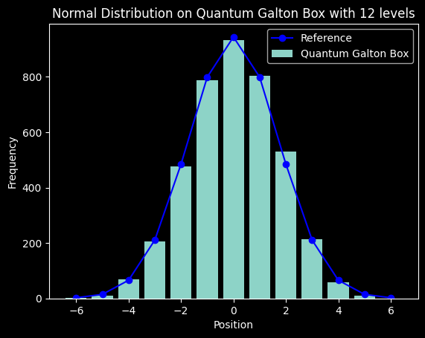
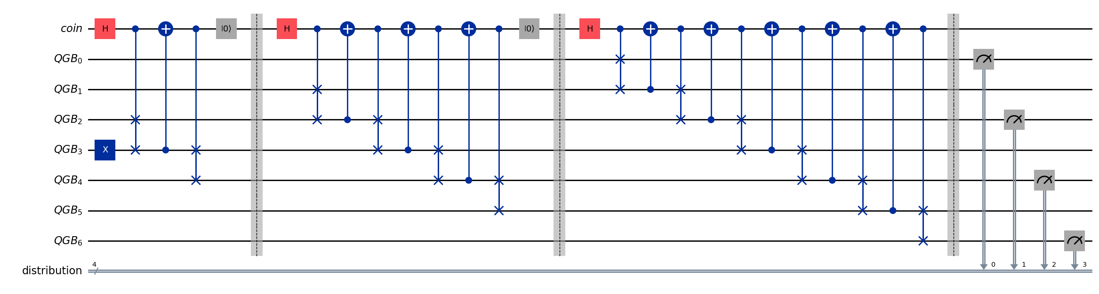
n-levels Galton Board: Quantum Circuit
Diagram for n=3:
For n levels
Qubits: 2n + 2
Depth: 4 + 8 + 12 + … + 3n = 2(n² + n) = O(n²)

Slide 5
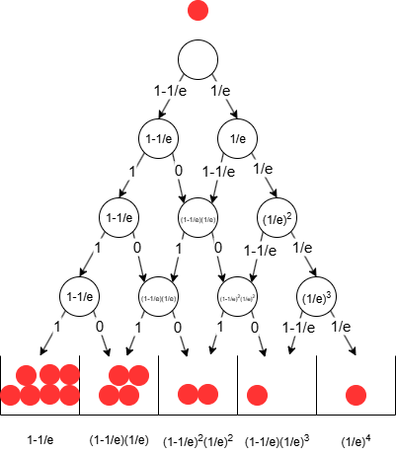

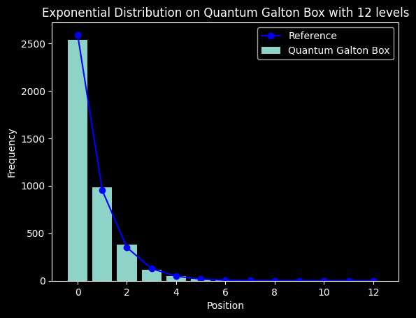
Exponential Distribution
To achieve a different distribution, probabilities must be adjusted at each level
The figure illustrates assigning probabilities only to the rightmost quantum peg, requiring either a rotation of the "coin" qubit by a specific angle or flipping it
In the quantum circuit, this involves modifying the quantum coin function using controlled RY rotations to bias the "coin" accordingly
The angle of rotation is given by

Slide 6
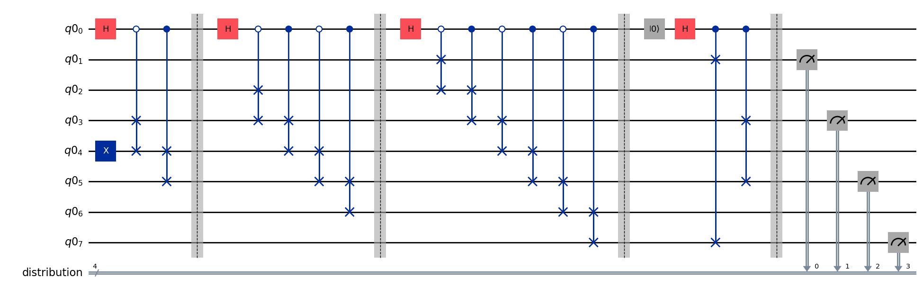
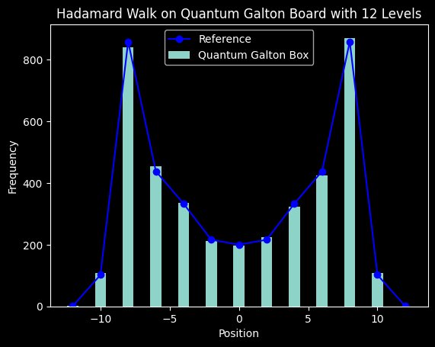
Hadamard Random Walk (bi-modal) Distribution
The walk must be conducted in superposition to maintain the interference effect
Alternate the control value for each CSWAP gate to simulate stepping in superposition
Refrain from resetting the coin state to preserve interference
Execute a final swap after all levels have been applied to ensure a symmetric distribution

Slide 7
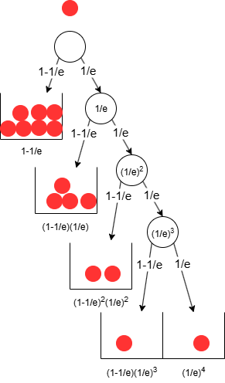
Symmetric DAG => Optimal Decision Tree
The thinking was inspired by observing the Exponential Distribution decision DAG

Slide 8
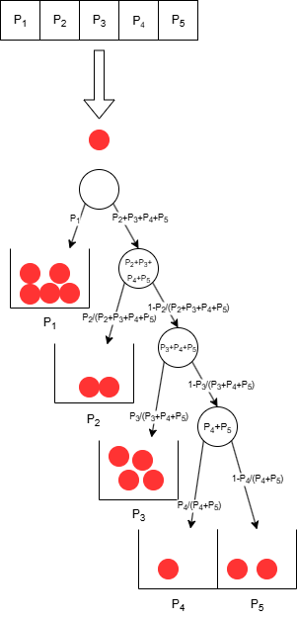

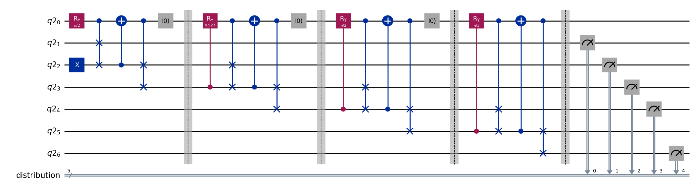
Optimal Decision Tree for an Arbitrary Distribution
Given a vector of n+1 probabilities, we can build an optimized coin function
Quantum circuit will assure the ball reaches each tally bin with the desired probability
The circuit resembles the one-sided look of the decision tree
Rotation angle for level i is given by:
Qubits: n + 3
Depth: 4n = O(n)

Slide 9
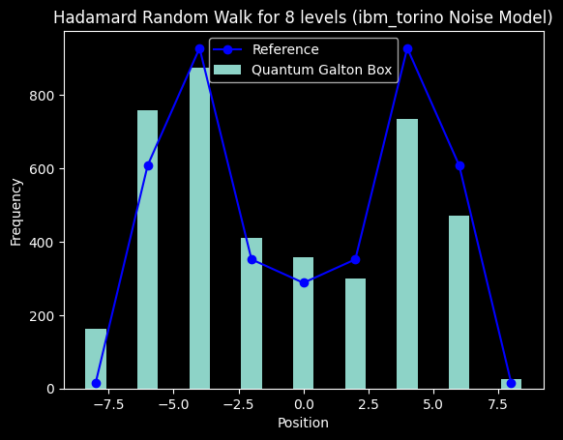
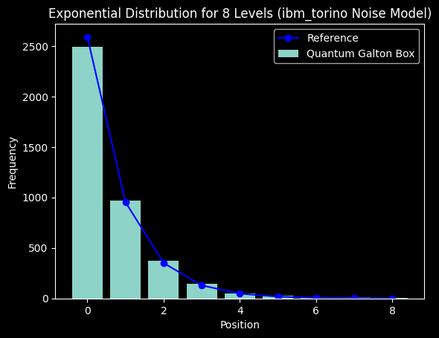
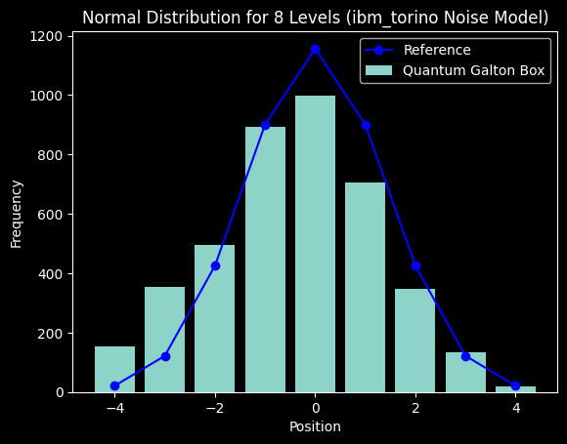
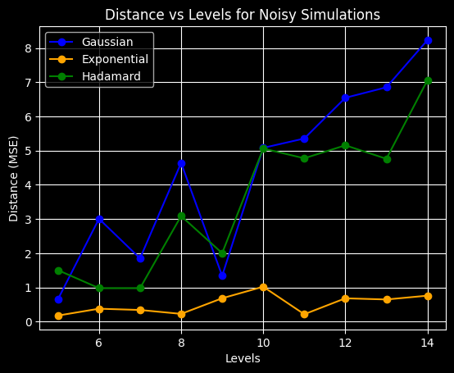
Noisy Simulations
The exponential distribution demonstrated the greatest improvement in accuracy following the Galton Board optimizations
By decreasing the number of required qubits from 2n+2 to n+3 and markedly reducing the circuit depth, the results remained sufficiently close to the reference values for all distributions despite the presence of noise
The visual similarity of the distributions is preserved up to 14 levels with presence of noise

Slide 10
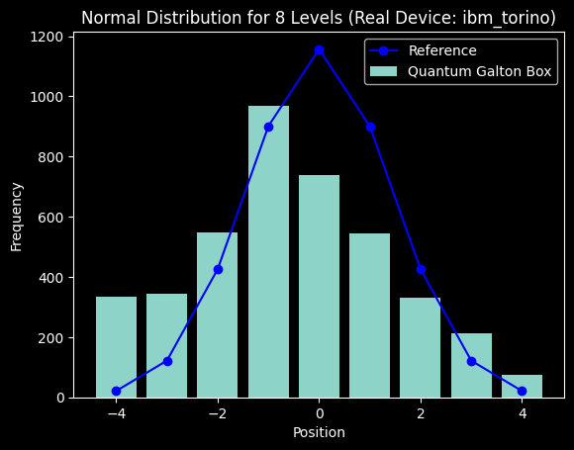
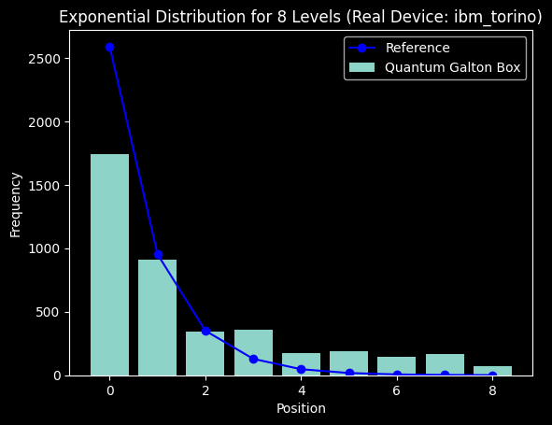
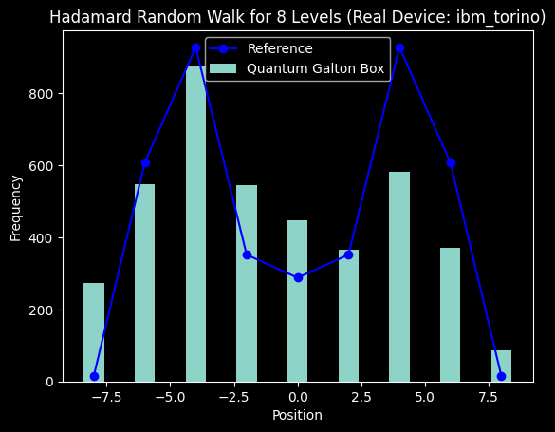
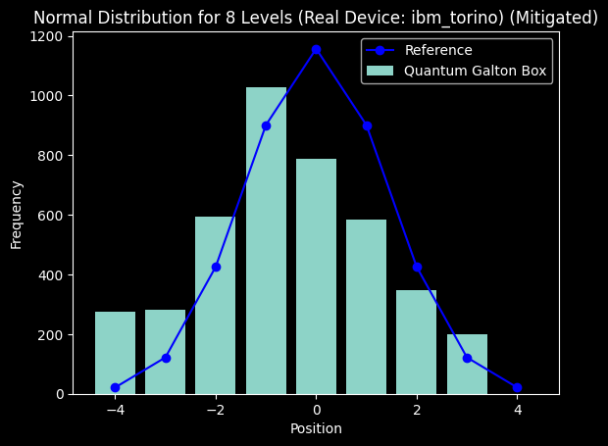
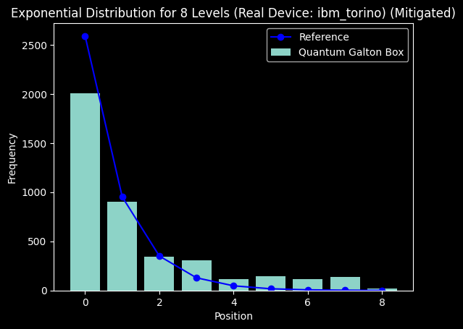
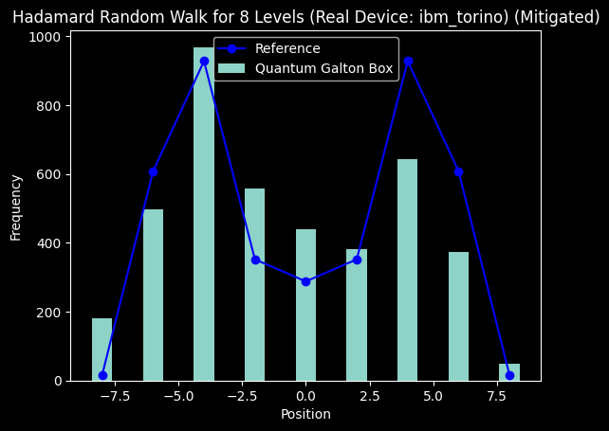
Real Backend Execution
Despite large distances from the reference, the distribution shapes are identifiable
Noise reduction using the M3 package had minimal impact
Overall, the IBM Torino backend performed impressively!!! 🎉🎉🎉

Slide 11
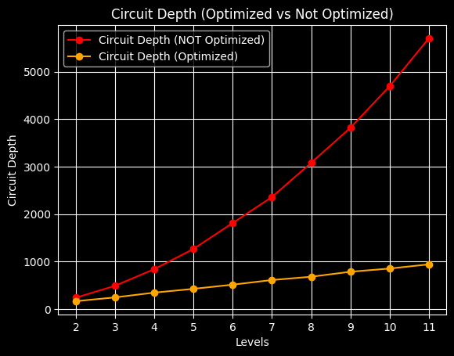
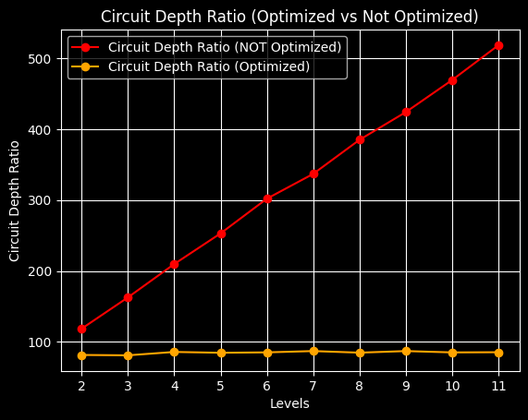
Circuit Depth Study
Optimized circuits
​
Maintaining a constant depth-to-levels ratio results in a linear dependency on levels
​​
Non-optimized circuits
​
A linearly increasing ratio signifies a quadratic dependency on levels

Slide 12
Conclusions
Demonstrated universal distribution simulator as a superposition of Hamming Weight 1 states
Reduced qubits needed from 2n+2 to n+3
Improved circuit depth from O(n²) to O(n) ensuring resource efficiency and noise resilience
MSE distance stayed below 5 at most levels
Optimistic outlook for NISQ devices: execution on real backend showcased impressive results

Slide 13
References
"Universal Statistical Simulator", Mark Carney, Ben Varcoe (arXiv:2202.01735)
"Quantum random walks - an introductory overview", J. Kempe (arXiv:quant-ph/0303081)
"Scalable Mitigation of Measurement Errors on Quantum Computers", Paul D. Nation, Hwajung Kang, Neereja Sundaresan, and Jay M. Gambetta, PRX Quantum 2, 040326 (2021).

