Slide 1

Quantum Walks and Monte Carlo
WISER Quantum Projects 2025
Team Quantotto: Yevgeny Menaker
09 August 2025
Notes:
Hello,
I’m Yevgeny Menaker from team Quantotto and I'm presenting
the quantum walks and Monte Carlo project as part of WISER
Quantum Program 2025. The
project is focusing on applying quantum computing techniques to statistic processes which are
foundational in quantum algorithm development.

Slide 2
Project Goals
Quantum Galton Board Implementation: Construct a quantum analogue of the n-level Galton Board to illustrate symmetric Gaussian distributions
State Preparation: Apply the Universal Statistical Simulator method (from research paper) to generate a range of distributions as a superposition of quantum states
Distribution Adjustment: Alter quantum pegs and coin parameters to produce various distributions, including Exponential and Hadamard Random Walk (Bi-Modal)
Noise-Resilient Optimization: Design a Galton Board-inspired method to load arbitrary distributions and demonstrate outcomes on noisy simulators using the IBM ibm_torino noise model
Performance and Depth Analysis: Evaluate circuit accuracy under noisy conditions and examine the relationship between circuit depth and the number of Galton Board levels
Real Backend Runs: Execute Resulting Circuits on physical QPUs and observe the results
Notes:
Generated by Copilot Here we outline the core objectives of the project. The first goal is to build a quantum analogue of the n-level Galton Board to demonstrate symmetric Gaussian distributions. Next, we apply the Universal Statistical Simulator method to prepare quantum states representing various distributions. By adjusting quantum pegs and coin parameters, we aim to generate diverse distributions such as Exponential and Hadamard Random Walks. We also focus on noise-resilient optimization to ensure reliable results on noisy quantum simulators, specifically using the IBM ibm_torino noise model. Performance analysis will assess circuit accuracy and depth, and finally, we plan to run these circuits on real quantum processing units (QPUs) to validate our approach. ______

Slide 3
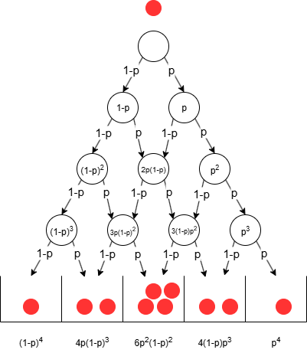
Galton Board as Decision DAG
Galton Board is a decision DAG (Directed Acyclic Graph)
If p=1/2, a symmetric normal distribution is achieved in the tally bins
Modifying the probability ( p ) will skew the distribution either to the left or right
Notes:
The work is based on the scientific paper universal statistical simulator where Galton board is taken as the
model and implemented on quantum computer. We can basically view the golden board as a decision
tree more precisely decision direct specific graph where each node is assigned with probability to go
left and right and this behavior can be modeled on quantum computer. By measuring the tally qubits
We can obtain various distributions.
if you set probability p to be equal 1/2 on each node we will obtain the classic Gaussian. With creative
modifications of quantum pegs and probabilities we can control the output distribution. ______

Slide 4
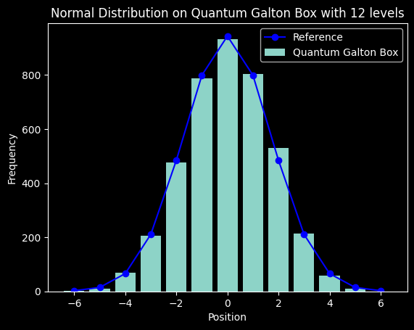
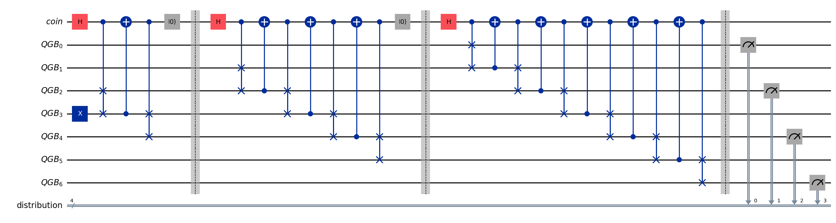
n-levels Galton Board: Quantum Circuit
Diagram for n=3:
For n levels
Qubits: 2n + 2
Depth: 4 + 8 + 12 + … + 3n = 2(n² + n) = O(n²)
Notes:
The implementation as described in the scientific paper does lead to the classic Gaussian distribution as shown
on this picture where we executed the circuit on the noiseless simulator with 12 levels of the
Galton board. Generally the n level Galton board will require 2 n + 2 cubits and the depths of the
circuit will be 2 * n square + n or big O of n^2. ______

Slide 5
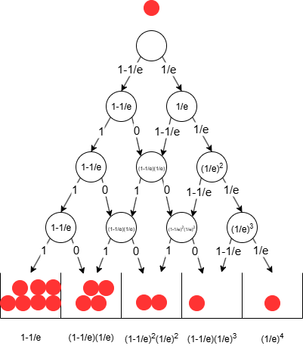

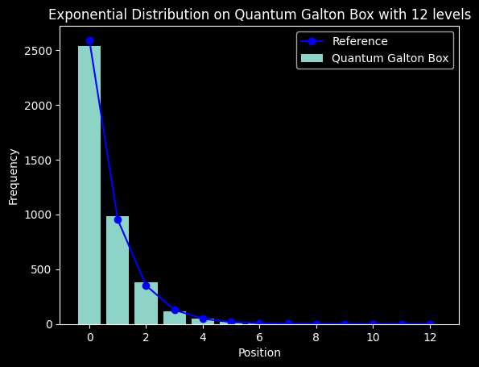
Exponential Distribution
To achieve a different distribution, probabilities must be adjusted at each level
The figure illustrates assigning probabilities only to the rightmost quantum peg, requiring either a rotation of the "coin" qubit by a specific angle or flipping it
In the quantum circuit, this involves modifying the quantum coin function using controlled RY rotations to bias the "coin" accordingly
The angle of rotation is given by
Notes:
Exponential distribution can be obtained by modifying the quantum pegs. As we can see
the pegs on the right have a probability of 1/e and on the left 1-1/e.
We can achieve that by applying a certain rotation to
the coin cubit that controls the SWAP gates within the circuit.

Slide 6
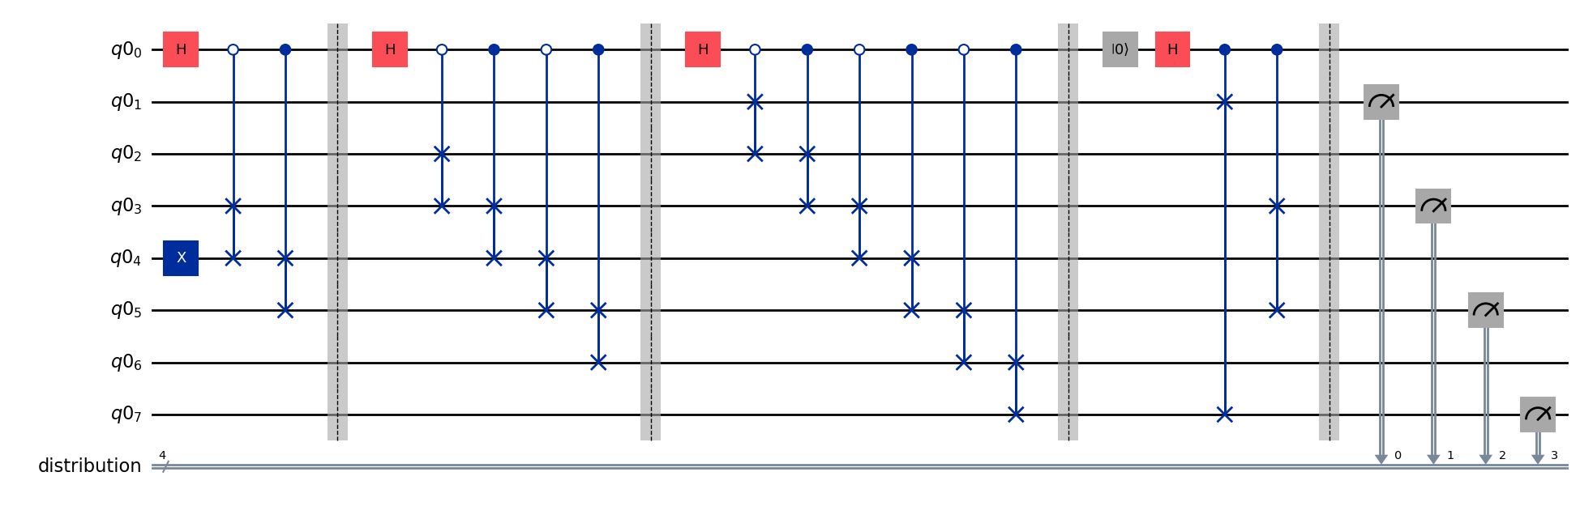
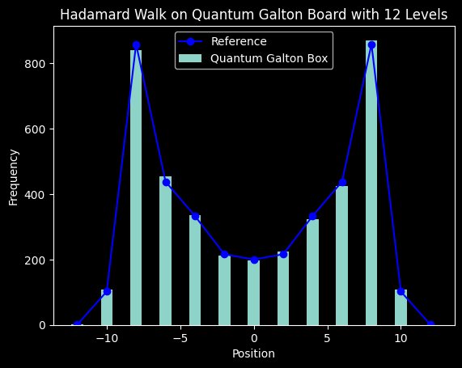
Hadamard Random Walk (bi-modal) Distribution
The walk must be conducted in superposition to maintain the interference effect
Alternate the control value for each CSWAP gate to simulate stepping in superposition
Refrain from resetting the coin state to preserve interference
Execute a final swap after all levels have been applied to ensure a symmetric distribution
Notes:
Hadamard random walk or bi modal distribution is slightly more involved. It requires stepping in super-position and as
you can see in the circuit we do not make any coin qubit resets between the levels. However, to achieve the
symmetric view of the distribution, we do need to perform a final swap between the symmetric
qubits to achieve that nice bimodal look. Otherwise, the distribution will be biased to the
left or to the right.

Slide 7
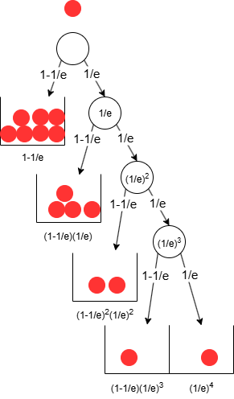
Symmetric DAG => Optimal Decision Tree
The thinking was inspired by observing the Exponential Distribution decision DAG
Notes:
Generated by Copilot The concept here is transforming a symmetric Directed Acyclic Graph into an optimal decision tree. This insight was inspired by examining the Exponential Distribution decision DAG. By leveraging symmetry, the decision tree can be optimized to reduce complexity and improve efficiency in quantum circuit design. The visual comparison between the DAG and the decision tree underscores how structural properties can be exploited to streamline quantum algorithms for distribution simulation. ______

Slide 8
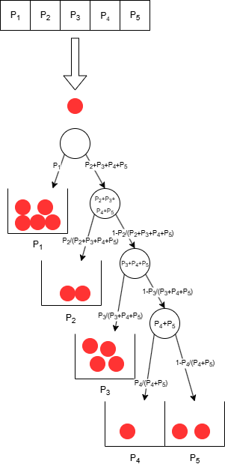

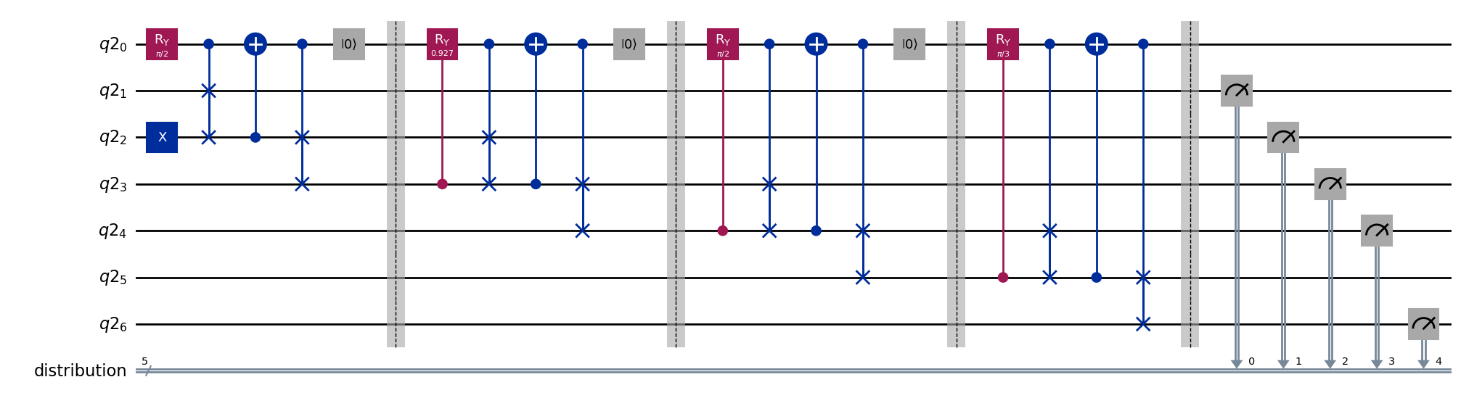
Optimal Decision Tree for an Arbitrary Distribution
Given a vector of n+1 probabilities, we can build an optimized coin function
Quantum circuit will assure the ball reaches each tally bin with the desired probability
The circuit resembles the one-sided look of the decision tree
Rotation angle for level i is given by:
Qubits: n + 3
Depth: 4n = O(n)
Notes:
In order to run the quantum circuit in the noisy environments, optimization
of the circuit construction is required. The solution we offer applies to any distribution.
Given a vector on n+1 probabilities, we can load it using Galton board inspired approach.
as you can see on the figure
we got rid of most of the pegs. keeping only the side ones.
knowing the probability vector, we are about to load, we can carefully
calculate the rotation angles on each level and assure that the quantum ball reaches each
tally bin with the required probability.
this reduces the number of qubits required from 2n + 2 to n + 3 and the depth is on 4n or Big O of (n).

Slide 9
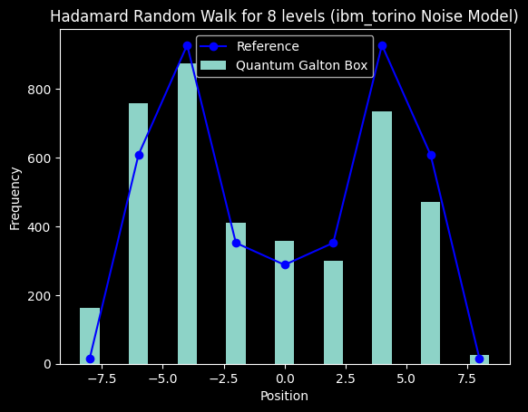
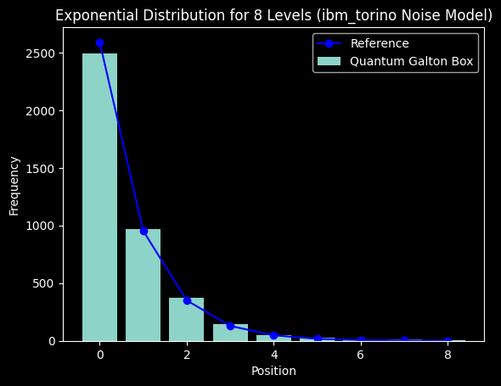
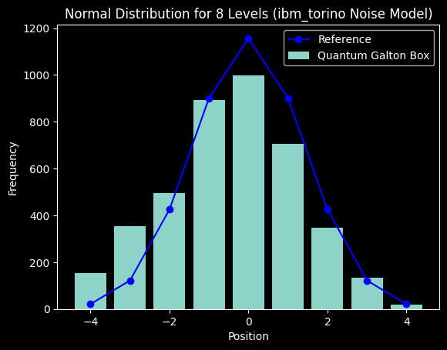
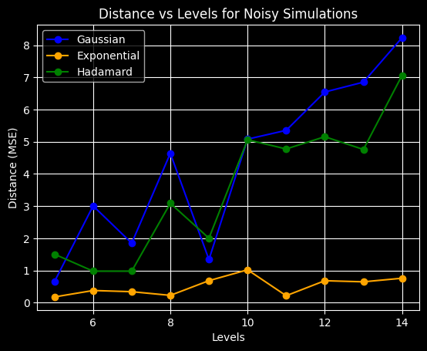
Noisy Simulations
The exponential distribution demonstrated the greatest improvement in accuracy following the Galton Board optimizations
By decreasing the number of required qubits from 2n+2 to n+3 and markedly reducing the circuit depth, the results remained sufficiently close to the reference values for all distributions despite the presence of noise
The visual similarity of the distributions is preserved up to 14 levels with presence of noise
Notes:
This approach has led to much more accurate simulation in the noisy environment and much faster execution of those simulations. ______

Slide 10
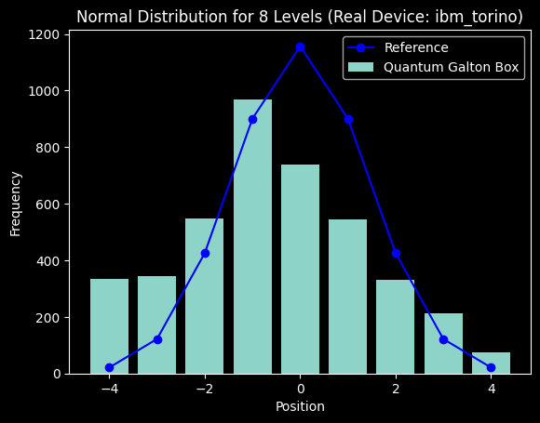
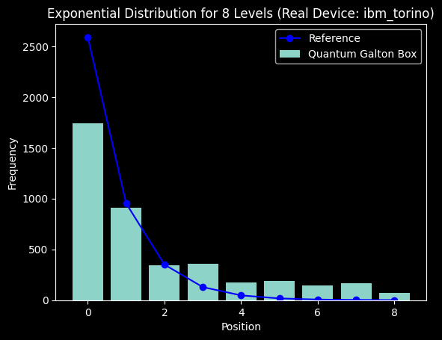
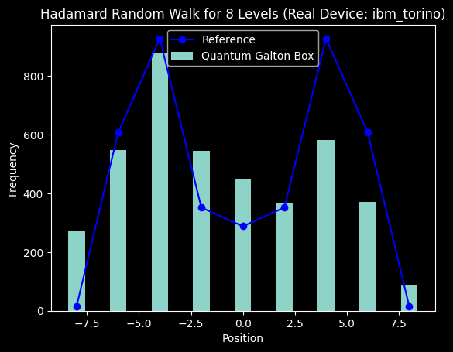
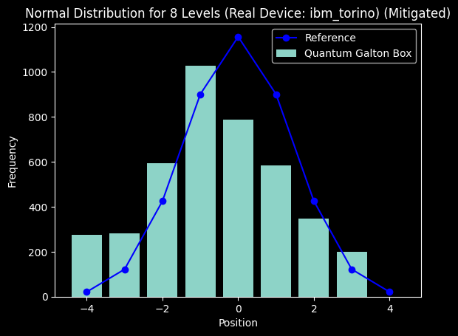
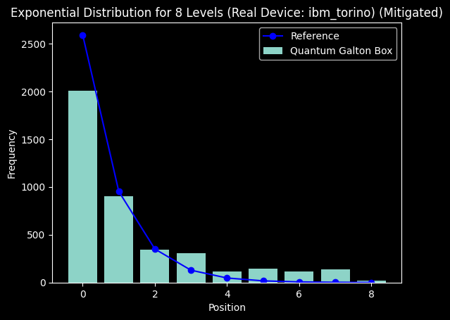
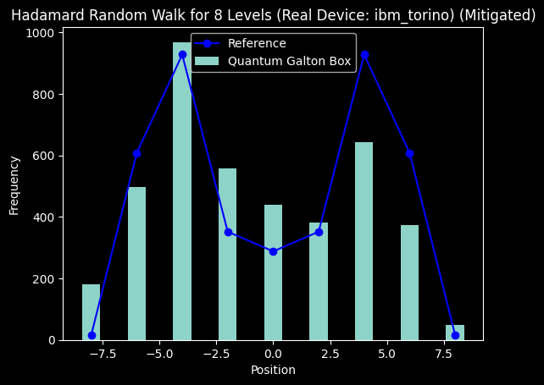
Real Backend Execution
Despite large distances from the reference, the distribution shapes are identifiable
Noise reduction using the M3 package had minimal impact
Overall, the IBM Torino backend performed impressively!!! 🎉🎉🎉
Notes:
The circuit was also executed on the real back end IBM Torino and showed very promising results where we can observer the resemblance of the
distributions that we were required to model (Gaussian, Exponential and Hadamard) with 8 levels of Galton board. ______

Slide 11
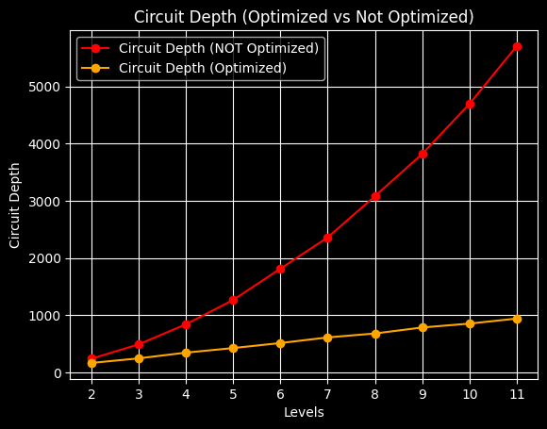
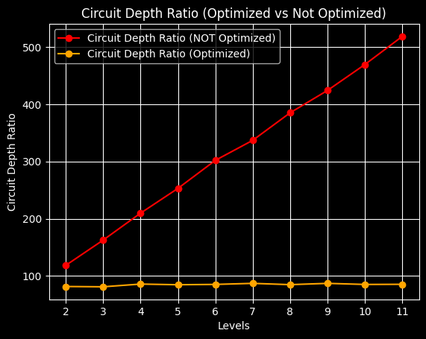
Circuit Depth Study
Optimized circuits
​
Maintaining a constant depth-to-levels ratio results in a linear dependency on levels
​​
Non-optimized circuits
​
A linearly increasing ratio signifies a quadratic dependency on levels
Notes:
We studied the transpiled depth of the circuit for optimized and non-optimized construction and as expected discovered the linear dependency on levels in the optimized case and quadratic otherwise.

Slide 12
Conclusions
Demonstrated universal distribution simulator as a superposition of Hamming Weight 1 states
Reduced qubits needed from 2n+2 to n+3
Improved circuit depth from O(n²) to O(n) ensuring resource efficiency and noise resilience
MSE distance stayed below 5 at most levels
Optimistic outlook for NISQ devices: execution on real backend showcased impressive results
Notes:
In conclusion, the project successfully demonstrated a universal distribution simulator. We are proud to reduce the qubit count from 2n+2 to n+3, and circuit depth from quadratic to linear scaling,
Which helped enhancing accuracy, resource efficiency and noise resilience.
Execution on real devices yielded promising results, which supports our optimistic outlook for practical quantum distribution simulations
in the near future.
Thank you very much!

Slide 13
References
"Universal Statistical Simulator", Mark Carney, Ben Varcoe (arXiv:2202.01735)
"Quantum random walks - an introductory overview", J. Kempe (arXiv:quant-ph/0303081)
"Scalable Mitigation of Measurement Errors on Quantum Computers", Paul D. Nation, Hwajung Kang, Neereja Sundaresan, and Jay M. Gambetta, PRX Quantum 2, 040326 (2021).
Notes:
Generated by Copilot This slide lists key academic references that underpin the research presented. These include foundational papers on the Universal Statistical Simulator, introductory overviews of quantum random walks, and advanced techniques for mitigating measurement errors on quantum computers. These sources provide theoretical and practical context, supporting the methodologies and findings discussed throughout the presentation. ______

