Slide 1
Random Walks and Monte Carlo
WISER Quantum Projects 2025
Team Quantotto: Yevgeny Menaker
09 August 2025
Notes:
Generated by Copilot This slide introduces the presentation on "Random Walks and Monte Carlo" as part of the WISER Quantum Projects 2025. The team Quantotto, led by Yevgeny Menaker, is responsible for this work. The minimalist design sets a professional tone, emphasizing the focus on quantum computing techniques applied to stochastic processes like random walks and Monte Carlo simulations, which are foundational in probabilistic modeling and quantum algorithm development. ______

Slide 2
Project Goals
Quantum Galton Board Implementation: Construct a quantum analogue of the n-level Galton Board to illustrate symmetric Gaussian distributions
State Preparation: Apply the Universal Statistical Simulator method (from research paper) to generate a range of distributions as a superposition of quantum states
Distribution Adjustment: Alter quantum pegs and coin parameters to produce various distributions, including Exponential and Hadamard Random Walk (Bi-Modal)
Noise-Resilient Optimization: Design a Galton Board-inspired method to load arbitrary distributions and demonstrate outcomes on noisy simulators using the IBM ibm_torino noise model
Performance and Depth Analysis: Evaluate circuit accuracy under noisy conditions and examine the relationship between circuit depth and the number of Galton Board levels
Real Backend Runs: Execute Resulting Circuits on physical QPUs and observe the results
Notes:
Generated by Copilot Here we outline the core objectives of the project. The first goal is to build a quantum analogue of the n-level Galton Board to demonstrate symmetric Gaussian distributions. Next, we apply the Universal Statistical Simulator method to prepare quantum states representing various distributions. By adjusting quantum pegs and coin parameters, we aim to generate diverse distributions such as Exponential and Hadamard Random Walks. We also focus on noise-resilient optimization to ensure reliable results on noisy quantum simulators, specifically using the IBM ibm_torino noise model. Performance analysis will assess circuit accuracy and depth, and finally, we plan to run these circuits on real quantum processing units (QPUs) to validate our approach. ______

Slide 3
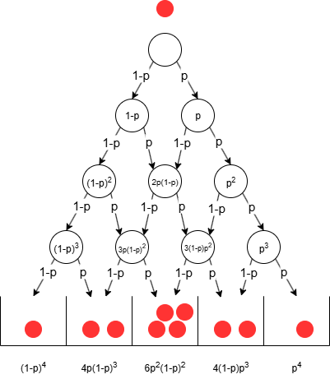
Galton Board as Decision DAG
Galton Board is a decision DAG (Directed Acyclic Graph)
If p=1/2, a symmetric normal distribution is achieved in the tally bins
Modifying the probability ( p ) will skew the distribution either to the left or right
Notes:
Generated by Copilot This slide explains the Galton Board as a decision Directed Acyclic Graph (DAG). When the probability p equals 1/2, the tally bins produce a symmetric normal distribution, reflecting the classic binomial outcome. Adjusting the probability p skews the distribution left or right, allowing us to model asymmetric outcomes. The visual diagram helps illustrate how each decision node in the DAG corresponds to a quantum operation, linking classical probability concepts with quantum circuit design. ______

Slide 4
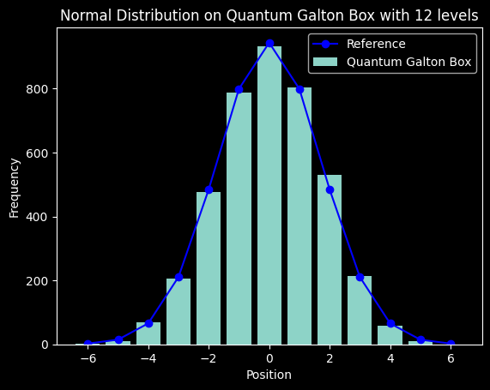
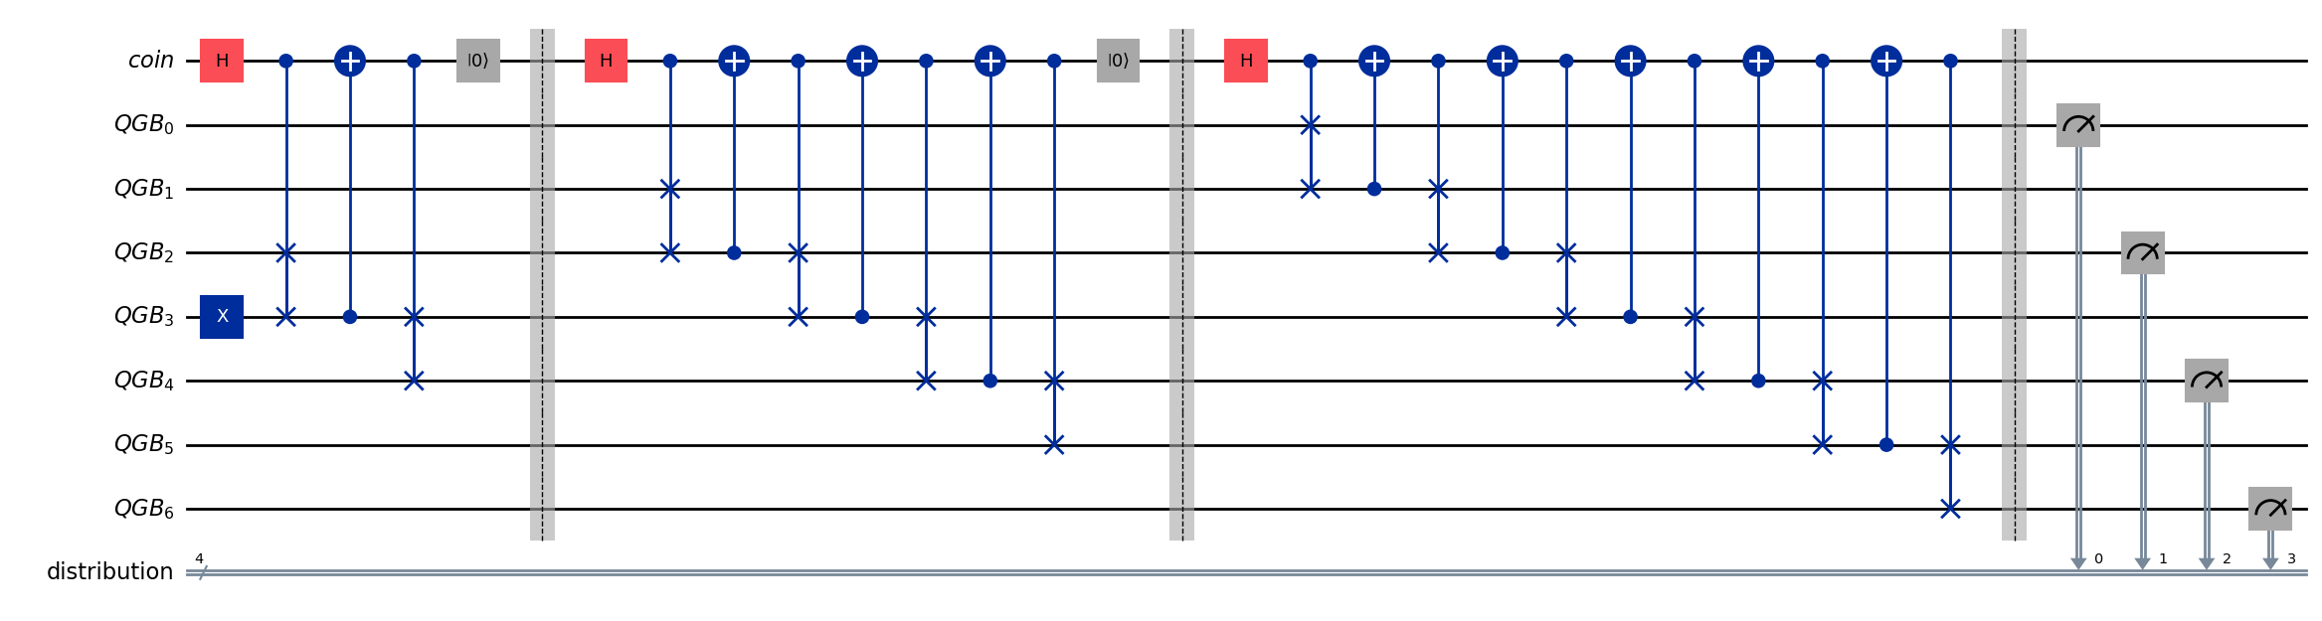
n-levels Galton Board: Quantum Circuit
Diagram for n=3:
For n levels
Qubits: 2n + 2
Depth: 4 + 8 + 12 + … + 3n = 2(n² + n) = O(n²)
Notes:
Generated by Copilot We delve into the quantum circuit implementation of an n-level Galton Board. The number of qubits required scales as 2n plus 2, and the circuit depth grows quadratically with n, specifically as 2(n² + n). The diagram for n=3 visually represents the circuit structure and particle distribution. The histogram on the right confirms that the quantum Galton Board closely replicates the expected normal distribution for 12 levels, demonstrating the circuit's effectiveness in simulating classical probabilistic behavior within a quantum framework. ______

Slide 5
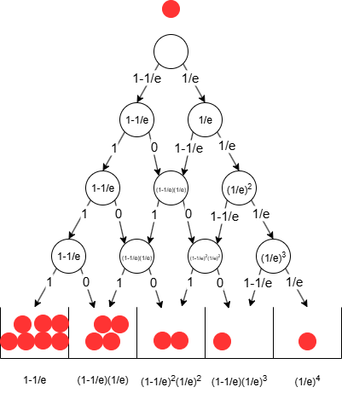

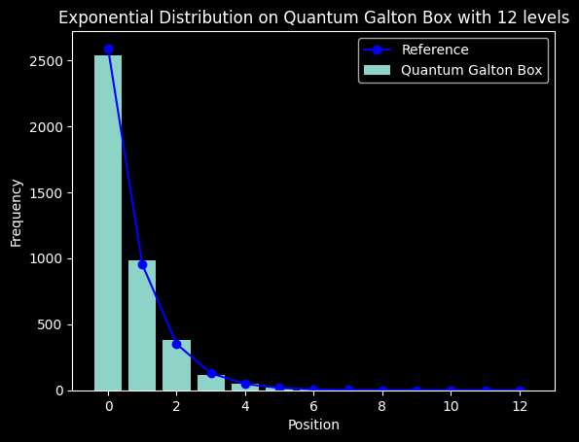
Exponential Distribution
To achieve a different distribution, probabilities must be adjusted at each level
The figure illustrates assigning probabilities only to the rightmost quantum peg, requiring either a rotation of the "coin" qubit by a specific angle or flipping it
In the quantum circuit, this involves modifying the quantum coin function using controlled RY rotations to bias the "coin" accordingly
The angle of rotation is given by
Notes:
Generated by Copilot To achieve an exponential distribution, we adjust the probabilities at each level by biasing the quantum coin. This is done by applying controlled RY rotations to the coin qubit, effectively rotating it by a specific angle to favor one outcome. The figure illustrates assigning probabilities only to the rightmost quantum peg, which simplifies the control mechanism. This approach allows us to tailor the quantum walk to produce non-symmetric distributions, expanding the versatility of the quantum Galton Board beyond the symmetric Gaussian case. ______

Slide 6
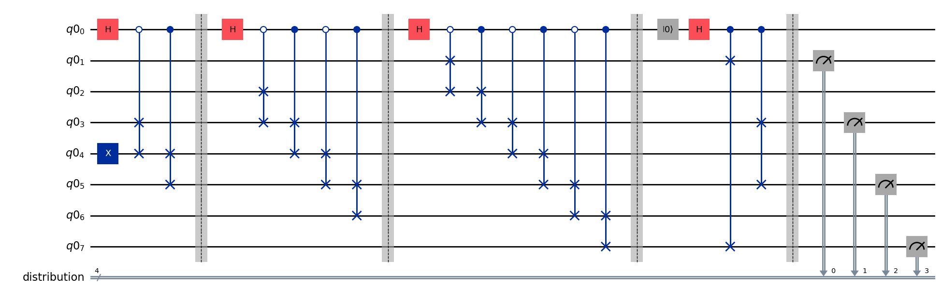
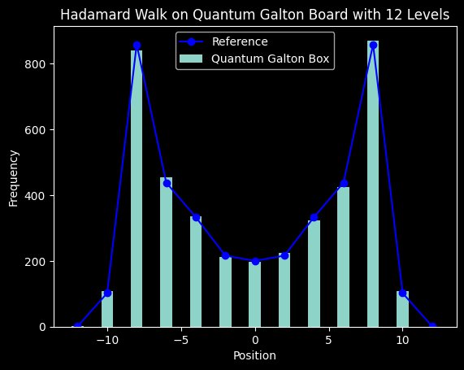
Hadamard Random Walk (bi-modal) Distribution
The walk must be conducted in superposition to maintain the interference effect
Alternate the control value for each CSWAP gate to simulate stepping in superposition
Refrain from resetting the coin state to preserve interference
Execute a final swap after all levels have been applied to ensure a symmetric distribution
Notes:
Generated by Copilot This slide covers the Hadamard Random Walk, which produces a bi-modal distribution through quantum superposition and interference. Key to this process is maintaining the walk in superposition by alternating control values for each CSWAP gate, simulating steps without collapsing the quantum state. Importantly, the coin state is not reset between steps to preserve interference effects. A final swap operation ensures the resulting distribution is symmetric. The diagram and graph illustrate how these quantum operations lead to the characteristic bi-modal distribution, highlighting the unique quantum behavior compared to classical random walks. ______

Slide 7
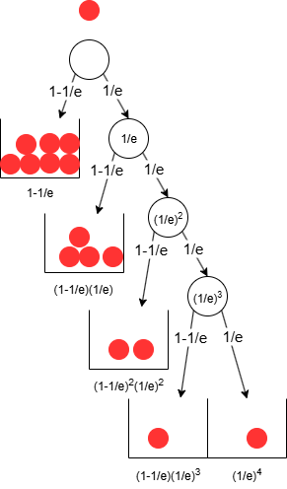
Symmetric DAG => Optimal Decision Tree
The thinking was inspired by observing the Exponential Distribution decision DAG
Notes:
Generated by Copilot The concept here is transforming a symmetric Directed Acyclic Graph into an optimal decision tree. This insight was inspired by examining the Exponential Distribution decision DAG. By leveraging symmetry, the decision tree can be optimized to reduce complexity and improve efficiency in quantum circuit design. The visual comparison between the DAG and the decision tree underscores how structural properties can be exploited to streamline quantum algorithms for distribution simulation. ______

Slide 8
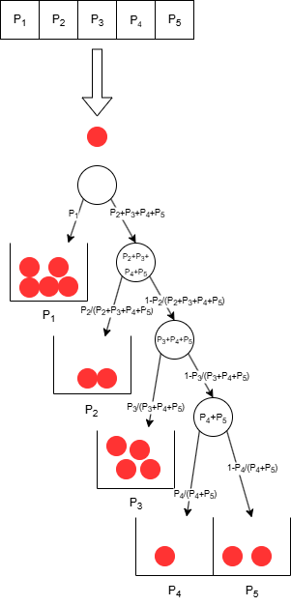

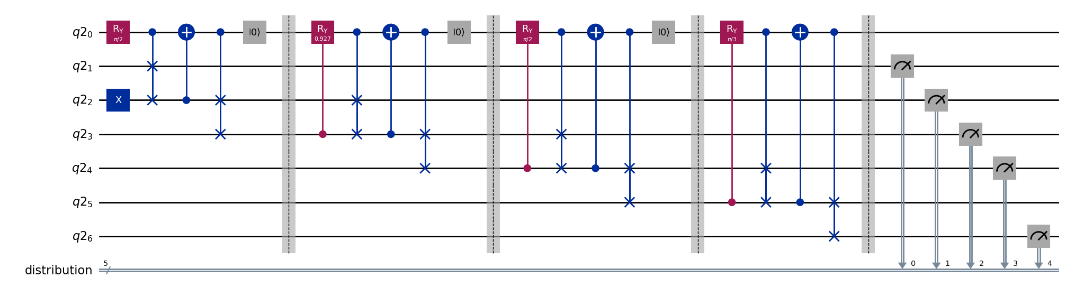
Optimal Decision Tree for an Arbitrary Distribution
Given a vector of n+1 probabilities, we can build an optimized coin function
Quantum circuit will assure the ball reaches each tally bin with the desired probability
The circuit resembles the one-sided look of the decision tree
Rotation angle for level i is given by:
Qubits: n + 3
Depth: 4n = O(n)
Notes:
Generated by Copilot This slide presents the construction of an optimal decision tree for any arbitrary distribution given a vector of probabilities. The quantum circuit is designed to ensure that the quantum ball reaches each tally bin with the exact desired probability. The circuit's structure resembles a one-sided decision tree, with rotation angles at each level calculated to match the target distribution. Notably, this approach reduces the qubit count to n plus 3 and achieves a circuit depth linear in n, significantly improving resource efficiency compared to previous designs. ______

Slide 9
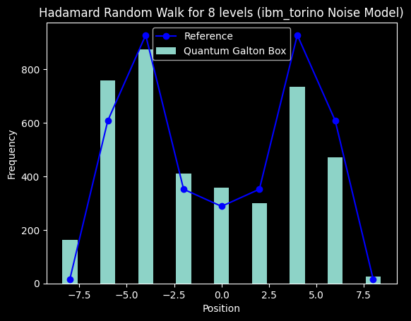
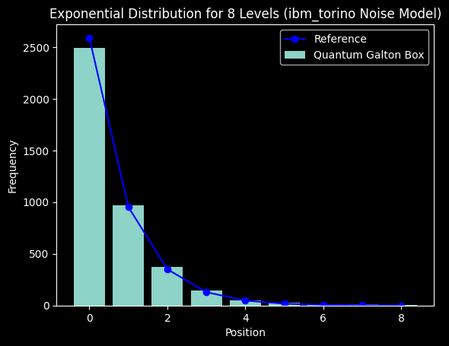
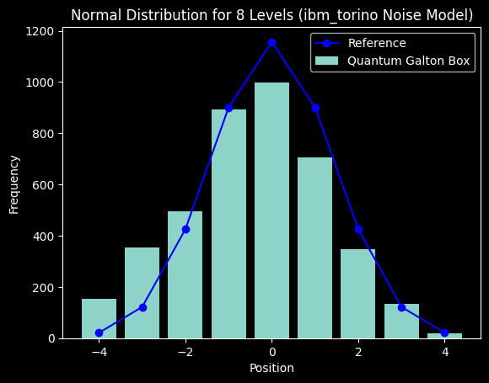
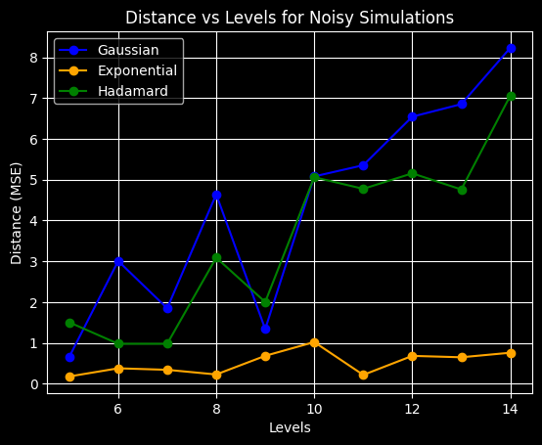
Noisy Simulations
The exponential distribution demonstrated the greatest improvement in accuracy following the Galton Board optimizations
By decreasing the number of required qubits from 2n+2 to n+3 and markedly reducing the circuit depth, the results remained sufficiently close to the reference values for all distributions despite the presence of noise
The visual similarity of the distributions is preserved up to 14 levels with presence of noise
Notes:
Generated by Copilot Noisy simulations demonstrate the robustness of the optimized Galton Board circuits. The exponential distribution, in particular, shows the greatest accuracy improvement after optimization. By reducing qubit requirements and circuit depth, the circuits maintain results close to reference values despite noise. The histograms and line graph illustrate that the visual similarity of distributions is preserved up to 14 levels, confirming that the optimizations enhance noise resilience and make these quantum simulations more practical on current noisy intermediate-scale quantum (NISQ) devices. ______

Slide 10
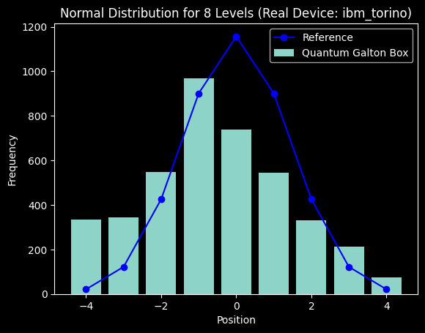
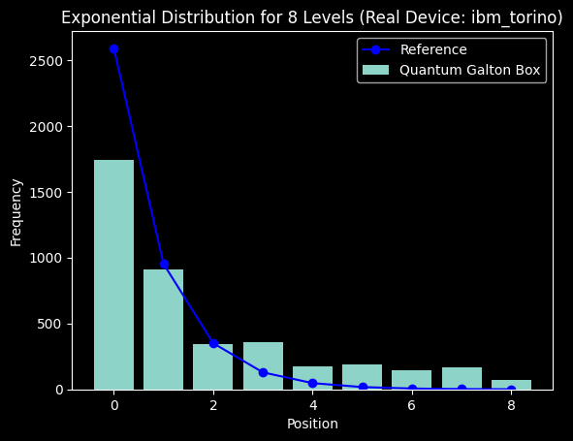
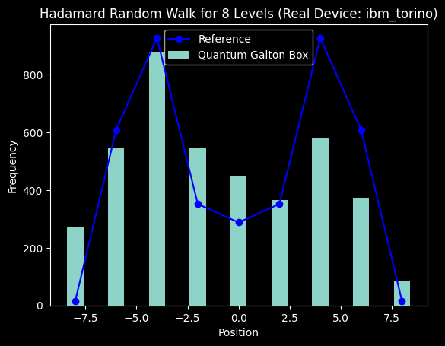
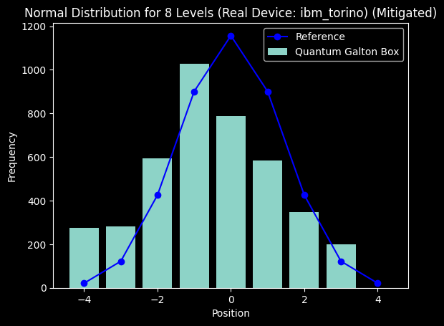
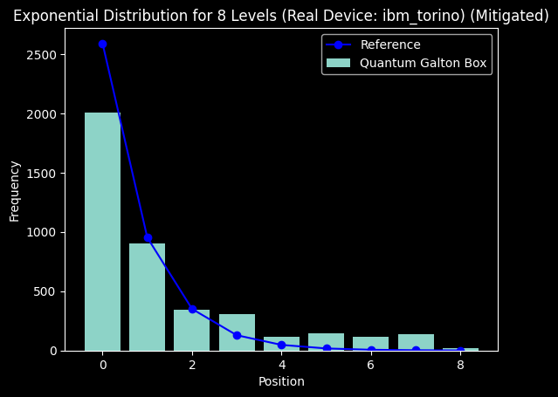
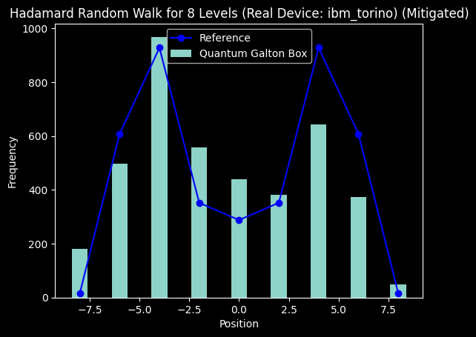
Real Backend Execution
Despite large distances from the reference, the distribution shapes are identifiable
Noise reduction using the M3 package had minimal impact
Overall, the IBM Torino backend performed impressively!!! 🎉🎉🎉
Notes:
Generated by Copilot This slide reports on executing the quantum circuits on a real IBM Torino backend. Although the distributions deviate significantly from ideal references due to noise, the overall shapes remain recognizable, indicating meaningful quantum behavior. Attempts to reduce noise using the M3 package had limited effect, but the backend's performance is still impressive given current hardware limitations. This real-world validation highlights the progress and challenges in running complex quantum algorithms on existing quantum processors. ______

Slide 11
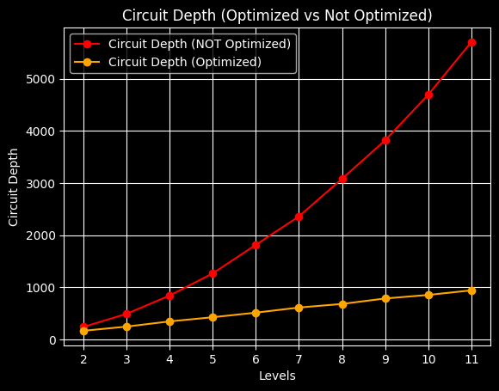
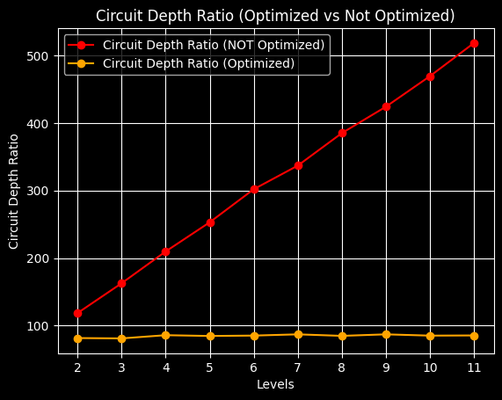
Circuit Depth Study
Optimized circuits
​
Maintaining a constant depth-to-levels ratio results in a linear dependency on levels
​​
Non-optimized circuits
​
A linearly increasing ratio signifies a quadratic dependency on levels
Notes:
Generated by Copilot The circuit depth study compares optimized and non-optimized quantum circuits. Optimized circuits maintain a constant depth-to-levels ratio, resulting in a linear increase in depth as levels grow. In contrast, non-optimized circuits exhibit a linearly increasing ratio, leading to quadratic growth in depth. These findings emphasize the importance of circuit optimization to manage resource demands and improve scalability, which is critical for practical quantum computing applications involving complex distributions. ______

Slide 12
Conclusions
Demonstrated universal distribution simulator as a superposition of Hamming Weight 1 states
Reduced qubits needed from 2n+2 to n+3
Improved circuit depth from O(n²) to O(n) ensuring resource efficiency and noise resilience
MSE distance stayed below 5 at most levels
Optimistic outlook for NISQ devices: execution on real backend showcased impressive results
Notes:
Generated by Copilot In conclusion, the project successfully demonstrated a universal distribution simulator using a superposition of Hamming Weight 1 states. The qubit count was reduced from 2n+2 to n+3, and circuit depth improved from quadratic to linear scaling, enhancing both resource efficiency and noise resilience. The mean squared error remained low across most levels, indicating high accuracy. Execution on real NISQ devices yielded promising results, supporting an optimistic outlook for practical quantum distribution simulations in the near future. ______

Slide 13
References
"Universal Statistical Simulator", Mark Carney, Ben Varcoe (arXiv:2202.01735)
"Quantum random walks - an introductory overview", J. Kempe (arXiv:quant-ph/0303081)
"Scalable Mitigation of Measurement Errors on Quantum Computers", Paul D. Nation, Hwajung Kang, Neereja Sundaresan, and Jay M. Gambetta, PRX Quantum 2, 040326 (2021).
Notes:
Generated by Copilot This slide lists key academic references that underpin the research presented. These include foundational papers on the Universal Statistical Simulator, introductory overviews of quantum random walks, and advanced techniques for mitigating measurement errors on quantum computers. These sources provide theoretical and practical context, supporting the methodologies and findings discussed throughout the presentation. ______

