Slide 1

L/S Gamma Weekly Update
Week of November 5 – 11, 2026
Gabe Soler (PM), Ben Gorenc, Brandon Scheidler, Elizabeth Bighiu, Zach Glazer
November 11, 2026
QUANTT · L/S Gamma Desk

Slide 2
Week at a glance
The paper book made its first trades, the shadow books went live on the hub, and the learning-to-rank put picker failed
41
1
0 / 1
1
Long
Commits
Experiment run (6 trials)
Passed / run
New report (PDF)
Paper signal (VRP −8.25%)
Headlines
First paper trades: a short put, then a flip to a long call
Sold the Dec 4 737 put on Nov 5 at $14.22 (VRP +5.18%); after SPY's 4.4% drop the signal flipped to long and the book switched to the Dec 4 741 call. Book P&L −$57 (realized −$27)
Learning-to-rank put picker failed its pre-registered bar
Sharpe 0.64 vs 0.84 in 2014–2019; its full-window lead (0.84 vs 0.52) came from a gate that sat out the 2020 crash, and it made $80.1k vs $121.5k
Shadow books now run every idea on the live snapshot
7 books replay their exact rules daily from Sep 26 (no orders). The two stress-sized put books are up $3.2k and $3.4k after 23 days, too early to compare
Sources: git log (all branches), research cards, results/research/registry.parquet, results/paper ledger, research/shadow.json; as of 2026-11-11
QUANTT · L/S Gamma Desk
2

Slide 3
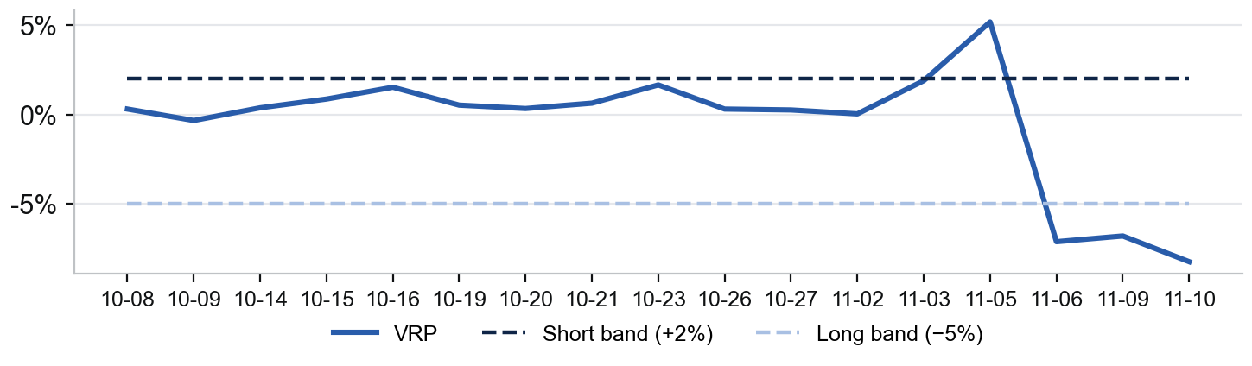
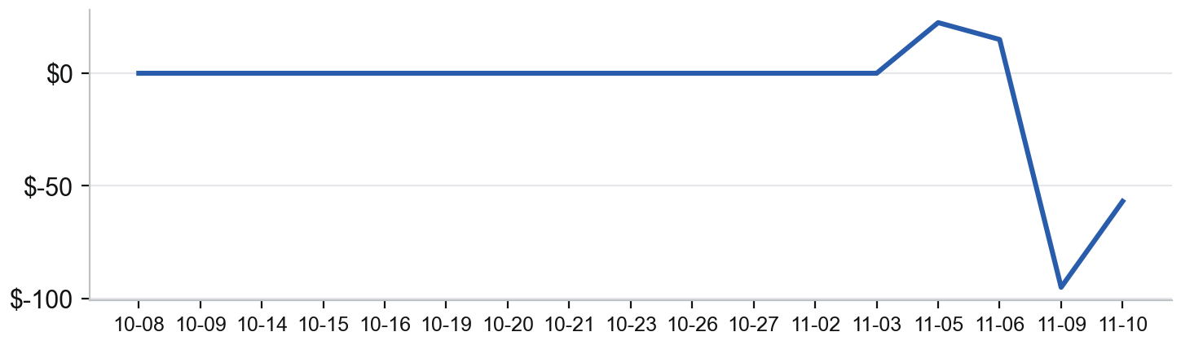
Paper Trading
The book traded for the first time: a short put on Nov 5, then a flip to a long call on Nov 6
Book Today (2026-11-10)
VRP vs Signal Bands
Signal:
Long
VRP (IV − RV fcst):
−8.25%
ATM IV (Dec 11, 31 DTE):
16.75%
GARCH RV forecast:
25.01%
Bands (long / short):
< −5% / > +2%
Position:
Long 1 Dec 4 741 call, −60 SPY
Book P&L:
−$57 (realized −$27)
Trades this week:
3 (2 opens, 1 close)
Runner days this week:
4 of 5
Capital (paper):
$250,000
Cumulative Paper P&L (Option + Hedge)
Fills This Week
Date | Fill | Price
11-05 | Sell 1 Dec 4 737 put (open) | $14.22
11-05 | Sell 46 SPY (hedge) | $738.46
11-06 | Buy 1 737 put (close, flip) | $13.46
11-06 | Buy 1 Dec 4 741 call (open) | $16.01
11-06 | Net sell 5 SPY (4 orders) | $739–741
11-09 | Sell 11 SPY (hedge) | $748.71
11-10 | Buy 2 SPY (hedge) | $748.63
Sources: results/paper/ (signals, trades, hedges), research/desk.json, configs/paper.toml; GARCH forecast, ATM IV at the target expiry; one row per runner day (last run wins); paper account only; as of 2026-11-10
QUANTT · L/S Gamma Desk
3

Slide 4
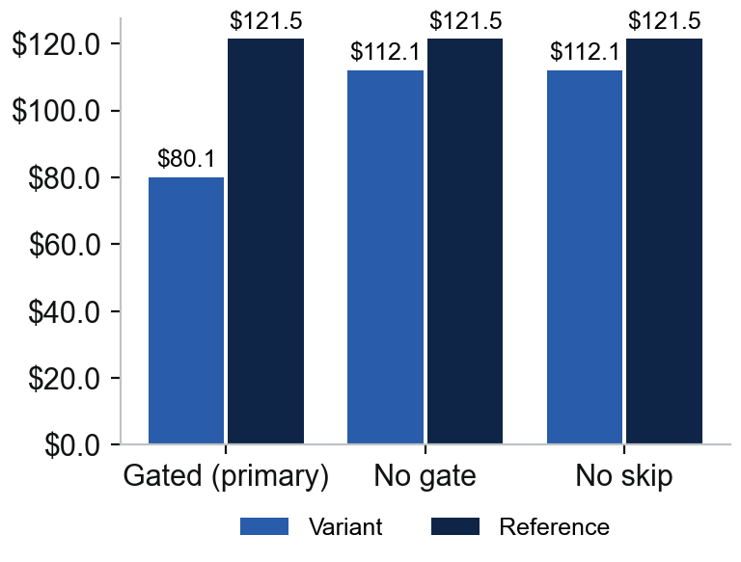
Recent Research
The learning-to-rank put picker failed: its full-window Sharpe lead came from a gate that sat out the 2020 crash
Pre-Registered Cards (Reference: 2026-10-22 Hedged Book)
Net P&L at 1x ($k)
Experiment | Topic | Idea | Verdict | Net P&L 1x vs ref
Learning-to-rank puts | Agentic Routing | LightGBM ranker picks the daily put delta, or no trade | Failed | $80.1k vs $121.5k
1DTE vol surface | Alpha Generation | Card scaffold; no hypothesis yet | Planned | —
What We Learned
The gate did the work: it abstained on all 49 days from 19 Feb to 30 Apr 2020; outside that window Sharpe was 0.85 vs 0.81
SKIP almost never won: the ranker put no-trade first on 1 of 1,944 test days, so the no-gate and no-skip books are identical
Skill, but no money edge: its pick was the day's best put 25% of the time vs 12.5% by chance, but the P&L edge ($69 a day) is not reliable (t = 0.57)
Sources: research/Agentic_Routing/2026-11-05-ltr-puts/ (card, summary, report), research/Alpha_Generation/2026-11-11-1DTE-Vol-Surface/; research/registry.csv; development window 2014-06-02 to 2024-12-31, out of sample untouched; aggregate figures only
QUANTT · L/S Gamma Desk
4

Slide 5
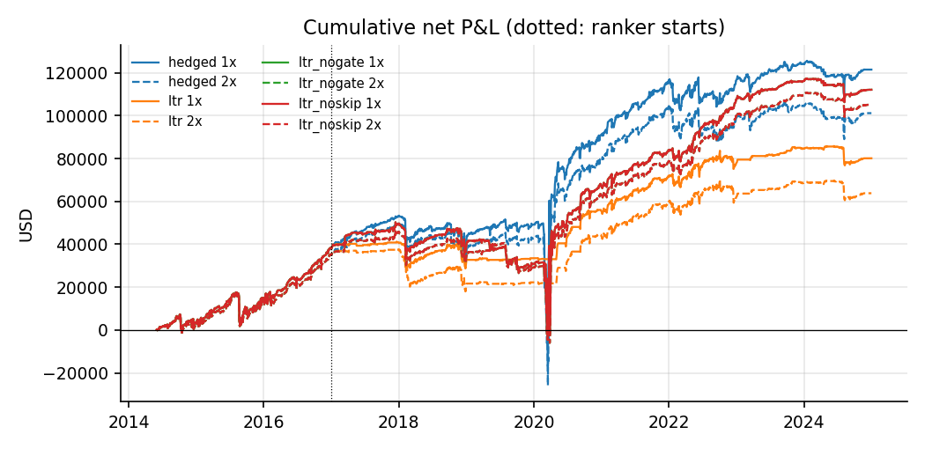
Research Results
The ranker's book trailed the reference from 2017 and stayed flat through March 2020, when the reference made most of its lead
Learning-to-Rank Puts: Failed (cumulative net P&L, 1x and 2x)
Sources: research/Agentic_Routing/2026-11-05-ltr-puts/figures/cum_pnl.png; net P&L at 1x and 2x spreads, 2014-06 to 2024-12; aggregates only
QUANTT · L/S Gamma Desk
5

Slide 6
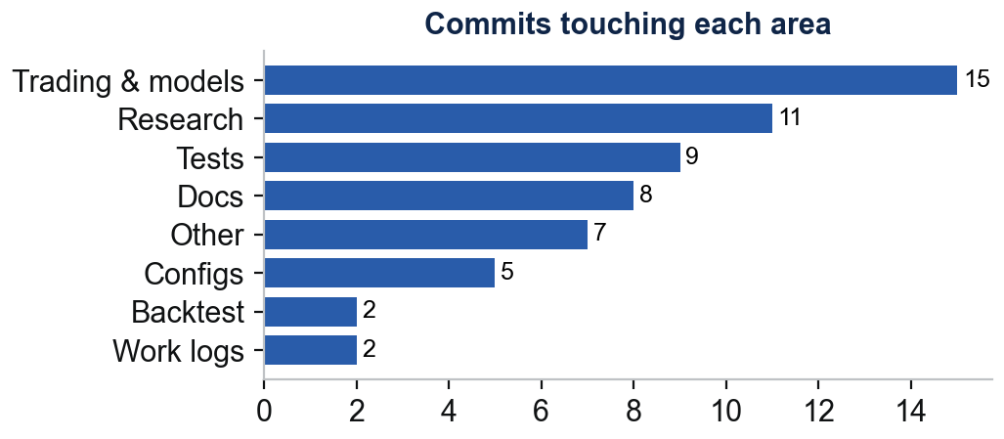
Repo and Team
Repo Changes by Area
Who Did What
Trading: first paper trades; hedges sent as limits off option-implied spot; option limits now mid + $0.30 after the flip close missed three times
Shadow books: 7 ideas replayed daily on the live snapshot (hourly book waits on automation), on a new hub page
Research hub: site live at lsgamma.quantt.ca (Cloudflare) with This week, Live desk and team pages
Research: learning-to-rank card run and reported (6 trials, registry at 140); Alpha Generation card started
Gabe Soler (PM)
37 commits · Took the paper book live, ran the learning-to-rank card, and built the research hub and shadow books
Ben Gorenc
1 commit · Setting up an Oracle cloud VM to run the strategy automatically; nearly done, waiting for capacity (Nov 7)
Brandon Scheidler
3 commits · No work-log entry this week (last: Nov 3); opened an empty 1DTE vol-surface card
Elizabeth Bighiu
0 commits · No work-log entry this week (last: Oct 21)
Zach Glazer
0 commits · No work-log entry this week (last: Oct 21)
Sources: git log --branches --remotes, 2026-11-05 to 2026-11-11; work-logs/*; one-sentence summaries are Claude's, the logs themselves are the analysts' own words
QUANTT · L/S Gamma Desk
6

Slide 7
Next Week
Priorities (draft)
Decisions & Blockers (draft)
x
x
x
x
x
x
Sources: To be written by the PM; as of 2026-11-11
QUANTT · L/S Gamma Desk
7

