Slide 1

L/S Gamma Weekly Update
Week of October 27 – November 2, 2026
Gabe Soler (PM), Ben Gorenc, Brandon Scheidler, Elizabeth Bighiu, Zach Glazer
November 2, 2026
QUANTT · L/S Gamma Desk

Slide 2
Week at a glance
Four tweaks to the stress-sized put book all failed; the paper book stayed flat
10
4
0 / 4
5
Flat
Commits
Experiments (22 trials)
Passed / run
New reports (PDF)
Paper signal (VRP +0.03%)
Headlines
No tweak beat the 35% stress-sized hedged book
Friday-only entry, VRP-gated hedging, slope sizing and VVIX sizing were tested against the +$121.5k reference (1x), and all four failed the pre-registered bar
March 2020 drove the biggest differences
The largest piece of each variant's gap to the reference is one crash path (Feb–Apr 2020), so none is a clean signal
Paper book flat; runner ran on 2 of 5 trading days
VRP was +0.25% and +0.03%, inside the −5% / +2% dead band, so no trades were opened
Sources: git log (all branches), research cards, results/research/registry.parquet, results/paper/signals.parquet; as of 2026-11-02
QUANTT · L/S Gamma Desk
2

Slide 3
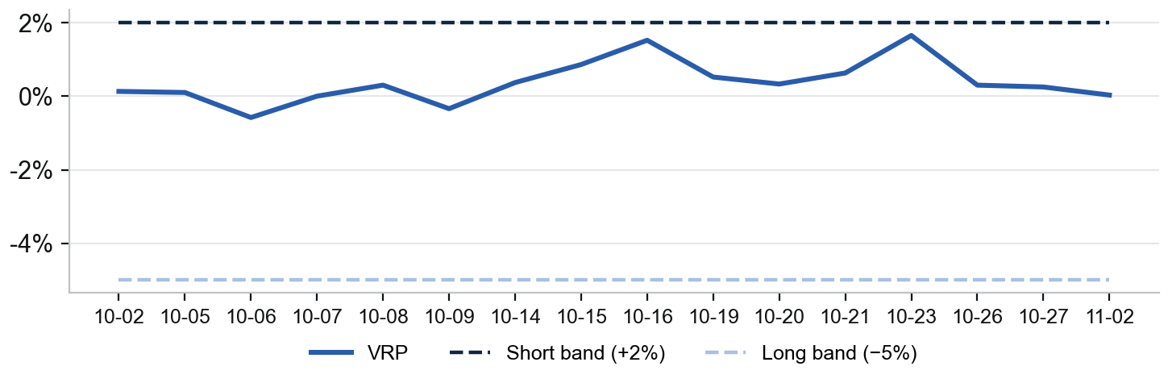
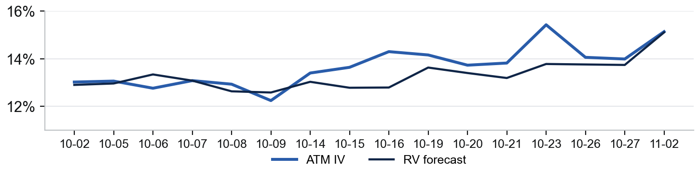
Paper Trading
VRP sat inside the dead band all week: no trades, no position
Book Today (2026-11-02)
VRP vs Signal Bands
Signal:
Flat
VRP (IV − RV fcst):
+0.03%
ATM IV (Dec 4, 32 DTE):
15.14%
GARCH RV forecast:
15.11%
Bands (long / short):
< −5% / > +2%
Position:
None
Trades this week:
0
Runner days this week:
2 of 5
Capital (paper):
$250,000
ATM IV vs GARCH RV Forecast
Trades This Week
No trades. VRP never left the dead band, so the runner stayed flat. VRP peaked at +1.65% on Oct 23, still below the +2% short band. Once the book trades, a fills table and cumulative P&L (option + hedge) go here.
Sources: results/paper/signals.parquet (16 runner days since 2026-10-02), configs/paper.toml; GARCH forecast, ATM IV at the target expiry; paper account only
QUANTT · L/S Gamma Desk
3

Slide 4
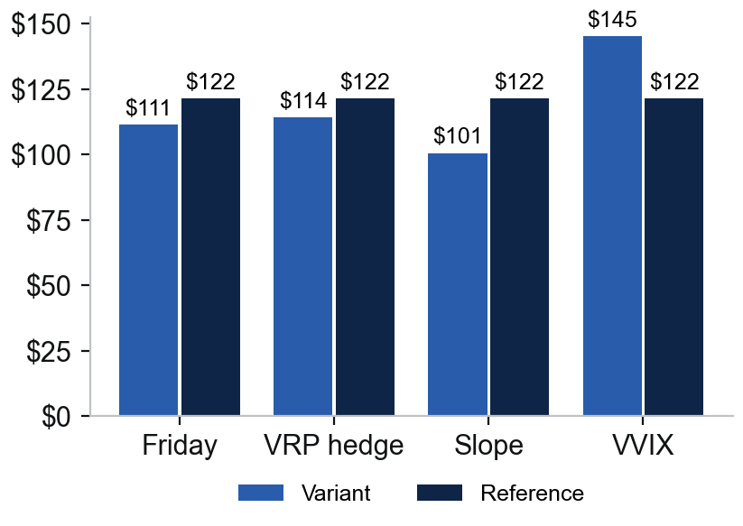
Recent Research
All four cards failed; only VVIX sizing out-earned the reference, and it broke the risk budget
Pre-Registered Cards (Reference: 2026-10-22 Hedged Book)
Net P&L at 1x ($k)
Experiment | Topic | Idea | Verdict | Net P&L 1x vs ref
Friday-only entry | Agentic Routing | Re-enter puts only on Fridays | Failed | $111.3k vs $121.5k
VRP-gated hedge | Deep Hedging | Leave puts unhedged when VRP > 2 pts | Failed | $114.1k vs $121.5k
Slope sizing | Risk Management | Tilt stress budget to steep contango | Failed | $100.6k vs $121.5k
VVIX sizing | Risk Management | Tilt stress budget to high VVIX | Failed (risk) | $145.2k vs $121.5k; DD $106.6k > $87.5k
What We Learned
One crash decides: the largest piece of each gap is February–April 2020 (45% of VVIX's lead, $9.7k of slope's shortfall)
No sorting: VVIX and VIX-slope terciles did not order per-contract P&L, against what the papers predict
Size-up costs drawdown: VVIX sizing gained +$23.7k but pushed max drawdown from $70.4k to $106.6k; slope sizing cut risk but lost $20.9k
Sources: research/*/2026-11-02-*/README.md and summary.md; figures/pass_bar.csv; development window 2014-06-02 to 2024-12-31, hold-out untouched; aggregate figures only
QUANTT · L/S Gamma Desk
4

Slide 5
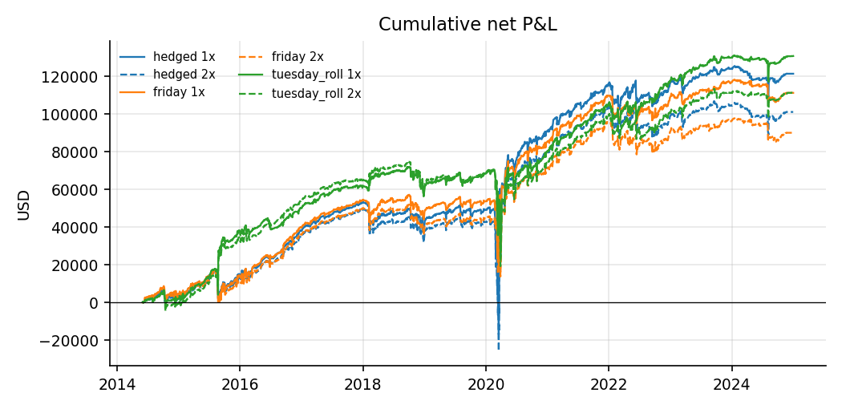
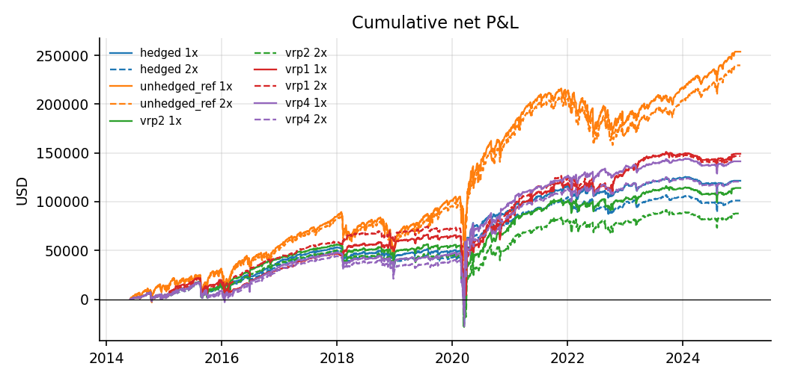
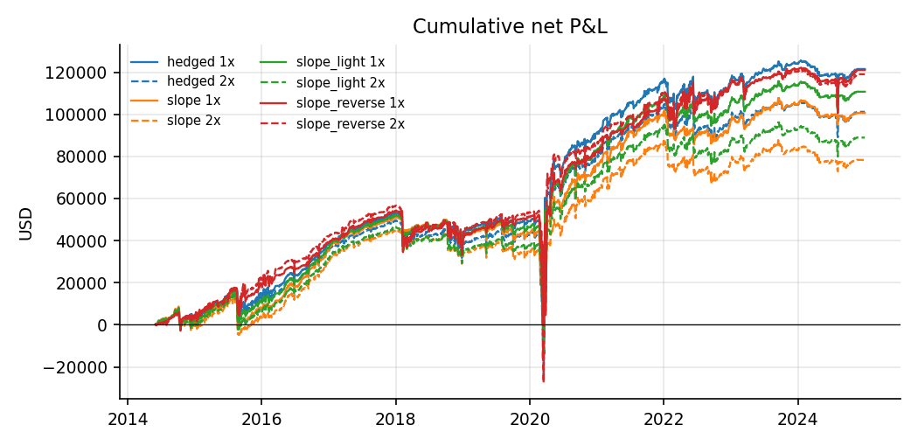
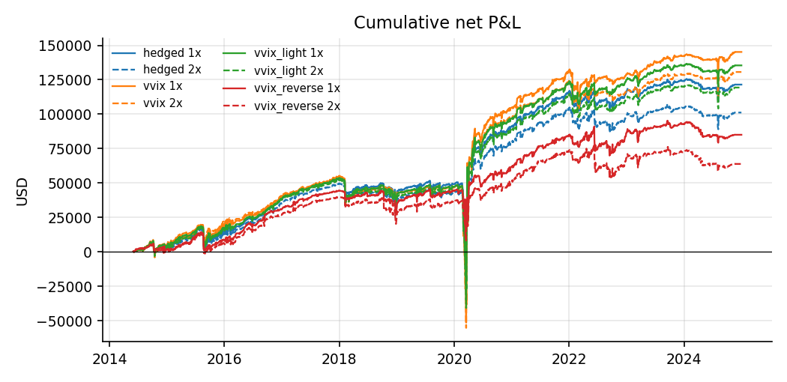
Research Results
Friday-Only Entry: Failed
VRP-Gated Hedge: Failed
Slope Sizing: Failed
VVIX Sizing: Failed (Risk)
Sources: research/*/2026-11-02-*/figures/cum_pnl.png (experiment reports); cumulative net P&L, 1x and 2x spreads, 2014-06 to 2024-12
QUANTT · L/S Gamma Desk
5

Slide 6
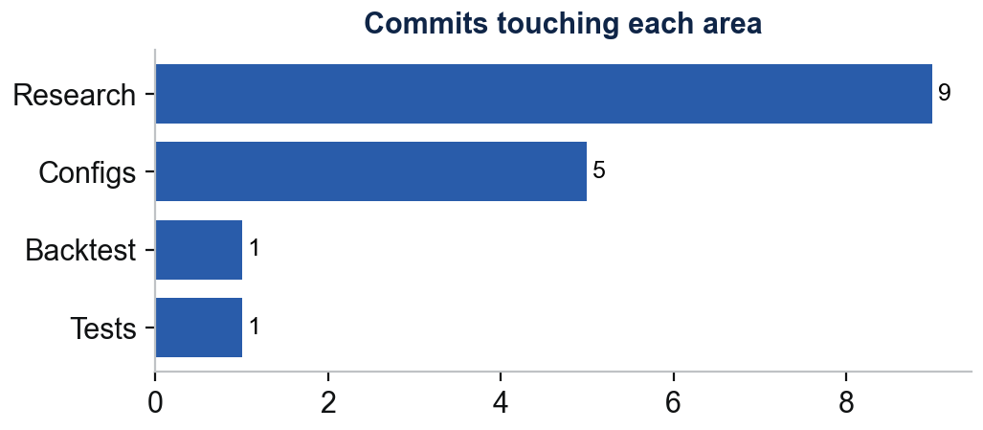
Repo and Team
Repo Changes by Area
Who Did What
Backtest: 4 research-only engine switches (entry_weekdays, size_by, size_tilt, vrp_unhedge), with tests
Research: 4 cards pre-registered, run and reported; 22 trials, registry now at 98
Reports: strategy research Signals beyond VRP (Oct 31) plus 4 experiment PDFs
Configs: 4 experiment TOMLs in configs/experiments/
Gabe Soler (PM)
10 commits · Ran the four 2026-11-02 experiments on the stress-sized put book and added their backtest switches
Ben Gorenc
0 commits · No work-log entry this week (log file is empty)
Brandon Scheidler
0 commits · No work-log entry this week (last: Oct 21)
Elizabeth Bighiu
0 commits · No work-log entry this week (last: Oct 21)
Zach Glazer
0 commits · No work-log entry this week (last: Oct 21)
Sources: git log --branches --remotes, 2026-10-27 to 2026-11-02; work-logs/*; one-sentence summaries are Claude's, the logs themselves are the analysts' own words
QUANTT · L/S Gamma Desk
6

Slide 7
Next Week
Priorities (draft)
Decisions & Blockers (draft)
x
x
x
x
x
x
Sources: Drafted from the 2026-11-02 summaries' next steps and the paper ledger; every item is a draft for PM review
QUANTT · L/S Gamma Desk
7

