Slide 1

L/S Gamma Weekly Update
Week of October 29 – November 4, 2026
Gabe Soler (PM), Ben Gorenc, Brandon Scheidler, Elizabeth Bighiu, Zach Glazer
November 4, 2026
QUANTT · L/S Gamma Desk

Slide 2
Week at a glance
Eleven cards on the stress-sized put book: only the 20-delta put passed (in-sample); the paper book stayed flat
31
11
1 / 11
14
Flat
Commits
Experiments (58 trials)
Passed / run
New reports (PDF)
Paper signal (VRP +1.89%)
Headlines
The 20-delta put passed in-sample, but its lead is mostly one month
$149.9k vs $121.5k at 1x (Sharpe 0.78 vs 0.52); on the 92 shared entry days it earned the same per contract, and August 2015 gives $26.5k of the $28.4k lead
Ten other cards failed; registry now at 134 trials
Sizing, hedging and crash-call tweaks mostly re-timed March 2020; FOMC/CPI and skew diagnostics justify no card; out-of-sample window left untouched
Paper book flat; runner ran on 2 of 4 trading days so far
VRP rose to +1.89% on Nov 3, just under the +2% short band, so no trade was opened
Sources: git log (all branches), research cards, results/research/registry.parquet, results/paper/signals.parquet; as of 2026-11-04
QUANTT · L/S Gamma Desk
2

Slide 3
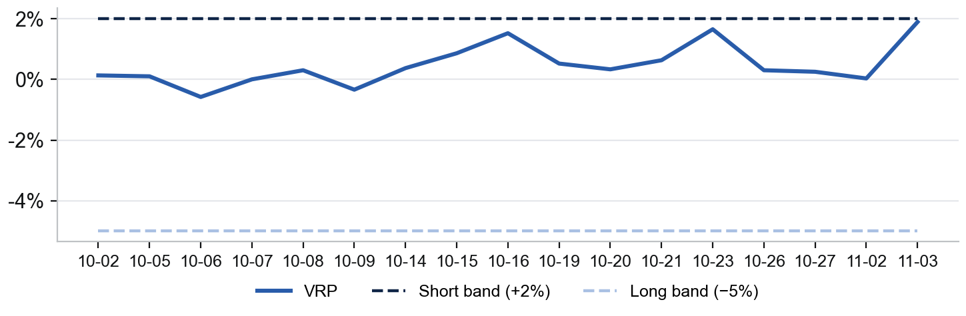
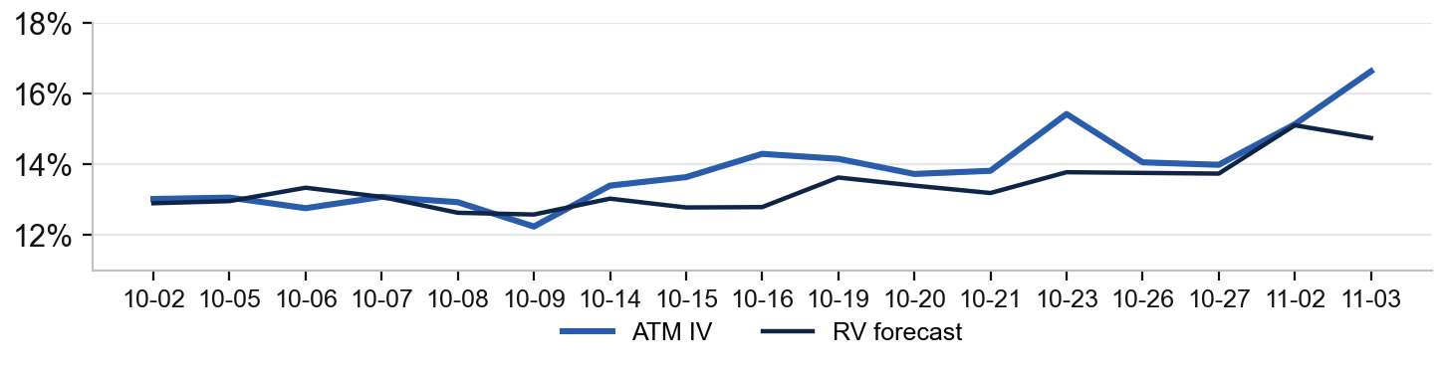
Paper Trading
VRP climbed to +1.89% on Nov 3, just short of the +2% band: no trades, no position
Book Today (2026-11-03)
VRP vs Signal Bands
Signal:
Flat
VRP (IV − RV fcst):
+1.89%
ATM IV (Dec 4, 31 DTE):
16.64%
GARCH RV forecast:
14.75%
Bands (long / short):
< −5% / > +2%
Position:
None
Trades this week:
0
Runner days this week:
2 of 4 (Nov 4 pending)
Capital (paper):
$250,000
ATM IV vs GARCH RV Forecast
Trades This Week
No trades. VRP stayed inside the dead band, but rose to +1.89% on Nov 3 (IV 16.6% vs a 14.8% forecast), the closest to the +2% short band since the runner started. Once the book trades, a fills table and cumulative P&L (option + hedge) go here.
Sources: results/paper/signals.parquet (17 runner days since 2026-10-02), configs/paper.toml; GARCH forecast, ATM IV at the target expiry; paper account only
QUANTT · L/S Gamma Desk
3

Slide 4
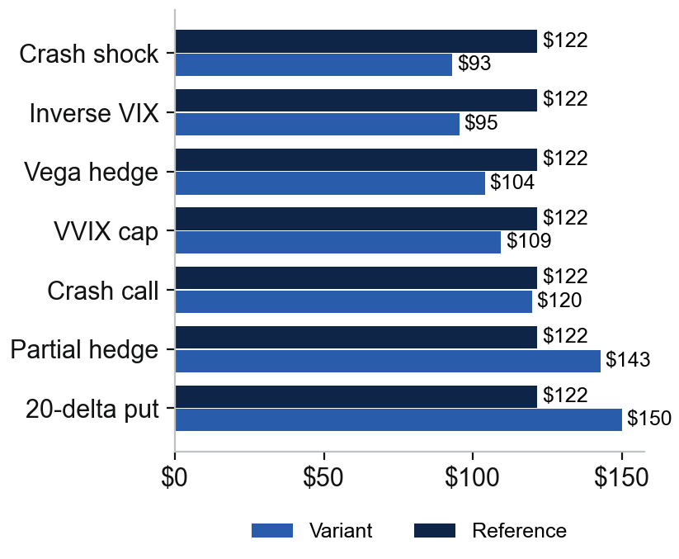
Recent Research
Seven follow-up cards: the 20-delta put passed in-sample; the partial hedge out-earned the reference but broke the risk budget
Pre-Registered Cards (Reference: 2026-10-22 Hedged Book)
Net P&L at 1x ($k)
Experiment | Topic | Idea | Verdict | Net P&L 1x (ref $121.5k)
20-delta put | Agentic Routing | 20-delta, not 25-delta | Passed (in-sample) | $149.9k
Partial hedge | Deep Hedging | Half hedge above 2 VRP pts | Failed (risk) | $142.7k; DD $98.2k
Crash call | Agentic Routing | Calls when VIX/VIX3M ≥ 1.1 | Failed | $119.8k; DD worse
VVIX cap | Risk Management | Size down on calm VVIX | Failed | $109.4k
Vega hedge | Deep Hedging | Vega term in the hedge | Failed | $104.0k
Inverse VIX | Risk Management | Smaller when VIX is high | Failed | $95.4k
Crash shock | Risk Management | Stress at 1.5× IV | Failed | $93.0k
What We Learned
The pass is fragile: same per-contract P&L on shared days; the lead was fully given back by 2021 and rebuilt in 2022–24
Smaller is not better: 25% and 15% budgets keep the same Sharpe (0.48, 0.51 vs 0.52); inverse-VIX's gain is March 2020 only
VRP timing shows up again: the half hedge made +$21.2k, but one 2 March 2020 put pushed drawdown to $98.2k
Sources: research/*/2026-11-02-*/README.md and summary.md; figures/pass_bar.csv; development window 2014-06-02 to 2024-12-31, out-of-sample window untouched; aggregate figures only
QUANTT · L/S Gamma Desk
4

Slide 5
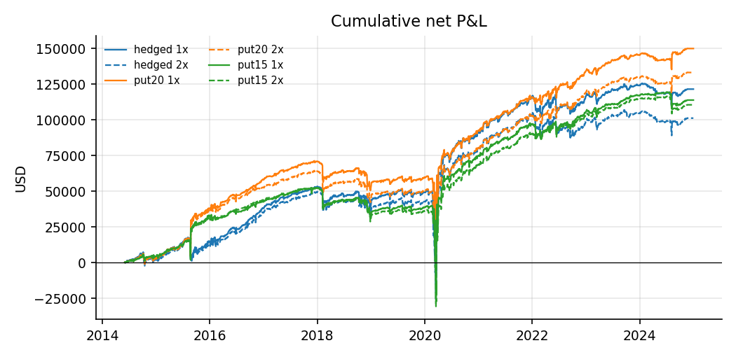
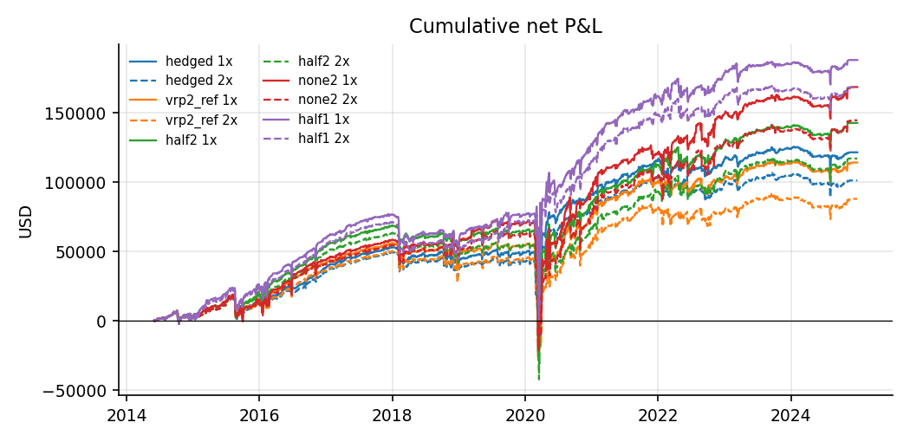
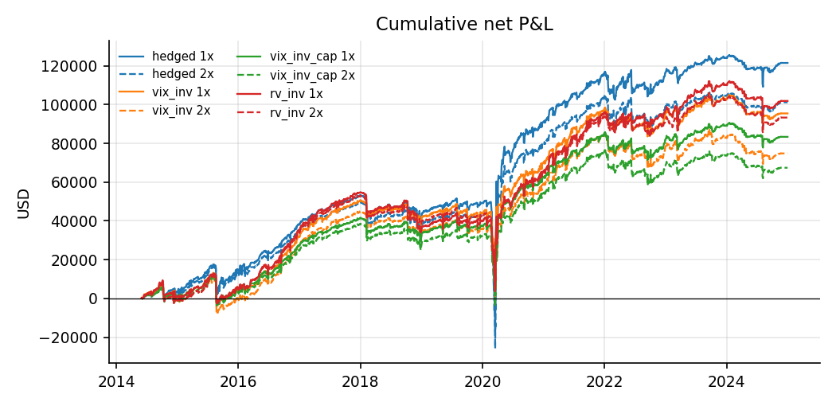
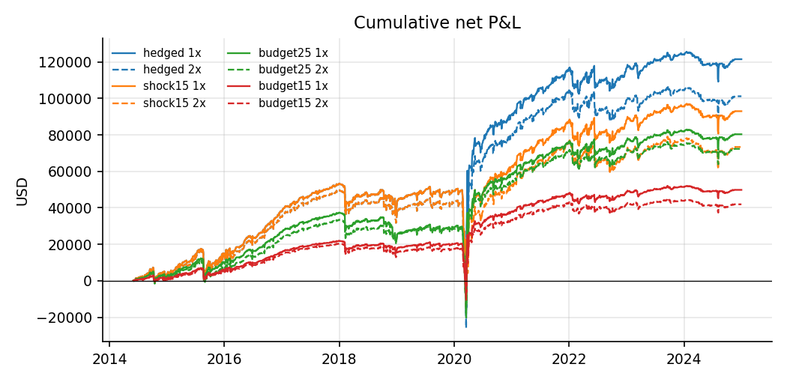
Research Results
Each book's gap to the reference is made in a few episodes: August 2015 for the 20-delta put, March 2020 for the rest
20-Delta Put: Passed (In-Sample)
Partial Hedge: Failed (Risk)
Inverse-VIX Sizing: Failed
Crash-Vol Shock: Failed
Sources: research/*/2026-11-02-*/figures/cum_pnl.png (experiment reports); cumulative net P&L, 1x and 2x spreads, 2014-06 to 2024-12
QUANTT · L/S Gamma Desk
5

Slide 6
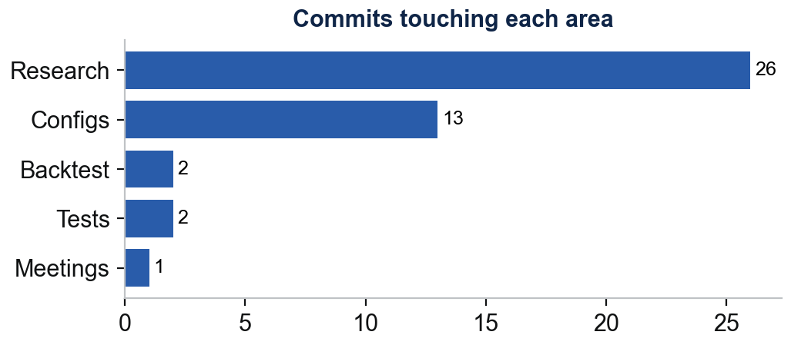
Repo and Team
Repo Changes by Area
Who Did What
Backtest: 13 research-only flags in 2 commits (sizing tilt and cap, VRP hedge ratio, vega hedge, crash call), 190 tests pass
Research: 11 cards pre-registered, run and checked; 58 trials, registry now at 134; 2 diagnostics
Reports: Signals beyond VRP (Oct 31), 11 experiment PDFs, FOMC/CPI and skew notes; turbulence-LSTM review drafted (uncommitted)
Configs: 11 experiment TOMLs in configs/experiments/
Gabe Soler (PM)
31 commits · Ran eleven experiments and two diagnostics on the stress-sized put book, added their engine switches, and reviewed the financial-turbulence LSTM paper
Ben Gorenc
0 commits · No work-log entry this week (last: Oct 21)
Brandon Scheidler
0 commits · No work-log entry this week (last: Oct 21)
Elizabeth Bighiu
0 commits · No work-log entry this week (last: Oct 21)
Zach Glazer
0 commits · No work-log entry this week (last: Oct 21)
Sources: git log --branches --remotes, 2026-10-29 to 2026-11-04; work-logs/*; one-sentence summaries are Claude's, the logs themselves are the analysts' own words
QUANTT · L/S Gamma Desk
6

Slide 7
Next Week
Priorities (draft)
Decisions & Blockers (draft)
x
x
x
x
x
x
Sources: Drafted from the 2026-11-02 summaries' next steps and the paper ledger; every item is a draft for PM review
QUANTT · L/S Gamma Desk
7

