Slide 1
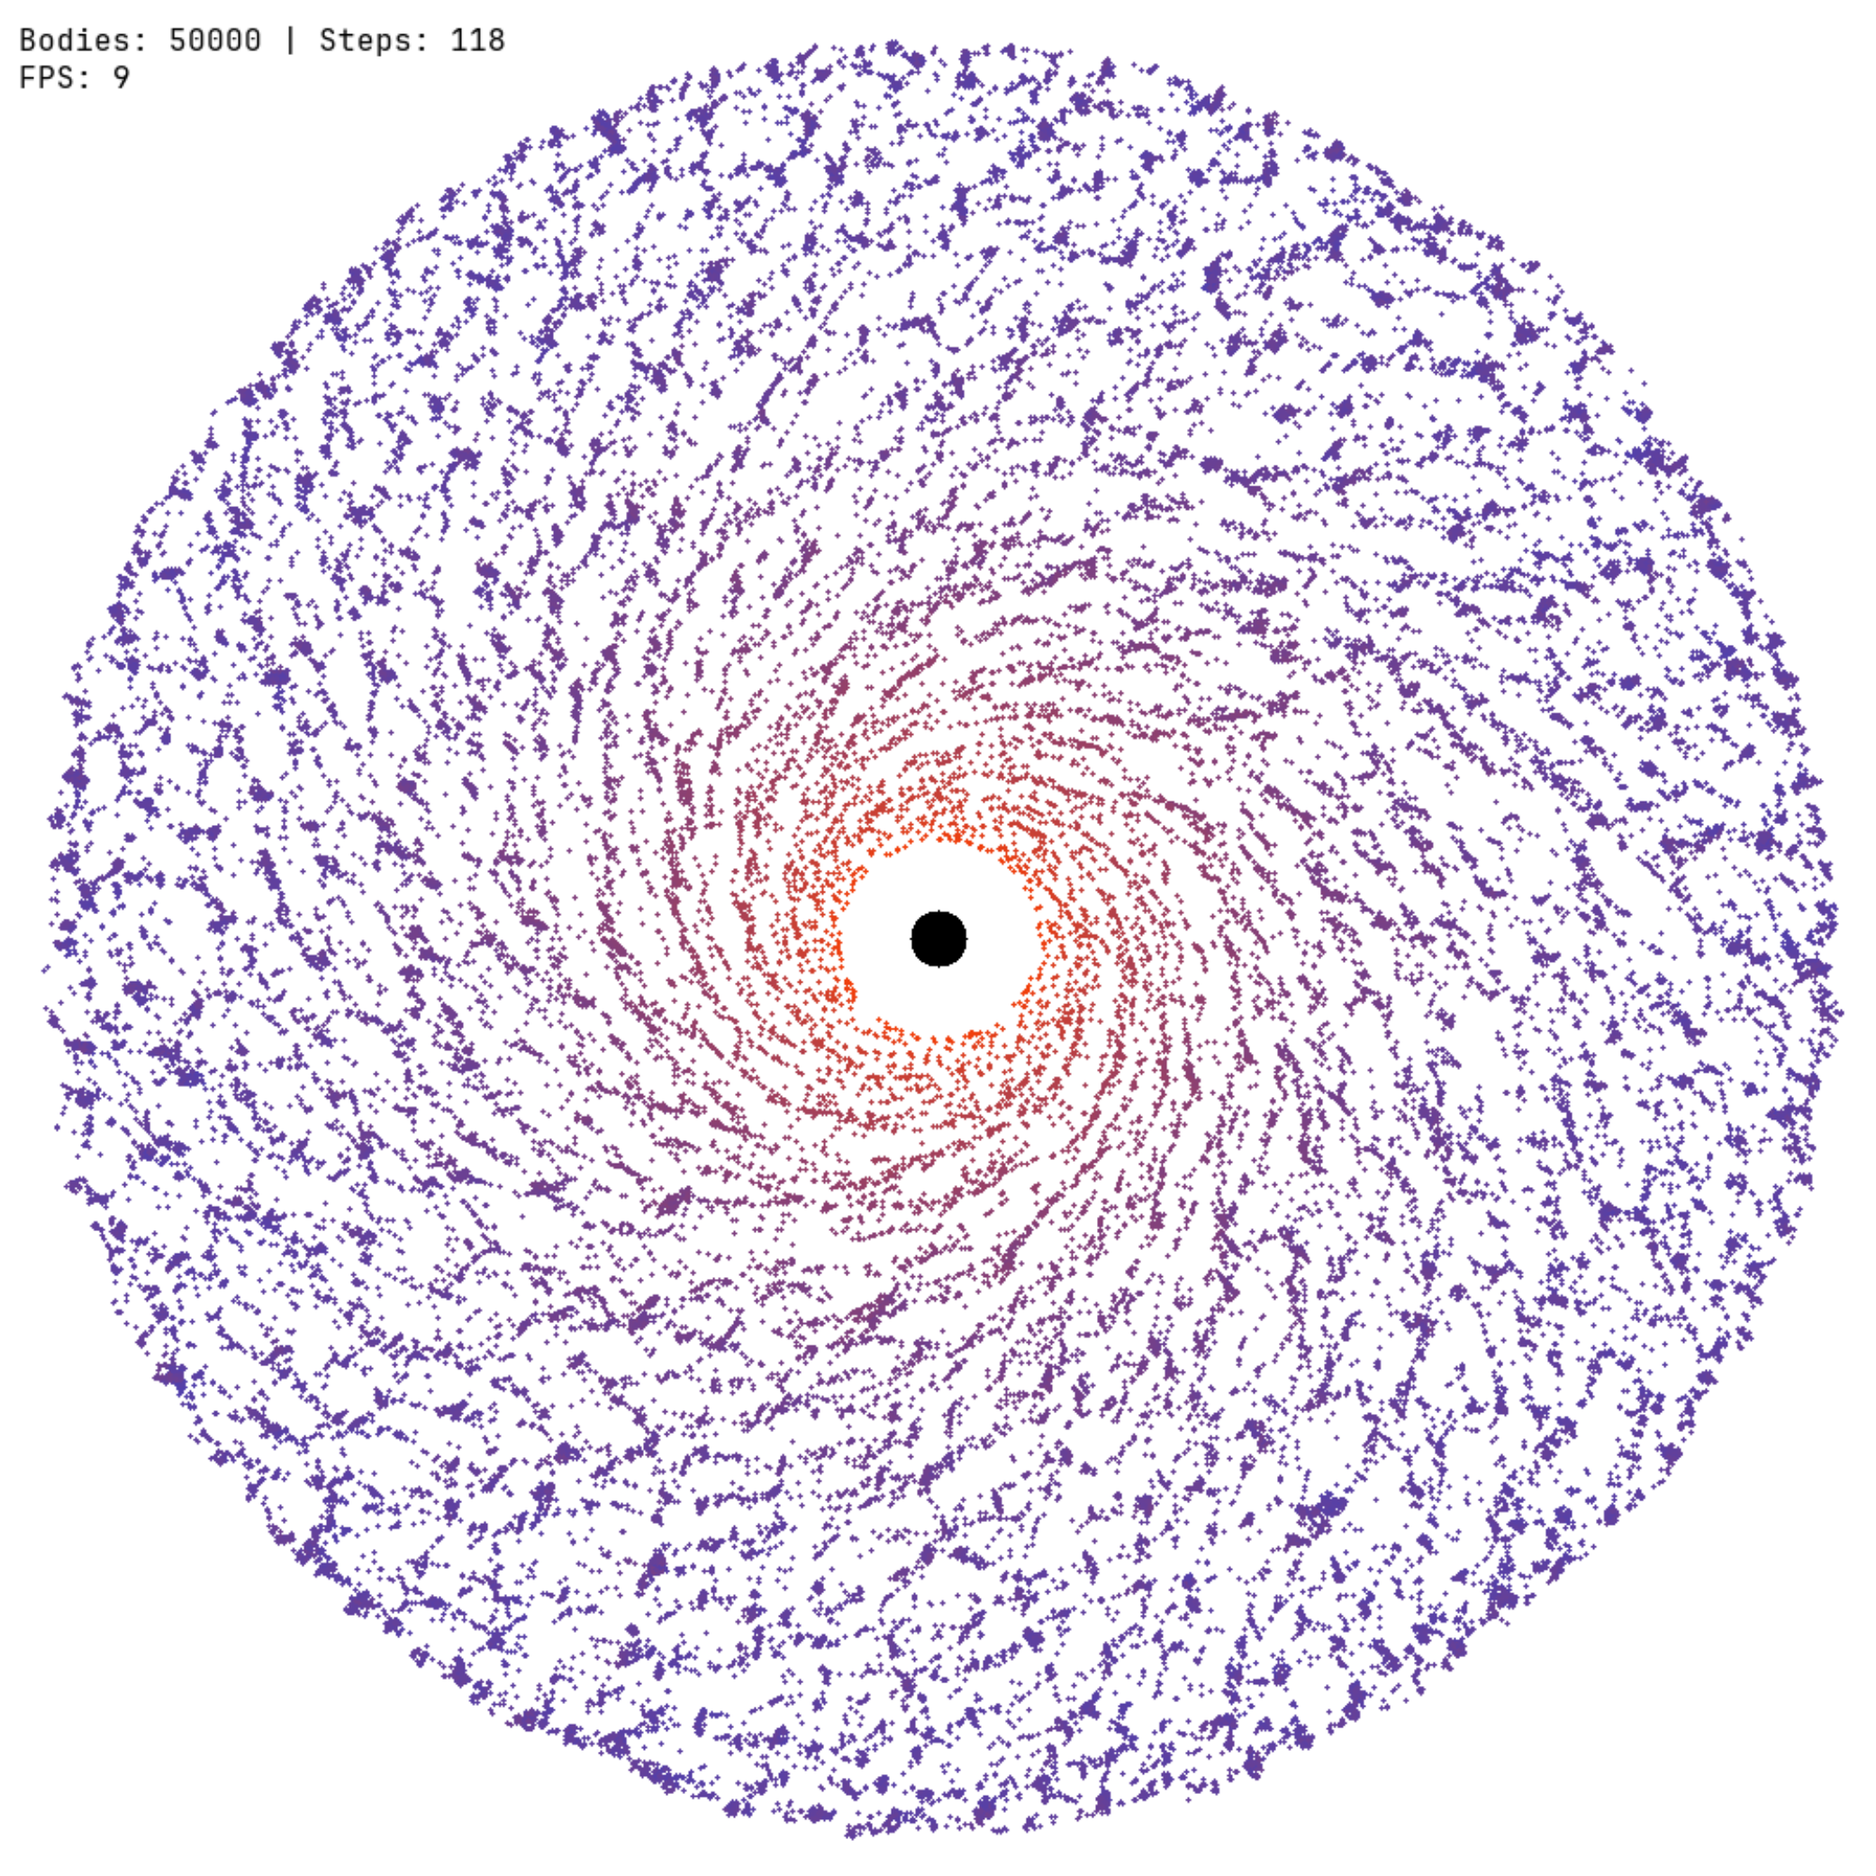
Numerical Performance Analysis of the Direct and Barnes-Hut Algorithm for Solving the N-Body Problem
By:
Balarezo J. Gabriel
Advaced Programming
June 3, 2025

Slide 2
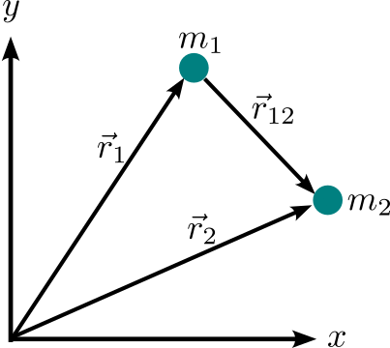

Agenda
The Barnes-Hut Approximation
Results
Conclusions
References

Slide 3




The Barnes-Hut approximation
The Barnes-Hut algorithm is an approximation algorithm for performing
an N-body simulation with a time complexity of
Direct method
BH-approximation

Slide 4
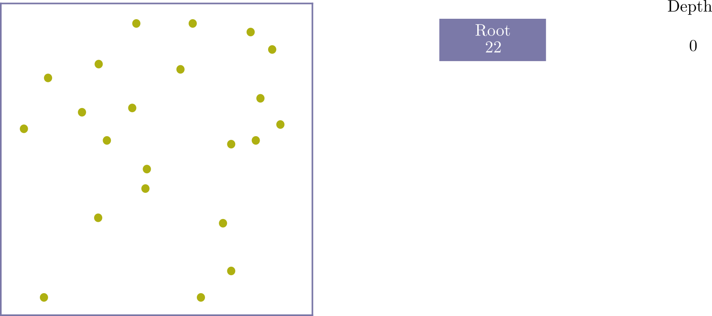
The Barnes-Hut approximation
How does it work?...
It utilises a hierarchical tree structure—a quadtree in 2D and an octree in 3D—to represent the spatial distribution of bodies and their interactions. The tree is built by recursively subdividing the simulation area into quadrants until each node contains either zero or one body.

Slide 5
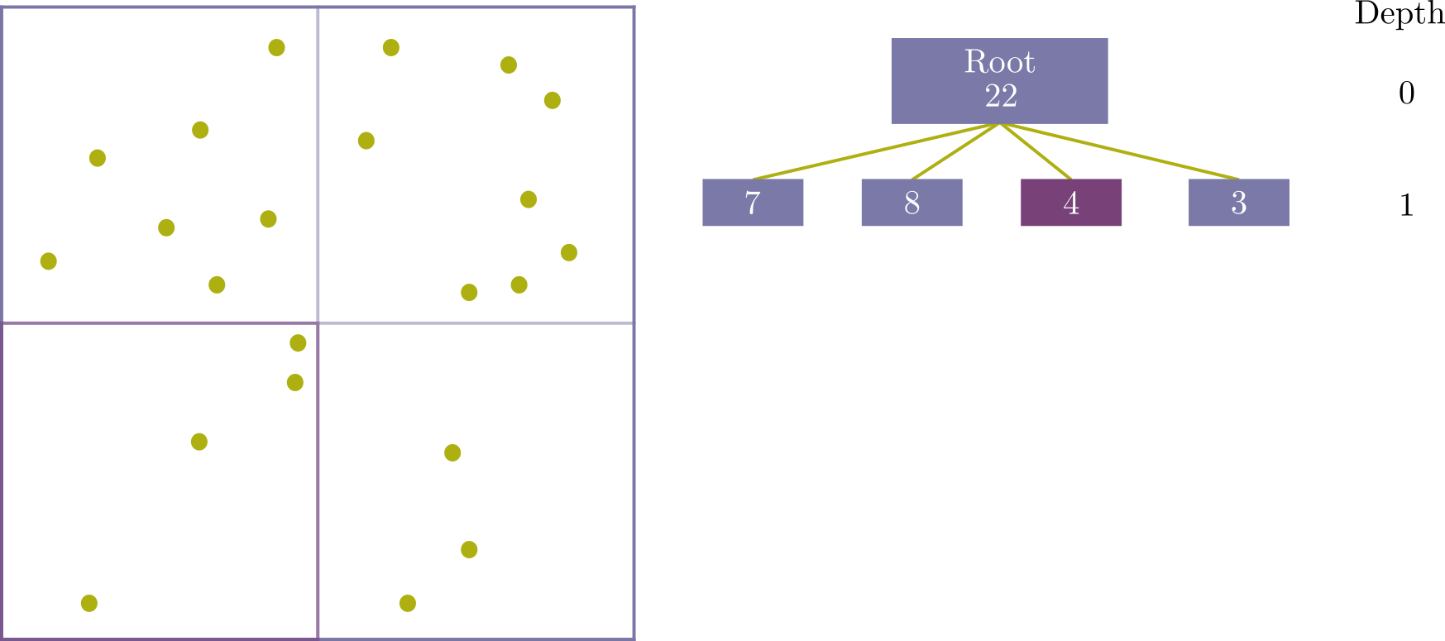
The Barnes-Hut approximation
How does it work?...
It utilises a hierarchical tree structure—a quadtree in 2D and an octree in 3D—to represent the spatial distribution of bodies and their interactions. The tree is built by recursively subdividing the simulation area into quadrants until each node contains either zero or one body.

Slide 6
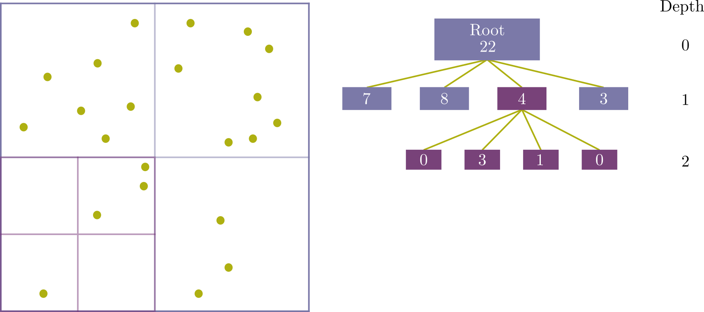
The Barnes-Hut approximation
How does it work?...
It utilises a hierarchical tree structure—a quadtree in 2D and an octree in 3D—to represent the spatial distribution of bodies and their interactions. The tree is built by recursively subdividing the simulation area into quadrants until each node contains either zero or one body.

Slide 7
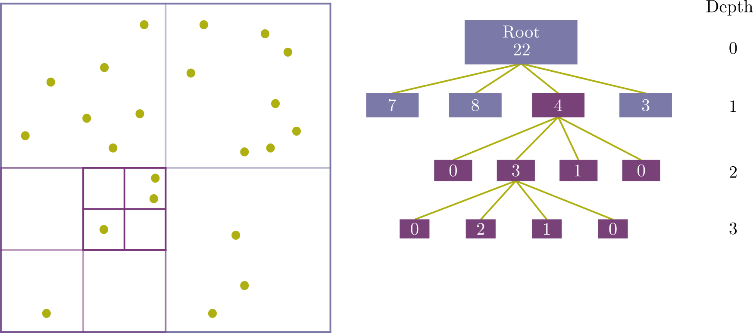
The Barnes-Hut approximation
How does it work?...
It utilises a hierarchical tree structure—a quadtree in 2D and an octree in 3D—to represent the spatial distribution of bodies and their interactions. The tree is built by recursively subdividing the simulation area into quadrants until each node contains either zero or one body.

Slide 8
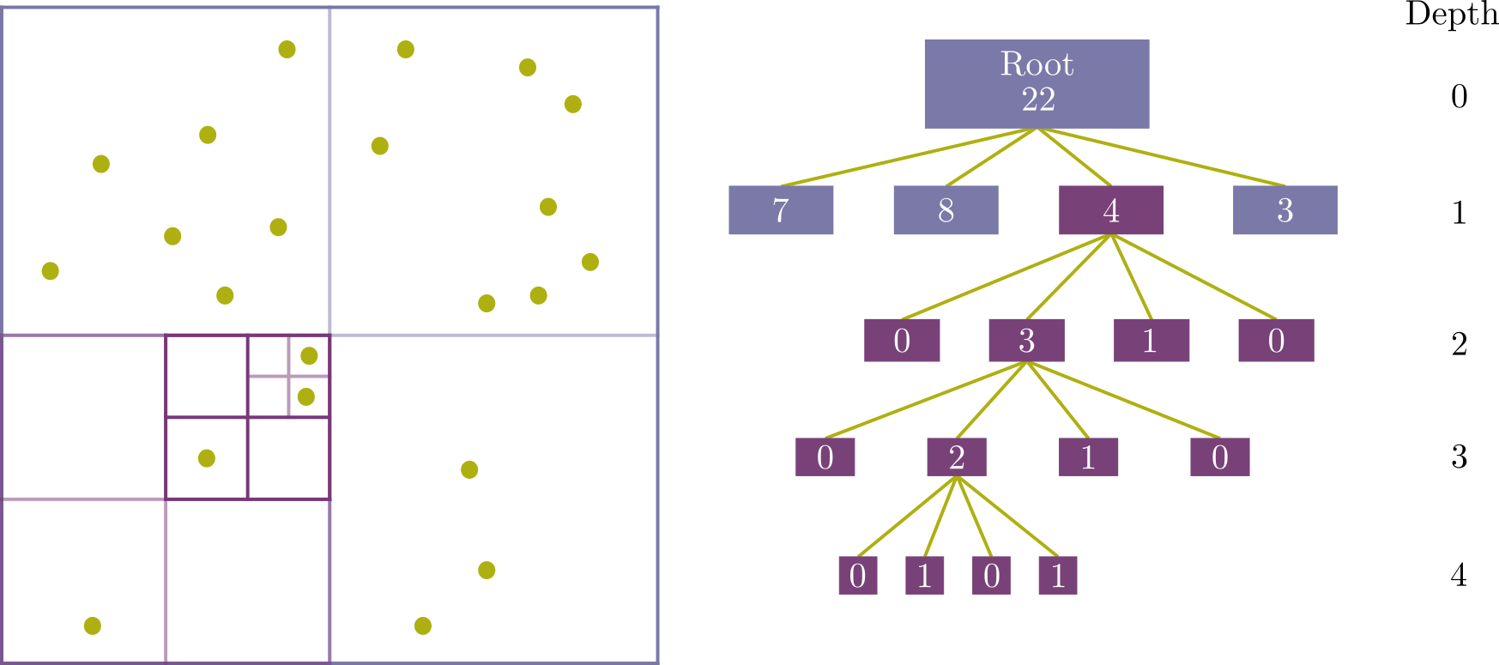
The Barnes-Hut approximation
How does it work?...
It utilises a hierarchical tree structure—a quadtree in 2D and an octree in 3D—to represent the spatial distribution of bodies and their interactions. The tree is built by recursively subdividing the simulation area into quadrants until each node contains either zero or one body.

Slide 9
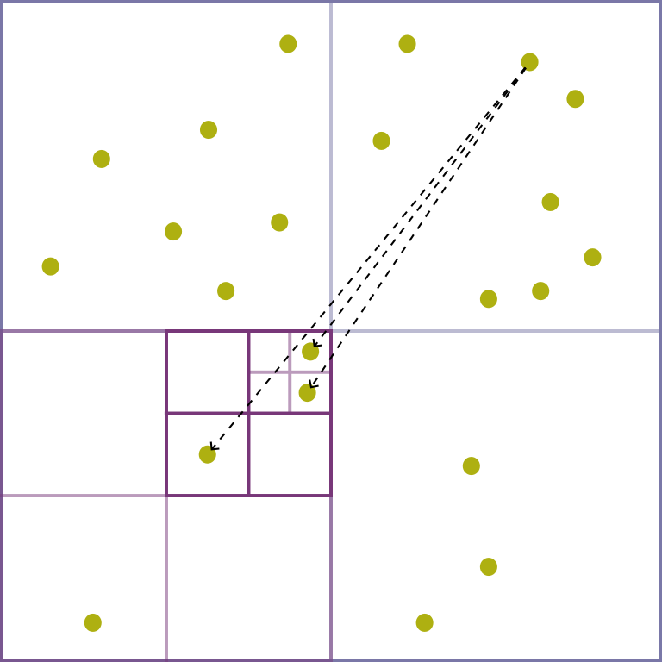
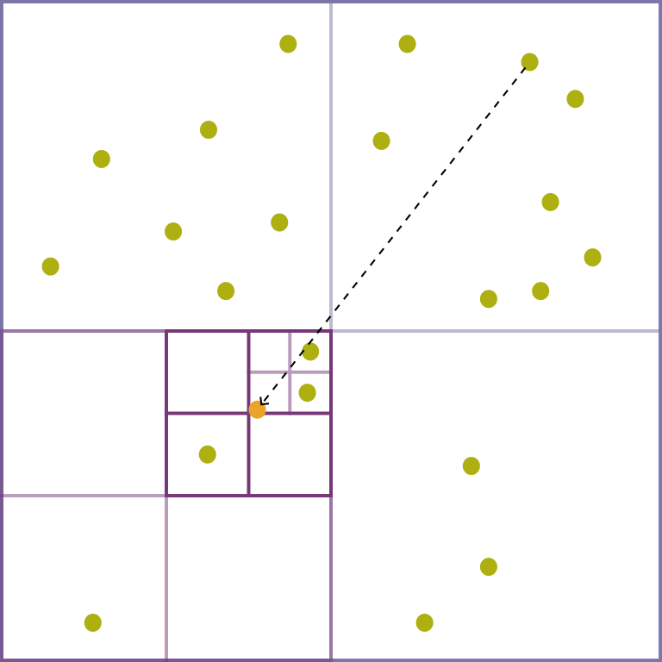
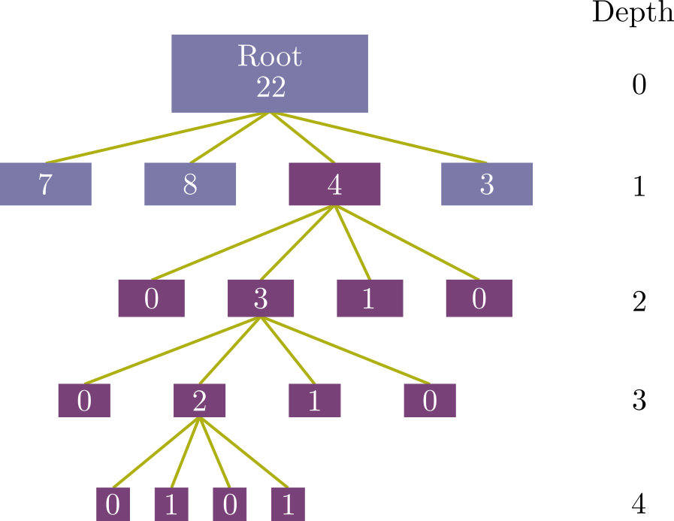
The Barnes-Hut approximation
Each node stores its centre of mass and the total mass of the bodies contained in the node.
We compute the distance d between mi and the centre of mass of the node. We also keep track of the size s of the node, i.e. the length of one side of the quadrant represented by the node.
Use the θ criterion to decide if a node is sufficiently far away or if we need to traverse its child nodes.

Slide 10
The Barnes-Hut approximation
How do we update our system?
Verlet Integrator
Verlet integration is a numerically stable, time-reversible, and conservative method ,
making it well-suited for simulations of this nature.
Since Verlet is not a self-starting method, we utilise a suitable approximation to
perform the first update.

Slide 11
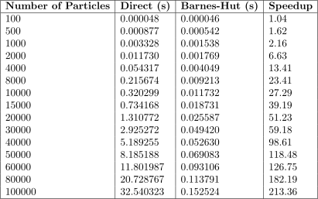
Results
Each system size was simulated using both methods for 100 time steps.
Execution times were recorded for each time step and averaged afterwards.
Benchmark results

Slide 12
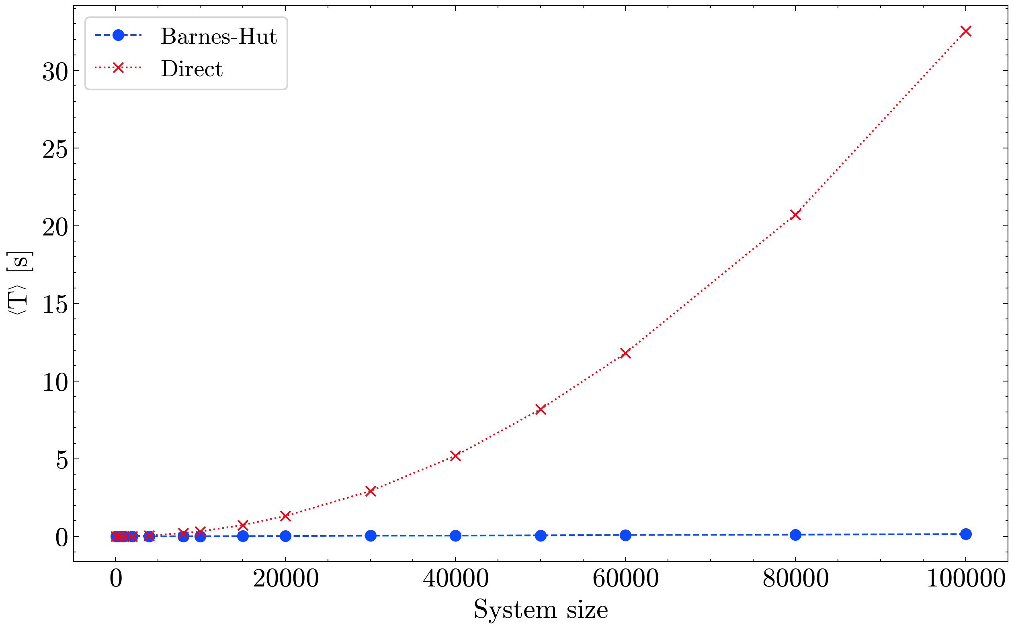
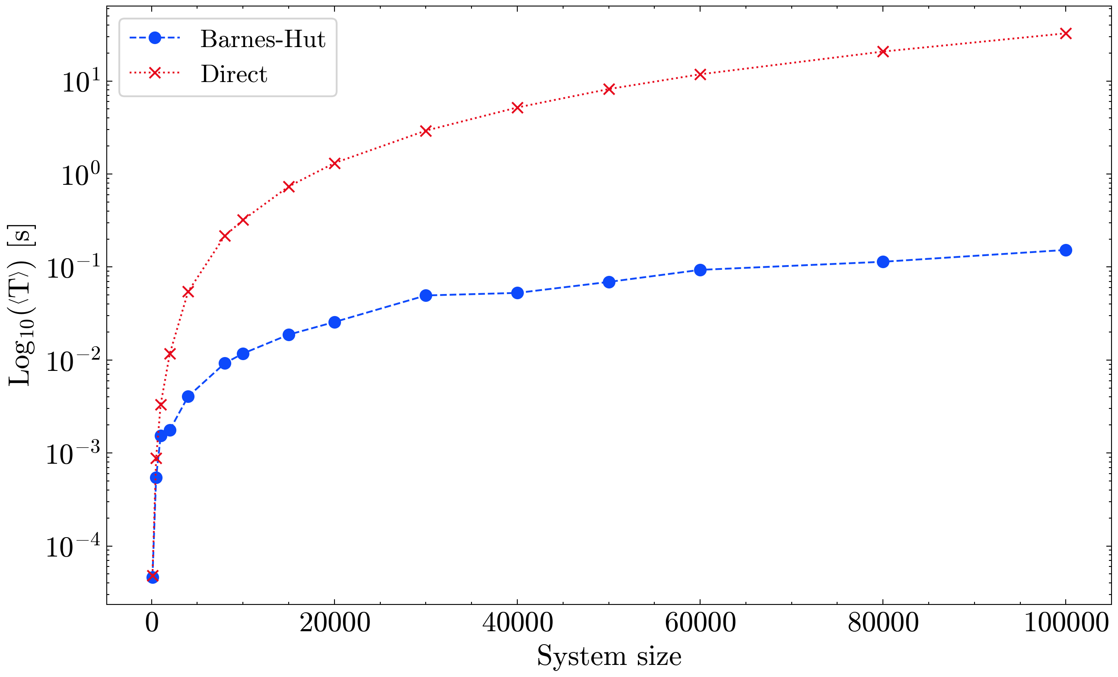
Results

Slide 13
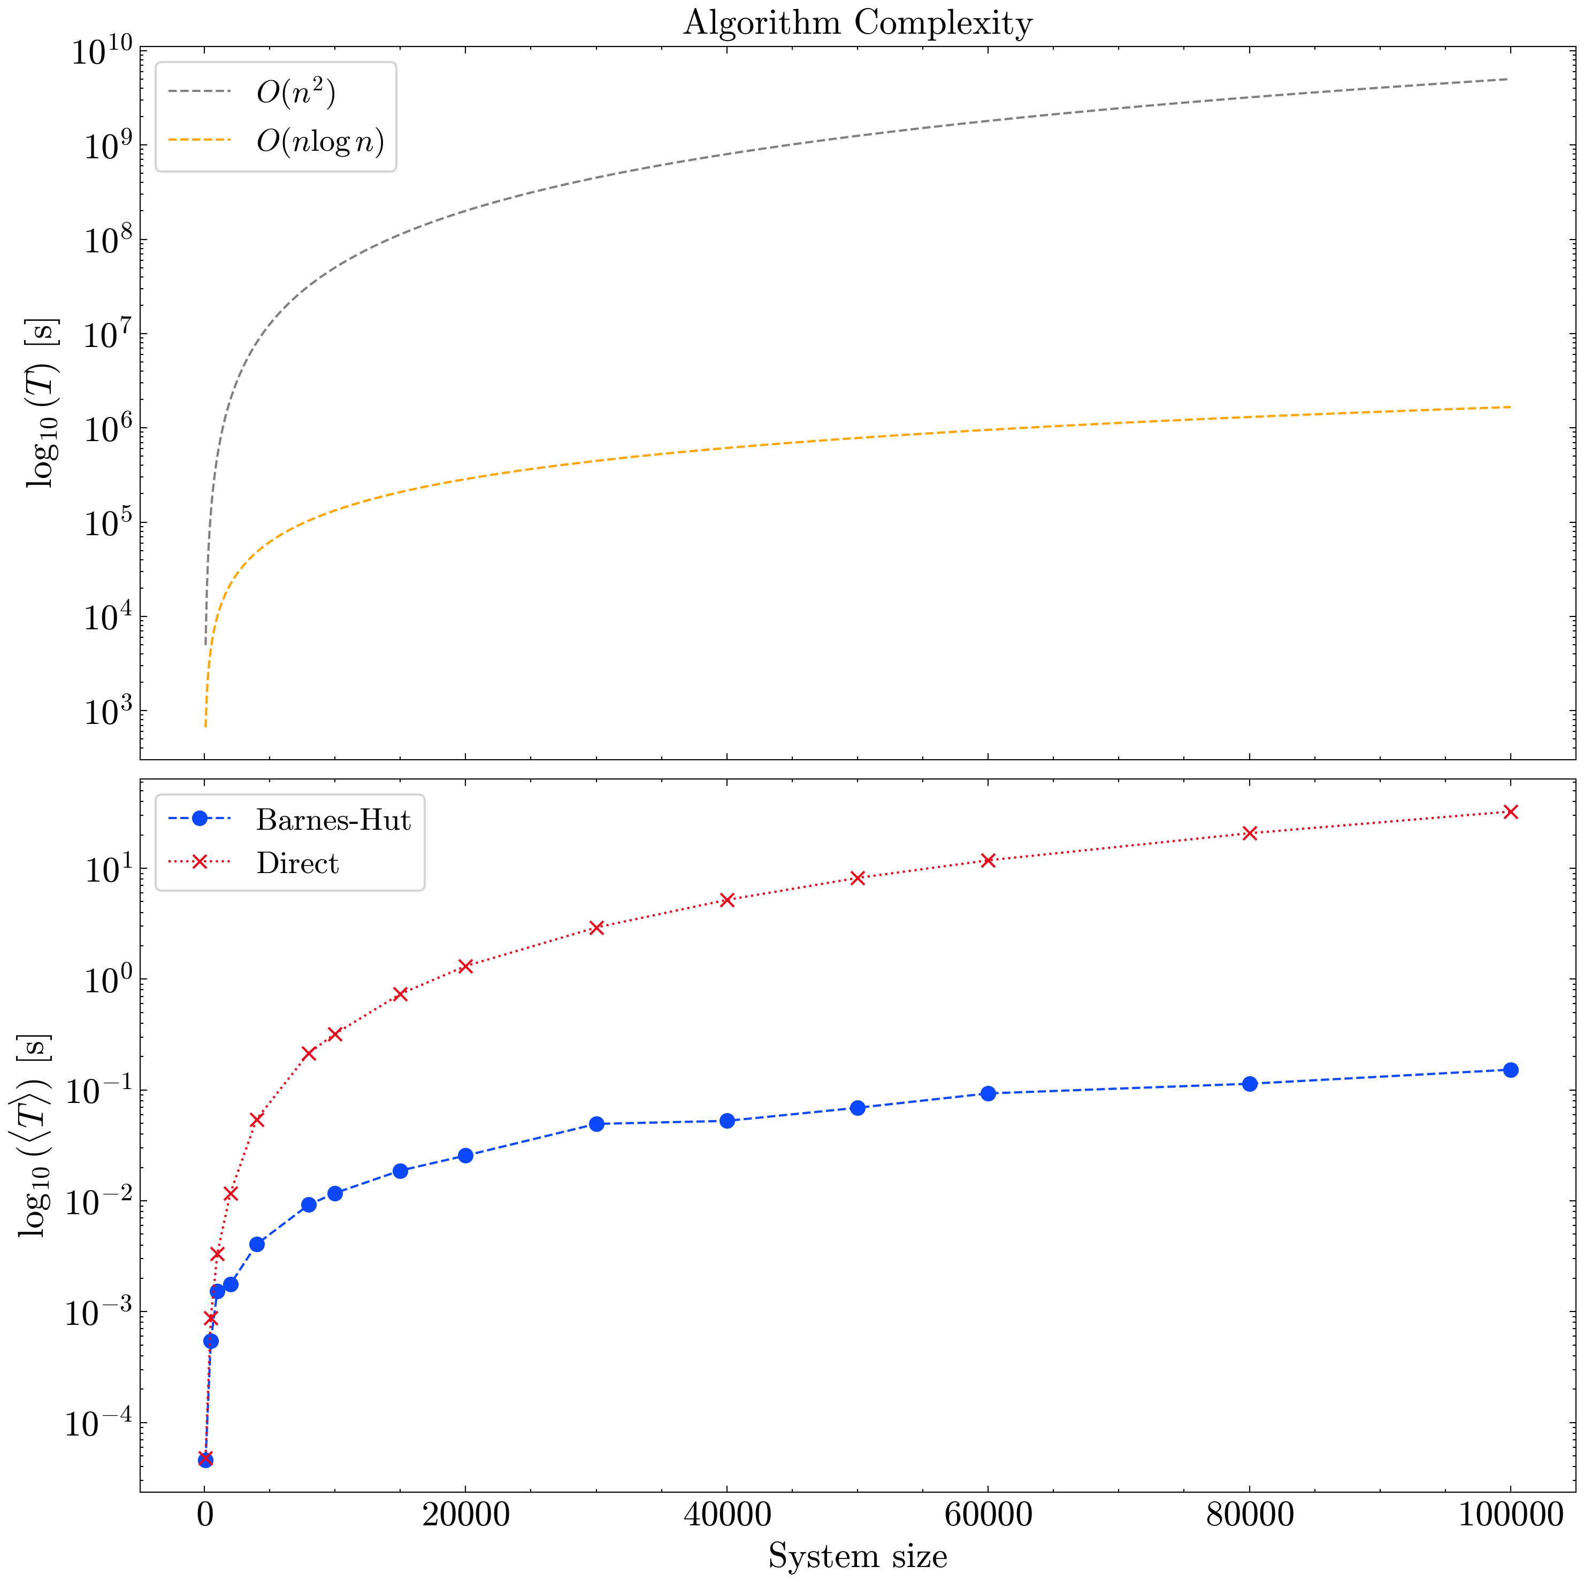
Results

Slide 14
Conclusions
The direct method provides high accuracy but scales poorly with system size due to its complexity, making it suitable only for small-scale simulations.
The Barnes-Hut algorithm dramatically reduces computational cost for large systems, achieving over 200× speedup at N=10^4, while maintaining reasonable accuracy.
By using a hierarchical tree structure and the theta criterion, Barnes-Hut achieves scaling, making it ideal for astrophysical and cosmological N-body simulations.
Leveraging OpenMP for parallel force computation and integration further enhances both methods’ performance—especially critical for real-time or large-scale scenarios.

Slide 15
Thanks for your attention!!
Any questions?

